Slide 1
Dataiku tech assessment
Stavros Emmanouilidis

Slide 2
AGENDA
Executive Summary
Exploratory Data Analysis
​Data Preparation
Data Modeling
​Summary & the Future​
Questions

Slide 3
Executive summary

Slide 4



Situation
Complication
question
US Census Bureau collects demographic and economic data for strategic planning.
Data is used to allocate funding for public services.
A sample dataset of ~300,000 individuals is provided for analysis.
Need to analyze extensive data to identify characteristics that correlate with income level.
Goal is to understand what factors are associated with making more or less than $50,000 per year.
Important for understanding economic disparities and policy planning.
What characteristics are associated with a person making more or less than $50,000 per year in the sample dataset?

Slide 5
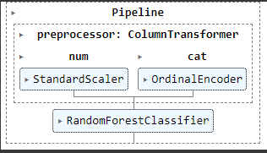
Trained a Random Forest Classifier that achieved the following Test set performance
  Accuracy: 0.9538
  Precision: 0.7276
  Recall: 0.4064
  F1-Score: 0.5215
  ROC AUC: 0.9340
Over 90% accuracy!
However 93% of the instances belong to the `-50000` class.

Slide 6
Exploratory data analysis

Slide 7
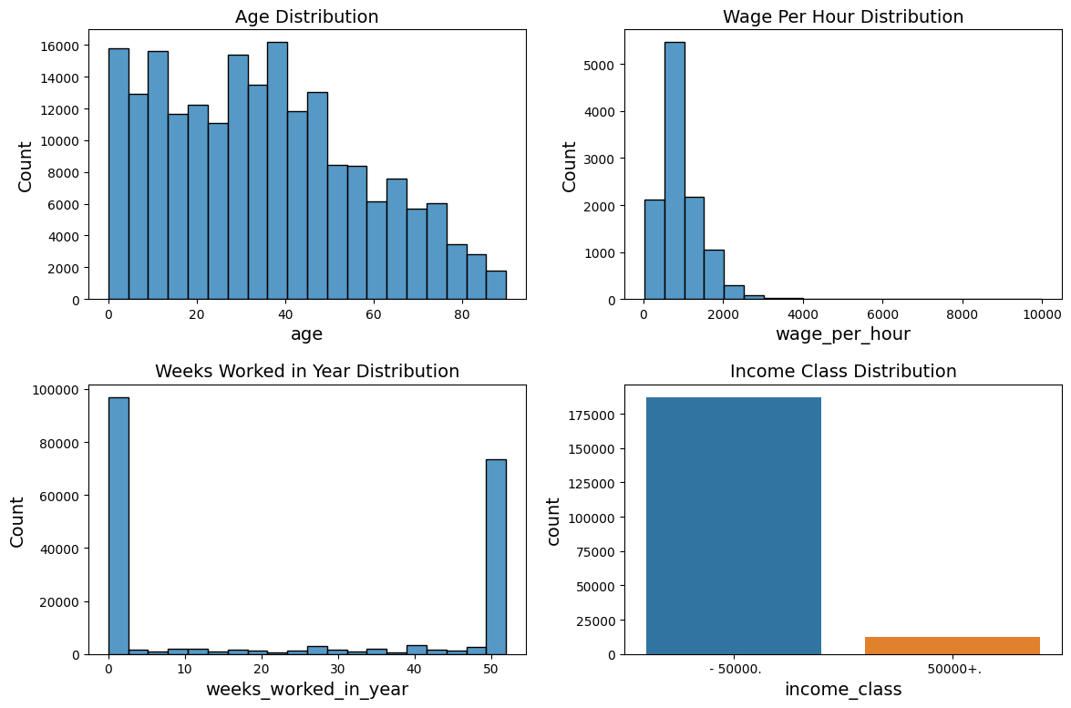
Age Distribution: Most people in the dataset are between 15 and 60 years old. We can see a decline in the number of people as age increases, which is expected.
Wage Per Hour Distribution: Most people have a wage of $0 per hour, which likely means they are not currently employed or their primary income is not from hourly wages. For those who do earn an hourly wage, the distribution is positively skewed.
Weeks Worked in Year Distribution: A significant number of people have worked zero weeks in the year, likely indicating unemployment or other forms of non-employment (e.g., students, retirees). Many others have worked the full 52 weeks in a year.
Income Class Distribution: The majority of people in the dataset earn less than $50,000 per year. This shows that the target variable is imbalanced, which is something to consider during modelling.

Slide 8
Data preparation

Slide 9
Data prep steps
HANDLING MISSING VALUES
CATEGORICAL ENCODING
FEATURE ENGINEERING
DATA NORMALIZATION
Although the dataset doesn't have explicit NaN values, some entries like "Not in universe" might act as placeholders for missing or inapplicable data.
Many machine learning algorithms require numerical input and output variables. We’ll need to convert the categorical variables to a format that could be provided to machine learning algorithms.
New features were created based on existing ones to better represent the underlying problem to the machine learning models.
Some machine learning algorithms are sensitive to the scale of input variables. We'll normalize the features to make them comparable.

Slide 10
Handling missing values
Several columns have missing values:
class_of_worker: 100,245 missing
enrolled_in_edu_inst_last_wk: 186,943 missing
major_industry_code: 100,684 missing
major_occupation_code: 100,684 missing
member_of_labor_union: 180,459 missing
reason_for_unemployment: 193,453 missing
full_or_part_time_employment_stat: 123,769 missing
... and so on.
To handle missing values I decided to replace them with a separate category labelled `Unknown`, since when the value is missing it might be for a reason that is meaningful to the research question.
For example, `reason_for_unemployment` being missing likely indicates that the person is not unemployed, which is itself informative.

Slide 11
Data Normalization
Categorical encoding
7 numerical features
Standardize features by removing the mean and scaling to unit variance.
The standard score of a sample x is calculated as:
    z = (x - u) / s
  where u is the mean of the training, and s is the standard deviation of the training
29 categorical features
Used Ordinal Encoding which encodes categorical features as an integer array.
It’s the simplest form of Categorical Encoding.
Discriminatory features like `race`, `Hispanic origin`, `sex` were dropped

Slide 12
Feature engineering
Idea | Engineered Feature
Interaction Features: Create new features by combining two or more variables | net_capital_gain: Represents the net capital gain, calculated as capital gains – capital losses
Polynomial Features: Create new features by raising an existing feature to a power. Could help capture non-linear relationships | age_squared: A polynomial feature representing the square of the age.
Categorical Aggregations: Aggregate numerical variables based on categorical variables. | avg_wage_per_industry: The average wage per hour for each industry. avg_wage_per_occupation: The average wage per hour for each occupation.
Binning: For numerical variables we could create bins to transform them into categorical variables. This could help capture non-linear relationships. | age_bin: Binned age categories.
Boolean Features: Create new features that indicate the presence or absence of a certain condition. | has_capital_gain_or_loss: A boolean feature indicating whether a person has any capital gains or losses.

Slide 13
Data modeling

Slide 14
Models trained using 5-fold cross-validation
LogisticRegression
RandomForestClassifier
GradientBoostingClassifier
Based on performance I chose the RandomForestClassifier model for the task.
Random Forest Balanced is an attempt at dealing with class imbalance.
Random Forest Combined used a combination of the original features as well as the engineered ones.
Fine tuning was also attempted but did not offer a major improvement.
 | Accuracy | Precision | Recall | F1-Score | ROC AUC
Logistic Regression | 0.946322 | 0.722933 | 0.218947 | 0.336102 | 0.914026
Random Forest | 0.953038 | 0.719918 | 0.398159 | 0.512741 | 0.932968
Gradient Boosting | 0.953689 | 0.751199 | 0.379422 | 0.504185 | 0.942203
 | Accuracy | Precision | Recall | F1-Score | ROC AUC
Random Forest Balanced | 0.951073 | 0.708931 | 0.358989 | 0.476624 | 0.930751
 | Accuracy | Precision | Recall | F1-Score | ROC AUC
Random Forest Combined | 0.953669 | 0.731963 | 0.399855 | 0.517184 | 0.933487

Slide 15
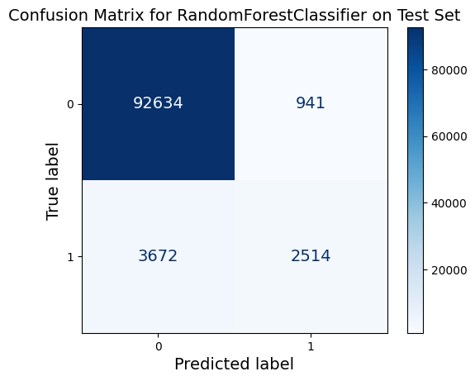
A RandomForestClassifier using the default parameters was trained on the full training set, and evaluated on the test set.
Test set metrics:
  Accuracy: 0.9538
  Precision: 0.7276
  Recall: 0.4064
  F1-Score: 0.5215
  ROC AUC: 0.9340
The results on the test set remain consistent with the performance during training, which indicates good generalisation performance.

Slide 16
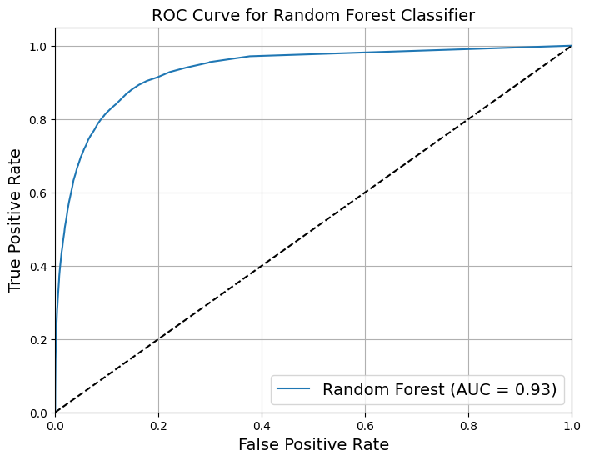
Looking at the ROC curve, we may think that the classifier is really good.
However, this is mostly because there are few positives (+50000) compared to the negatives (-50000).

Slide 17
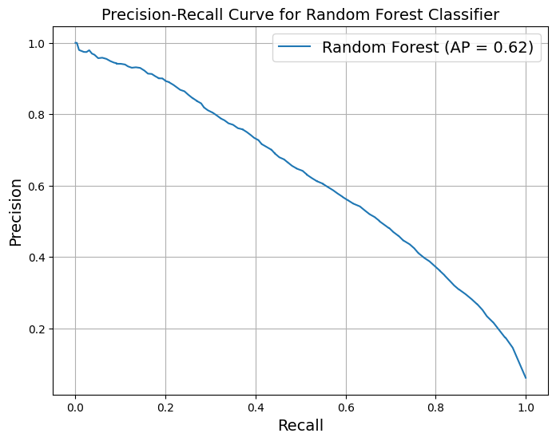
The Precision/Recall (PR) curve makes it clear that the classifier has a lot of room for improvement.
The curve could really be closer to the top right corner.
The PR curve is preferred when the positive class is rare.

Slide 18
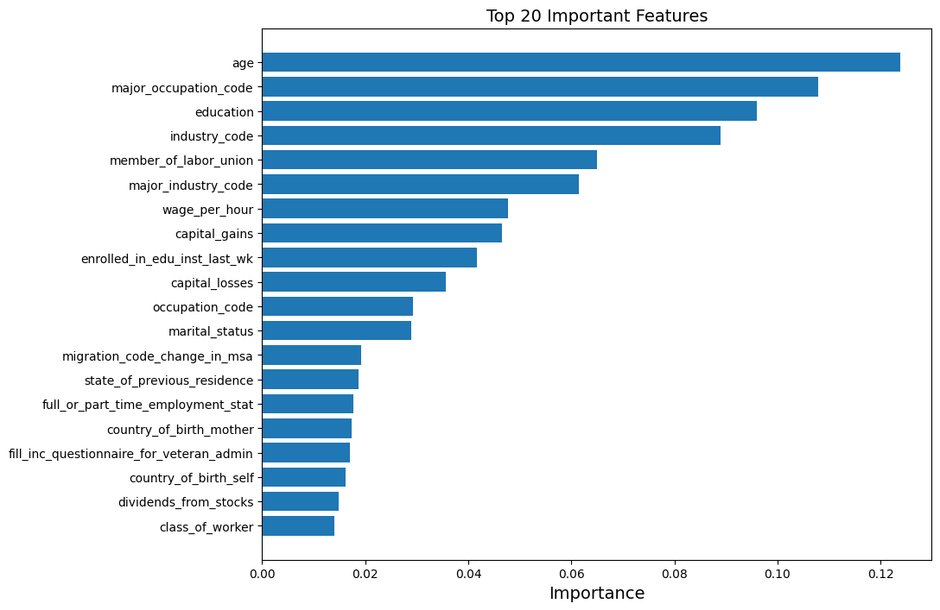
The cumulative feature importance scores by category are as follows:
  Occupational 30.1%
  Other 21.9%
  Demographic 20%
  Educational 13.7%
  Financial 9.7%
  Geographic 4.3%
Features related to occupation and industry account for 30% of the model's decision-making, indicating the importance of job-related factors in income.

Slide 19
Summary & future

Slide 20
Summary
Objective
To identify characteristics associated with an individual earning more or less than $50,000 per year using U.S. Census data.
Methodology
Exploratory Data Analysis (EDA)
  Identified missing values and data types.
  Visualized the distribution of the target variable and key features.
Data Preprocessing
  Handled missing values by labeling them as 'Unknown'.
  Encoded categorical variables.
Feature Engineering
  Generated new features like net_capital_gain, total_income, age_squared, avg_wage_per_industry, and avg_wage_per_occupation.
Model Building
  Utilized Logistic Regression, Random Forest, and Gradient Boosting models.
  Employed cross-validation for robust performance assessment.
Model Evaluation
  Metrics used: Accuracy, Precision, Recall, and F1 Score.
  Random Forest showed the highest accuracy and F1 score on the training dataset.

Slide 21
Recommendations & future improvements
Address Class Imbalance
  The target variable is imbalanced; resampling techniques like oversampling/under sampling, or SMOTE can improve performance.
Hyperparameter Tuning
  Fine-tune model parameters for better predictive power.
Additional Feature Engineering
  Further engineered features can provide more insights and improve model performance.
More Comprehensive EDA
  Correlation analysis, outlier detection, etc.
Advanced Models
  Experiment with ensemble methods or neural networks.
Real-world Validation
  Test the model's performance on new, real-world data to assess its generalizability.

Slide 22
Questions?

Slide 23
THANK YOU
Stavros Emmanouilidis

