Slide 1
Logging in to the
JASMIN Notebook Service
(with training accounts)

Slide 2
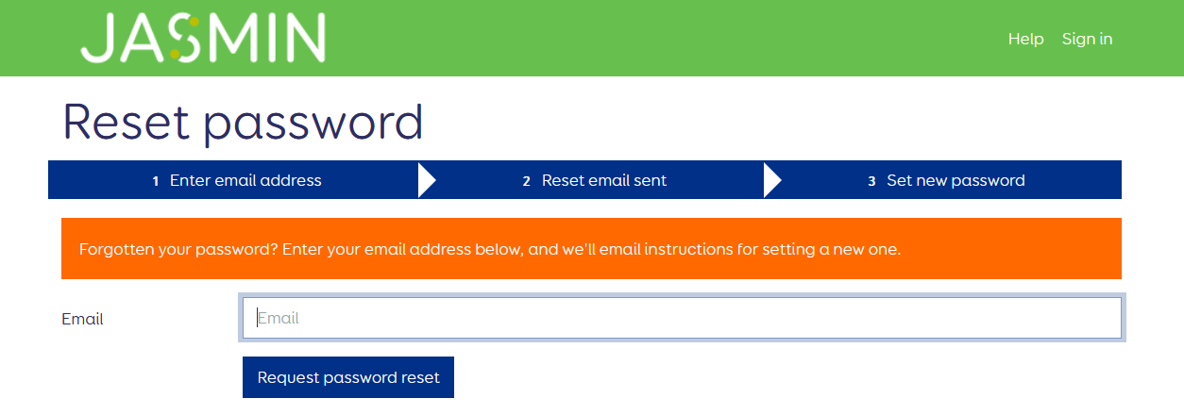
Go to: https://accounts.jasmin.ac.uk/account/password_reset/
Enter the email address you provided for the training account.
Click "Request password reset"

Slide 3
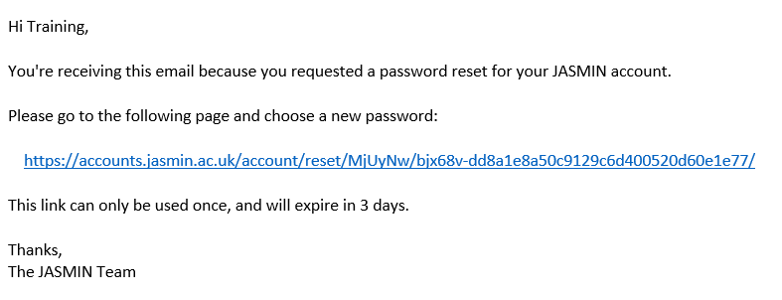
Check your email and click the link…

Slide 4
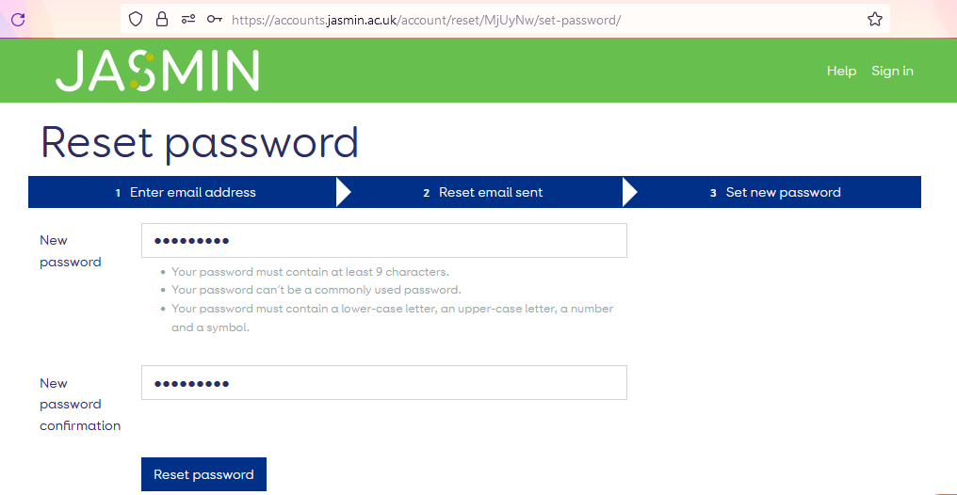
Enter a new password in both boxes.
Click "Reset password".

Slide 5
Once you have set your password
Go to the Notebook Service at: https://notebooks.jasmin.ac.uk/
Use your username (train***) and password to login.
You will need to use the two-step verification

Slide 6
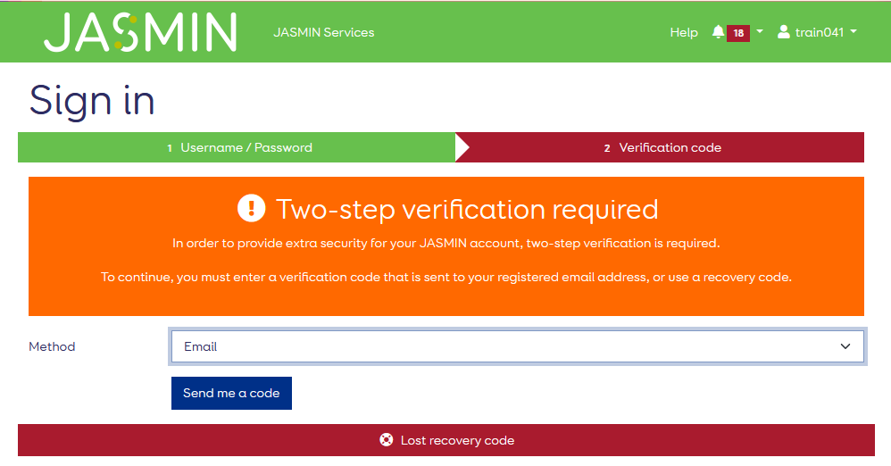
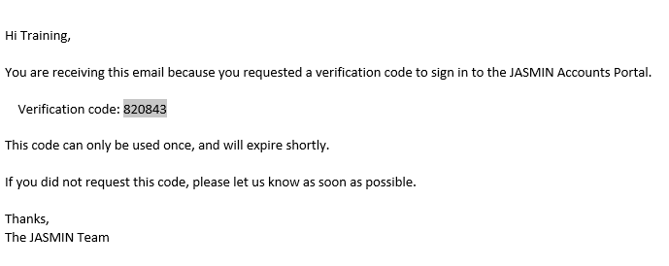
3. You will receive an email - copy the verification code and paste it into this page.
Select "Email" as the method.
Click "Send me a code"

Slide 7
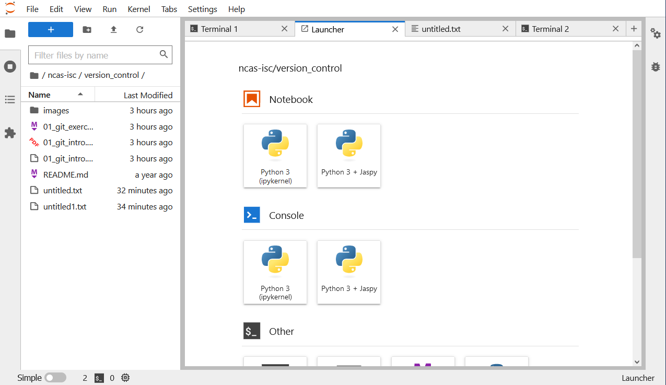
Now you should be in….

