Slide 1

Your Construction Runner app
A simple guide for operatives and anyone who uses the phone on site
iPhone & Android · Version 1.0 · September 2026

Slide 2
This guide is for you
You work on site — this is the app you use every day
You do not log in on the website. Use Construction Runner on your phone
Sign in when you arrive, complete induction, read RAMS and briefings, do your tasks, sign out when you leave
Ask your supervisor if something is waiting for approval
Construction Runner · App guide for operatives · info@construction-runner.com

Slide 3
First time
1. Install Construction Runner from the App Store or Google Play
2. Sign in, or Register with the company invite code — then wait for approval
3. Set Location to Always (iPhone) or Allow all the time (Android)
4. Profile → My Inductions → complete induction for your site
5. Profile → My Info → add an emergency contact
Construction Runner · App guide for operatives · info@construction-runner.com

Slide 4
Every day on site
1. Home → Check In / Out → pick your site → stand inside the boundary → Sign In
2. Open Safety — Sign & acknowledge any new briefings or RAMS
3. Do your Tasks. Use Deliveries, Assets or Messages if you need them
4. When you leave: tap Sign Out, or walk out of the site fence (auto sign-out)
Construction Runner · App guide for operatives · info@construction-runner.com

Slide 5
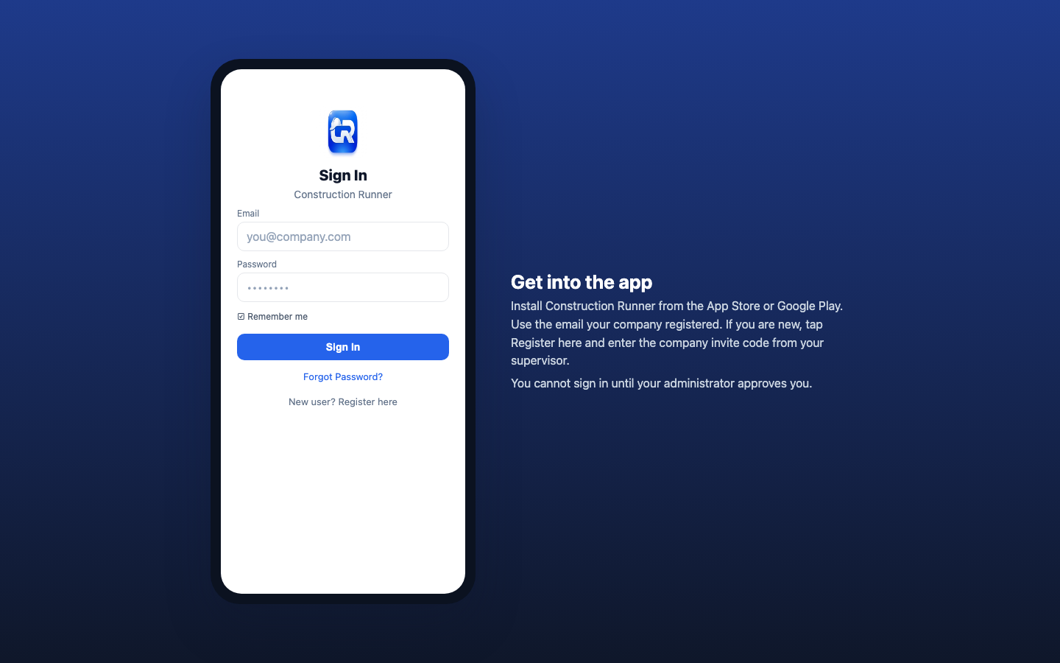
Sign in to the app
Construction Runner · App guide for operatives · info@construction-runner.com

Slide 6
Location must be Always
Used only to detect the site boundary — not to track you around town
iPhone: Allow While Using, then Change to Always Allow
Android: Permissions → Location → Allow all the time
While Using or Allow Once cannot sign you out after you leave — Sign In stays locked
If asked, tap Continue, then Open Settings
Construction Runner · App guide for operatives · info@construction-runner.com

Slide 7
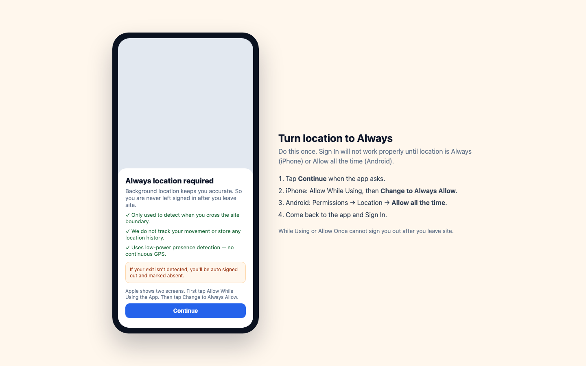
Always location
Construction Runner · App guide for operatives · info@construction-runner.com

Slide 8
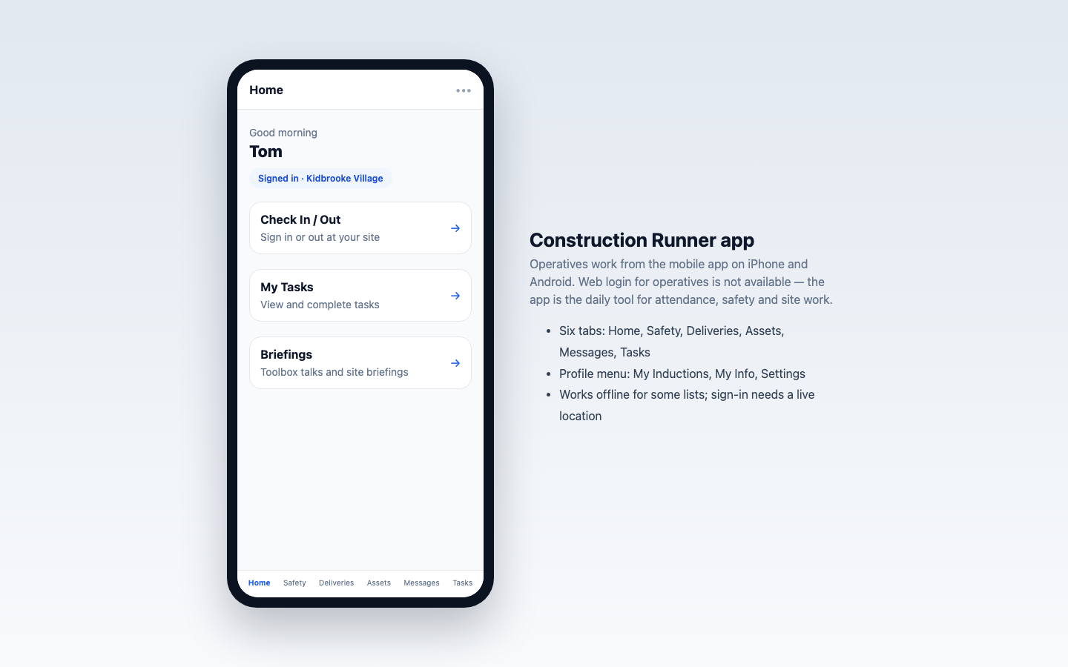
Home
Construction Runner · App guide for operatives · info@construction-runner.com

Slide 9
Check In when you arrive
Home → Check In / Out → Select site
Wait for Inside Site Boundary — you cannot check in from outside the fence
Complete Site induction if asked, then Complete induction
Accept RAMS if asked (Accept & Sign In)
Tap Sign In
Construction Runner · App guide for operatives · info@construction-runner.com

Slide 10
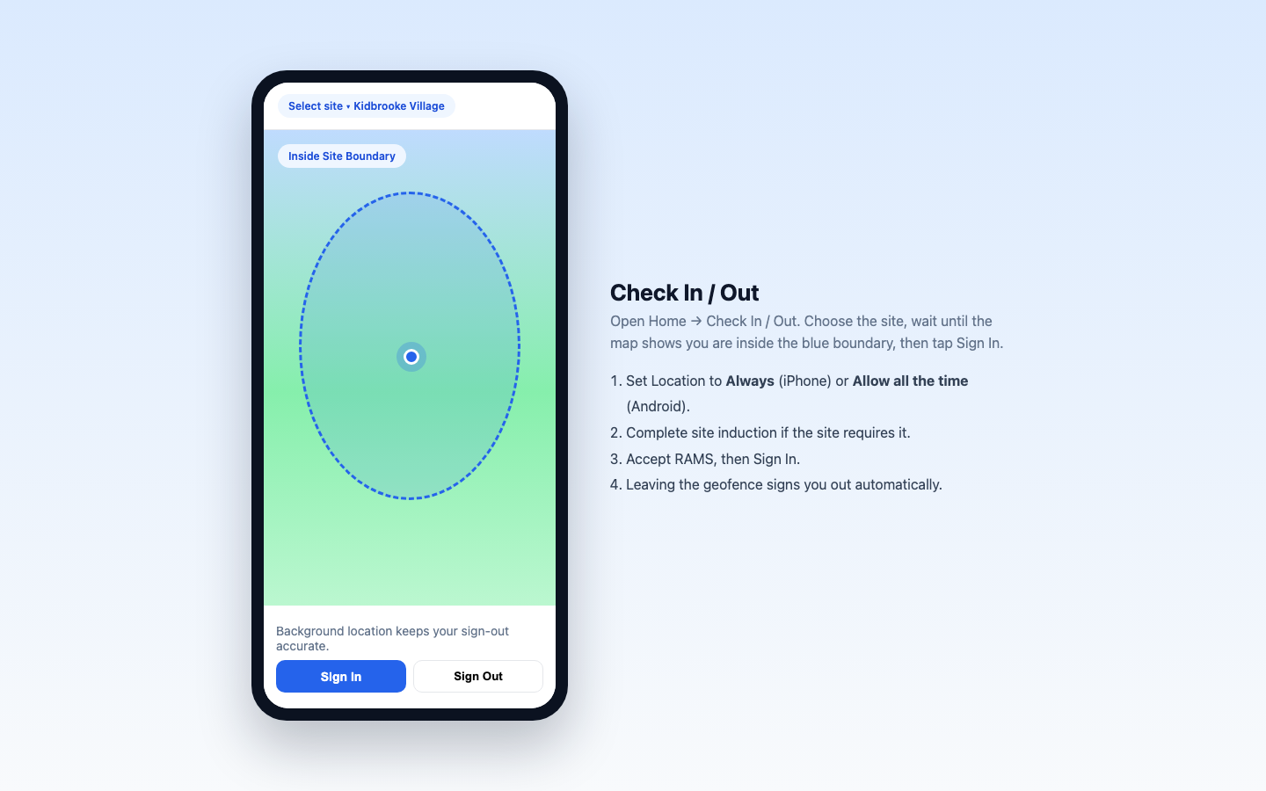
Check In / Out
Construction Runner · App guide for operatives · info@construction-runner.com

Slide 11
Sign out when you leave
Open Check In / Out and tap Sign Out
Or walk out of the geofence — You left the site — signed out automatically
No signal? Sign Out can wait and sync later
Do not stay signed in overnight if you have left site
Day off? Mark as absent → Lock this day
Construction Runner · App guide for operatives · info@construction-runner.com

Slide 12
Induction for each site
Profile → My Inductions
Not Started → Start Induction
Completed lasts 365 days — Expired means do it again
Read site safety, acknowledge RAMS, confirm site rules, Complete induction
If the site requires induction, you cannot finish Sign In until this is done
Construction Runner · App guide for operatives · info@construction-runner.com

Slide 13
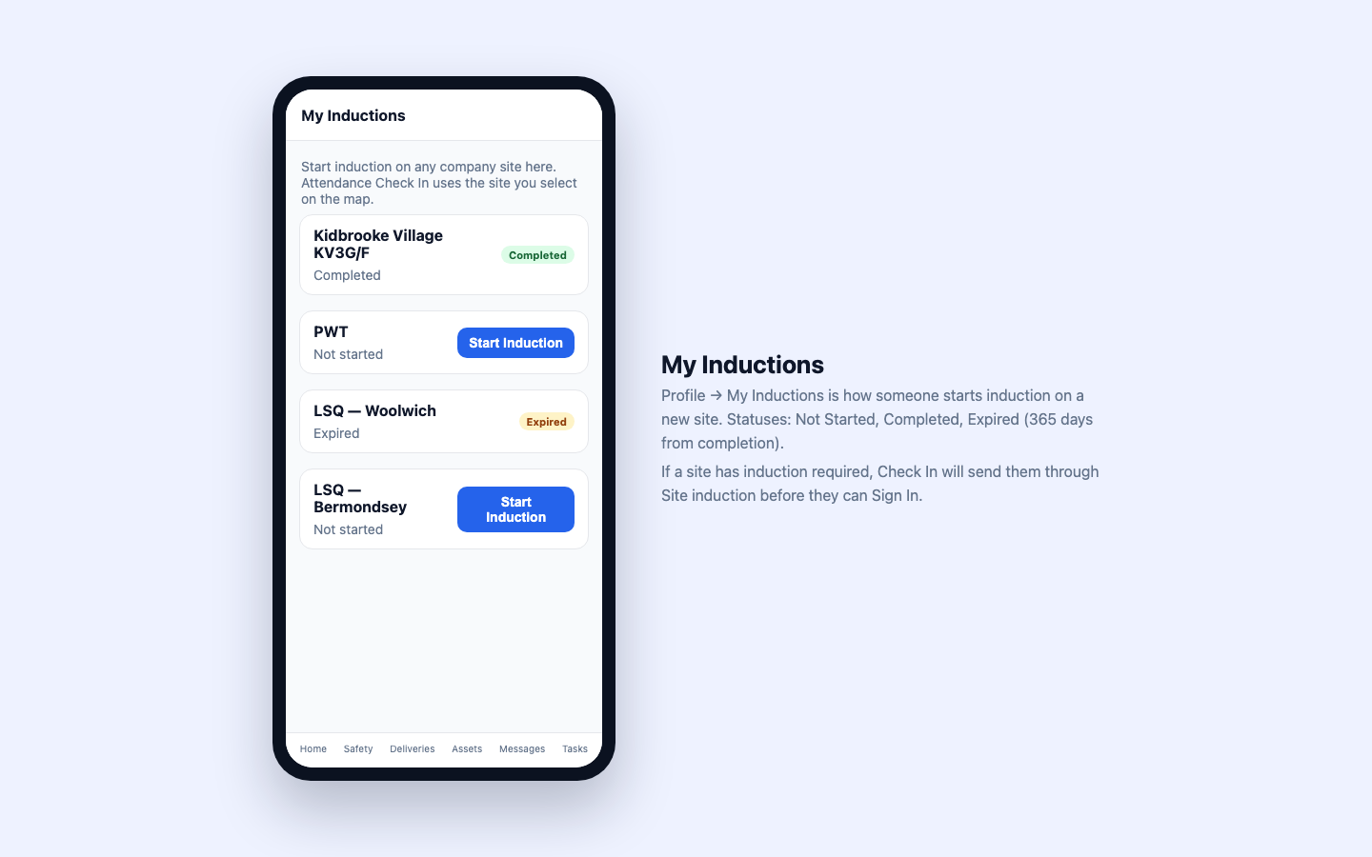
My Inductions
Construction Runner · App guide for operatives · info@construction-runner.com

Slide 14
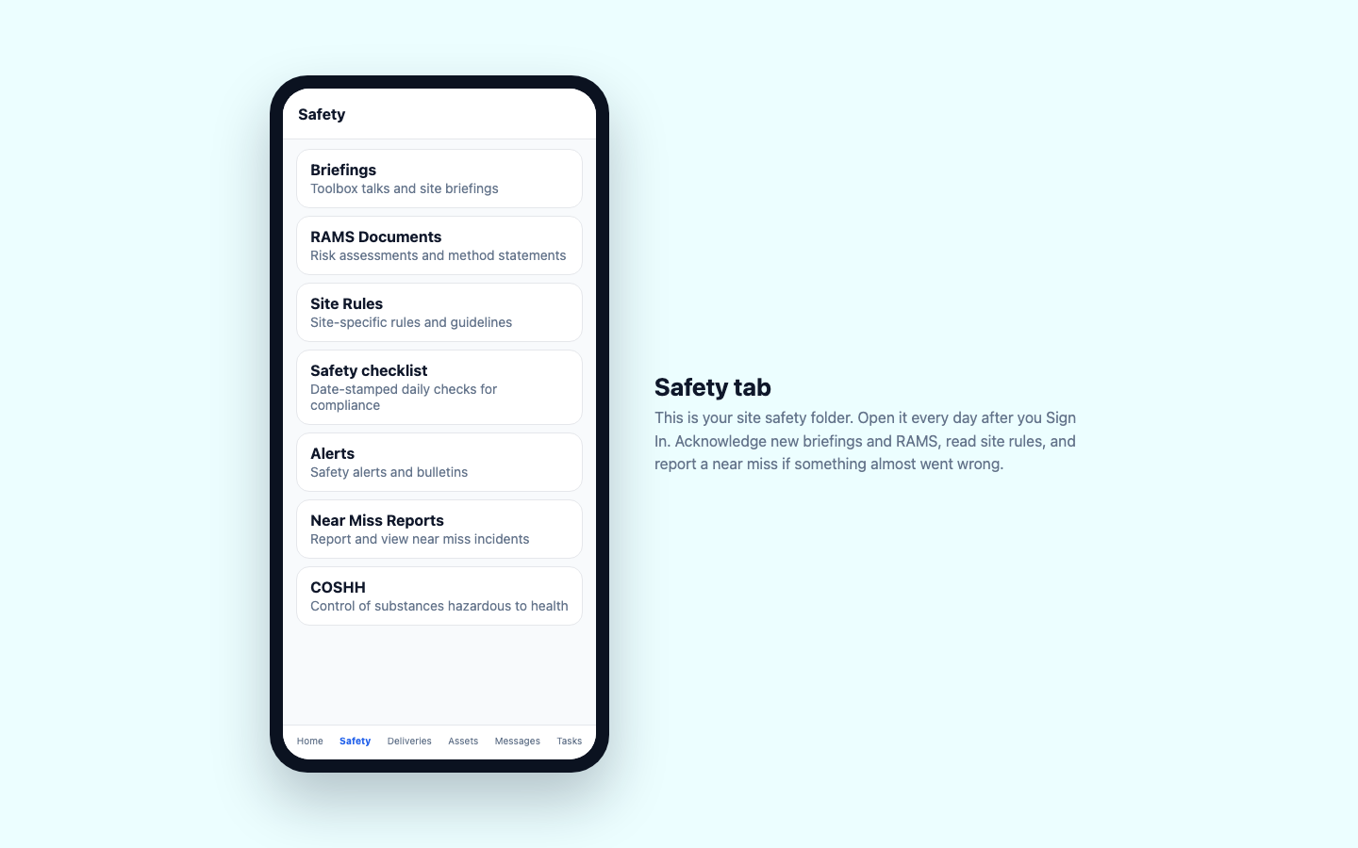
Safety tab
Construction Runner · App guide for operatives · info@construction-runner.com

Slide 15
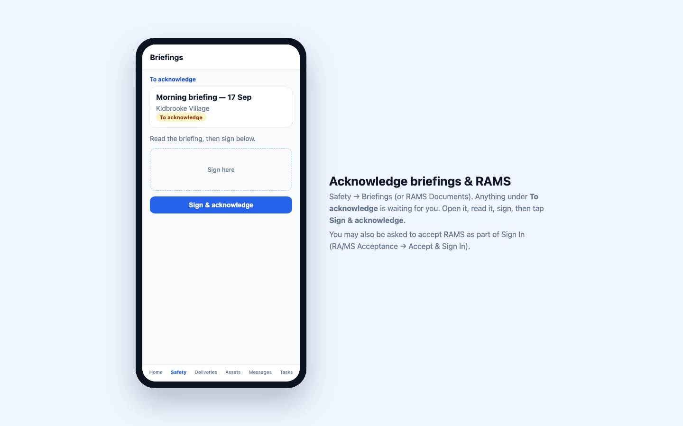
Sign & acknowledge
Construction Runner · App guide for operatives · info@construction-runner.com

Slide 16
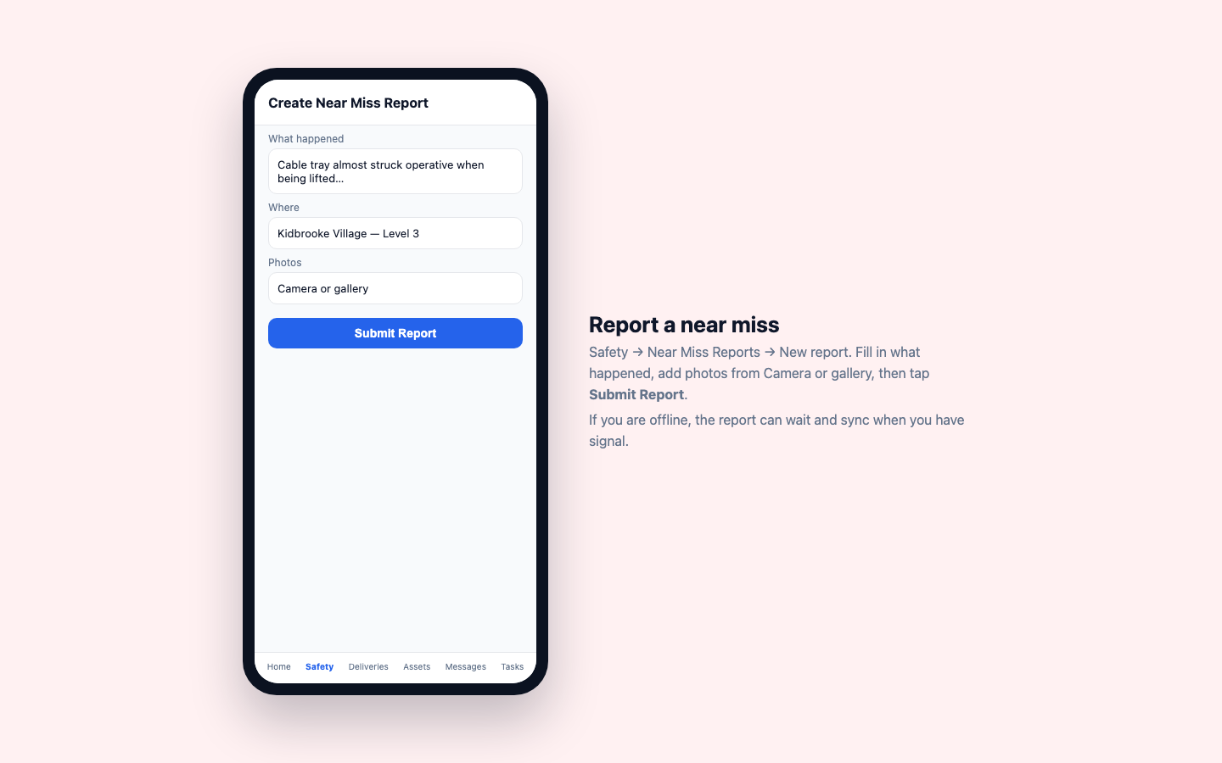
Near miss
Construction Runner · App guide for operatives · info@construction-runner.com

Slide 17
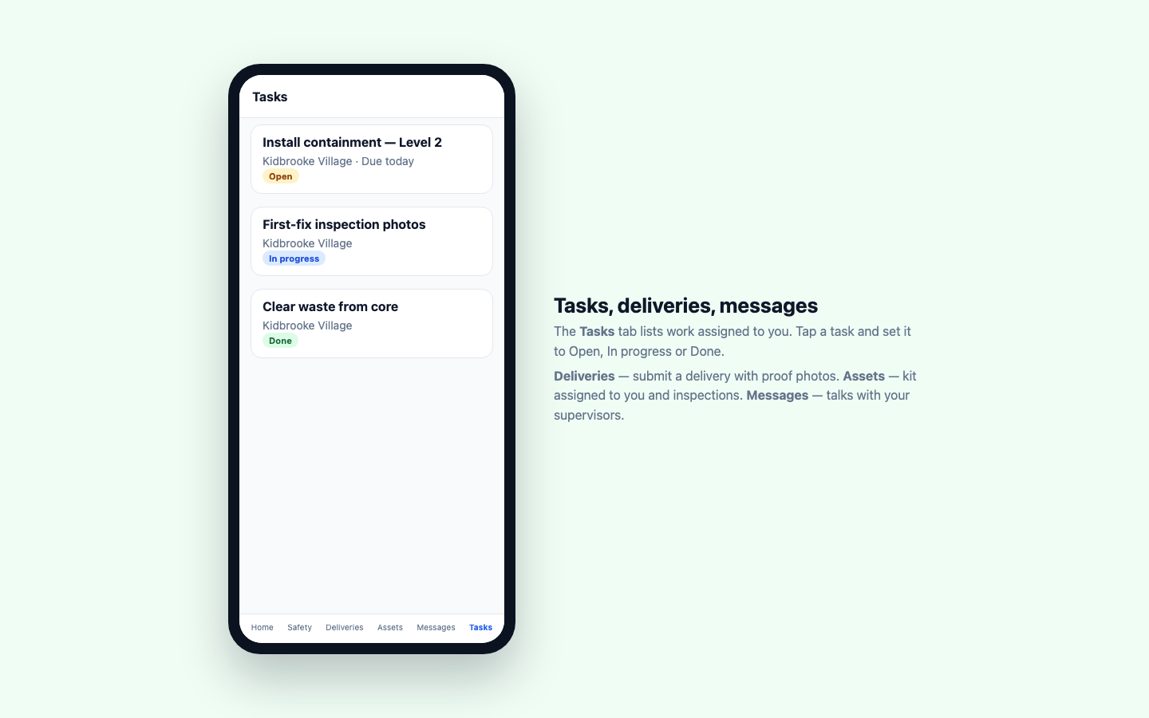
Tasks and the other tabs
Construction Runner · App guide for operatives · info@construction-runner.com

Slide 18
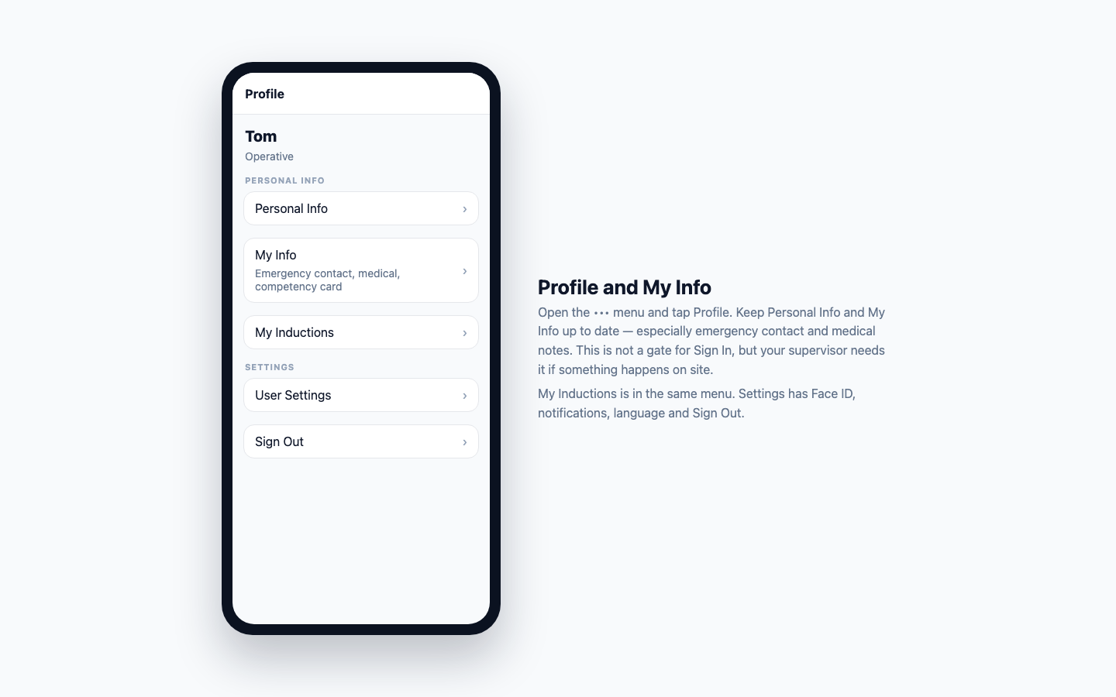
Profile
Construction Runner · App guide for operatives · info@construction-runner.com

Slide 19
If it is not working
Cannot sign in after register — wait for your supervisor to approve you
Sign In locked / needs Always — set Location to Always, then come back
Outside Site Boundary — walk onto the site and refresh location
Asked for induction — Profile → My Inductions → Start Induction
Did not auto sign out — Location is still While Using; Sign Out manually this time
Forgot password — Forgot Password? on the sign-in screen
Help: your supervisor, or info@construction-runner.com
Construction Runner · App guide for operatives · info@construction-runner.com

