Slide 1

Construction Runner
User Guide
Web admin and mobile app · Version 1.1 · September 2026
www.construction-runner.com · info@construction-runner.com

Slide 2
What this guide covers
How people join, sign in and reset a password
Roles: Super Admin, Site Admin, Supervisor, Operative, Subcontractor admin
Sites as folders — documents and tasks stay on the site you pick
Users, pending approvals, and ticking multiple sites for admins & supervisors
Attendance on web and GPS check-in on the app
Safety: RAMS, briefings, induction safety, site rules, alerts, near miss
Missing Info, induction (365-day expiry), and the Construction Runner mobile app
Construction Runner · User Guide · www.construction-runner.com

Slide 3
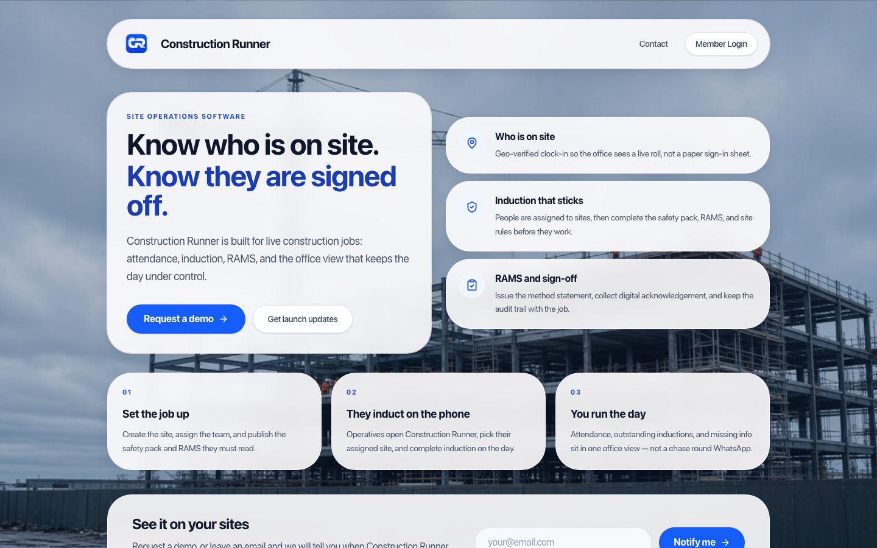
Two products, one company
Web admin — www.construction-runner.com → Member Login
For Super Admins, Site Admins, Supervisors and Subcontractor admins
Mobile app — Construction Runner on iPhone and Android
Operatives use the app only (web login is not available for operatives)
Same account: email, password, then admin approval before first sign-in
Construction Runner · User Guide · www.construction-runner.com

Slide 4
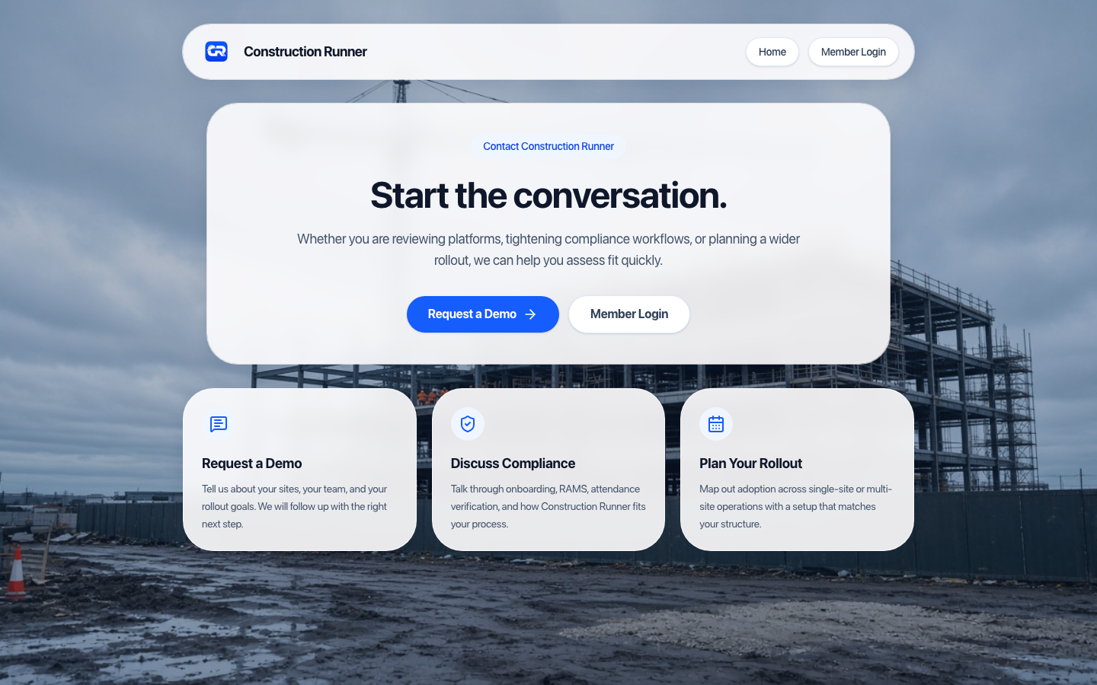
Website and contact
Construction Runner · User Guide · www.construction-runner.com

Slide 5
Roles at a glance
Super Admin — whole company, create sites, grant any role including Super Admin
Site Admin — only ticked sites; cannot create sites or grant Super Admin
Supervisor — same site ticks; live attendance, tasks, safety; app Supervisor Tools
Operative — app: geofence sign-in, induction, RAMS, tasks, near miss
Subcontractor admin — onboard their operatives on linked sites
Site Admins and Supervisors can work on more than one site — tick every site they need
Construction Runner · User Guide · www.construction-runner.com

Slide 6
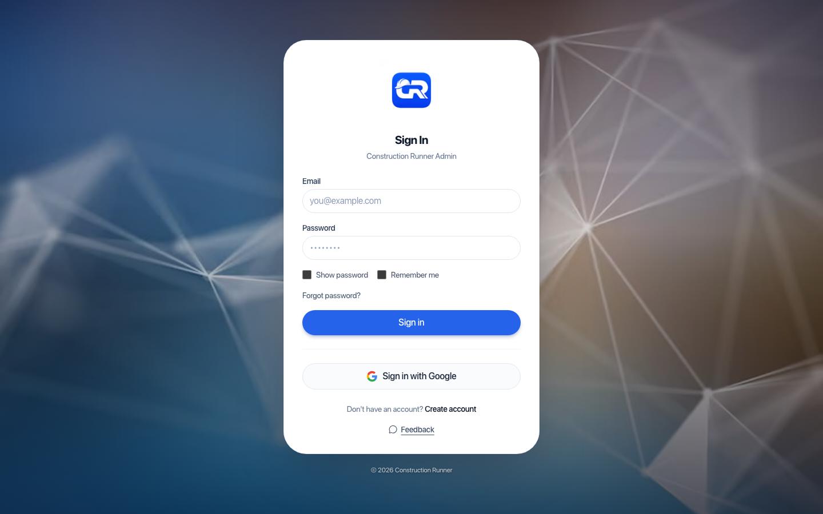
Sign in to the web admin
Construction Runner · User Guide · www.construction-runner.com

Slide 7
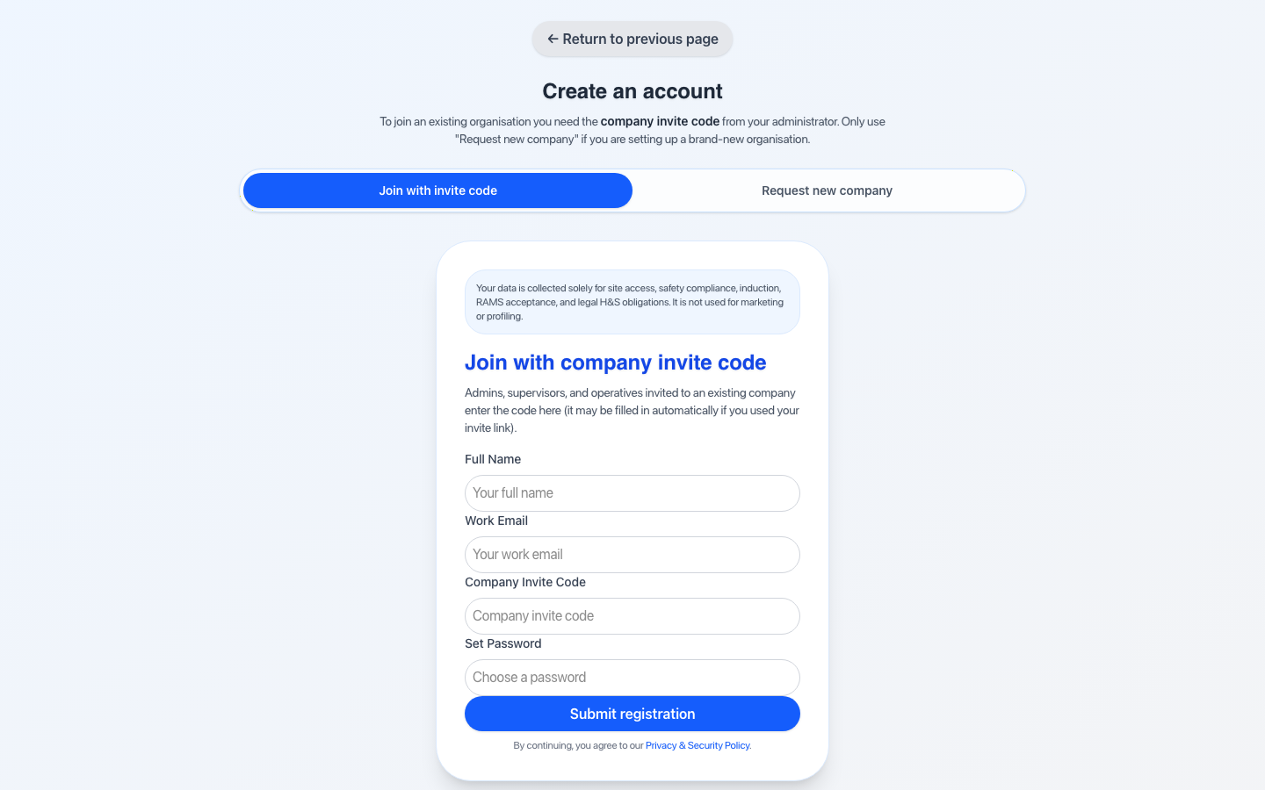
Create an account
Join with invite code — code from Settings → Company
Or Request new company — pending superuser approval
After submit: “Account request submitted. Pending approval.”
They cannot use web or app until someone approves them
Construction Runner · User Guide · www.construction-runner.com

Slide 8
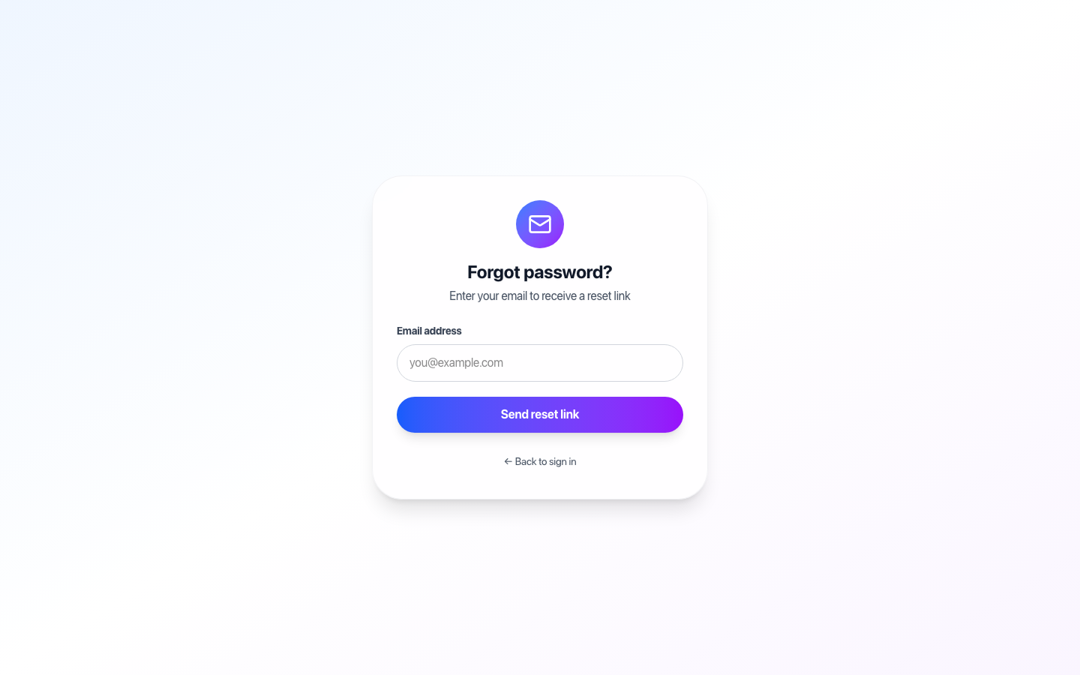
Forgot password
Sign in → Forgot password? → enter email → Send reset link
Open the email, set a new password, sign in
Super Admins can also Users → Send reset email
If the link has expired, request a new one
Construction Runner · User Guide · www.construction-runner.com

Slide 9
Sites — one folder per site
Super Admin: Add New Site — name, map, geofence radius, show on mobile map
Tick Induction required if people must induct before Sign In
Site Admin / Supervisor: assigned sites only — no Add Site
Open a site for Details, Subcontractors and Induction tabs
RAMS, briefings, tasks, alerts and rules stay on the site you selected
Construction Runner · User Guide · www.construction-runner.com

Slide 10
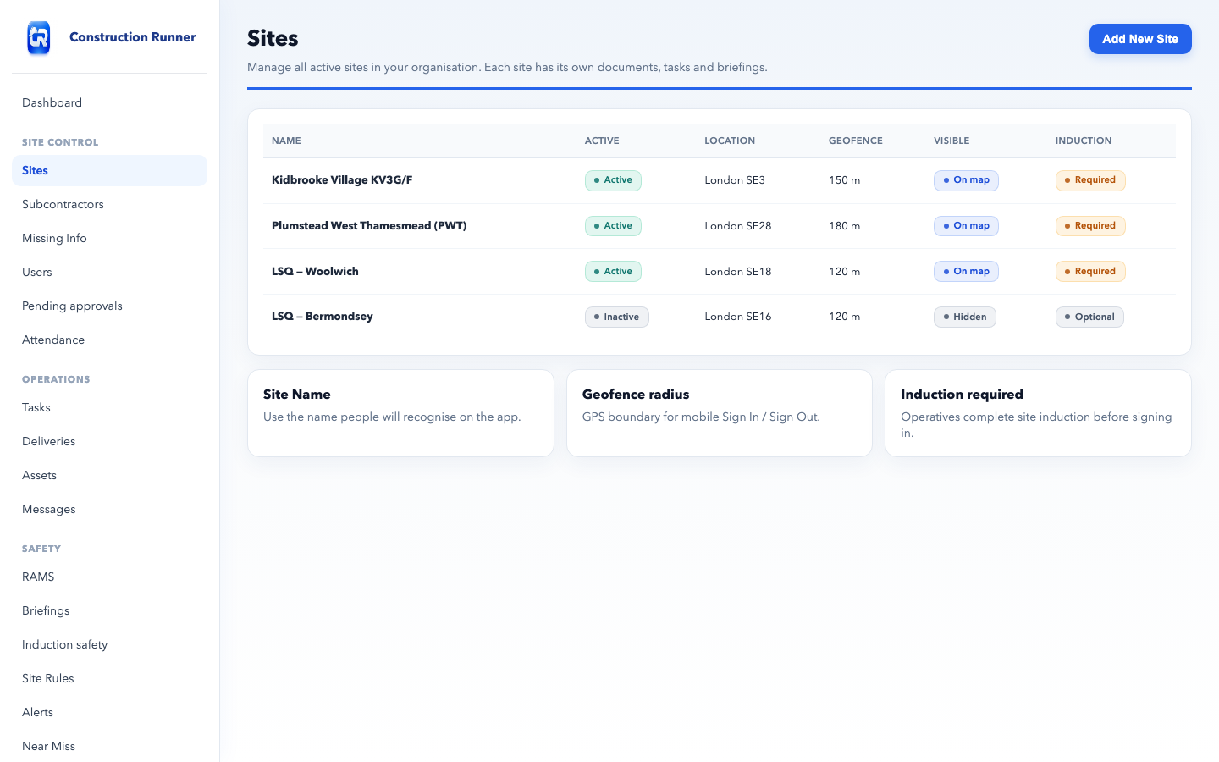
Sites
Construction Runner · User Guide · www.construction-runner.com

Slide 11
Pending approvals
Until approved, the person cannot sign in on web or app
Assign role: Operative, Supervisor, Site Admin, Super Admin
Only a Super Admin can grant Super Admin
Supervisor and Site Admin: tick all sites they can access — at least one
Approve or Reject
Construction Runner · User Guide · www.construction-runner.com

Slide 12
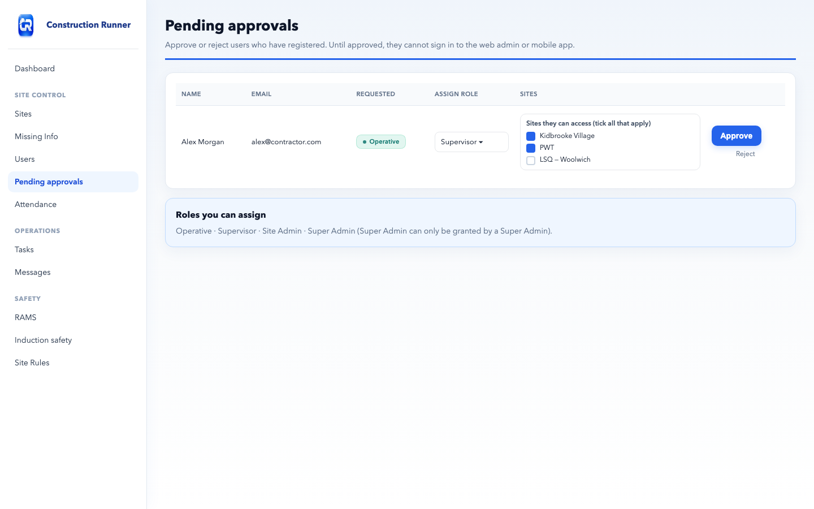
Pending approvals
Construction Runner · User Guide · www.construction-runner.com

Slide 13
Assign sites — admins and supervisors
Users → row menu → Assign sites…
Same picker for Site Admin and Supervisor
Tick every site they work on — they may cross over sites
Select all / Clear, then Save
Invite User shows the same ticks when the role needs sites
Construction Runner · User Guide · www.construction-runner.com

Slide 14
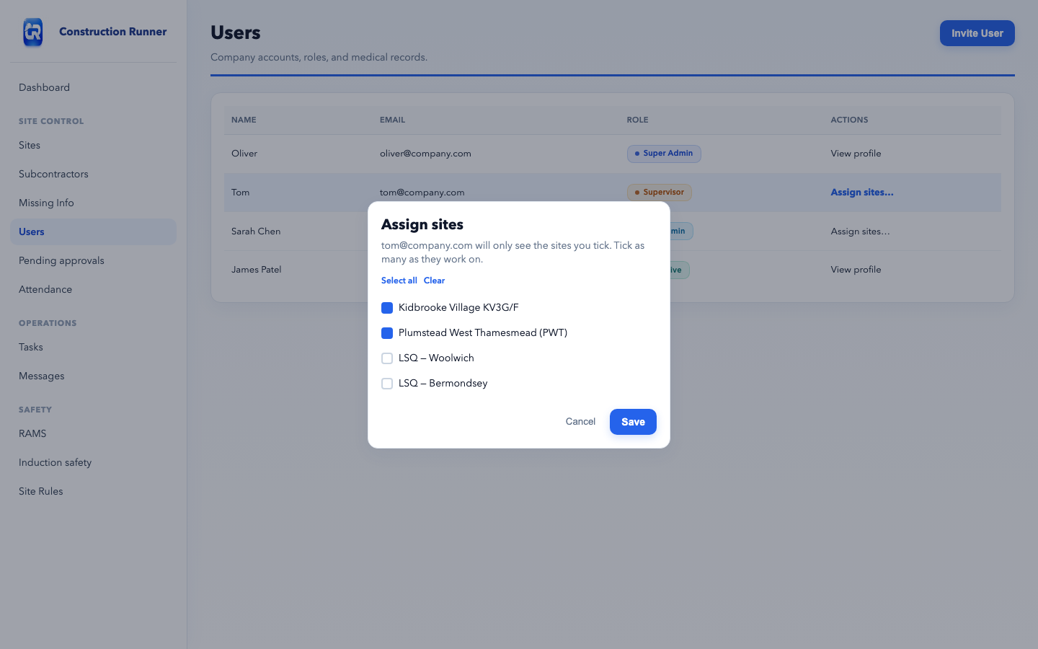
Assign sites
Construction Runner · User Guide · www.construction-runner.com

Slide 15
Attendance (web)
Live — who is signed in; archives at midnight UK
Role Call — fire roll; Signed in / Signed out; Export CSV or PDF
Record attendance — optional manual web sign-in/out
GPS check-in on the app is the source of truth on site
Auto sign-out can show as geofence exit or left site
Construction Runner · User Guide · www.construction-runner.com

Slide 16
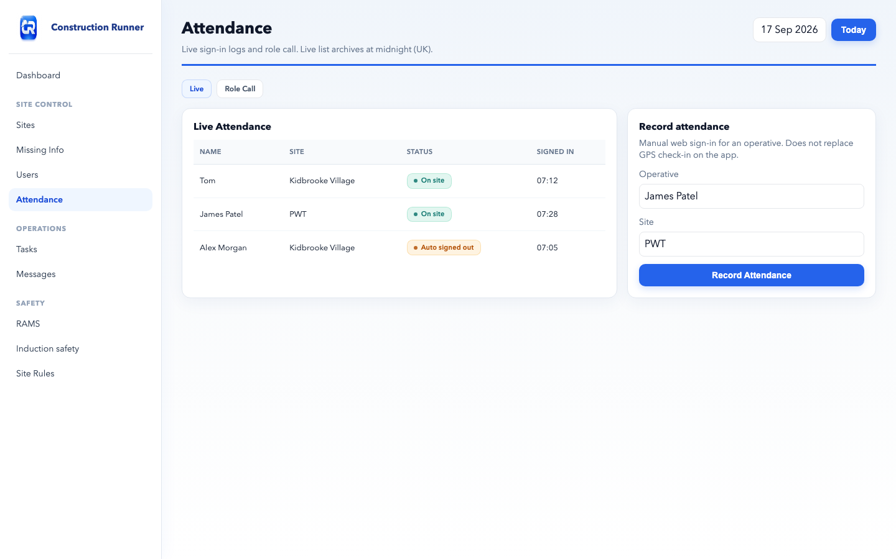
Attendance
Construction Runner · User Guide · www.construction-runner.com

Slide 17
Day-to-day work
Tasks — Add Task: title, people, required Site, due date
Deliveries — reference, supplier, site, scheduled time; photos on the app
Assets — equipment, assign, inspections
Messages — only threads you are in; New → pick people (optional company broadcast)
Always choose the correct site before you save
Construction Runner · User Guide · www.construction-runner.com

Slide 18
Safety
RAMS — upload PDF for one site; operatives acknowledge on the app
Briefings — toolbox talks; Sign & acknowledge; download reports
Induction safety — company pack shown during induction (not Site Rules)
COSHH — substances, symbols, PPE
Site Rules — PPE, emergency procedures, conduct — per site
Alerts — Info / Warning / Critical + site
Near Miss — from the app; Mark reviewed; badge on Safety until cleared
Construction Runner · User Guide · www.construction-runner.com

Slide 19
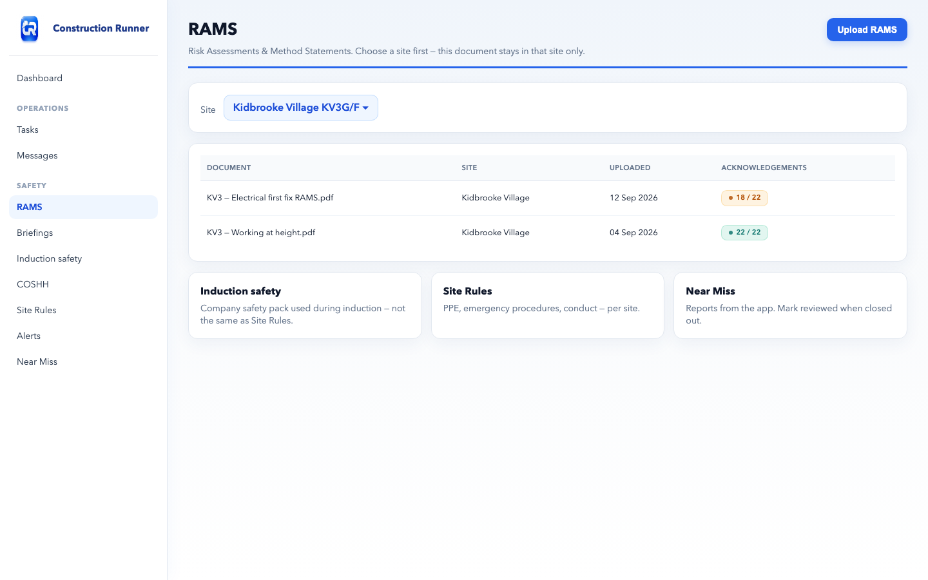
RAMS
Construction Runner · User Guide · www.construction-runner.com

Slide 20
Induction and Missing Info
Per site. Expires 365 days after completion
Missing Info — people missing emergency contact or medical details
Induction steps: Induction safety pack → RAMS → site rules → Complete
Site → Induction tab: mark complete or reset
App: Profile → My Inductions → Start Induction
If induction is required, Check In will not finish until it is completed
Construction Runner · User Guide · www.construction-runner.com

Slide 21
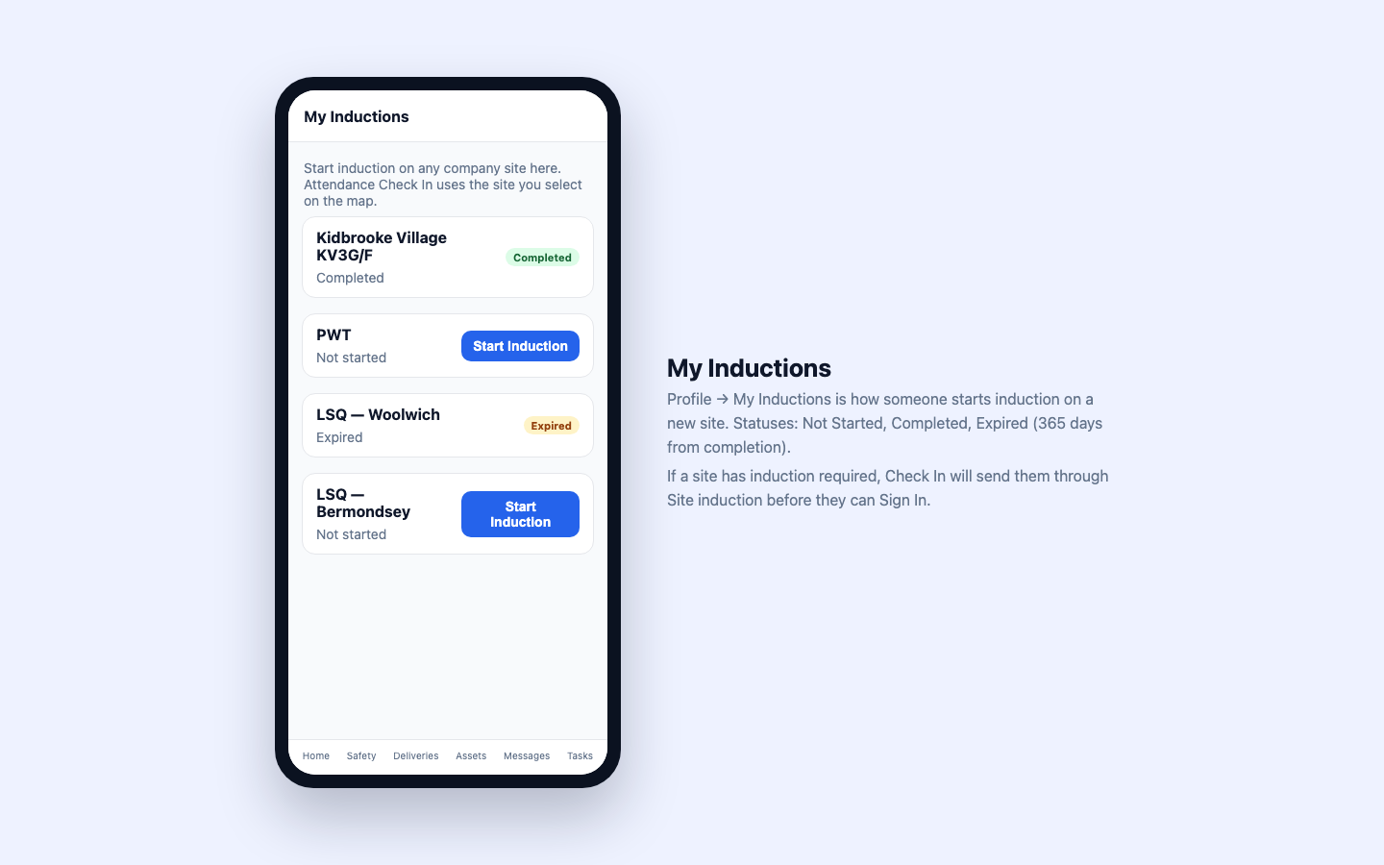
My Inductions
Construction Runner · User Guide · www.construction-runner.com

Slide 22
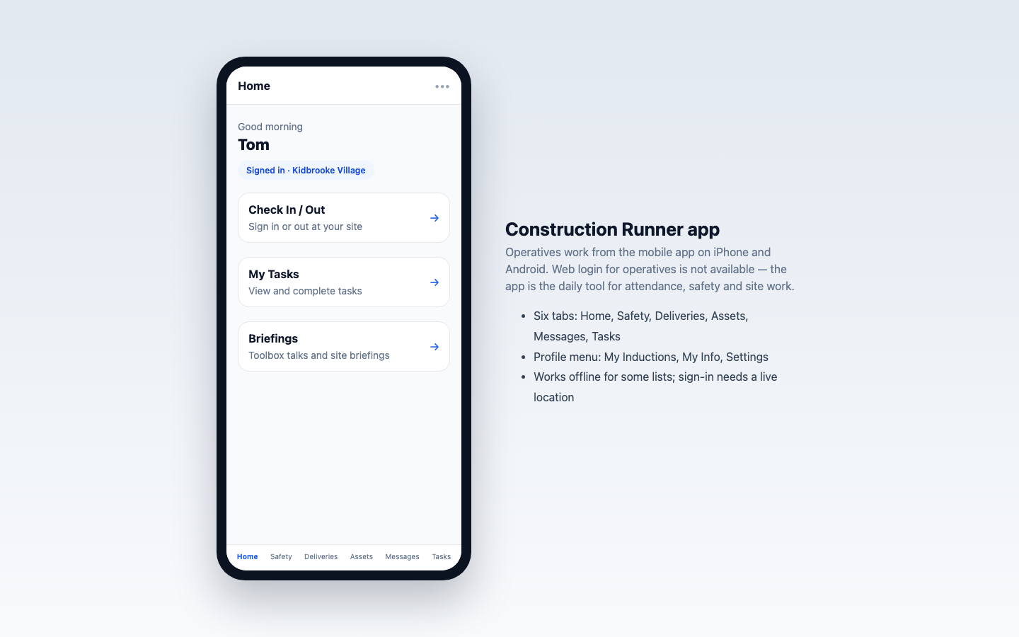
Mobile app — Home
Construction Runner · User Guide · www.construction-runner.com

Slide 23
Check In / Out
Home → Check In / Out → Select site
Wait for Inside Site Boundary, then Sign In
Complete induction and Accept & Sign In if asked
Sign Out, or leave the geofence for automatic sign-out
iPhone: Location = Always Android: Allow all the time
While Using / Allow Once will not sign you out after you leave
Construction Runner · User Guide · www.construction-runner.com

Slide 24
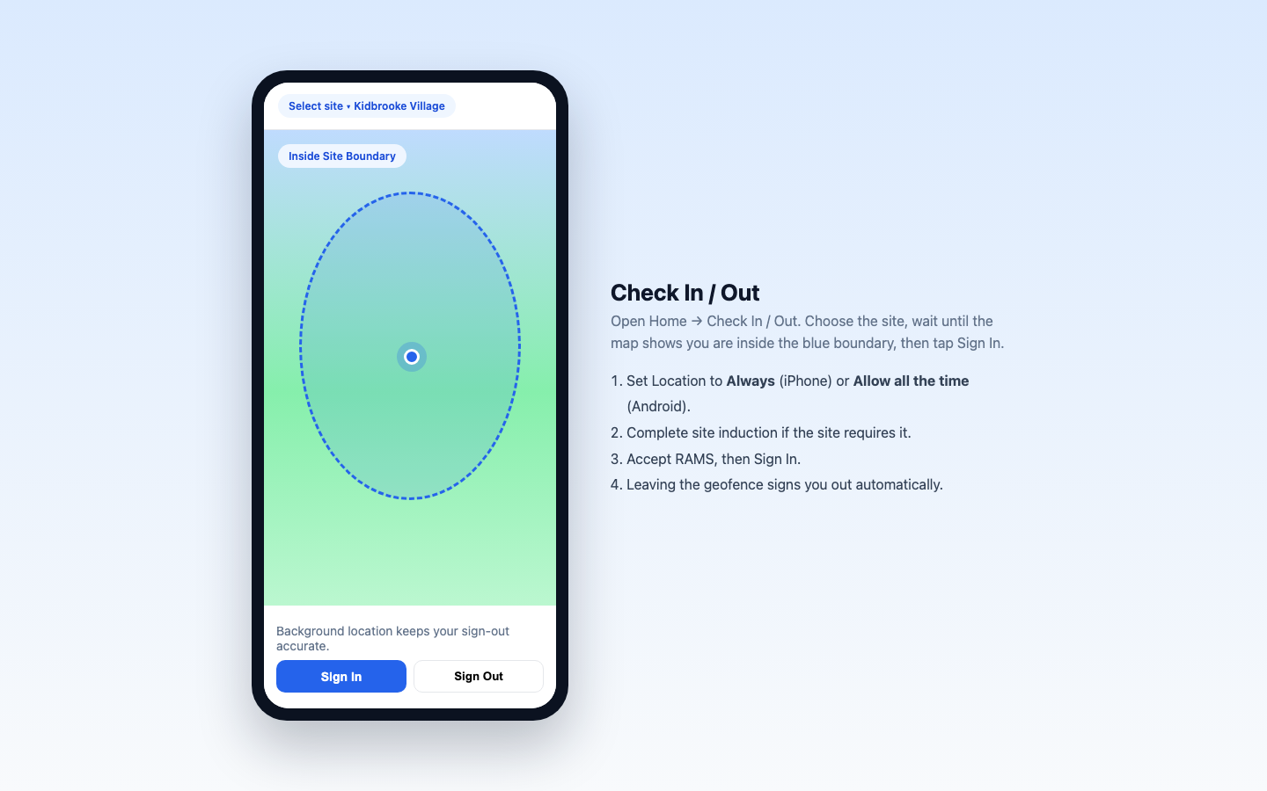
Check In / Out
Construction Runner · User Guide · www.construction-runner.com

Slide 25
App tabs
Home — Check In / Out, tasks, briefings
Safety — briefings, RAMS, site rules, alerts, near miss, COSHH
Deliveries — submit delivery, proof photos
Assets — My Assets, inspections
Messages and Tasks
Menu: Profile, My Inductions, Settings, Sign Out
Sign In needs a live connection and GPS — there is no web Offline queue
Construction Runner · User Guide · www.construction-runner.com

Slide 26
Subcontractors
Main contractor: Subcontractors → Invite Subcontractor → pick site → Generate invite code
Partner: www.construction-runner.com/join — Join as subcontractor
After approval they use Operative Onboarding for their own people
This is separate from the company invite code used by your own staff
Construction Runner · User Guide · www.construction-runner.com

Slide 27
If something goes wrong
Cannot sign in after registering — still pending approval
Supervisor / Site Admin sees nothing — Assign sites and tick at least one
Cannot Sign In on the app — Always location, inside geofence, induction, RAMS
Did not auto sign out — Location is not set to Always
Reset link expired — request a new one
Wrong documents — check which site was selected on upload
Construction Runner · User Guide · www.construction-runner.com

Slide 28
Support
Email: info@construction-runner.com
Website: www.construction-runner.com
Contact / demo: www.construction-runner.com/contact
Privacy: www.construction-runner.com/legal/privacy-and-security
This deck matches product labels as of September 2026 (guide v1.1, app 1.0.2)
Public website figures are live screenshots; admin figures match current table chrome and status chips
Construction Runner · User Guide · www.construction-runner.com

