Slide 1
3D Sound for VR
Practical Guide to implementing 360 sound in VR projects
Special Thanks to @NickLaMartina who presented this (and a lot more) at ONA16 and shared his assets and knowledge.
Notes:
Thank Host
Tell Jack Story
Time
Effort
Issues
Loss

Slide 2
What is 3D sound?
True Surround Sound or 360 Sound
Used in VR, AR and 360 video.
Works with Facebook 360 and Youtube 360 video

Slide 3
Why 3D sound?
Makes the experience immersive
Stimulating and provocative
Honesty and accuracy

Slide 4
Why 3D sound?
Makes the experience immersive
Stimulating and provocative
Honesty and accuracy

Slide 5
BECAUSE, IT ENGAGES YOUR AUDIENCE!

Slide 6
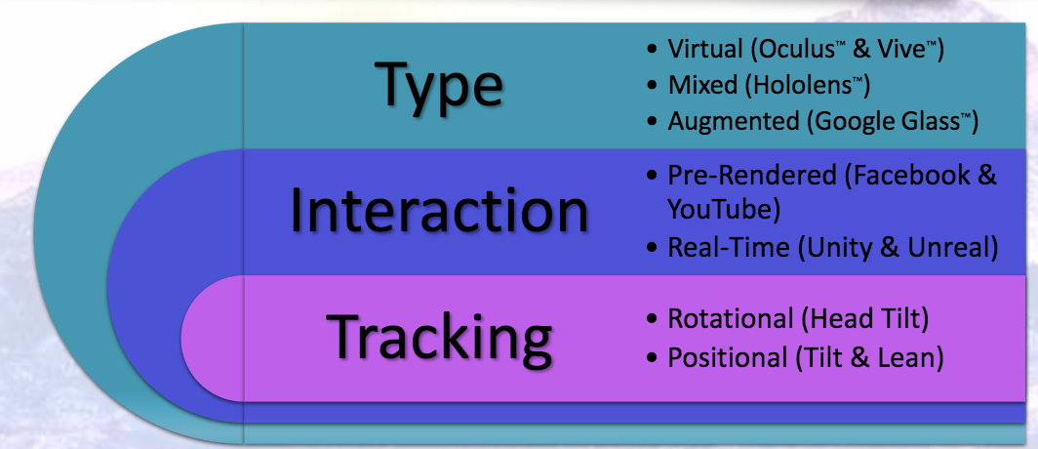
Planning for 3D Audio
Graphic by @NickLaMartina

Slide 7
Workflow for 360 Video (pre-rendered)
Sources
Renders
Platform
DAW/NLE
Ambisonic Panning
Spatialized Panning
Mono Record
Binaural streams
Ambisonic stream
Playback to headphones

Slide 8
Workflow for Real-time experience (VR)
Sources
Renders
Platform
DAW/NLE
Ambisonic Panning
Spatialized Panning
Mono Record
Binaural streams
Ambisonic stream
Playback to headphones

Slide 9
Two types of Spatial Audio
Point Source Spatialization
Ambosinic Matrix Panning

Slide 10
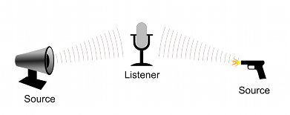
Point Source Spatialization Unity 3D Audio
Audio Model
Listener (Ears)
Multiple Sources (sounds)

Slide 11
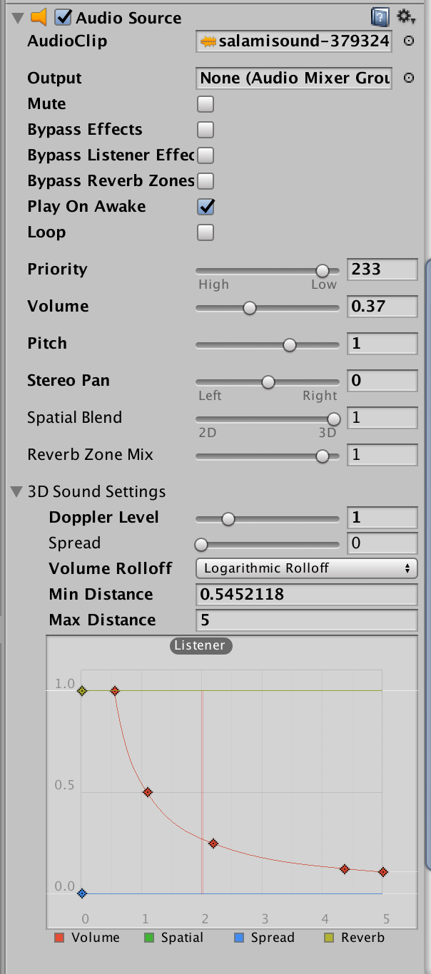
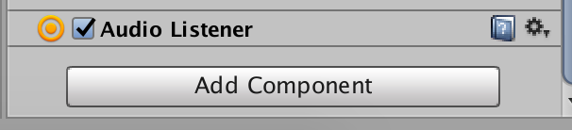
Point Source Spatialization Unity 3D Audio
Add Listener to Camera or FSP Controller
Add Source and Set 3D Sound
Spatial Blend to 3D
Play on Awake (till we learn events)
Priority low unless music
Set Distance relative to scene in meters

