Slide 1
VR Virtual Environments

Slide 2
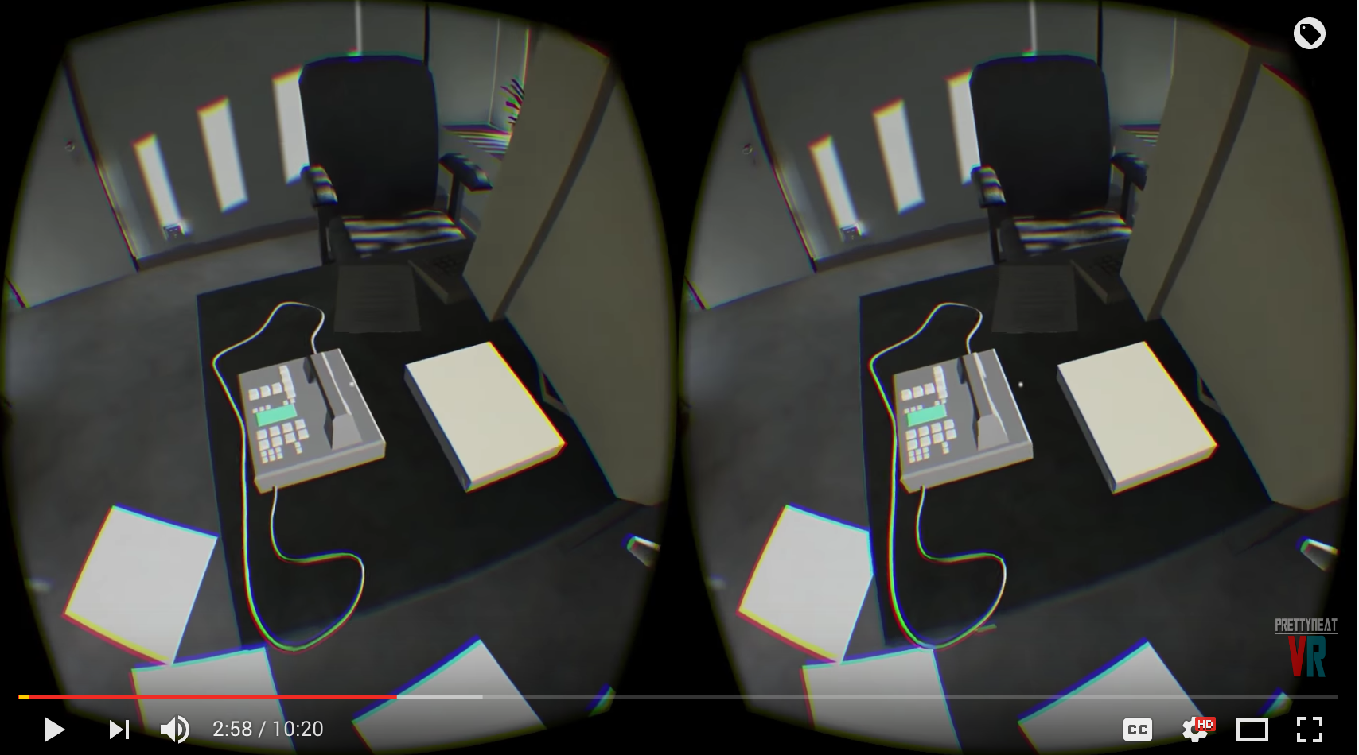
911 VR (offline)
https://www.youtube.com/watch?v=HuwHFGPHSIk

Slide 3
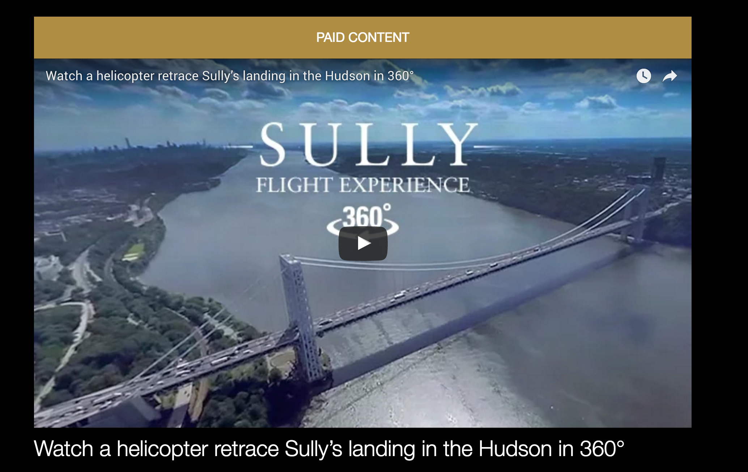
Sully by CNN
http://sponsorcontent.cnn.com/interactive/sully/

Slide 4
Connecting Unity and VR
J660 VR Design and Storytelling

Slide 5
The Plan
Start long downloads
Go to Unity and setup Oculus
Set up Vive
Build both
Try to set up for cardboard

Slide 6
Resources
Video Tutorials: learn.vrdev.school

Slide 7
Oculus Rift Settings
FPS Controller
Project Setting → Player → Enable Virtual Reality
Add Oculus Player

Slide 8
Oculus Rift Settings
Build and Run
Select Platform
Build and Test!

Slide 9
Vive Settings
Asset Store → Steam VR Plugin
Download and Install
Add the GvrMain to your scene.
Disable the FPS Controller
Build as before

Slide 10
Google Cardboard
Download and install xCode (mac only)
Download for the Android SDK for for your respective platform
Install Unity (already done!)
Install Java JDK
Download and Install Google VR SDK for Unity

Slide 11
xCode
Go to App Store and Download xCode. This could take a while.

Slide 12
Start Here
https://developers.google.com/vr/unity/get-started-controller

Slide 13
Download the Android SDK
https://developer.android.com/studio/index.html
Download for the SDK for for your respective platform
Install

Slide 14
Java JDK
http://www.oracle.com/technetwork/java/javase/downloads/jdk8-downloads-2133151.html
Download for the JDK for for your respective platform
Install

