Slide 1
Case Study: Bigger than Angry Birds (for a while)
From Class to Translate to top 10!

Slide 2
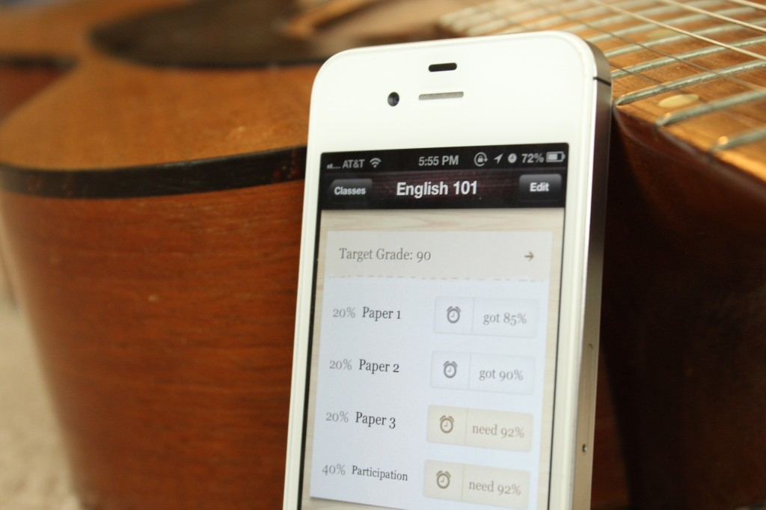
Grades App

Slide 3
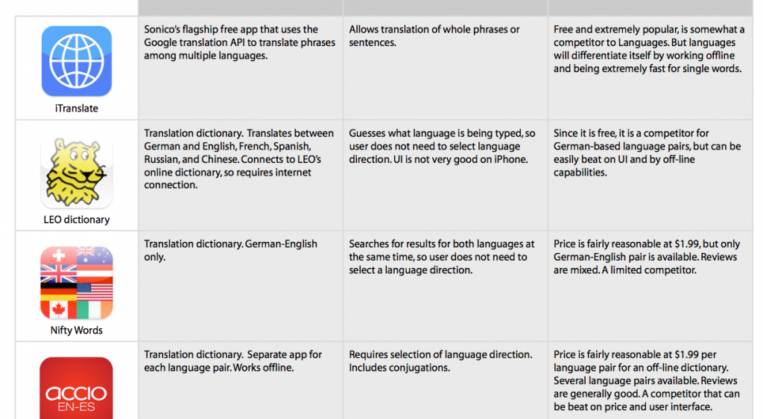
New Problem: Offline Translation

Slide 4
User Experience Mapping
Analyze users’ daily experience without the app — i.e. identify the problems they currently face.
Brainstorm ways that an ideal app could solve those problems.
Choose which problems to focus on, and decide which features were feasible for the first release.

Slide 5
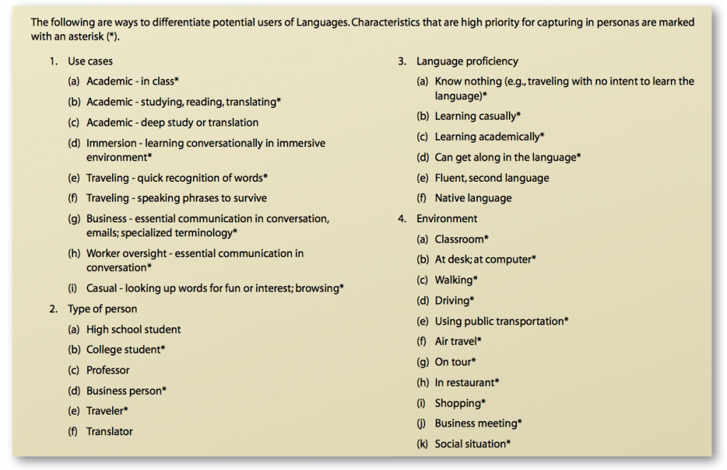
Step 1: Define Personas

Slide 6
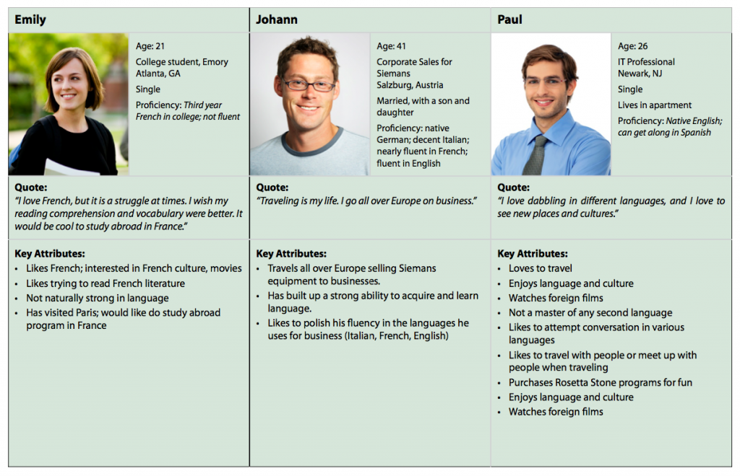

Slide 7
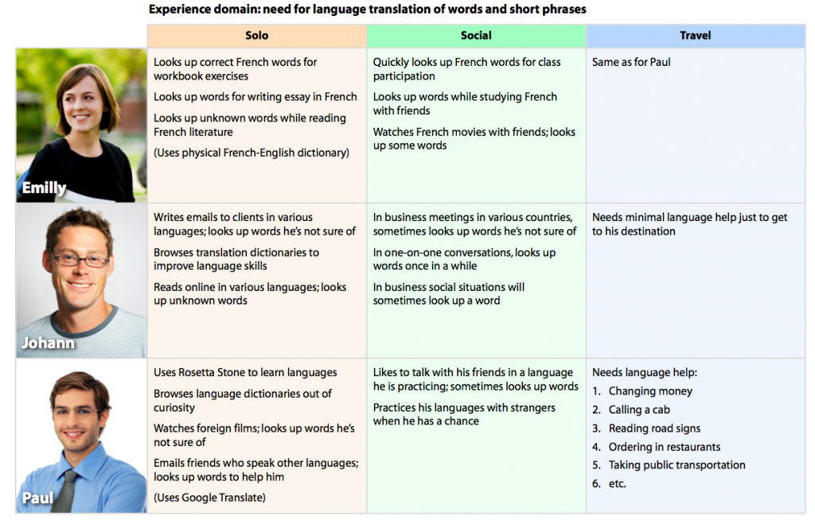

Slide 8
Step 3: First Idea Branstorm

Slide 9
Step 4: Kill the bad ideas
“Polishing an app takes a ridiculous amount of time. So, if you start out with too broad a feature set, your app will lack focus and you will have no way to polish those features adequately.”

Slide 10
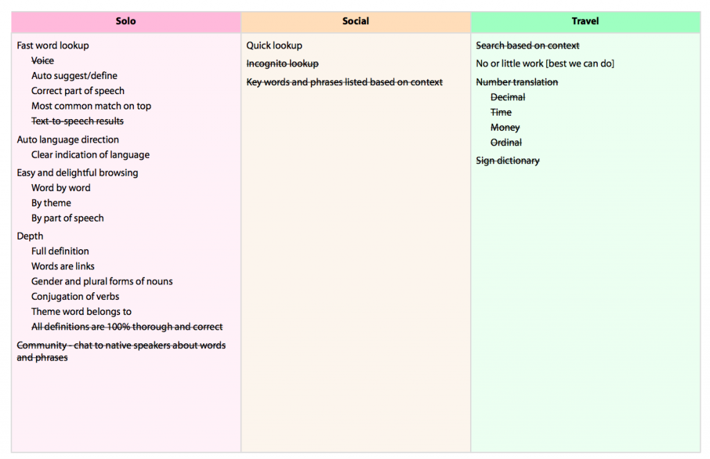

Slide 11
Define the App
“An offline translation dictionary that gives instant access to words and definitions at 99¢ for multiple language pairs.”

Slide 12
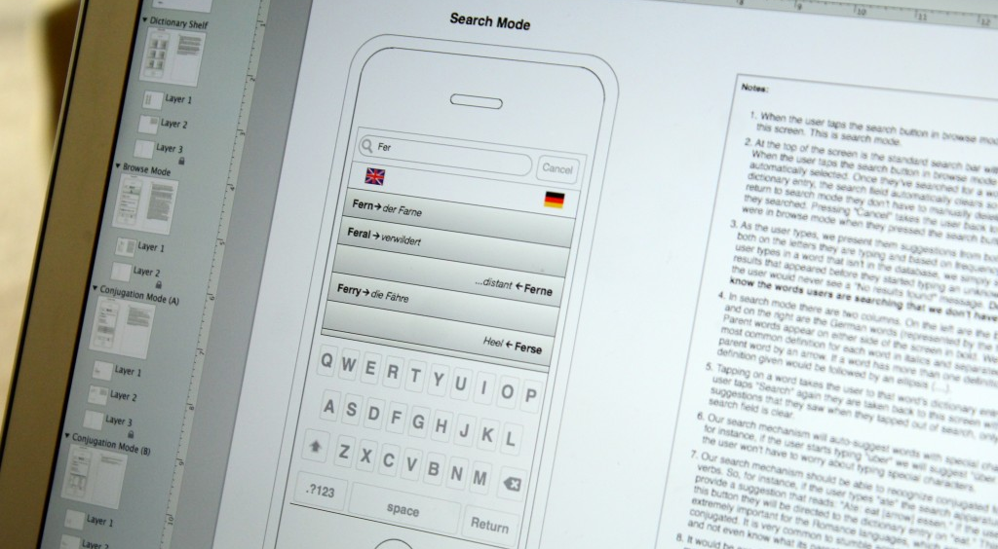
First Sketches

Slide 13
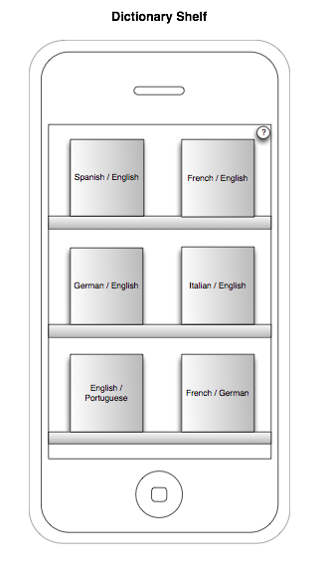
Physical Concept

Slide 14
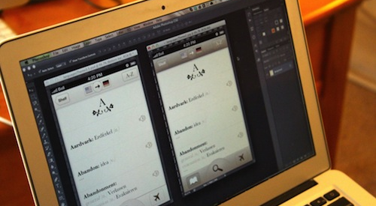
Color and Theme

Slide 15
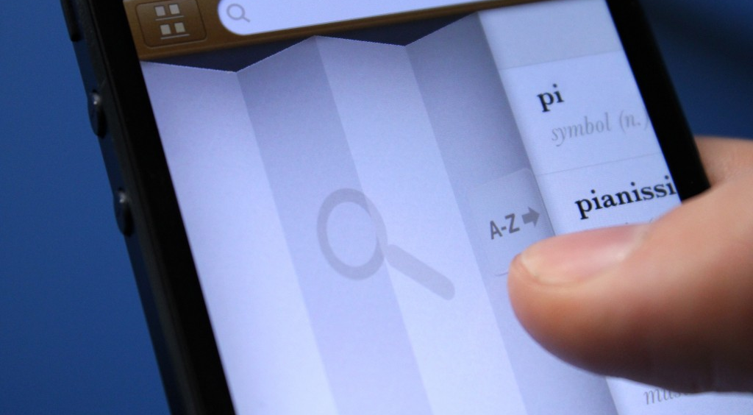
Details

Slide 16
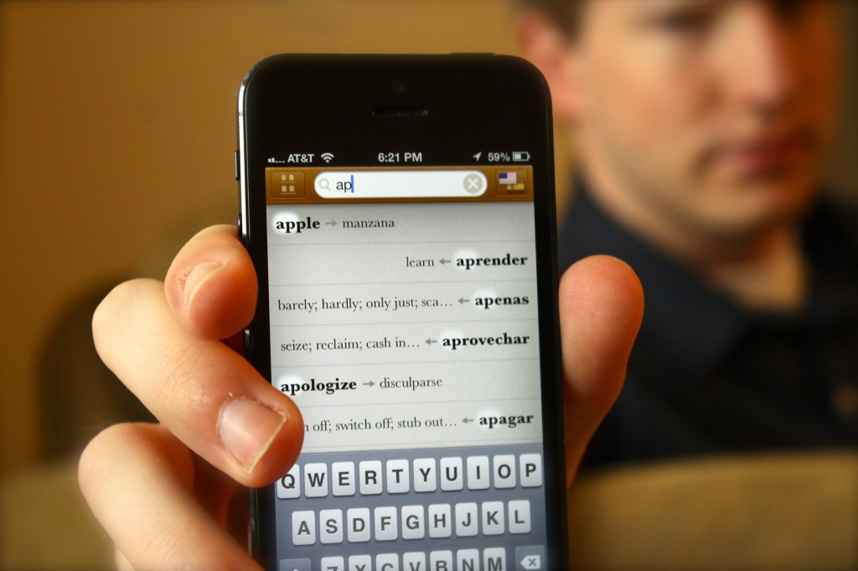

Slide 17
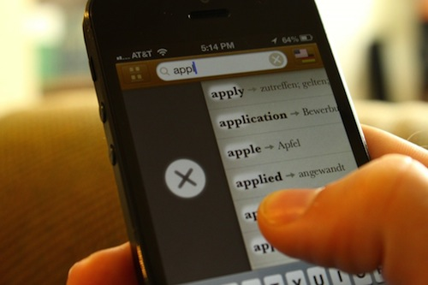
Different Ways to do something

Slide 18
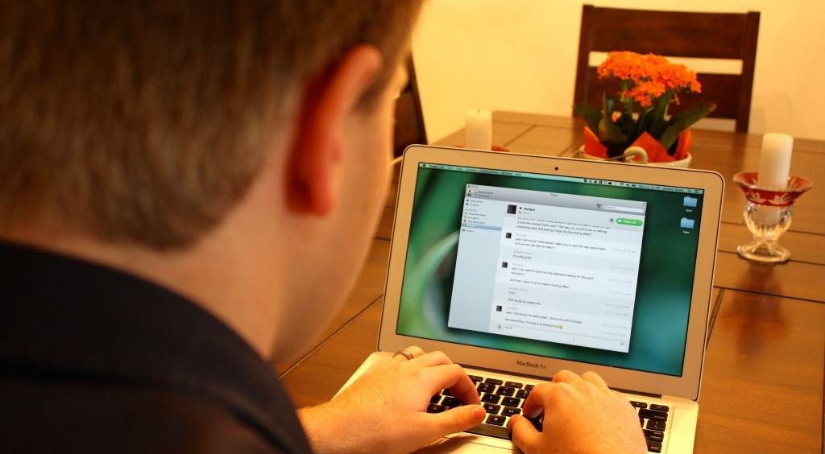
Designer and Programmer Together

Slide 19
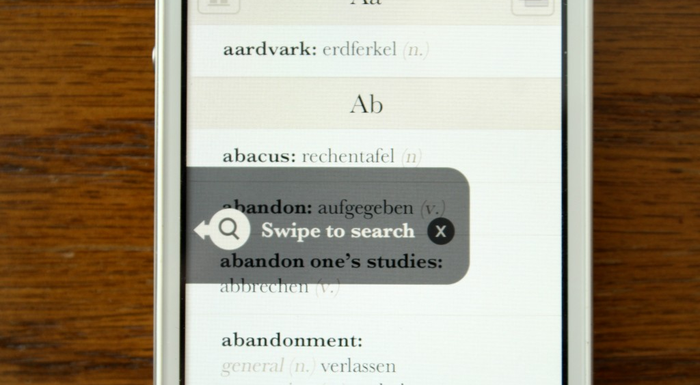
Testing, Testing, Testing

Slide 20
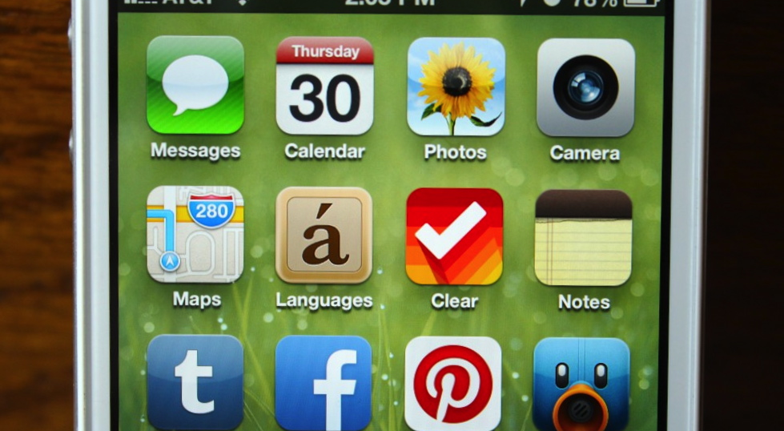
Launch

