Slide 1
App Economics
Making a business with Apps
Sources: developereconomics.com, Apple, Google Report, Fierce Developer, autosend.io/

Slide 2
Gold Rush!
Everyone wants to make a lot of money
Candy Crush
$829 million in 2013
Flappy Bird
$50k per day at peak
Forbes: http://www.forbes.com/sites/ewanspence/2014/07/08/smartphone-app-revenue-dominated-by-a-handful-of-games-and-developers/

Slide 3
Gold Rush? Not really!
Average Revenue over three year span:
iOS
App: $4,000
Developer : $21,276
Android
App: $1,125
Developer: $6,000
Forbes: http://www.forbes.com/sites/tristanlouis/2013/08/10/how-much-do-average-apps-make/

Slide 4
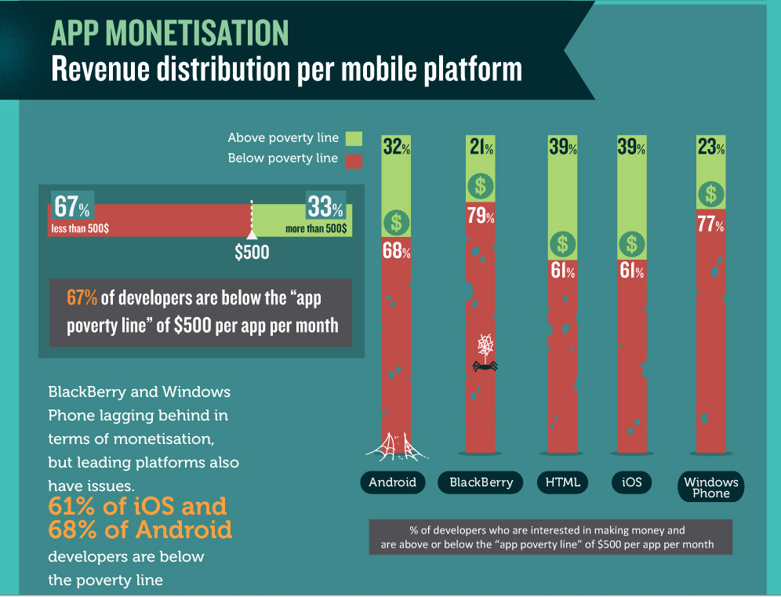

Slide 5
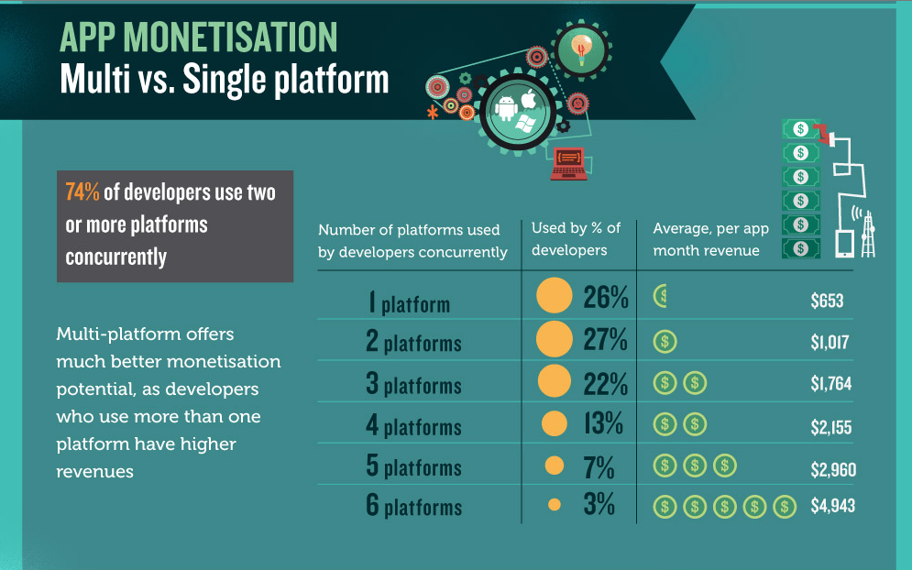
http://www.developereconomics.com/

Slide 6
Types of Apps
Games
Utility
Social
Enterprise

Slide 7
Games!
33% of developers are creating Games
80% of store revenue from games

Slide 8
Games!
33% of developers are creating Games
80% of store revenue from games
Important because:
67% of developers are competing for 20% of revenue

Slide 9
Niche
Not really as much competition. Actually competing for revenue inside your niche.
Ex: Social Photo Sharing competes with other social and photo apps not all non-game apps.

Slide 10
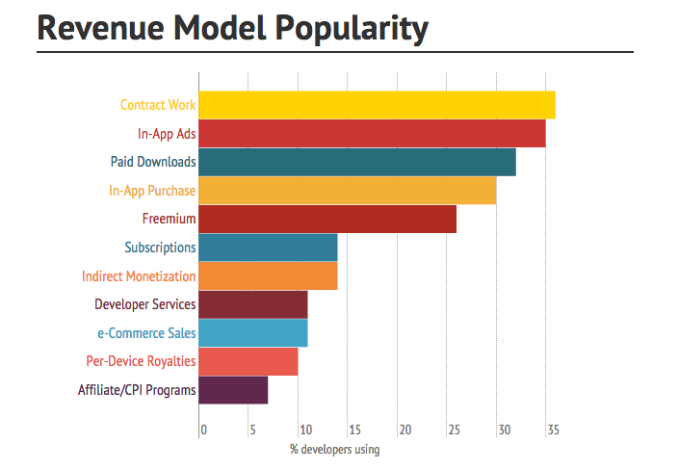
Lots of ways to make money

Slide 11
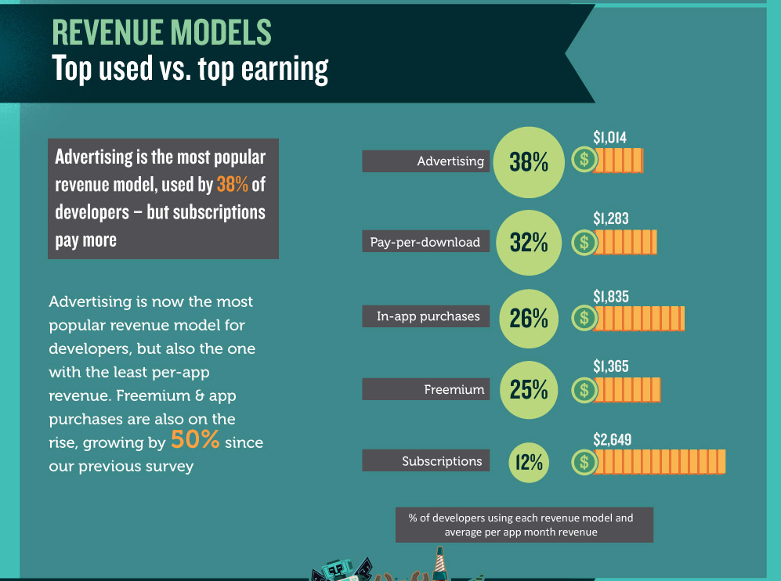

Slide 12
Contract Work
Building Apps for Companies
Stable, hourly, high demand
Medium Risk, Good Return
Hourly Rate: $100-$250

Slide 13
Enterprise Level Licensing
Creating technology or functionality for multiple companies or multiple apps
“In a gold rush the best business is selling shovels and pick axes.”
High Risk, High Return

Slide 14
Advertising
Free or low cost download, in-app ads for revenue.
Low Risk, Low Return
CPM: $0.53 to $1.56
$1000 = 1 million views
3.5 view per use 285,000 users

Slide 15
In Store Models
Direct Download, in-app-purchase, freemium
Inconsistent, high competition
Little Risk, Low Return (on average) but potential for high return if stars align.

Slide 16
Free, $99, $9.99, freemium or all
Which one or all of them? What is a developer to do?

Slide 17
Arguments for Free
90% of apps in use are free
Many developers who ran pricing experiments concluded that charging even $.99 significantly reduced demand for their apps
In-app purchases will drive 41% of the store revenue in 2016
Average App Price: $1.39, Game Price: $0.75, Overall Price: $1.29
Freemium, or free-to-play games generated 65% of all revenue from the top 100 grossing games in June
http://autosend.io/blog/should-my-app-be-free-or-paid/

Slide 18
Arguments against Free
Cost for Success (money)
You can’t afford it.
Ads are annoying and low payout. See prev.
Customers ignore revenue generators
Fee apps get worse ratings
Not downloaded by target audience

Slide 19
Did you consider?
The VOLUME of downloads it takes to make your free app profitable (80k users for $5k year)
The top 100 charts are dominated by apps made by big publishers
The marketing power the big boys have to get immediate downloads quickly, help them rank higher
Most apps are actually in the app store to extend brand recognition and brand awareness
http://autosend.io/blog/should-my-app-be-free-or-paid/

Slide 20
Focus on the Indie Developer
average developer makes less than $500/month
1/3 of those developers make less than $100 a month in ad revenue
80% of App Store revenue is from 20% of the app store developers
Games are downloaded 5-10x higher than other categories. So having a free game may work out better than having a free app
Freemium apps generally convert at a very low rate – usually less than 5%(0.5% to 6% to be specific) of total users directly contribute revenues through in-app purchases
http://autosend.io/blog/should-my-app-be-free-or-paid/

Slide 21
Free with In App Purchases
Goal: $500 per month
Need 10,000 downloads (334 per day)
With 5% of users make $.99 purchase
http://autosend.io/blog/should-my-app-be-free-or-paid/

Slide 22
Now, $0.99
Goal: $500
Need 500 downloads (17 per day)
Much more doable

Slide 23
All that work to break even?
Spend 4 months working nights and weekends to break even?
How can you actually make it a business?

Slide 24
Combine revenue models
Charge at least $0.99 if not more
Add targeted and useful in-app-purchases
Integrate affiliate model when useful
Watch what works and do more of that!

Slide 25
Example Paid Apps
Tap Tap Tap
Simogo
Cultured Code

Slide 26
Growing
Spend time keeping the users you have.
It costs $1.90 to gain a new user.
Give great customer support. Reply quickly
Stability over features
Ship with the minimum, add features as fast as possible.
Keep the app fresh, slight changes and improvements and tell them about them

Slide 27
Tricks
Play the listing odds.
Best way to generate downloads is to be higher ranked in a category.
So many apps are free, paid categories are less competitive
Go Free for limited time
Stimulate downloads and move up in rakings

Slide 28
Questions

