Slide 1
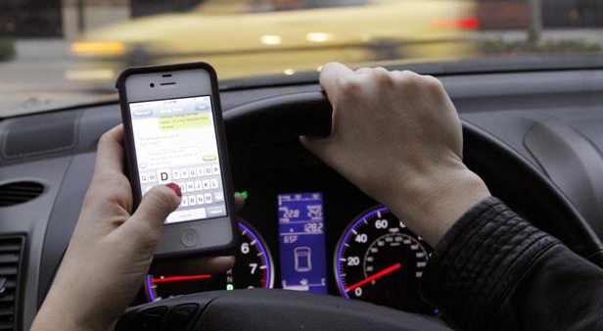
Human Centered Design
Problem to Solve
Steven King
UNC jSchool
@steven_king

Slide 2
Smartphone Usage while driving
1.6 Million Crashes per year
1 in 4 accidents caused by phone usage.
26%

Slide 3
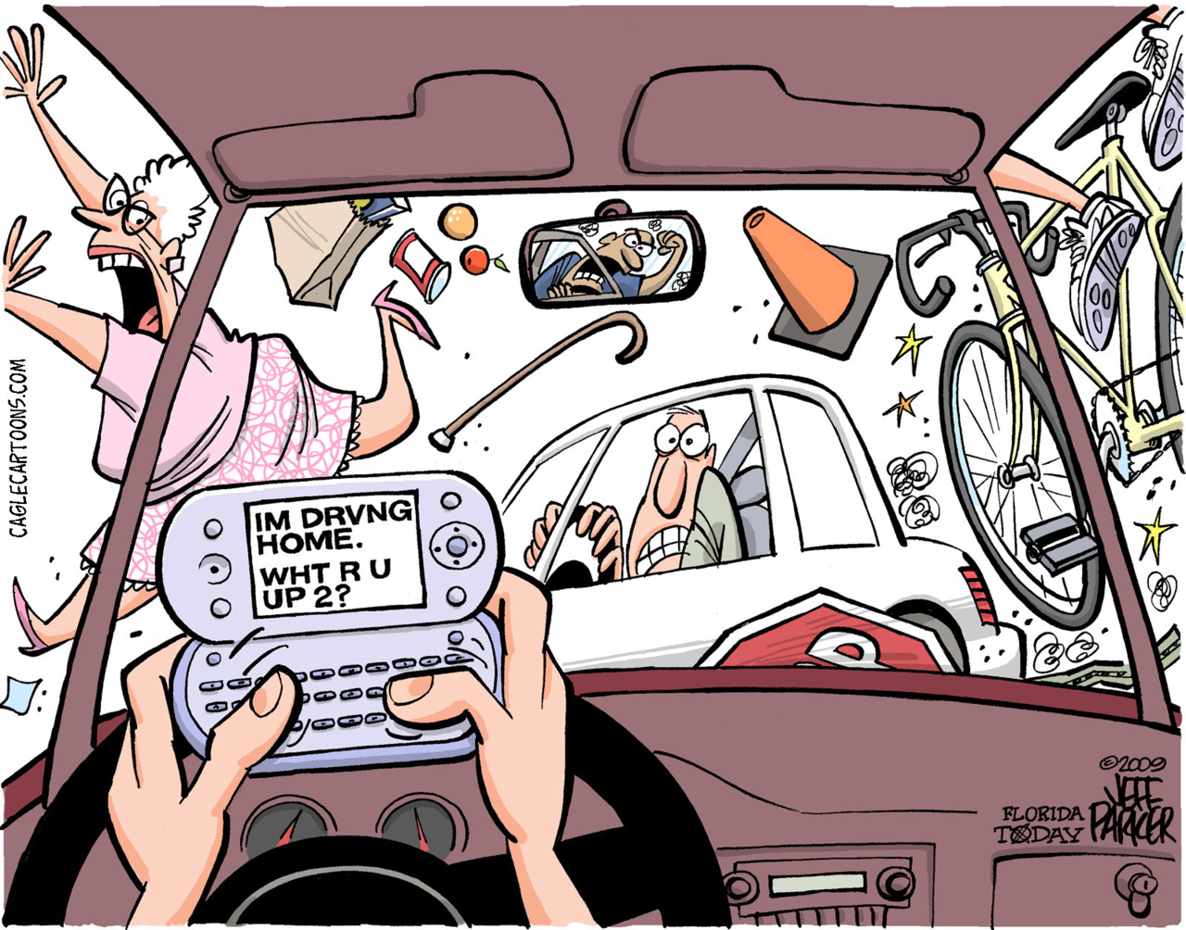

Slide 4
1. What is the problem?
2. Who will use the solution?
(user)

Slide 5
How will the user use the solution?
Call this user/use

Slide 6

Meet the user!
Interview and Observe!

