Slide 1
Steroids Class Questions and Parse with Form Data

Slide 2
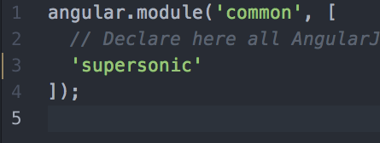
What is this dumb Parse Error?
“parse” is a reserve word in angular. Module must be named something else
Remove “parse” from the module lists in both scripts.js files in the app folder.

Slide 3
How do you link to a library
2 Ways
Static Link
Bower Way (multi-step)

Slide 4
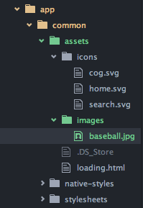

Static Library/Asset Include
Copy the file to app/common/assets/folder
Reference them locally from there.
Ex. icons/home.svg

Slide 5
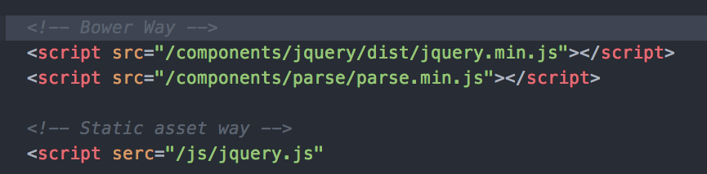
Examples of both

Slide 6
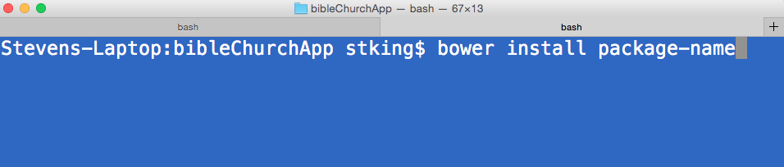
Bower Package Install
Run the command below from your app folder

Slide 7
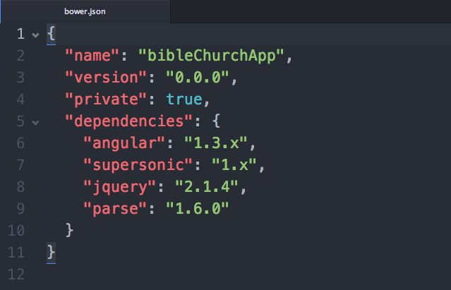
Bower Package Added
Update the bower.json

Slide 8
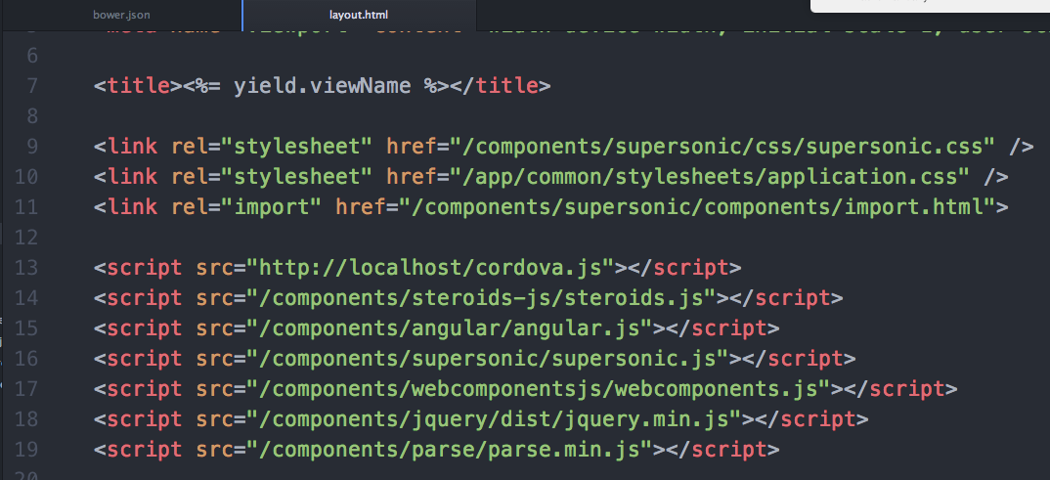
Bower Package Include
Add to app/common/views/layout.html head to be included in every view.

Slide 9
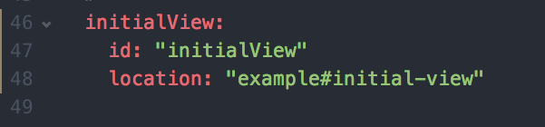
Change the Initial View
By default, it is your index tab.
Change it by including:
config/structure.coffee

Slide 10
Understanding Parse and Forms

Slide 11
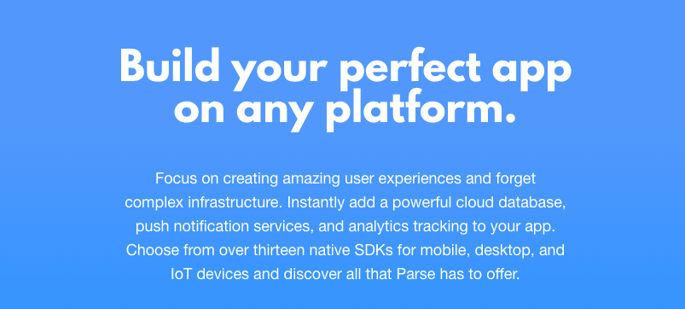
What is Parse?

Slide 12
Cloud Database for Apps
Custom DB for anything
Infrastructure managed
Build in User Models with Social Integration
Other services like push notifications and anlytics

Slide 13
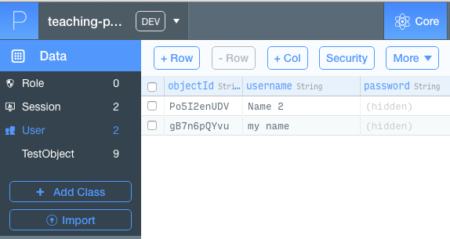
Understanding the DB

Slide 14
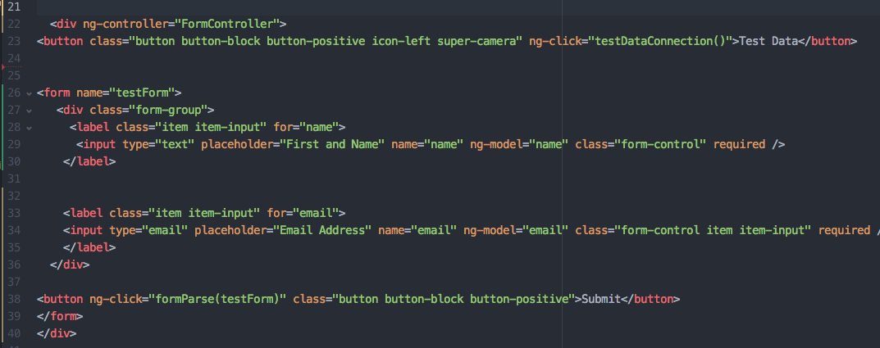
Form to Parse
In the view

Slide 15
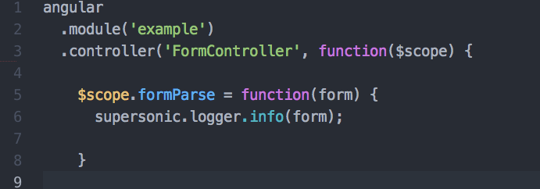
Form Data to Parse
In the controller

Slide 16
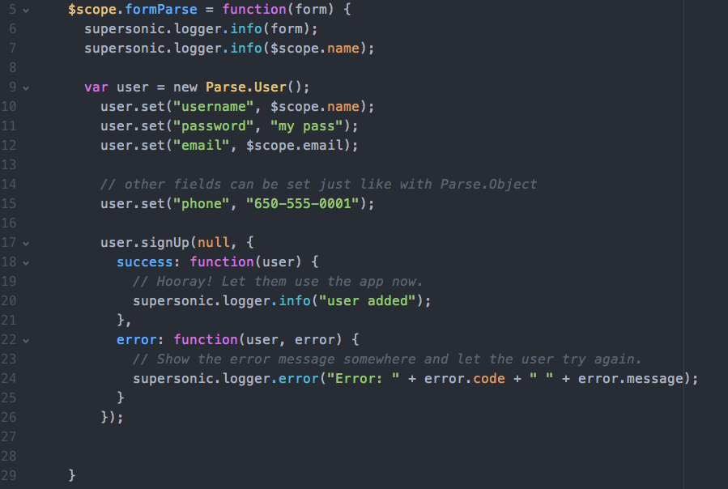
Form Data to Parse
In the controller

Slide 17
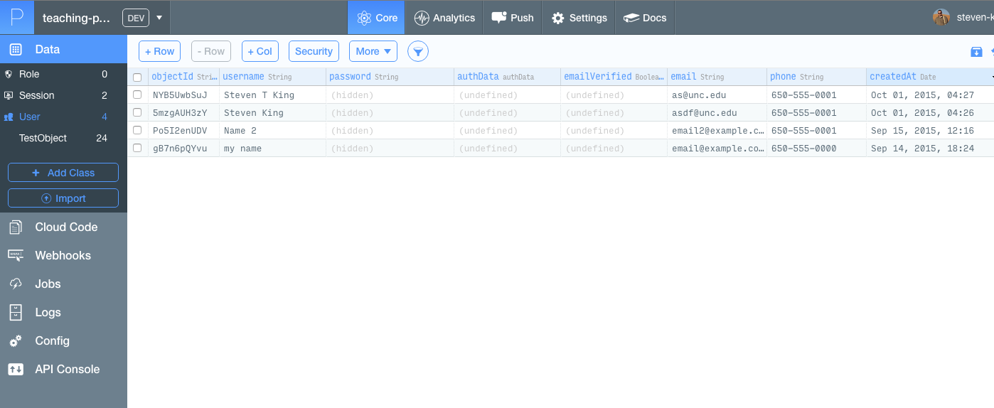
Check Parse Data
App > Core > User

