Slide 1

Illustrator Web Design

Slide 2
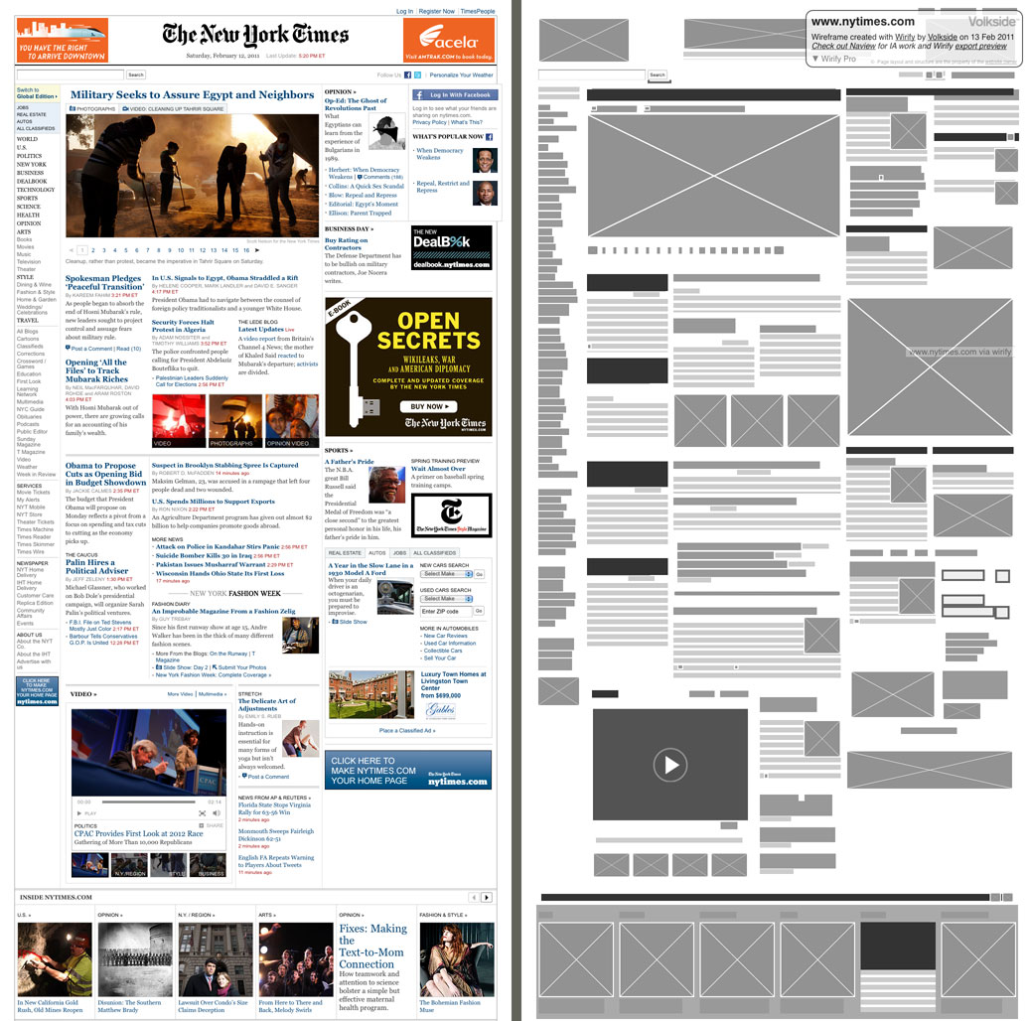
Wireframing

Slide 3
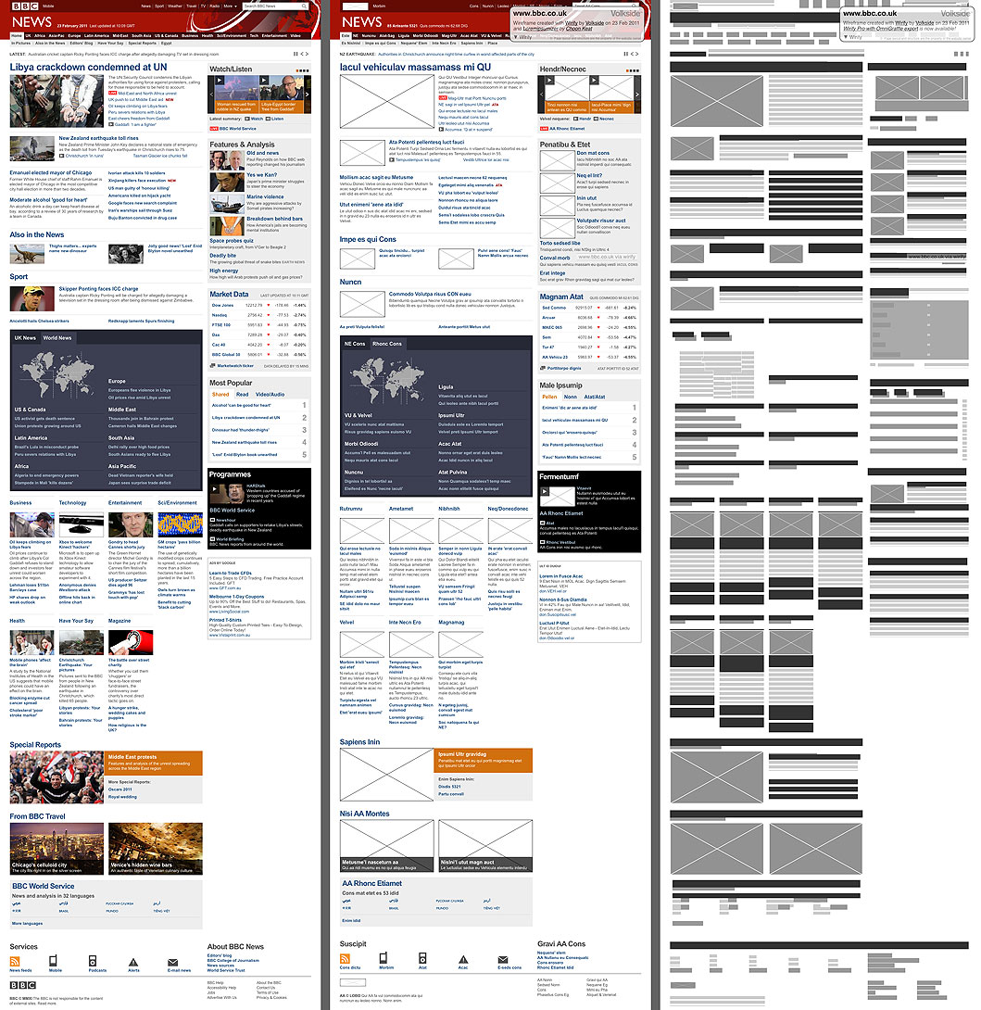

Slide 5
Project Setup
Stay Organized
Linked Files are Important
Separate Web files from design files

Slide 6
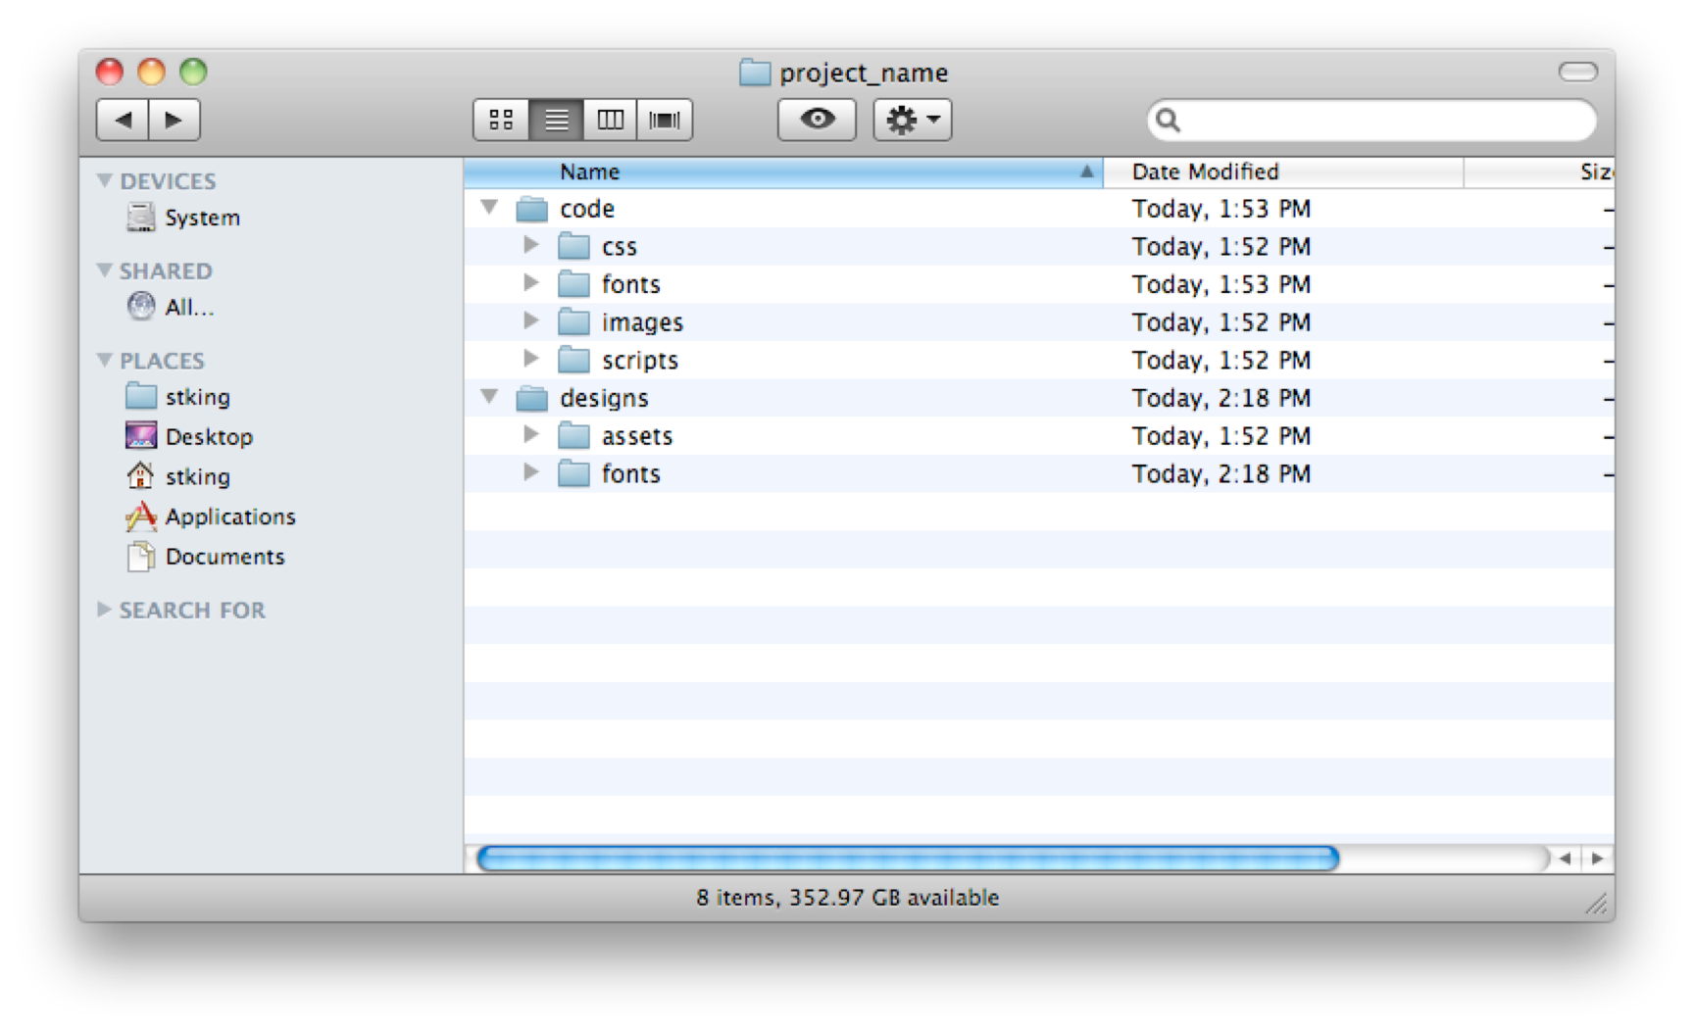

Slide 7
Consistency and Precision
Set Preferences to Pixels by default. Will have to do this every time on lab computers.

Slide 8
Making Illustrator Consistent and Fast
Swatches, Libraries and Symbols

Slide 9
Swatches
Swatches: Select Unsused. Trash all but the basics.
Go to Kulor and download the Swatch
Import into the Styles in the swatches library
Make swatches large.

Slide 10
Symbols
Great for reuse and other people have made them available for use.
Download and Import Design Framework
http://www.webalys.com/design-interface-application-framework.php

Slide 11
Styles
Import Framework
Change them for your project,
Makes starting your CSS code faster. Just follow what you made.

Slide 12
More on Illustrator
Great article from Smashing Magazine
http://www.smashingmagazine.com/2011/01/17/productive-web-design-with-adobe-illustrator/
More Downloads:
http://mashable.com/2010/08/05/free-web-ui-resources/

Slide 13
Example Comp

