Slide 1
Responsive Design

Slide 2

Online and Mobile Design
Adaptive Design
Responsive Design
Apps vs. Websites

Slide 3


New Models
Adaptive Design
Responsive Design

Slide 4
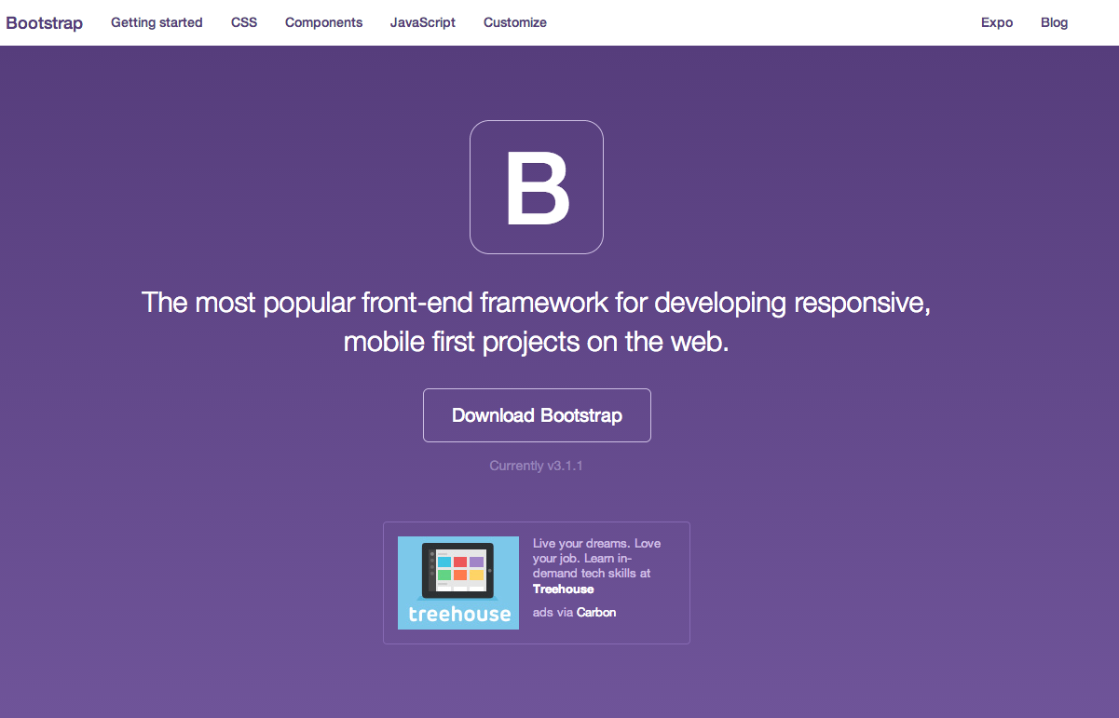
Various Frameworks

Slide 5
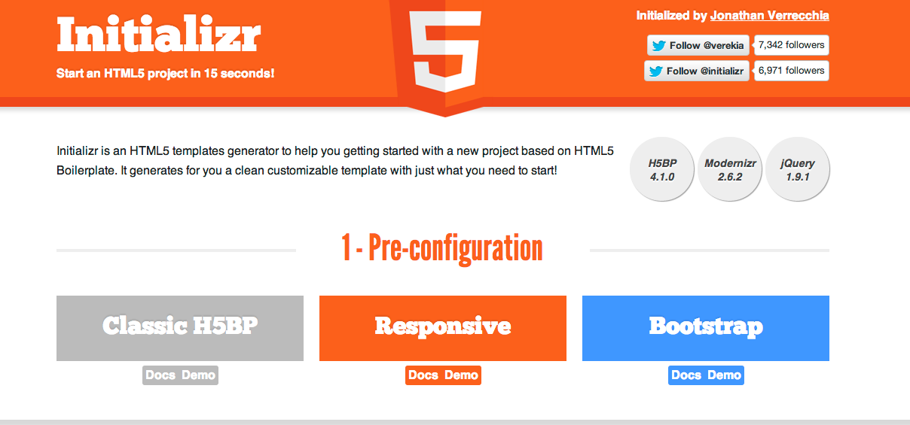
Bootstrap Responsive Framework

