Slide 1
PhoneGap Plugins
Camera and Mapping

Slide 2


PhoneGap Camera Plugin

Slide 3
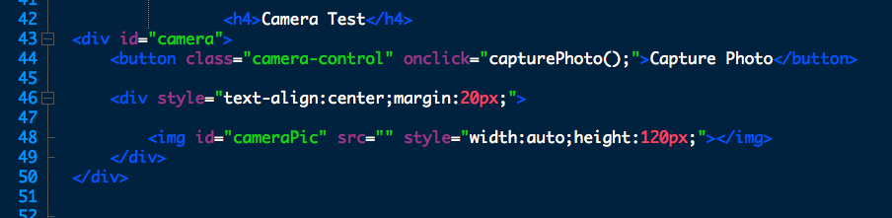
Create HTML
Add a button that calls a function and an img id to receive a preview of the photo.

Slide 4
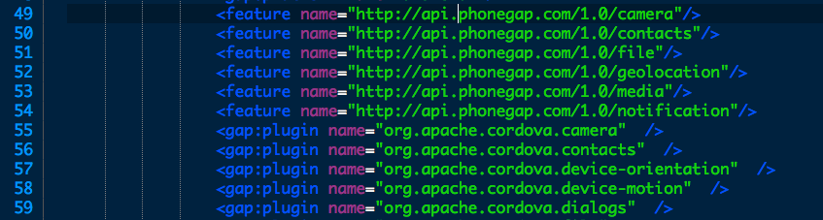
Include the plugin
edit config.xml in two places.
ex. line 49 and 55

Slide 5
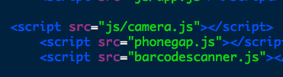
Adding JavaScript
First create camera.js and link the file.

Slide 6
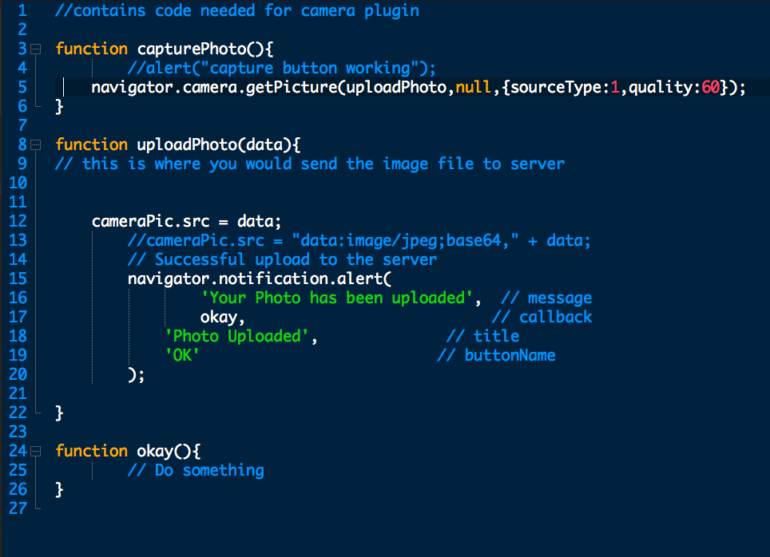

JavaScript Functions
camera.js

Slide 7

Mobile Mapping with PhoneGap
Using Google Maps with PhoneGap

Slide 8
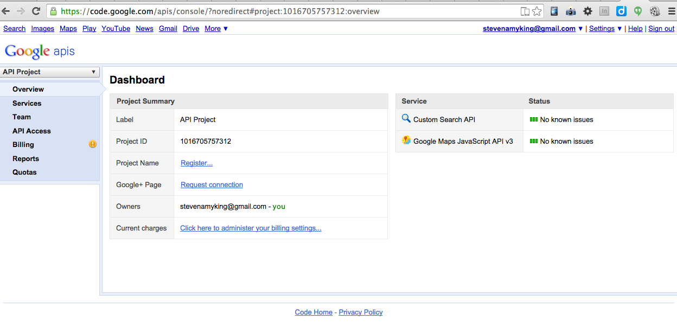
Sign Up for API
https://code.google.com/apis/console

Slide 9

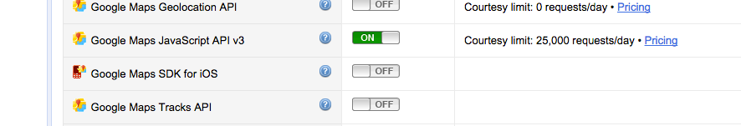
Select JavaScript v3 Map API
Turn on Services

Slide 10
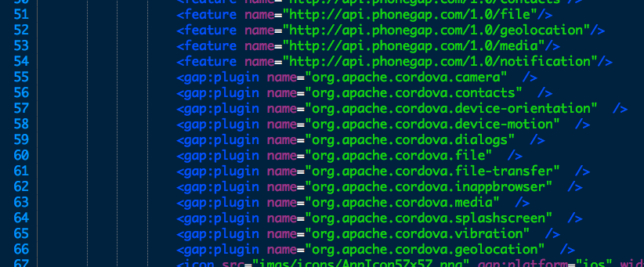
Config.xml to add plugin
Lines 52 and 66

Slide 11
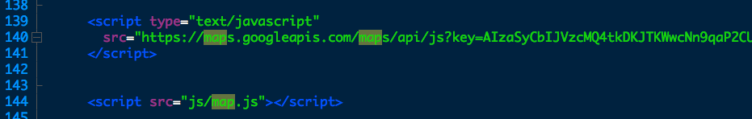
Link JavaScript
Add API Key and link map.js

Slide 12
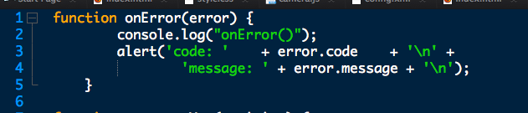
map.js 1 of 3

Slide 13
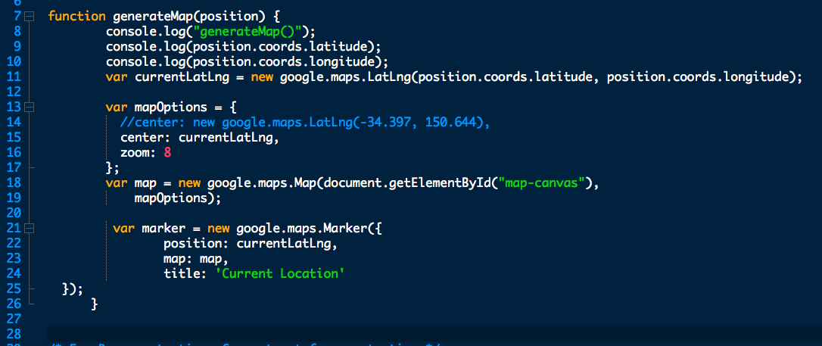
map.js 2 of 3

Slide 14
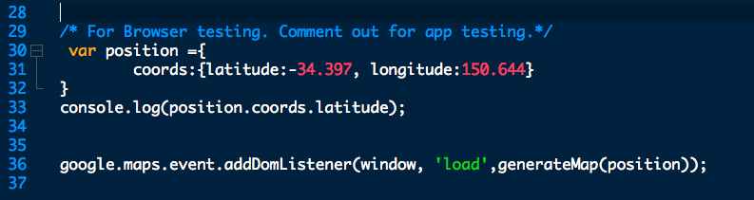
map.js 3 of 3

Slide 15
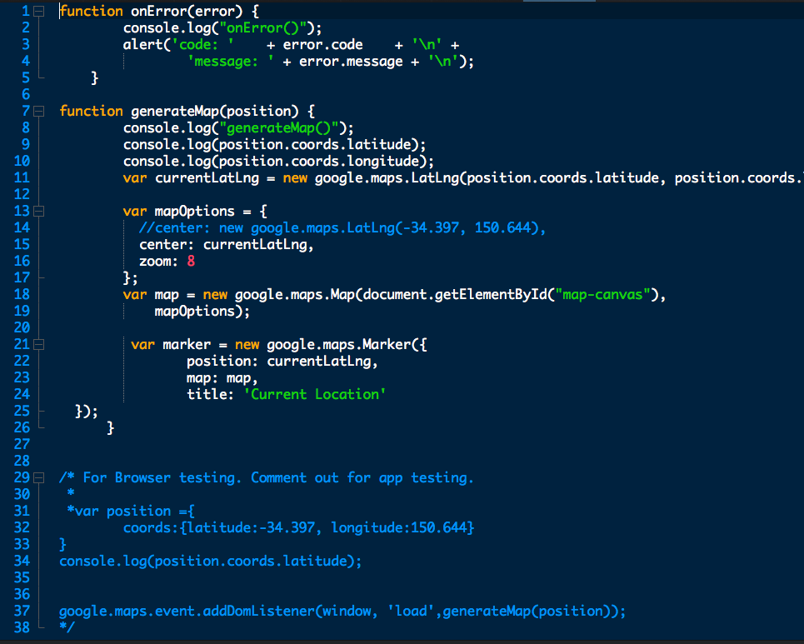

Slide 16
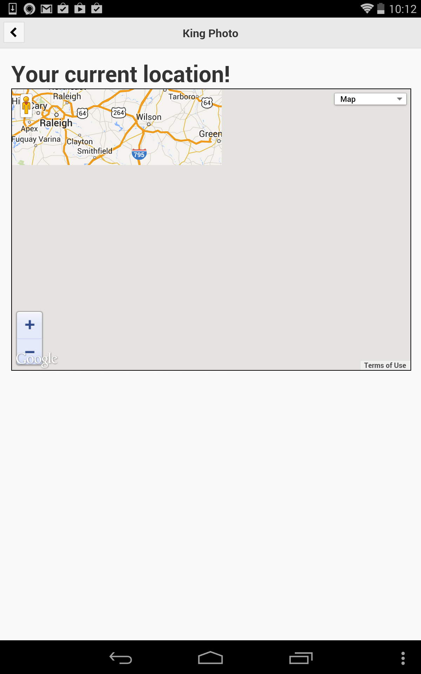
Display Problem?
Let’s Fix it!

Slide 17
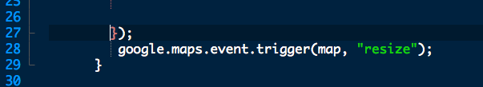
Need to resize after screen loads
Add to the end of the generateMap function

