Slide 1
App and Database Integration
Almost all good apps need a database

Slide 2
Device and Network Storage
Two type of Device Storage
Local (Temporary Cache)
Database

Slide 3
Network Storage
Database or Static files hosted on a server accessed via the network connection.
Multiple Technology Solutions

Slide 4
Possible Solutions
Requires a Scripting Language and Database
SCRIPTING LANGUAGE
PHP
Python
node.js

Slide 5
Databases
Relational
mySQL
postGIS
many others
Document Based
mongoDB
rethinkDB
few others

Slide 6
Another option…
Data Services
a hosted API to a database
Firebase

Slide 7
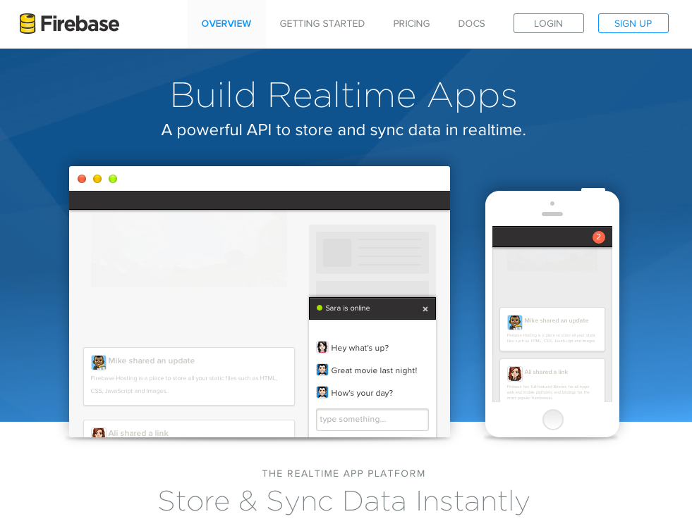

Slide 8
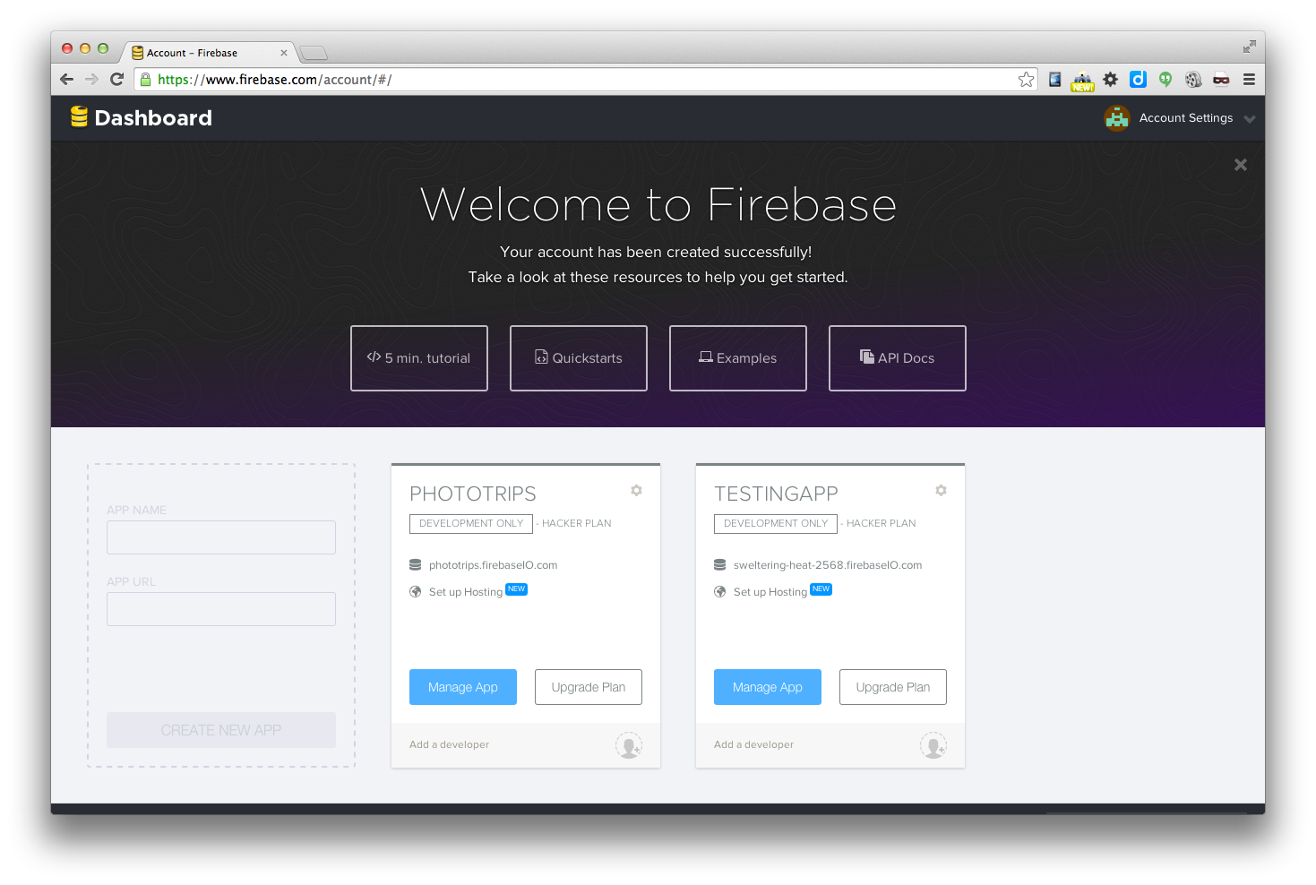
Signup and Create an App

Slide 9
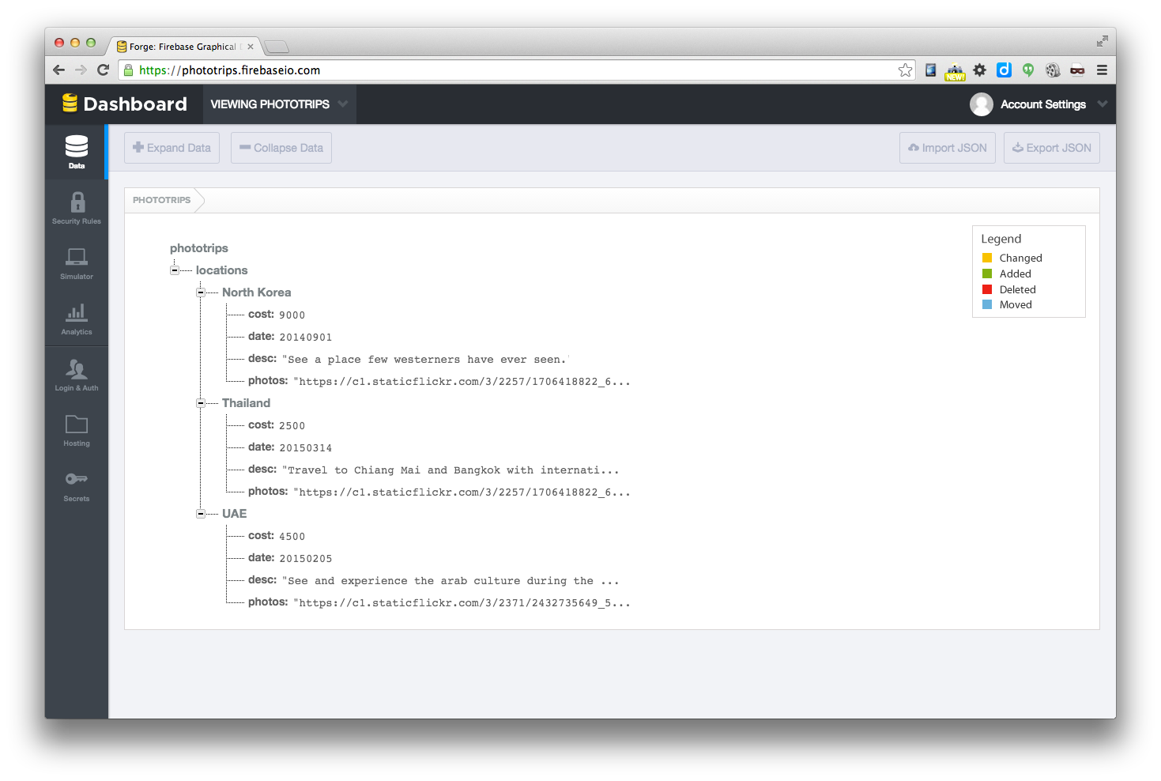
The Data

Slide 10
The Data
(manual and load json)

Slide 11
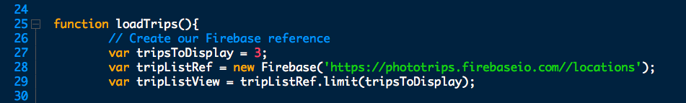
JavaScript Based.
open index.html
open app.js

Slide 12
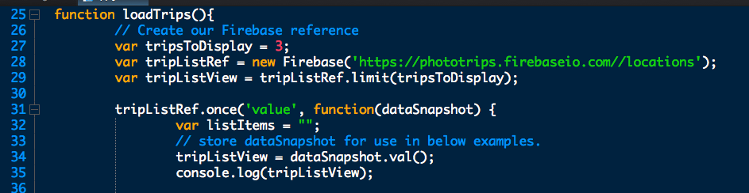
Data Connection API

Slide 13
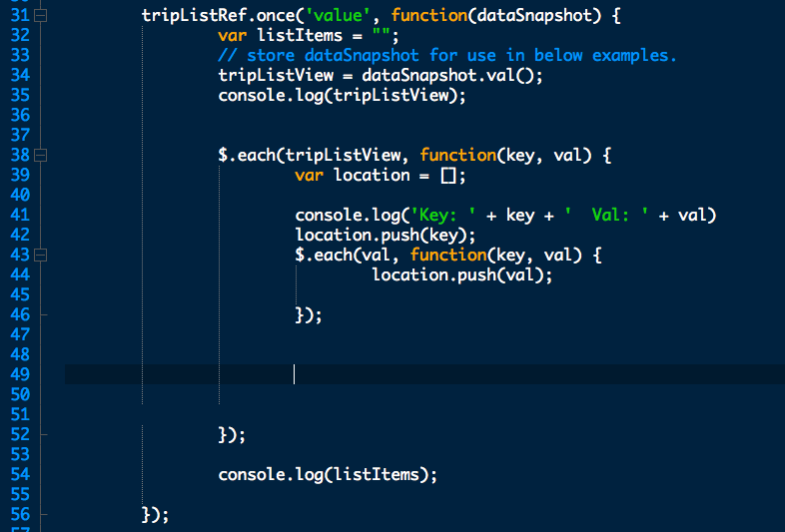
SnapShot with Loop

Slide 14
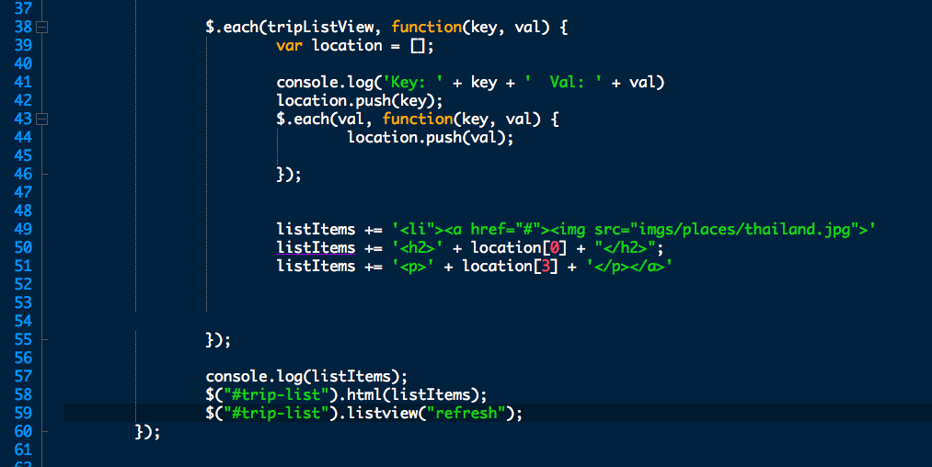
Write some HTML to page

Slide 15
It works! Dynamic App!

Slide 16
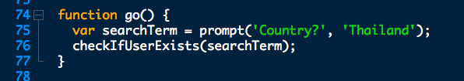
Test Query

Slide 17
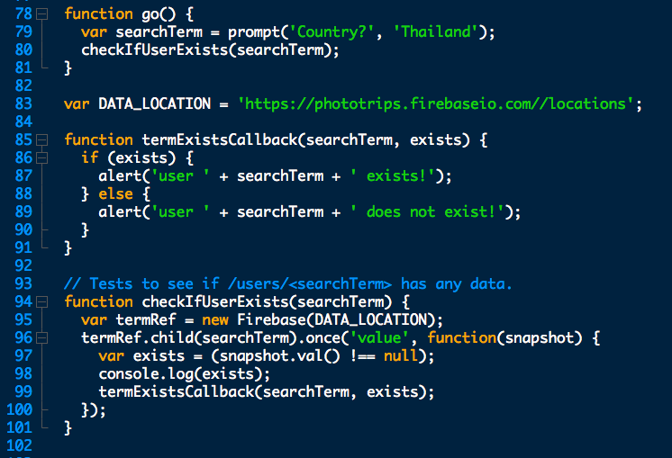
Test if in data?

Slide 18
Great job!
Now for your own learning…

Slide 19
Do Firebase Leaderboard tutorial
https://www.firebase.com/tutorial/#session/rtkdkdn77wt

Slide 20
Homework
Plan and outline your data structure
Input the starting data for your app into Firebase.
Write a Firebase query to display all records on an html page just like the example in class.

Slide 21
Ways to Update the Data

Slide 22
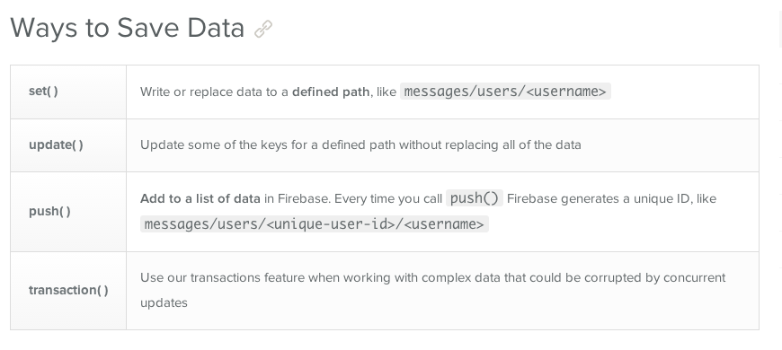
4 ways

Slide 23
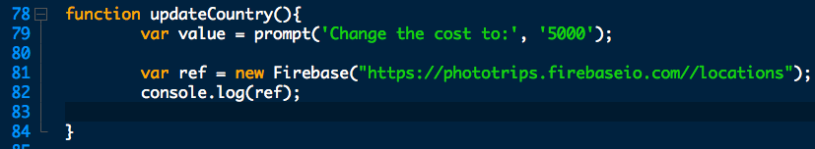
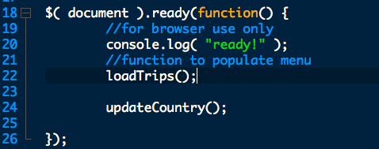
Set up Function

Slide 24
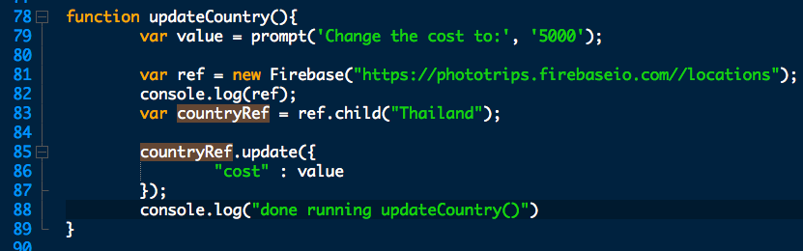
update()

Slide 25
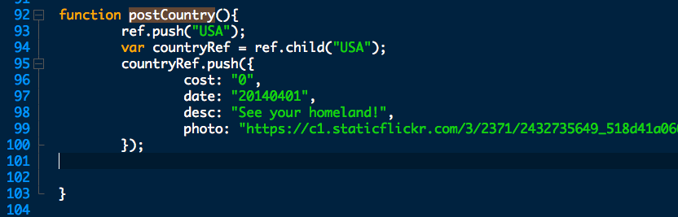
push()

Slide 26
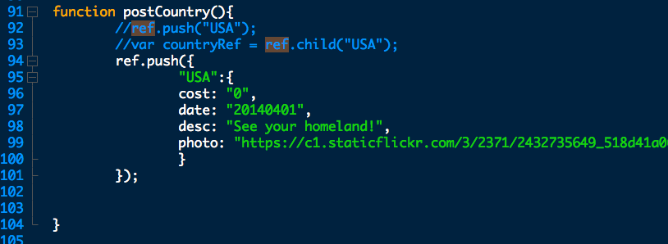
Same by different

Slide 27
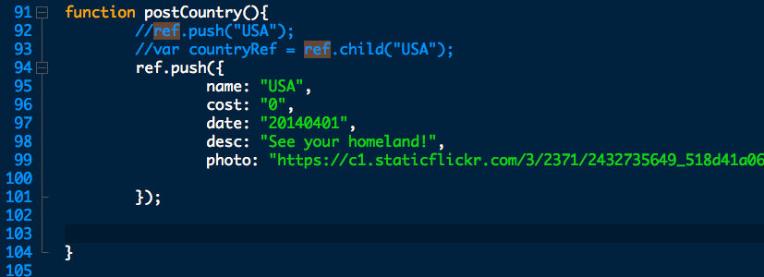
Another way…

Slide 28
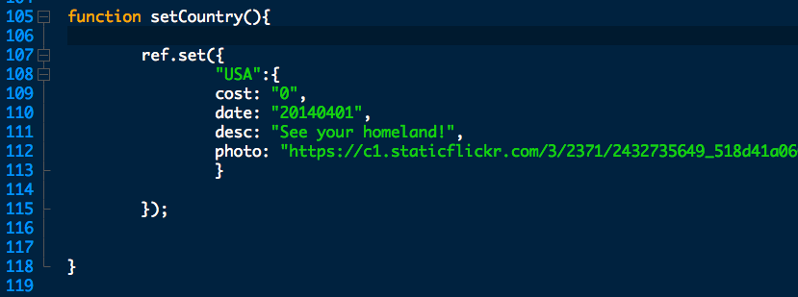
set()

Slide 29
Homework
Working on your app project, connect some element to your database.
After Fall Break you will have the entire app connected to a database.

