Slide 1
Design Part 3: Layout
Specific to web layout
Devine Proportion
Rule of Thirds in Layout
Standard Web Layouts
New World
Wireframes to Comp

Slide 2
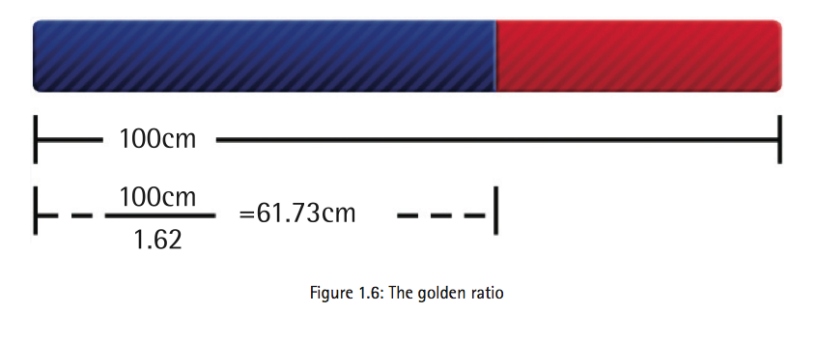
Devine Proportion
The Golden Ratio

Slide 3
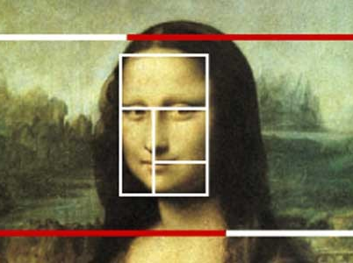

It does exist…

Slide 4

Rule of Thirds

Slide 5
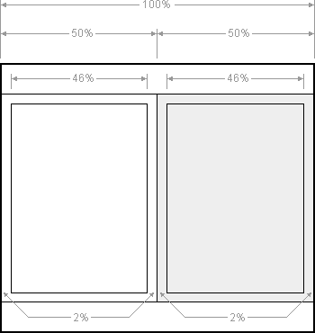
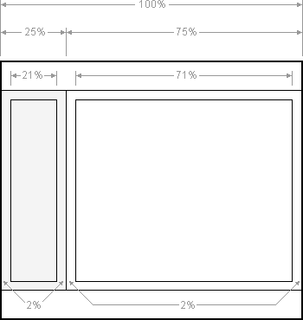
Standard Web Layouts
1 col
2 col
3 col

Slide 6
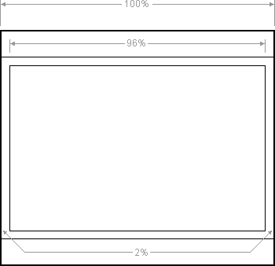
1 Column or Fluid Center

Slide 7
2 Column Fluid

Slide 8
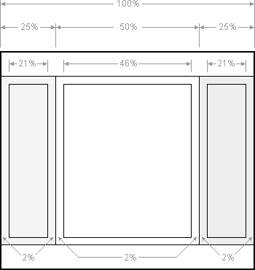
3 Column Fluid

Slide 9
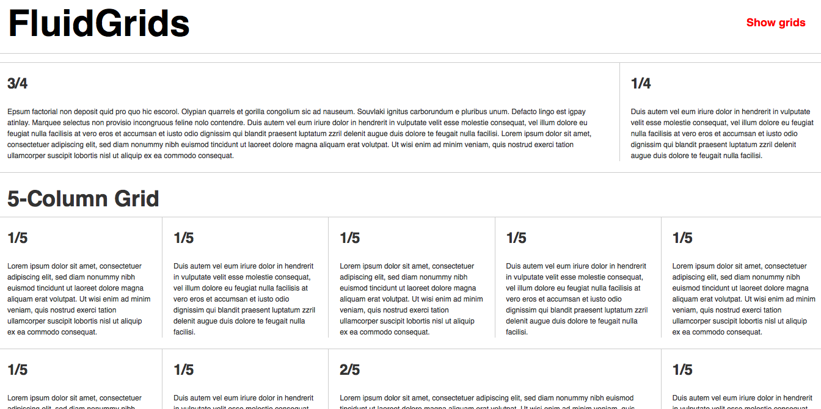
New Models
Adaptive Design
Responsive Design

Slide 10

Wireframing

Slide 11


Slide 13
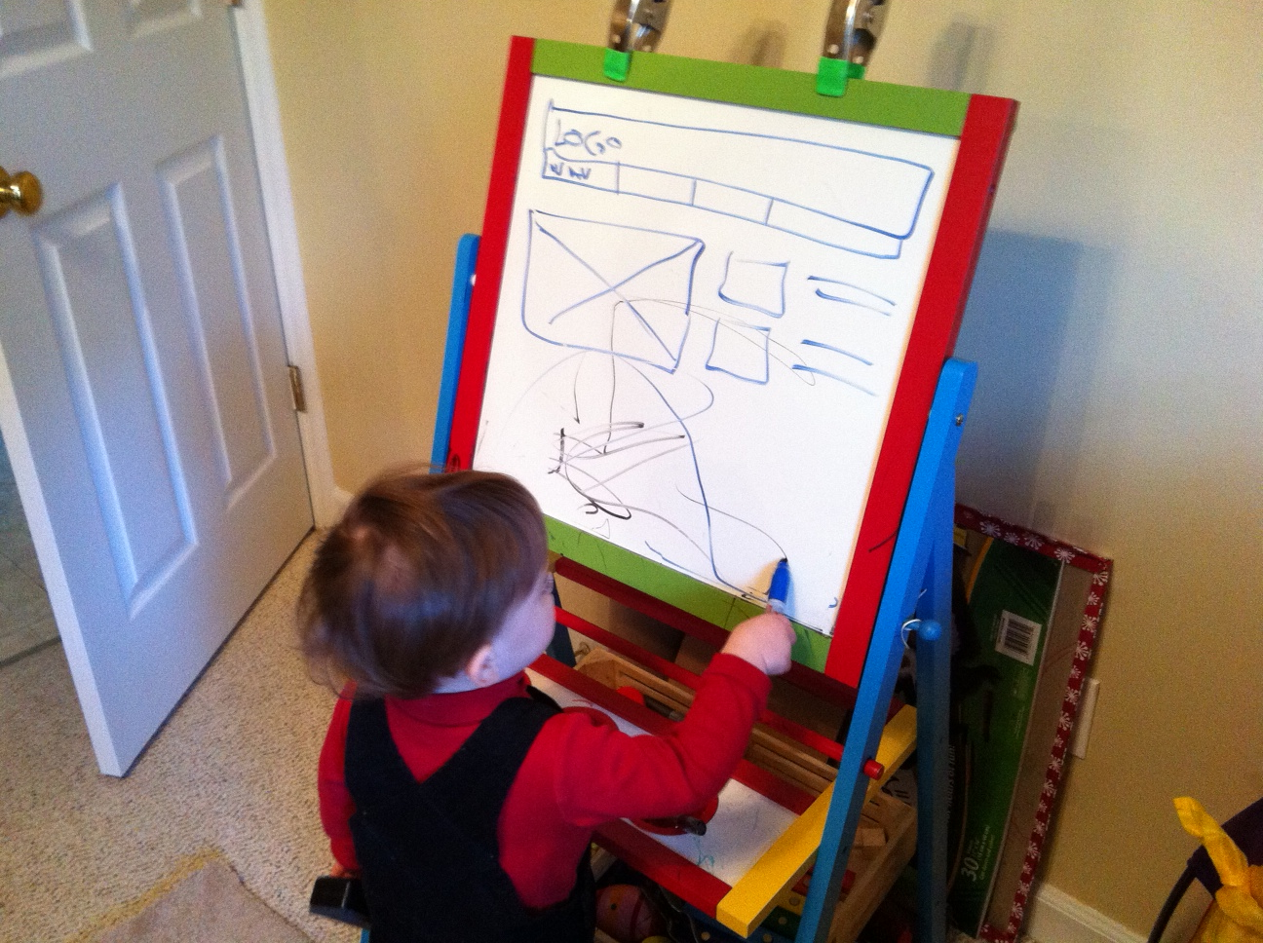

Slide 14
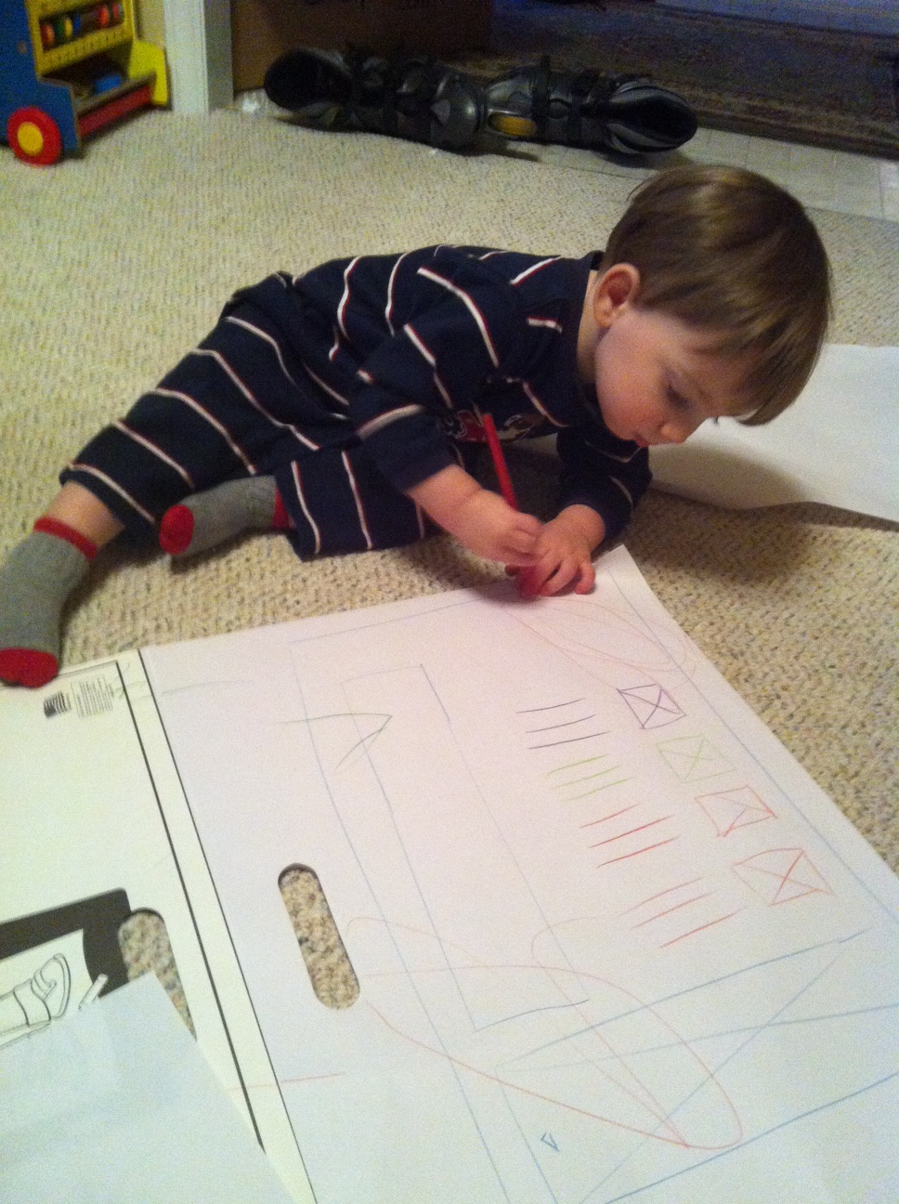

Slide 15


Slide 16
In Class Assignment

