Slide 1
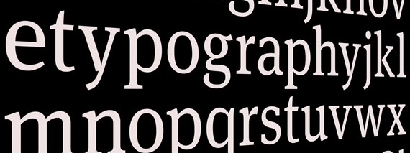
Design: Type
Readability
Relationships
Types of Type (Fonts
Type on the web

Slide 2
Readability
Type has multiple purposes but the most important is readability. The ability for a reader to easily read and understand the text.
Contributors/Distractors
Size, color, texture, light, font, weight, relationship etc.

Slide 3

Relationships

Slide 4
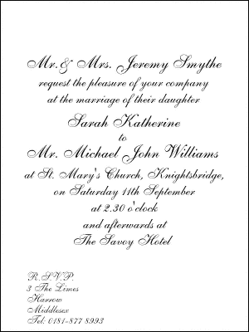
Concordant
Uses one type family with little change in style, size or weight. This can be used to communicate a sedated or formal situation but can also be dull.

Slide 5
Conflicting
When you combine type faces that are similar but not the same. This makes the page less interesting because it is not concordant.
Times New Roman
&
Palatino

Slide 6

Contrasting
When you combine separate typefaces that are distinct and different from each other. The best designs have contrast and this includes font.

Slide 7
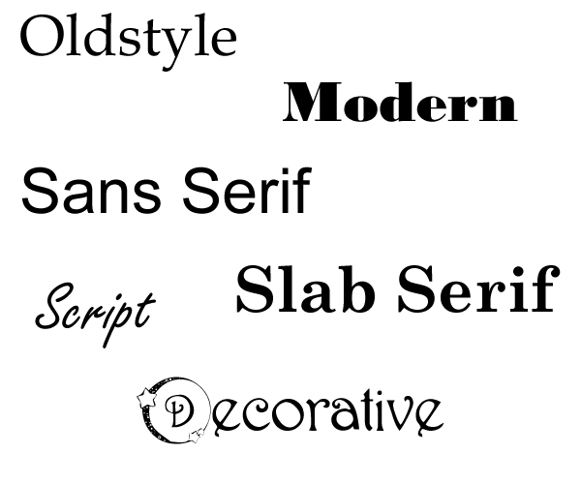
Type Categories
Remember them in groups of two:
Old/Modern, Serif/Sans, Script/Decorative

Slide 8
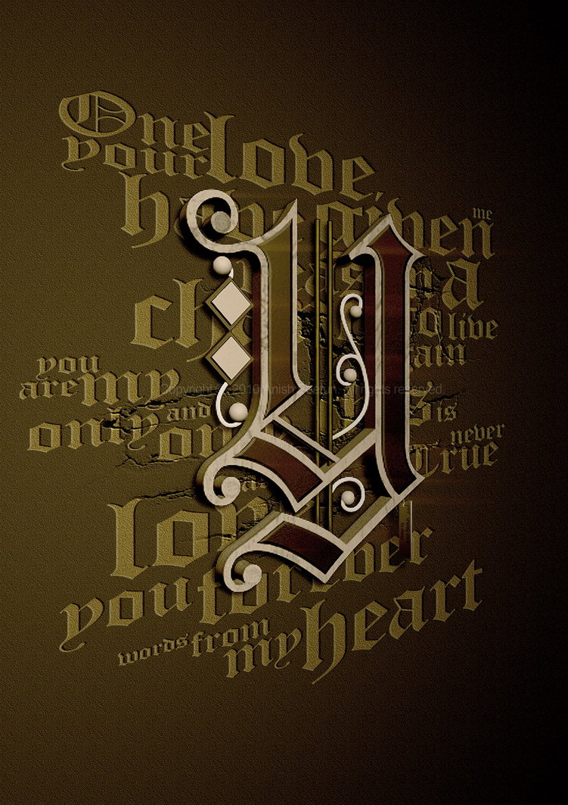
Oldstyle

Slide 9

Modern

Slide 10
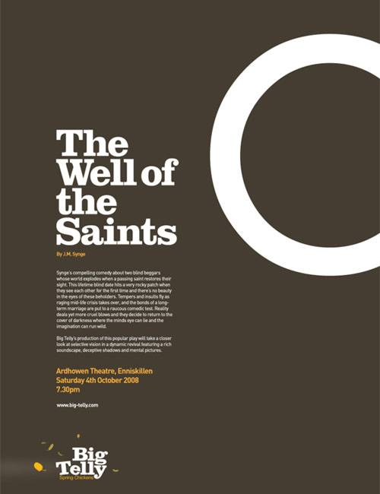
Slab Serif

Slide 11
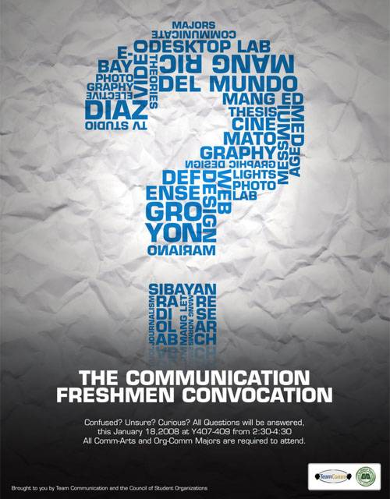
Sans Serif

Slide 12

Script

Slide 13
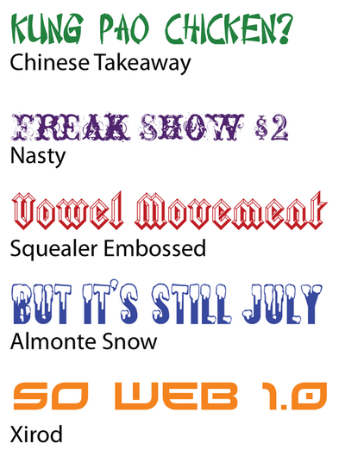
Decorative

Slide 14
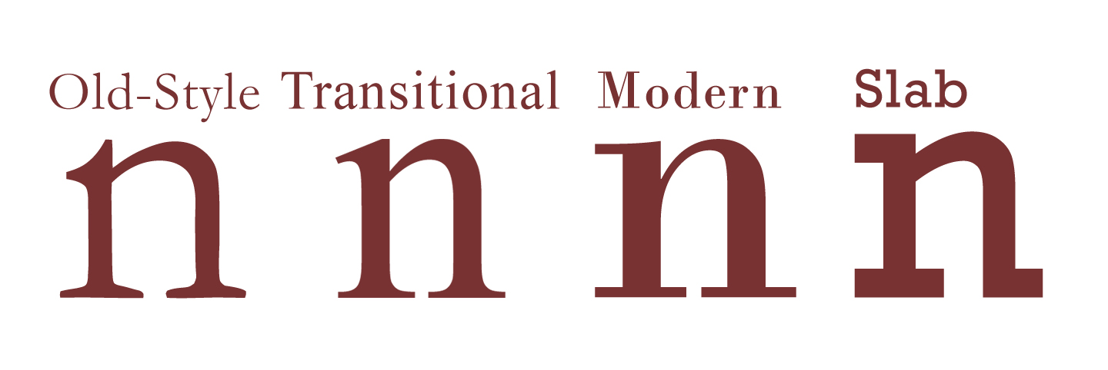
Type Categories

Slide 15

Type Contrasts
Size, Weight, Structure, Form, Direction and Color

Slide 16
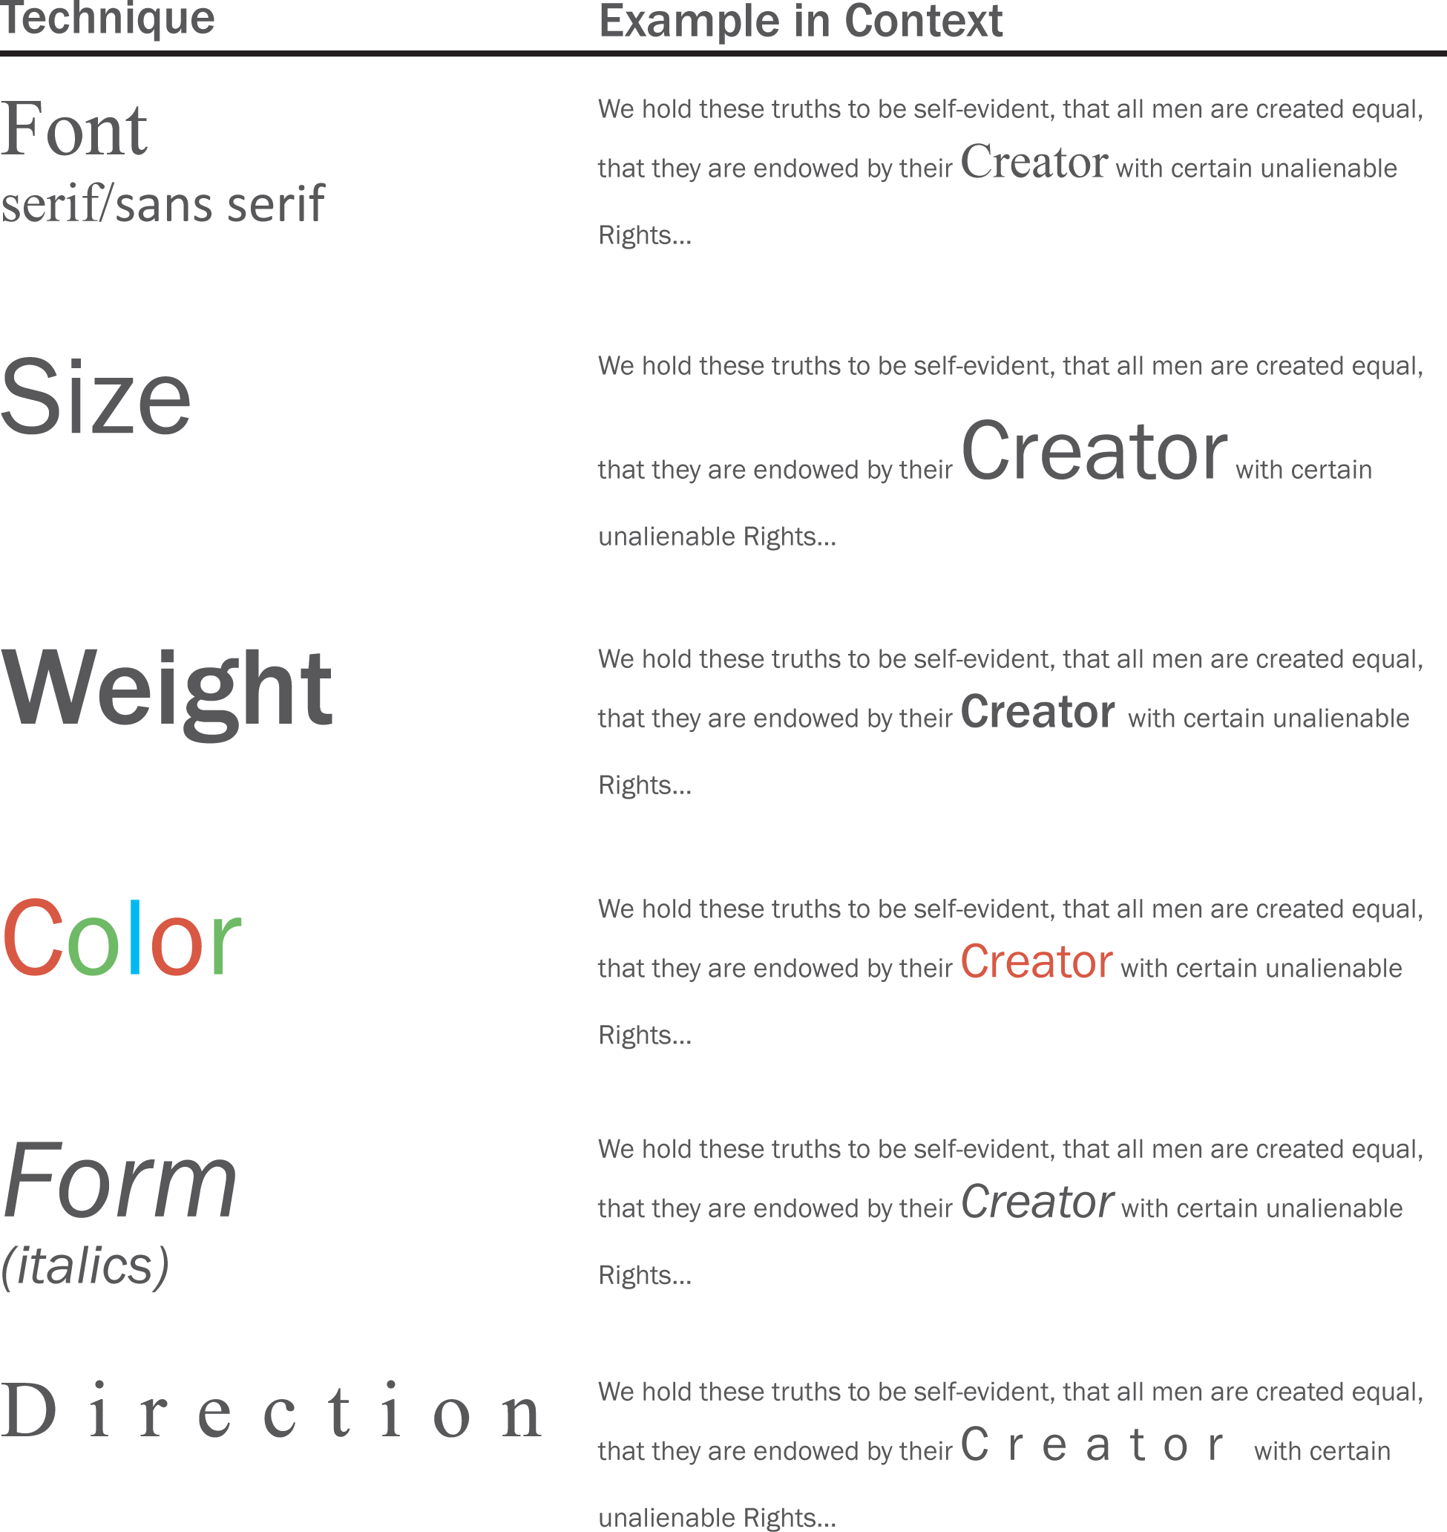

Slide 17
My Rules
Never use more than three fonts and two is probably enough
Never use more than one serif font
Never use more than one san serif font
Never use more than one decorative font and only in limited doses
Typically, I choose one Serif, one san and call it a style!

Slide 18
Fun
Dafont.com
What the Font

Slide 19
In class exercise

