Slide 1

Learn Git with GitHub
More than just version control. Its Social!

Slide 2
What is Git
Distributed Version Control
Source Code Management
Git is a command line utility
GitHub is an online and visual version

Slide 3
Why use GitHub
Incase you screw up, it’s backed up!
Once you understand it you will love it!
Only way to send me code from now on!

Slide 4
Steps
Signup for Git Hub
Setup Git (local)
Create a repository (repo)
Code
Publish
Code
Publish

Slide 5
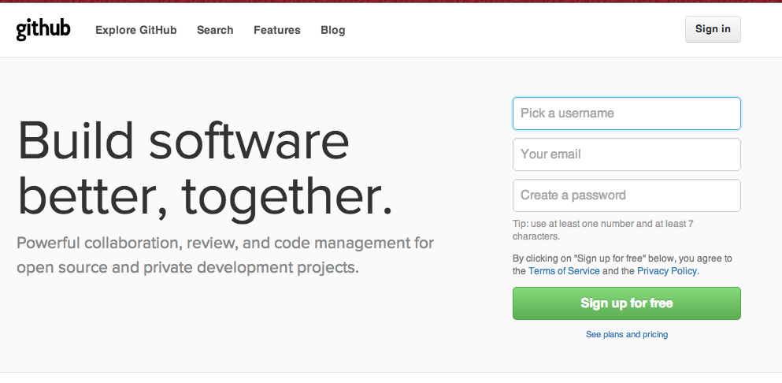
GitHub Setup
https://help.github.com/

Slide 6
Setup Git
https://help.github.com/articles/set-up-git
Download and install Git
http://git-scm.com/downloads

Slide 7
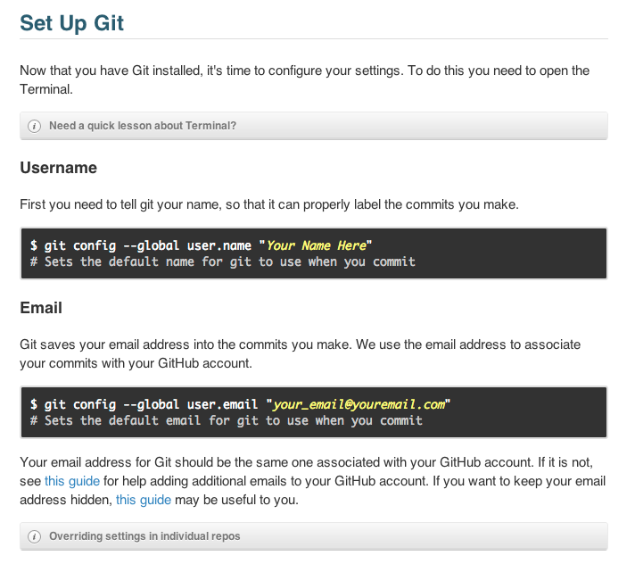
Setup Git (continued)

Slide 8
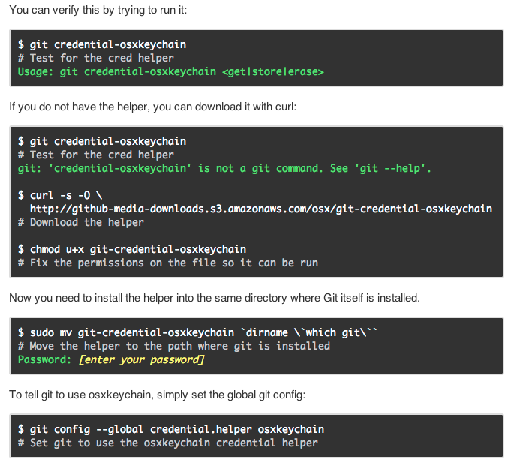
Git Password Caching

Slide 9
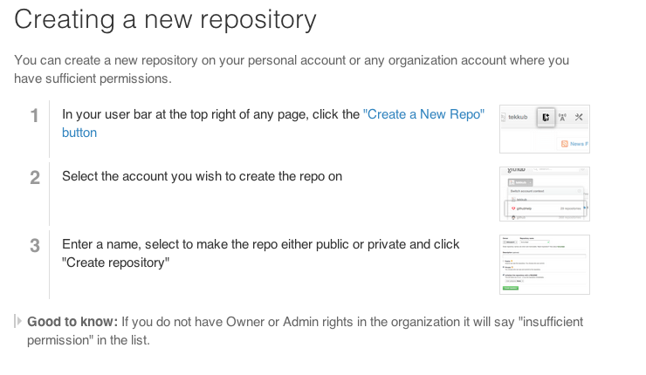
Create a Repo

Slide 10
Git Commands
Git Clone
Git Status
Git Add
Git Commit
Git Push
Git Pull

