Slide 1
Intro to the Command Line
Quit Wining and Shell!
Steven King
J583 Adv. Interactive Multimedia Programing

Slide 2
How to Shell
Type Everything I do
Memorize the Commands
Commit!

Slide 3
Open Terminal
Type something
Do it again
And again

Slide 4
First Commands
pwd
hostname
cd
ls
mkdir
rmdir
cp
mv
less
cat

Slide 5
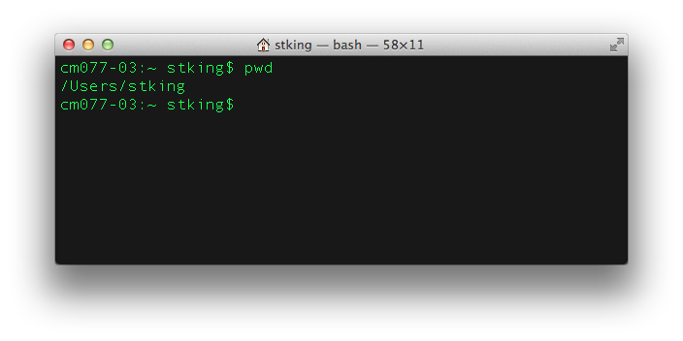
Paths, Folders, Directories (pwd)
Notes:
Explain Prompt
pwd print working directory
Type and say print working directory

Slide 6
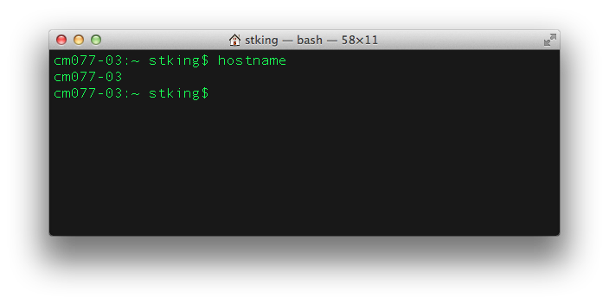
What’s Your Computer’s Name? (hostname)
Notes:
Explain Clear
Explain Hostname is the computer’s name

Slide 7
Learn how to Transverse “The Tree”
Create folders, move files, etc.

Slide 8
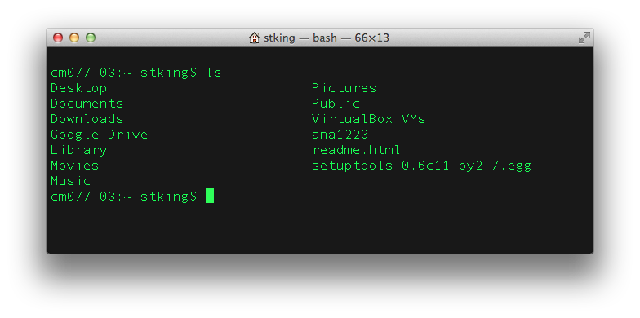
List (ls)

Slide 9
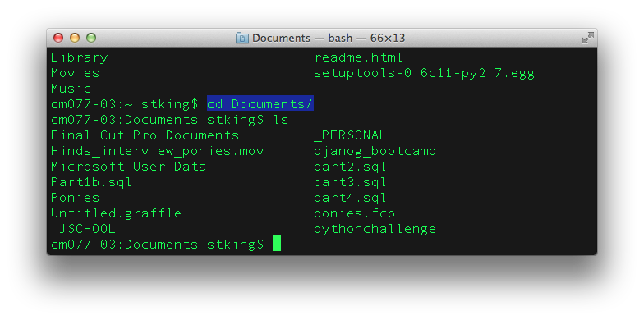
Change Directory (cd)
Notes:
Explain Tabs auto complete

Slide 10
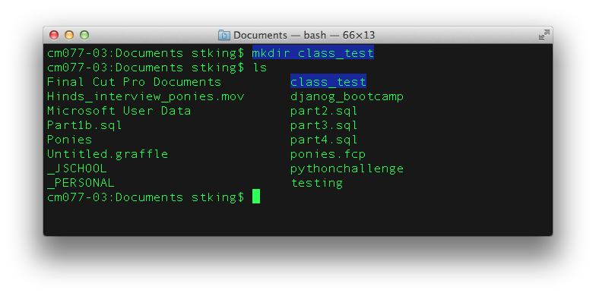
Make Directory (Folder)
Notes:
mkdir class_test
mkdir class_test/students
mkdir class_test/students/Katie
Mkdir class_test/teacher/Steven

Slide 11
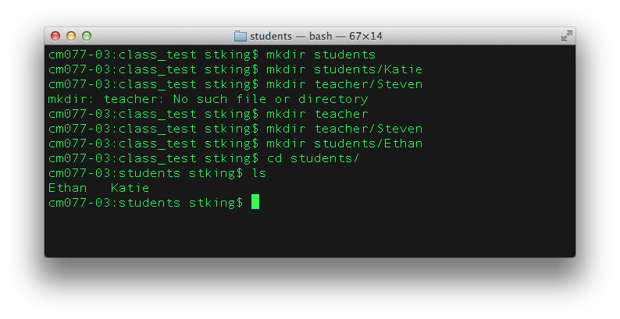
mkdir more
Notes:
mkdir class_test
mkdir class_test/students
mkdir class_test/students/Katie
Mkdir class_test/teacher/Steven

Slide 12
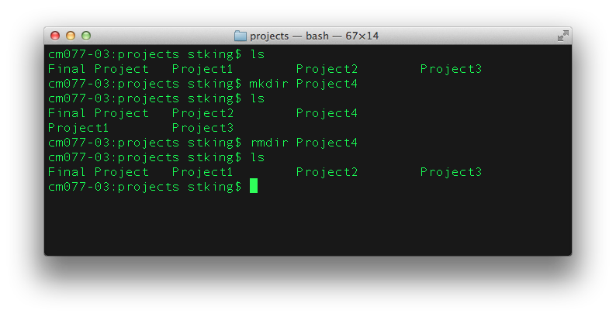
mkdir with spaces

Slide 13
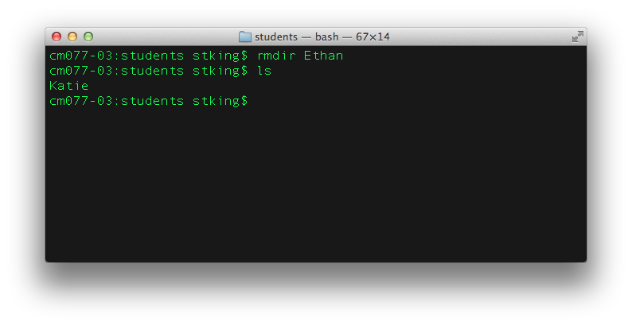
Remove Directory (rmdir)

Slide 14
rmdir and contents
rmdir –rf directory
Don’t do this: rm –r *

Slide 15
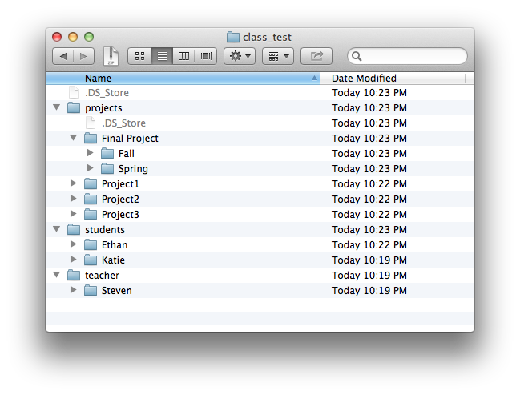
Now lets try it: cd, ls, mkdir, rmdir
In Class Exercise:
Create this directory structure using the commands you just learned.
Call me over when finished.
Hint: Pay attention to upper/lower case.
Notes:
Inside class_test, build this structure

Slide 16
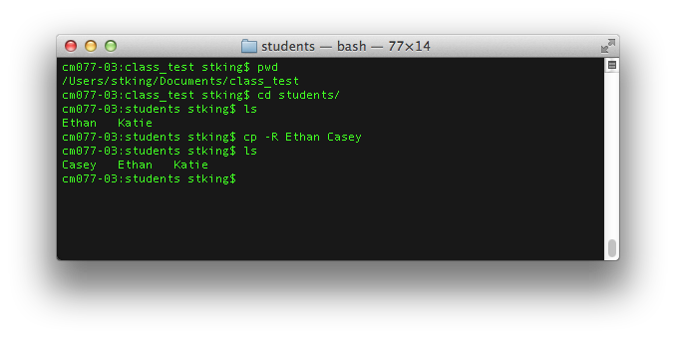
Copy (cp) From Space To

Slide 17
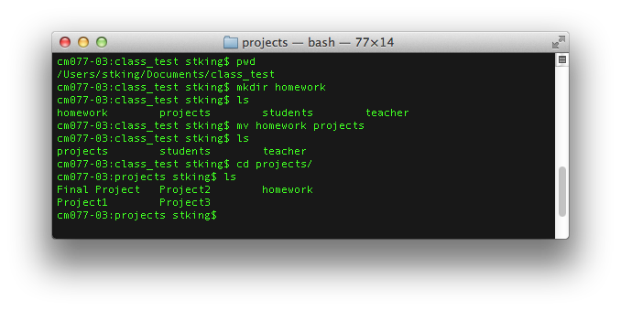
Move (mv) From Space To

Slide 18

Create/Update File (touch)
Notes:
Touch creates a file if it does not exists

Slide 19
Edit File (VI basics)
vi is a text editor in Terminal
i to Insert
Escape to get out of Insert
hjkl Left, Down, Up Right
:w to write
:q to quit
:wq! To do both at the same time.

Slide 20
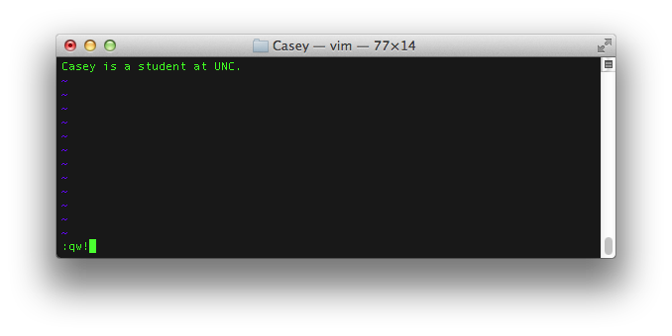
vi

Slide 21
View A File (cat or less)
Cat view a file
Less view file paged (for big files)
Notes:
Exit Control Z

Slide 22
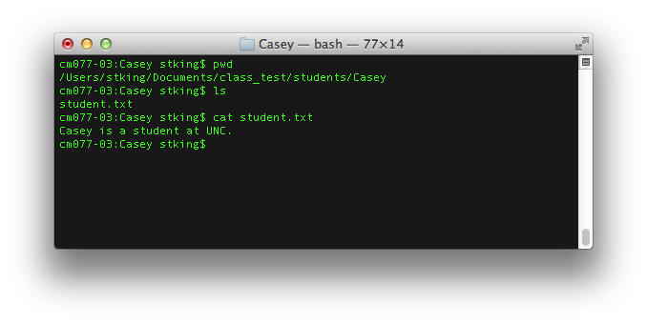
Cat

Slide 23
Questions
Questions, Comments, Fears

Slide 24
Assignment 1
Perform each of these commands 20 times. Saying the command each time.
Copy Files, Move Dirs, Delete Dirs
Save or Export the text of the entire script as LastName_First.
Don’t worry about your mistakes. Know you will make many of them
Email me with subject line J583 Assignment 1

Slide 25
For Wednesday
Turn in assignment 1 before class
Quiz on commands covered so far.

