Slide 1
Assignment 2
By Steven Snelling

Slide 2
Bad Smells - Found
Duplication – data_validator.py, Static Methods
Duplication – data_validator.py, validate_data() series of if statements
Duplication – interpreter.py, serialize_data_arr() & save_file()
Large Class – graph_view.py
Primitive Obsession - person/s array – database.py, insert_person()

Slide 3
Bad Smell 1 - Details
Name: Duplication
Location: data_validator.py – lines 68 to 157
Reasons: The 7 static methods are all very similar in that they take a string input and do a regular expression match and return either True or False. This is bad, because if the another piece of data is required would need to create a new method to validate it. Or if all the data changes will need to change each method to handle it.
Strategies / approaches: I will use the extract method to take the similar code and put it into a new method. For the variable data (regex patterns) I will use a dictionary and pass it into the new method gerenated.

Slide 4
Bad Smell 2 - Details
Name: Duplication
Location: data_validator.py – lines 21 to 47
Reasons: The reason I say its duplications and not a switch statement is that the series of if statements are similar in that it is calling function to validate data and that the left and right side arguments are both different. This is bad because if the data array had another item it would require another if statement to handle it.
Strategies / approaches: the best strategy to fix this would be the “Consolidate Conditional Expression” I would recommend doing this change after bad smell 1

Slide 5
Bad Smell 3 - Details
Name: Duplication
Location: interpreter.py – lines [38 to 50], [61 to 73]
Reasons: The try except handlers are the same in both the true and false part of the if statement.
Strategies / approaches: I would use the extract method to move the try except code to the outside of the if statement.

Slide 6
Bad Smell 4 - Details
Name: Large Class
Location: graph_view.py
Reasons: this view class has to much responsibility, it is doing the displaying of the graphs and the view for the CMD UI. This is bad as it goes against SOLID principles.
Strategies / approaches: I would use the extract class and interface strategy I will create a new interface to hold the relevant public methods for the CMD view and create a new view class to hold the implantation of those methods.

Slide 7
Bad Smell 5 - Details
Name: Primitive Obsession
Location: database.py - insert_person()
Reasons: This is bad because its just an array of data when looking at it its difficult to know what each item is for e.g. the first item is for employee id. Future development will require the developer to know the exact structure the array should be. Objects can handle different types of data better and will allow a much clearer understanding as to what person[i] is actually.
Strategies / approaches: I would use the Replace Array with Object strategy replacing the person array with a person object. I will create a person class with a set and get methods. In this person class initial state it will be its own bad smell (data class) but with more refactoring through out the program this may change and be a lesser problem than primitive data array.

Slide 8
Bad Smells – Selected to Resolve
1. Duplication – data_validator.py, Static Methods
2. Duplication – data_validator.py, validate_data() series of if statements
3. Duplication – interpreter.py, serialize_data_arr() & save_file()
4. Large Class – graph_view.py, i_graph_view.py

Slide 9
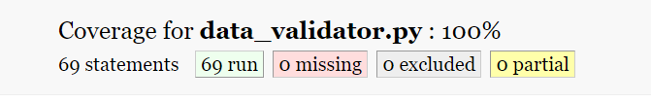
Bad Smell 1 – Test Coverage
Before Refactoring
Test Coverage = 100%
Test File: data_validator_tests.py

Slide 10

Bad Smell 1 – Test Coverage
After Refactoring
Test Coverage = 100%
Test File: data_validator_tests.py

Slide 11
Bad Smell 1 - Evaluation
Code Comparison:
Before
After
@staticmethod def validate_empid(empid): if re.compile("^[A-Z][0-9]{3}$").match(empid): return True else: return False
x7
@staticmethod def __test_data(data, pattern): if re.compile(pattern).match(data): return True else: return False
patterns = {
"empid": "^[A-Z][0-9]{3}$", "gender": "^[M|F]$", "age": "^[0-9]{2}$", "sales": "^[0-9]{3}$", "bmi": "^Normal|Overweight|Obesity|Underweight$", "salary": "^[0-9]{2,3}$", "birthday": "^([0-9]{1,2})-([0-9]{1,2})-([0-9]{4})$" }

Slide 12
Bad Smell 1 - Evaluation
Effectiveness:
I think I have eliminated the bad smell identified, reduced the 7 static methods to a single method. Also made the method more reusable by not hardcoding the pattern within the method(reduced its responsibility), the method can be given any data string and pattern.
I didn’t introduce any new bad smells during the refactoring process, I did update an existing bad smell “validate_data()” in the same class.

Slide 13
Bad Smell 4 – Test Coverage
Didn’t figure out how to write unit tests for the views
Did manual user tests during each step of the refactoring process.
Manual user tests will be:
Re-running the program
Cmd: “add –m” adding a manual person
Running each of the 4 graphs
Doing this will call each of the existing methods

Slide 14
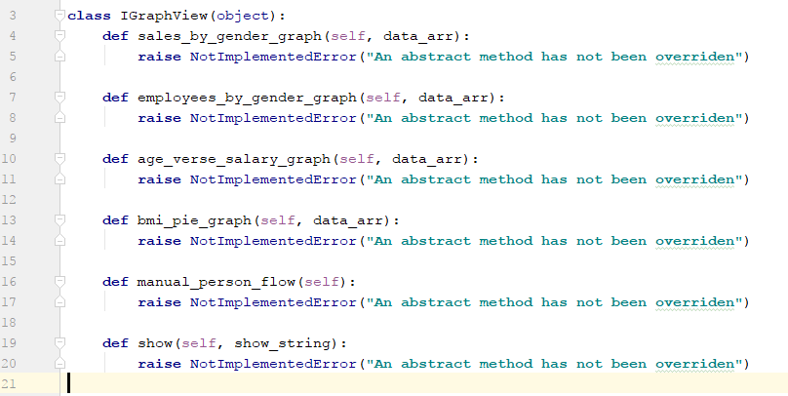
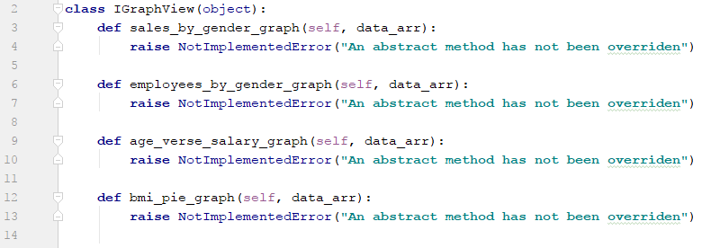
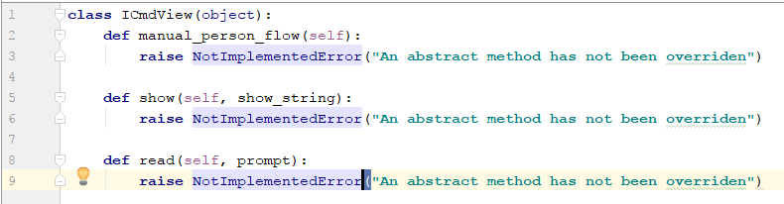
Bad Smell 1 - Evaluation
Code Comparison:
Before
After

Slide 15
Bad Smell 4 - Evaluation
Effectiveness:
I think I have successfully removed the bad smell of GraphView being a large class. I moved the methods that didn’t relate to the graph view into its own class. Now both view classes contain methods related to their name describes.
This is better for future developments as developers wont have to read and understand as much code if they have to update either of the views.

Slide 16
Bad Smell 2 – Test Coverage
Before Refactoring
Test Coverage = 100%
Test File: data_validator_tests.py

Slide 17


Bad Smell 2 – Test Coverage
After Refactoring
Test Coverage = 100%
Test File: data_validator_tests.py

Slide 18
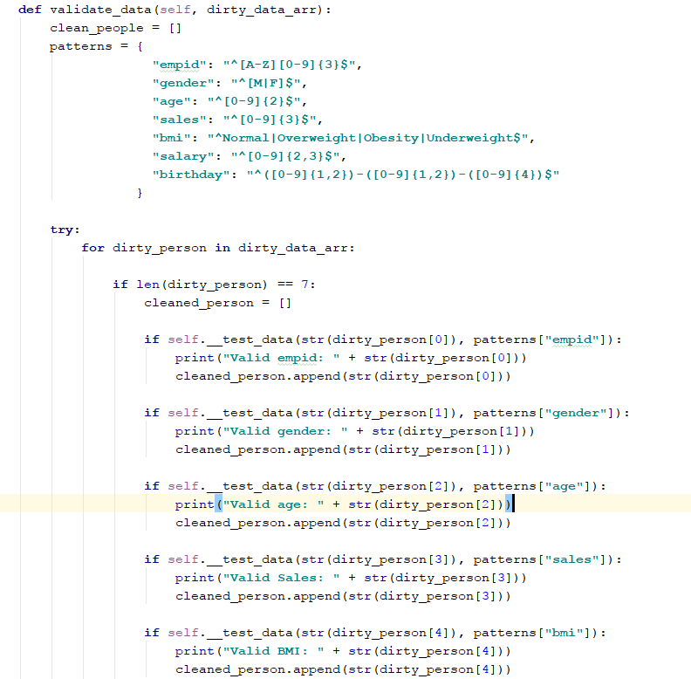
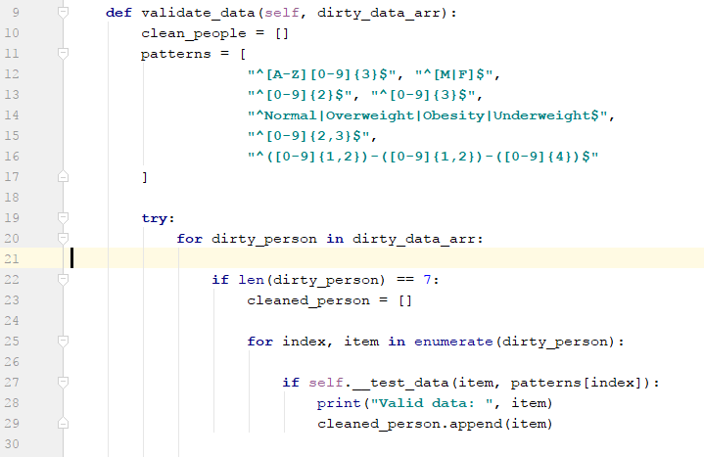
Bad Smell 2 - Evaluation
Code Comparison:
Before
After

Slide 19
Bad Smell 2 - Evaluation
Effectiveness:
I consolidated the 7 if statements into 1 using a loop to iterate over the dirty_person array. This got rid of the duplication bad smell.
To make it simpler to implement I changed my patterns dictionary to and array that I created when fixing bad smell 1. A potential issues is that this method is reliant on the dirty_person array and patterns array being in the same order. If they were jumbled up the wrong pattern would be used.

Slide 20
Bad Smell 3 – Test Coverage
Didn’t figure out how to write unit tests for this
Did manual user tests during each step of the refactoring process.
Manual user tests will be:
Re-running the program
Run command: add -l _load_files/testing_data.csv
Run command: save -s _load_files/save.shelf
Run command: save -f _load_files/save.csv
Doing this will call each of the existing methods

Slide 21
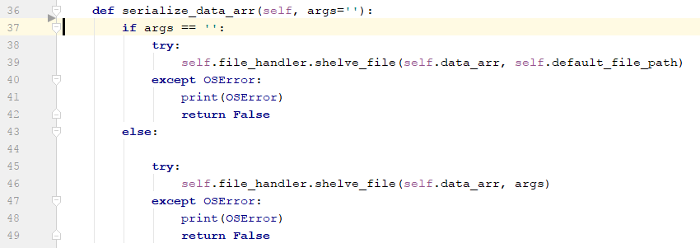
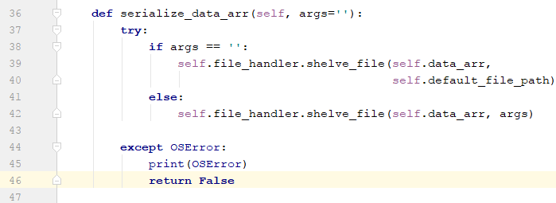
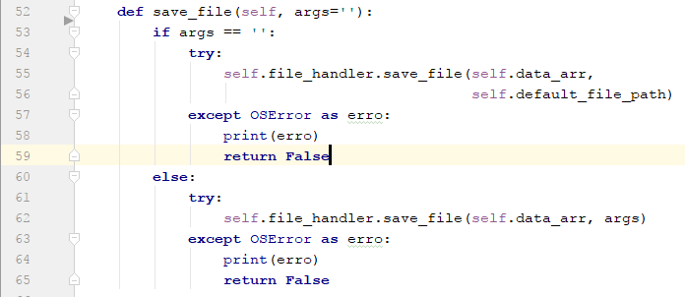
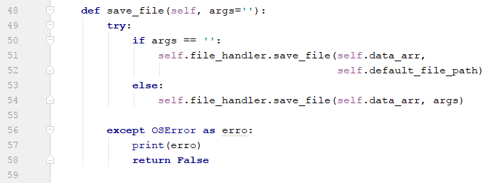
Bad Smell 3 - Evaluation
Code Comparison:
Before
After

Slide 22
Bad Smell 3 - Evaluation
Effectiveness:
I removed this bad smell successfully this was the simplest one that I had found. I didn’t add any new bad smells as a result of this.

