Slide 1
CSC7991: Information Retrieval Course Project
Chunghao Chao

Slide 2
support vector machine (SVM)
Dataset
AMAZON DATASET
https://www.kaggle.com/snap/amazon-fine-food-reviews/data#Reviews.csv
IMDB DATASET
https://www.kaggle.com/lakshmi25npathi/imdb-dataset-of-50k-movie-reviews

Slide 3
AMAZON Dataset
label | Summary | text
__label__2 | Good Quality Dog Food | I have bought several of the Vitality canned dog food products and have found them all to be of good quality. The product looks more like a stew than a processed meat and it smells better. My Labrador is finicky and she appreciates this product better than most.
__label__1 | Not as Advertised | Product arrived labeled as Jumbo Salted Peanuts...the peanuts were actually small sized unsalted. Not sure if this was an error or if the vendor intended to represent the product as "Jumbo".

Slide 4
support vector machine (SVM)
Data Preprocessing
Change all the text to lower case.
Training & Testing
Training dataset: Amazon reviews
User Interface
Web Interface for testing
Tokenization
Remove Stop words
Remove Non-alpha text
Word Stemming
70% for training
30% for testing
TF-IDF
Kernel: Linear

Slide 5
Training & Testing
Different type of data
Different data size
Different size of feature
Different C parameter

Slide 6
Training & Testing
Different type of data
200000 data
max_features=5000
Text | Summary
SVM Accuracy Score (C=1.0) -> 88.06 SVM Accuracy Score (C=0.9) -> 88.07833333333333 SVM Accuracy Score (C=0.8) -> 88.07666666666667 SVM Accuracy Score (C=0.7) -> 88.06166666666667 SVM Accuracy Score (C=0.6) -> 88.04666666666667 SVM Accuracy Score (C=0.5) -> 87.99666666666667 SVM Accuracy Score (C=0.4) -> 87.99666666666667 SVM Accuracy Score (C=0.3) -> 87.96833333333333 SVM Accuracy Score (C=0.2) -> 87.83833333333332 SVM Accuracy Score (C=0.1) -> 87.24 | SVM Accuracy Score (C=1.0) -> 84.71 SVM Accuracy Score (C=0.9) -> 84.74000000000001 SVM Accuracy Score (C=0.8) -> 84.74000000000001 SVM Accuracy Score (C=0.7) -> 84.66666666666667 SVM Accuracy Score (C=0.6) -> 84.61333333333333 SVM Accuracy Score (C=0.5) -> 84.49666666666667 SVM Accuracy Score (C=0.4) -> 84.26333333333334 SVM Accuracy Score (C=0.3) -> 84.06666666666666 SVM Accuracy Score (C=0.2) -> 83.67666666666666 SVM Accuracy Score (C=0.1) -> 82.73

Slide 7
Training & Testing
Different size of data
Using text
max_features=5000
200000 data | 100000 data
SVM Accuracy Score (C=1.0) -> 88.06 SVM Accuracy Score (C=0.9) -> 88.07833333333333 SVM Accuracy Score (C=0.8) -> 88.07666666666667 SVM Accuracy Score (C=0.7) -> 88.06166666666667 SVM Accuracy Score (C=0.6) -> 88.04666666666667 SVM Accuracy Score (C=0.5) -> 87.99666666666667 SVM Accuracy Score (C=0.4) -> 87.99666666666667 SVM Accuracy Score (C=0.3) -> 87.96833333333333 SVM Accuracy Score (C=0.2) -> 87.83833333333332 SVM Accuracy Score (C=0.1) -> 87.24 | SVM Accuracy Score (C=1.0) -> 87.59333333333333 SVM Accuracy Score (C=0.9) -> 87.58 SVM Accuracy Score (C=0.8) -> 87.6 SVM Accuracy Score (C=0.7) -> 87.62666666666667 SVM Accuracy Score (C=0.6) -> 87.59333333333333 SVM Accuracy Score (C=0.5) -> 87.62333333333333 SVM Accuracy Score (C=0.4) -> 87.55 SVM Accuracy Score (C=0.3) -> 87.3 SVM Accuracy Score (C=0.2) -> 86.96000000000001 SVM Accuracy Score (C=0.1) -> 85.55333333333334

Slide 8
Training & Testing
Different size of feature
Using text
200000 data
max_features=5000 | max_features=500
SVM Accuracy Score (C=1.0) -> 88.06 SVM Accuracy Score (C=0.9) -> 88.07833333333333 SVM Accuracy Score (C=0.8) -> 88.07666666666667 SVM Accuracy Score (C=0.7) -> 88.06166666666667 SVM Accuracy Score (C=0.6) -> 88.04666666666667 SVM Accuracy Score (C=0.5) -> 87.99666666666667 SVM Accuracy Score (C=0.4) -> 87.99666666666667 SVM Accuracy Score (C=0.3) -> 87.96833333333333 SVM Accuracy Score (C=0.2) -> 87.83833333333332 SVM Accuracy Score (C=0.1) -> 87.24 | SVM Accuracy Score (C=1.0) -> 84.53333333333333 SVM Accuracy Score (C=0.9) -> 84.51166666666666 SVM Accuracy Score (C=0.8) -> 84.50666666666666 SVM Accuracy Score (C=0.7) -> 84.48 SVM Accuracy Score (C=0.6) -> 84.47666666666666 SVM Accuracy Score (C=0.5) -> 84.45166666666667 SVM Accuracy Score (C=0.4) -> 84.44 SVM Accuracy Score (C=0.3) -> 84.37333333333333 SVM Accuracy Score (C=0.2) -> 84.36166666666666 SVM Accuracy Score (C=0.1) -> 84.08333333333333

Slide 9
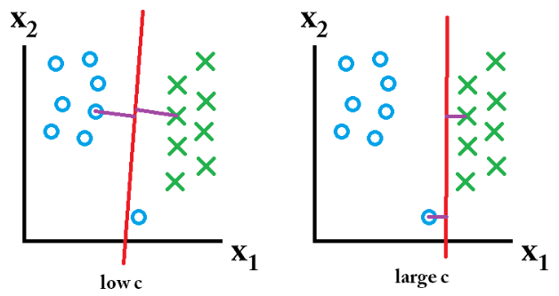
Training & Testing
C parameter -> how much you want to avoid misclassifying each training example.
For large value of C -> smaller-margin hyperplane.
For small value of C -> larger-margin separating hyperplane

Slide 10
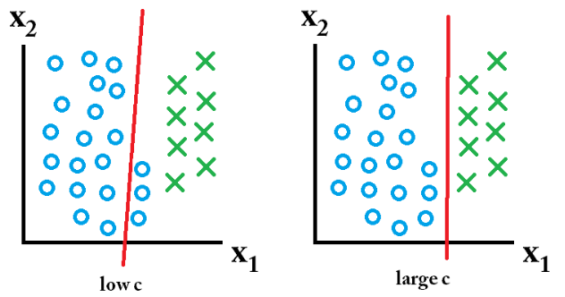
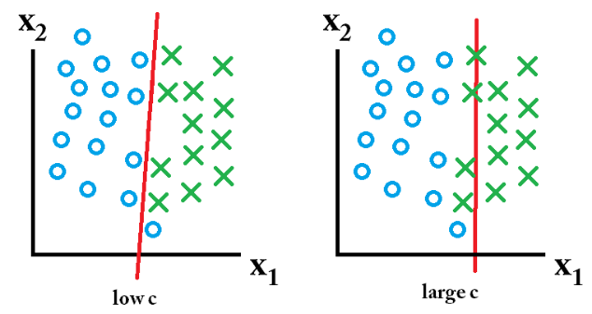
Training & Testing

Slide 11
User Interface
SVM.php
Training SVM and store the model to a file
Take the review from PHP and reload the model from a file to determine the value
User write a review and see it’s positive or negative
Review
Result
Predict.py
Training.py

