Slide 1
Sport-Advisor
Group Members:
Robert Donnelly
Evan Greaney
Steven Joyce
Supervisor: Kevin O’Brien

Slide 2
Overview
Project Overview – Slide 3
System Design – Slide 4
System Evaluation/Testing – Slide 5
Conclusions – Slide 6

Slide 3
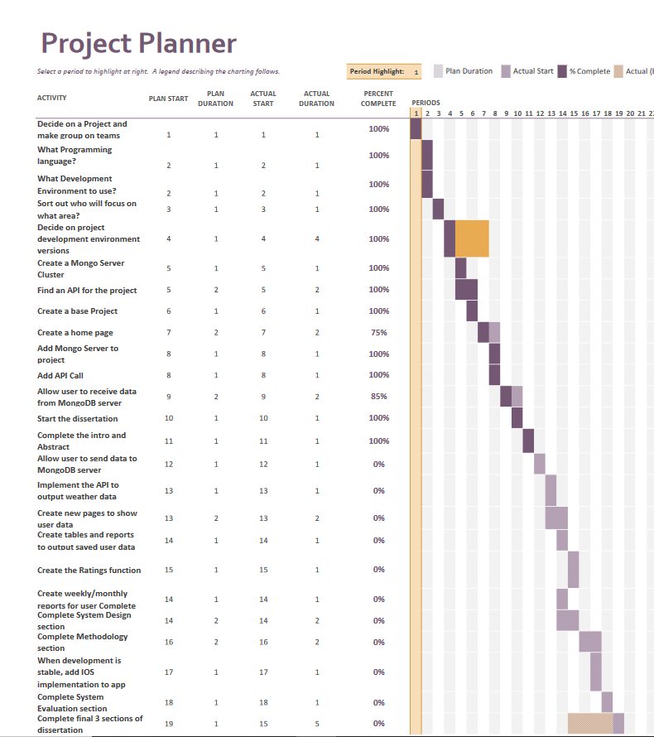
Project Overview
Project Planner, with goals and timelines to achieve objectives by

Slide 4
System Design
System Design
Back End – MongoDB(Cluster Integration)
Front End – Kotlin/Android Studio
API Implementation – Met Eireann weather API
For this we are working with a new language called Kotlin that had its first stable release in February of 2016. Currently using the latest stable release V1.4.21 (December 2020 stable version)
Kotlin is being used to write the front end of the App we are designing for Android Applications
We are using MongoDB to store user data and data from the API to allow the user to access previous days of activity.

Slide 5
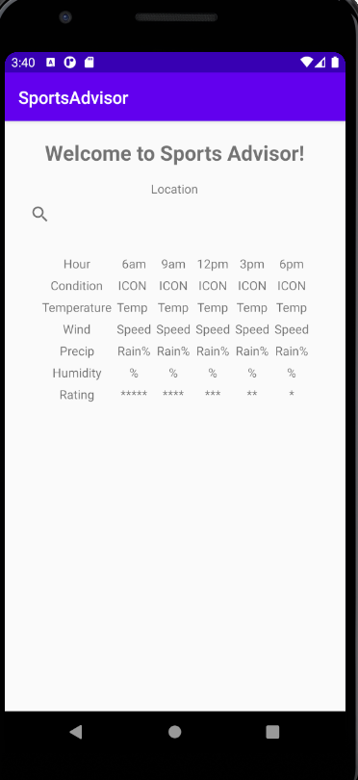
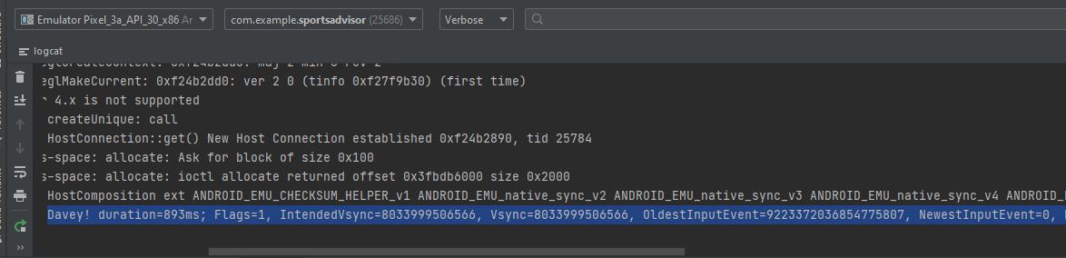
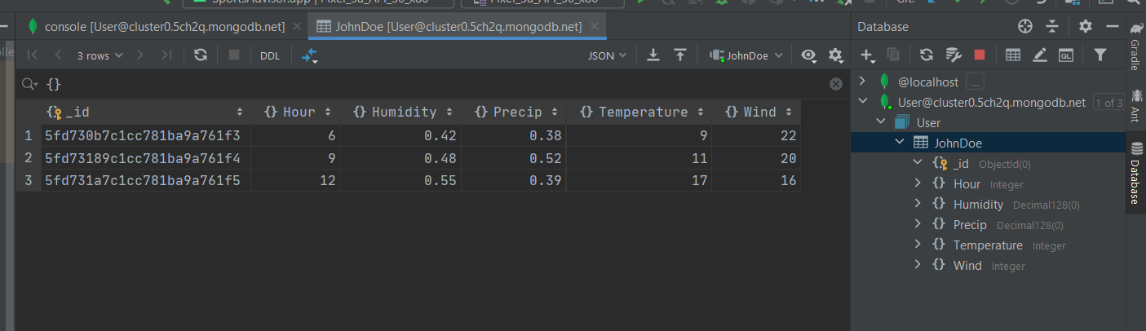
System Evaluation / Testing
Example of Front End displaying hard coded data to the user
Example of API Call retrieving JSON data from a URL
Mongo server data being read into the application

Slide 6
Conclusions
To continue to split up major tasks into smaller tasks to be completed every week
To have more weekly meetings scheduled instead of once a week
To have data being retrieved from the API and outputted to the server for future use
To implement a login feature to protect user data
All major goals/objectives we set out to achieve this semester have been reached except for the concept of MultiPlatform support
Originally , our goal was to have an app deployed to both iOS and Android, but due to the instability of Multiplatform IDE support in Kotiln, we have decided to temporarily remove from our goals until it becomes more stable

