Slide 1
Sport-Advisor
Group Members: Robert Donnelly
Evan Greaney
Steven Joyce
Supervisor: Kevin O’Brien

Slide 2
Overview
Table of contents for slide show.

Slide 3
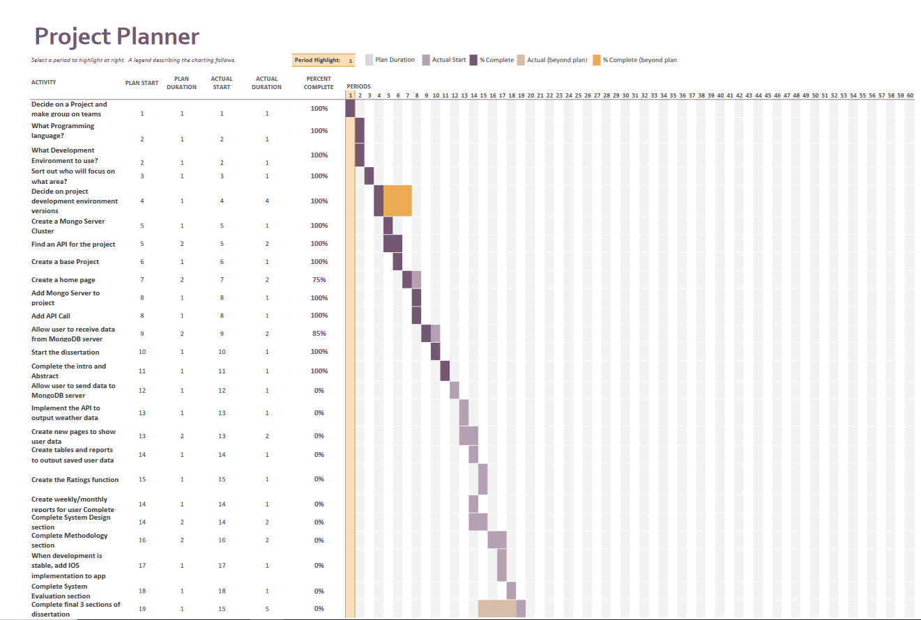
Project Overview
Project Planner, with goals and timelines to achieve objectives by

Slide 4
System Design
System Design
Back End – MongoDB(Cluster Integration)
Front End – Kotlin/Android Studio
API Implementation – Met Eireann weather API
For this we are working with a new language called Kotlin that had its first stable release in February of 2016. Currently using the latest stable release V1.4.21 (December 2020 stable version)
Kotlin is being used to write the front end of the App we are designing for Android Applications

Slide 5
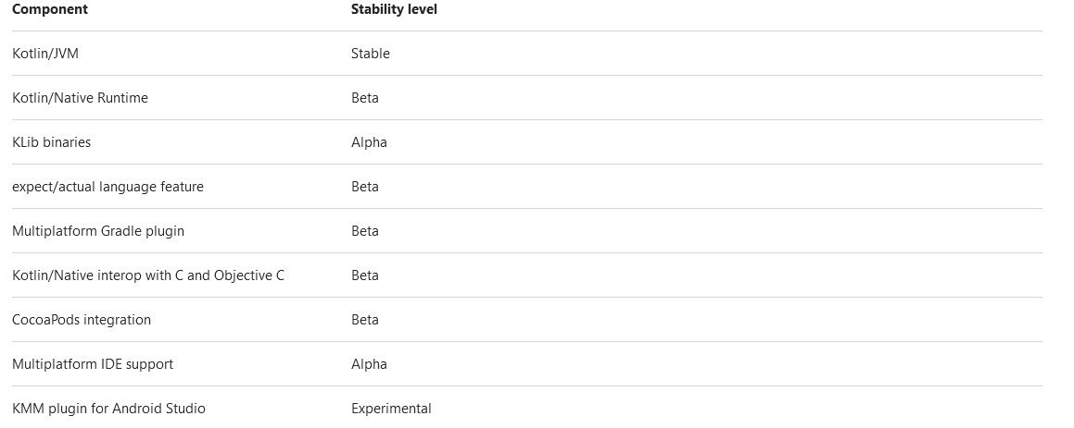
Multiplatform System
Multiplatform IDE support is in Alpha stability
We have decided that developing with a stable version would be best suited for this Application

Slide 6
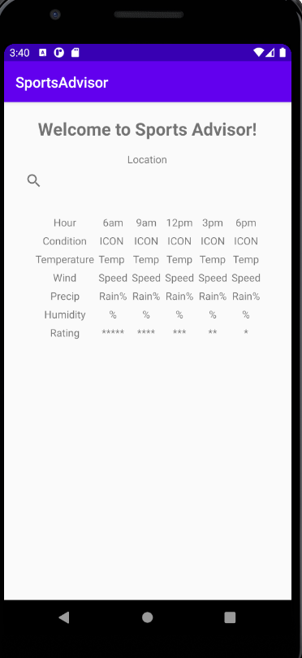
System Evaluation / Testing
Example of Front End so far of the Android Application Running in an Android Emulator

Slide 7
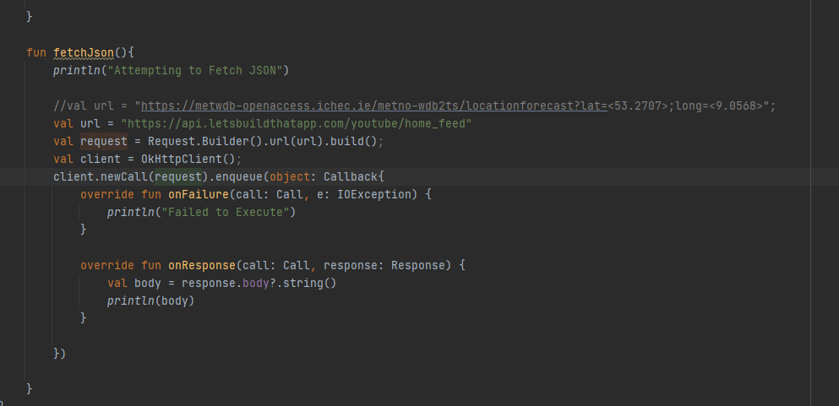
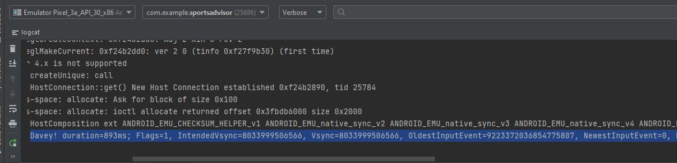
System Evaluation / Testing
Example of code stub that was used to fetch data from an API call
Example of data being fetched from the API call and printed to the terminal

Slide 8
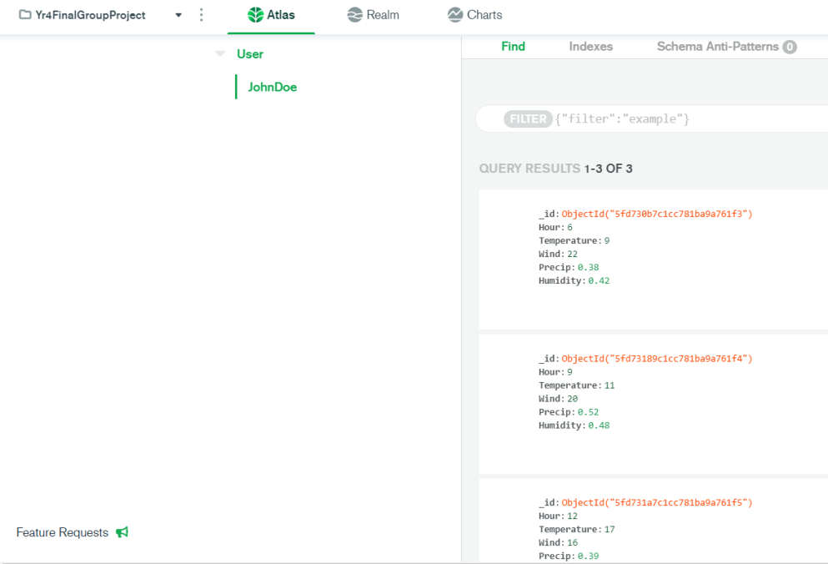
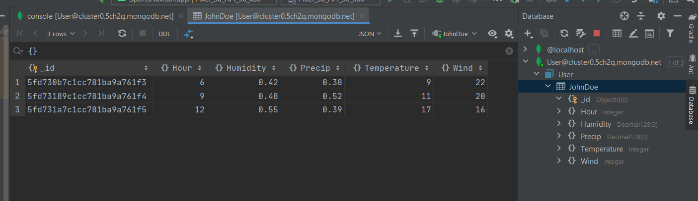
System Evaluation / Testing
Example of Mongo Cluster data set
Example of Database Integrated into the Application in IntelliJ

Slide 9
Conclusions
Recommendations / insights that arise from the software project.
Have each of the original goals / objectives been met?
If not, why?
A limitation of the technology used?
Over ambitious scope?
Changing or ambiguous requirements?

