Slide 1
Authentic / Inauthentic

Slide 2
#1.0 Heraclitus Fragment 124
Wisdom is "to know the thought by which all things are steered through all things”, which must not imply that people are or can be wise.
Only Zeus is wise. To some degree then Heraclitus seems to be in the mystic's position of urging people to follow God's plan without much of an idea what that may be.
In fact there is a note of despair: "The fairest universe (κάλλιστος κόσμος kallistos kosmos) is but a heap of rubbish (σάρμα sarma, sweepings) piled up (κεχυμένον kechumenon, i.e. "poured out") at random (εἰκῇ eikê, "aimlessly").”

Slide 3
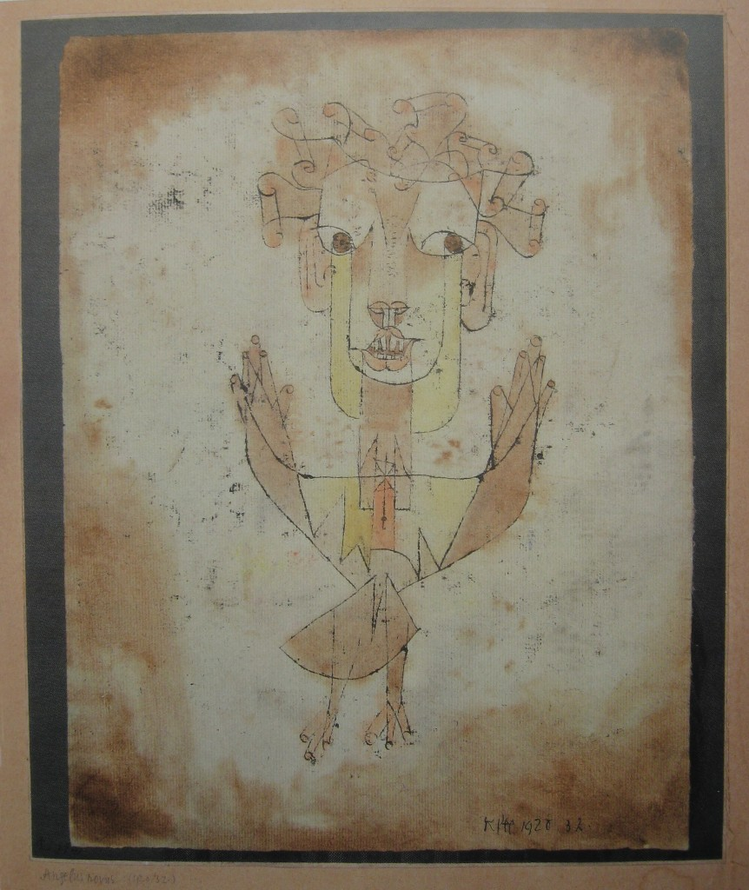
#1.1 Paul Klee Angelus Novus (1920)

Slide 4
#1.1 Paul Klee / Walter Benjamin Connection Angelus Novus
Created in 1920.
The Jewish mystical writer, Gerschom Scholem, bought it hung it in his apartment in Munich, Germany. Scholem’s close friend, the cultural philosopher Walter Benjamin, viewed it in a exhibit of Klee’s work at the Galerie Goltz in Munich and acquired it without hesitation. (Source).
Walter Benjamin carried it with him for the next 20 years. For him, “Angel’s eyes bear witness to the horrors of history since the dawn of ages and into an unknown future. But they are compassionate and empathetic.”
September 26, 1940: Walter Benjamin commits suicide at Port Bou. He was convinced that he was face impending arrest at the hands of the Vichy authorities who will then turn him over to the German authorities and ultimate doom. Before killing himself, Benjamin secured his papers, manuscripts and the Angel with the renown French writer, Georges Bataille, who then worked at the National Library (Bibliothèque Nationale) in Paris.

Slide 5
#1.2 Walter Benjamin Ninth Thesis on the Philosophy of History (1940)
There is a painting by Klee called Angelus Novus. It shows an angel who seems about to move away from something he stares at. His eyes are wide, his mouth is open, his wings are spread. This is how the angel of history must look. His face is turned toward the past. Where a chain of events appears before us, he sees one single catastrophe, which keeps piling wreckage upon wreckage and hurls it at his feet. The angel would like to stay, awaken the dead, and make whole what has been smashed. But a storm is blowing from Paradise and has got caught in his wings; it is so strong that the angel can no longer close them. This storm drives him irresistibly into the future to which his back is turned, while the pile of debris before him grows toward the sky. What we call progress is this storm.

Slide 6
#1.3 Laurie Anderson The Dream Before (1989)
Hansel and Gretel are alive and well
And they're living in Berlin
She is a cocktail waitress
He had a part in a Fassbinder film
And they sit around at night now
drinking schnapps and gin
And she says: Hansel, you're really
bringing me down
And he says: Gretel, you can really
be a bitch
He says: I've wasted my life on
our stupid legend, When my one
and only love was the wicked witch.
She said: What is history?
And he said: History is an angel
Being blown backwards into the future
He said: History is a pile of debris
And the angel wants to go back and fix
things, To repair the things that have
been broken
But there is a storm blowing
from Paradise
And the storm keeps blowing the angel
Backwards into the future
And this storm, this storm is called Progress

Slide 7
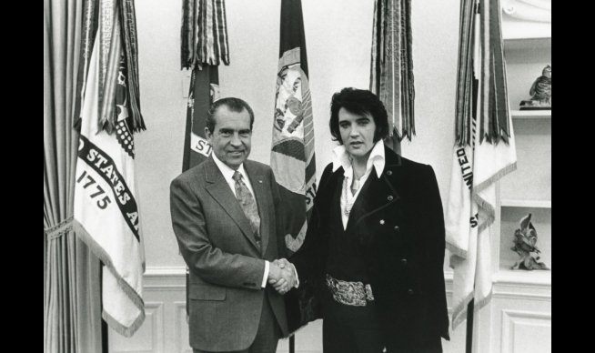
#2.0 Nixon / Elvis

Slide 8
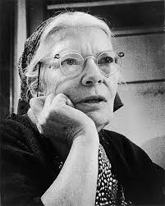
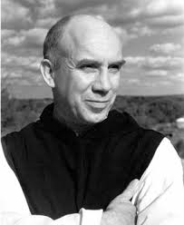
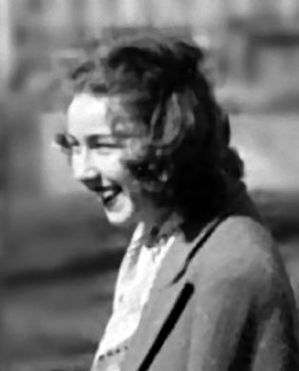
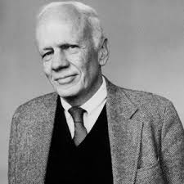
#3.0 – The Four
Dorothy Day - Thomas Merton - Flannery O’Connor - Walker Percy

Slide 9
#4.0 Costa Rica
President George W. Bush articulated that there were 49 countries in the Coalition of the Willing. Announced at the beginning of the U.S.-led invasion of Iraq on March 19, 2003.
In April, the Coalition of the Willing was reduced to 48 countries.
A citizen of Costa Rica filed suit against the Costa Rican government challenging their ability to be a member of the coalition. The Costa Rica Supreme Court ruled that they could not participate.
White House spin on this change generate thousands of emails.

