Slide 1
Automated Portfolio Management: System Architecture
A full-stack quantitative trading infrastructure project
By: Steven Oden

Slide 2
Project Overview
Purpose:
A standalone modular, Python-based trading system that ingests market data, generates trading signals through tested strategies, manages a portfolio, enforces risk constraints and simulates trade execution
Designed to mirror the architecture used by quantitative hedge funds and trading firms
Goals:
Demonstrate my ability to design and build distributed systems
Show practical experience with REST APIs, microservices and data pipelines
Build quantitative finance skills and experience: Strategy design, risk management, execution and portfolio management
Provides a realistic example of production-style trading infrastructure
Expand my knowledge and expertise in a subject that I am highly interested and passionate about, financial markets
Tech Stack
Python (Flask, FastAPI, pandas, NumPy)
REST APIs
Docker + Kuberbetes
PostgreSQL/ SQLite
Streamlit/Dash
AsynchIO / scheduling

Slide 3
High Level Architecture: System Diagram
Brain
Here are the approved orders
Here are the prices
Here are the signals
Here are the orders
Here are the fills
Market Data (Yahoo Finance etc.)
Data Service
Strategy Service(s)
Portfolio Service
Risk Service
Execution Service
Trade Data
Response
Universe Tell Fetcher which Symbols to pull data for
Strategy Tells Data Service New Symbols to include in Universe
Update Portfolio With Trade Data
Market Data
Asset Universe
Strategy Specific Data
Portfolio DB
Risk Specific Data
Trade History
System State

Slide 4
High Level Architecture
Data Service – gets cleans stores and serves daily OHLCV market data, maintains symbol universe, single source of data for other services
MarketData Service – Streams (no storing) intraday market data for symbols in Data Service’s Intraday Watchlist
Strategy Service – turns data into signals (BUY/SELL), identifies symbols to add to Data Service’s symbol universe for daily Market data or the Intraday watchlist for intraday price action -> used for evaluating when sell orders are hit since not executing through broker
Portfolio Service – tracks positions, PnL, and orders
Risk Service – monitors risk and enforces limits – coming soon
Execution Service – turns orders into trades (simulated or live), executes trades and maintains trade history, currently pull live price data at time order received as simulated execution
Dashboard – visualizes portfolio and strategy performance –coming soon
Correlation service – Manages how correlated positions in portfolio are – likely part of strategy

Slide 5
Running
To Run the services:
run .\run_all.bat
This will open four command prompts and spin up the Data Service, Portfolio Service, Execution Service and the MarketData Service.
To examine and playaround with the REST endpoints for each service go to:
http://localhost:8001/docs => Data Service
http://localhost:8002/docs => Portfolio Service
http://localhost:8003/docs => Execution Service
http://localhost:8004/docs => MarketData Service
http://localhost:8010/docs => IPO_Strategy Service
These services are built using FastAPI, at /docs you are able to try out the endpoints for yourself, read any documentation and examine the schemas associated with these routers. To try out an endpoint, click the drop down arrow on the desired route handler and click "try it out" in the top right hand corner. It will provide details on the input schema and output schema.

Slide 6
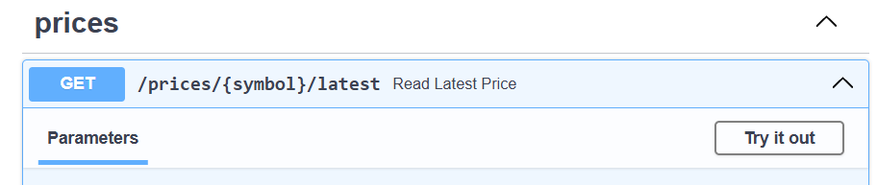
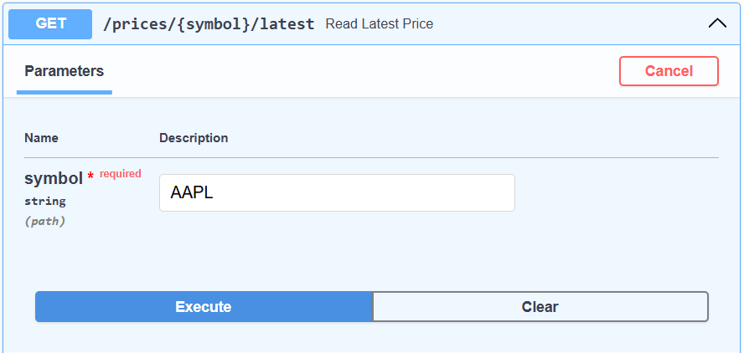
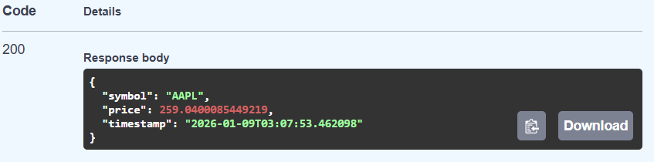
Example Data Service /docs
http//:localhost:8001/docs
Here we will try getting the latest price for AAPL
Enter AAPL as a string and it will return the current price and the timestamp for this execution

Slide 7
Data Service
Responsibilities:
Maintains Symbol Universe Table – Symbols we want to collect OHLCV market data on daily
Maintains IntraDay Watchlist Table – Symbols that one or more Strategy service requires intraday data on for determining stop loss / take profit fills
Fetches and stores latest prices
Why it matters: Everything downstream depends on clean, consistent data. All of the data fetching, cleaning and serving is centralized to one place

Slide 8
Strategy Service
Responsibilities:
Brains of the platform
Each strategy will be unique, but the general responsibility is to determine which symbols we want to evaluate, determine when to generate a buy order based on a certain rule set and what to set the take profit and stop loss sell orders at
The Strategy service will also evaluate the price action for symbols it has open positions on for when the stop loss or take profit prices are hit.
Details on specific “IPO Strategy” on following slide

Slide 9
IPO Strategy
Current strategy = “IPO_Strategy”:
Scrapes webpage for new companies that have an upcoming IPO.
Once a new symbol is detected, that symbol is added to DataService’s symbol universe and daily OHLCV data starts being stored.
The symbol is also added the the IPO_Service’s IPOEvent table.
The strategy monitors time and waits until the IPO day is reached.
On the day of the Symbol’s IPO, the strategy saves off the max(open_price,close_price).
A buy signal is generated from the strategy after the first day the the symbol closes over the previous high price.
The take profit is set at 20% above buy price, stop loss is set 10% below buy price.
The IPO Strategy service streams intraday data from the Market Data Service and initiates a sell order when either of these prices are hit
State Machine:
DISCOVERED -> WATCHING->IPO_DAY->READY->BUY_ORDER->HOLDING->EXITED

Slide 10
IPO Strategy Pipelines and schedule
Ingestion Pipeline:
Scrapes StockAnalysis Webpage, Creates a new IPOEvent row with state = “DISCOVERED”
If row for symbol already exists, update if there is new data
Run every hour to check if IPO date is changed to current day
Universe Pipeline:
Querys IPOEvent Table for symbols in state “DISCOVERED” adds them to data service symbolUniverse table to start pulling daily OHLCV data
Sets state = “WATCHING”
Run immediately after Ingestion Pipeline to add newly found symbols to Universe
IPO Day Pipeline:
Queries IPOEvent for “WATCHING” symbols, evaluates if current day is equal to stored ipo_date. If so state = “IPO_DAY” if date passed state = “MISSED”
Run immediately after Universe pipeline in case ipo_dates were updated to current day
Entry Evaluation Pipeline:
IPO_DAY - > READY
Saves off the ipo (open) price and the close price on the day of the IPO. Sets state = “READY”
Sets max(ipo_price,close_price) as the highest close for entry evaluation
READY -> BUY_SIGNAL
Queries IPOEvent for symbols in state = “READY” and where today != ipo_date
Evaluates the close price for the current day, if close price > highest_close set state = “BUY_SIGNAL”
Runs every day after market close
Buy Signal Pipeline:
Queries IPOEvent for symbols in state = “BUY_SIGNAL”
Send buy order to execution service as soon as market opens and sets state = “HOLDING” upon successful response from execution service
Sets the stop loss and take profit prices for exit evaluation pipeline to use, adds symbol/strategy pairing to intraday watchlist for intraday price streaming used by exit evaluation pipeline
Runs once as soon as market opens (execute buys right as market opens from signal generated night before)
Exit Evaluation Pipeline:
Runs continuously – evaluates intraday price for symbols in state = “HOLDING” to see if stop loss or take profit are hit
If they are, sends sell order to the execution service and sets state = “EXITED” upon successful execution and removes symbol/strategy pairing from intraday_watchlist

Slide 11
Portfolio Service
Responsibilities:
Maintain current positions, cash, and PnL
Track fills/trades (from execution service)
Expose:
GET /portfolio
POST /rebalance (given target weights)

Slide 12
Risk Service – Not yet implemented
Responsibilities:
Compute:
Volatility, drawdown, exposure by asset/sector, leverage, etc.
Enforce constraints:
Block/reduce orders that violate risk rules
Expose:
POST /check-orders (returns approved/trimmed orders + warnings)
GET /risk-metrics

Slide 13
Execution Service
Responsibilities:
Take orders from portfolio service (after risk check)
In v1: simulate fills using last/close price
Optionally: integrate a paper trading API later (Alpaca, Interactive Brokers, etc.)
Maintain trade history table
Monitor synchronicity with portfolio service.
If Execution service cannot properly update portfolio service, trade execution for buy orders is blocked until the portfolio is rebuilt using the execution service’s trade history
Prevents further decoupling and undesired signal generation / portfolio rebalancing
Expose:
POST /execute-orders
GET /orders, GET /trades

Slide 14
Dashboard – Not yet Implemented
Responsibilities:
Call the REST APIs of other services
Show:
Live/last PnL
Positions and exposures
Risk metrics
Recent orders/trades

