Slide 1

STAT 451 Class Presentation
Machine Learning for evaluating the popularity of
COVID-19-Related Posts on Twitter Platform
Group 7: Feiyu Guo, Rowan Shi, Steven Yang, Zening Duan
Instructor: Dr. Sebastian Raschka

Slide 2
Presentation Outline
Project Background
Building our Dataset
Train Machine Learning Models
Results
Feature Importance
Conclusion

Slide 3

Background
Train and evaluate machine learning models to predict the popularity of COVID-19-related tweets.

Slide 4
Data
Source: English tweets related to the COVID-19 pandemic posted by global users
Period: 15 June 2020 to 12 July 2020 (4 weeks)
Volume: 41,077,714 tweets in the entire four-week period and 2,285,379 unique original tweets in the first two weeks.
We took a random 10% sample of the total 2,285,379 unique original tweets for this project.
Notes:
To further filter our datasets, we applied 25 keyword that were believed to capture essential issues that happened in the four-week period.
We took a random 10% sample of the total 2,285,379 unique original tweets for this project, due to the overwhelming number of the tweets.

Slide 5
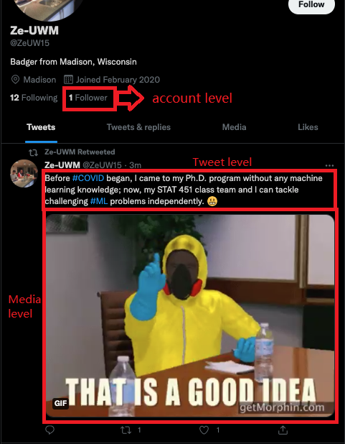
Data Structure
Four levels of features:
Account Level
Media Level
Tweet Level
Geolocation Level
Four response variables:
Retweets
Likes
Replies
Quotes
Notes:
Here is the structure of data we collected
The features in the dataset consist of information from four levels: Account level such as the number of followers, Media level such as whether tweet contains picture, Tweet level, for example, the number of positive word in the tweet,and the final level Geolocation level. There are 34 independent variables in total. Because only 1% of the tweets have the Geolocation data, we decided to exclude all Geolocation variables.
The diffusion of the tweet is determined by four response variables: numbers of retweets, likes, replies, and quotes of the tweet.

Slide 6
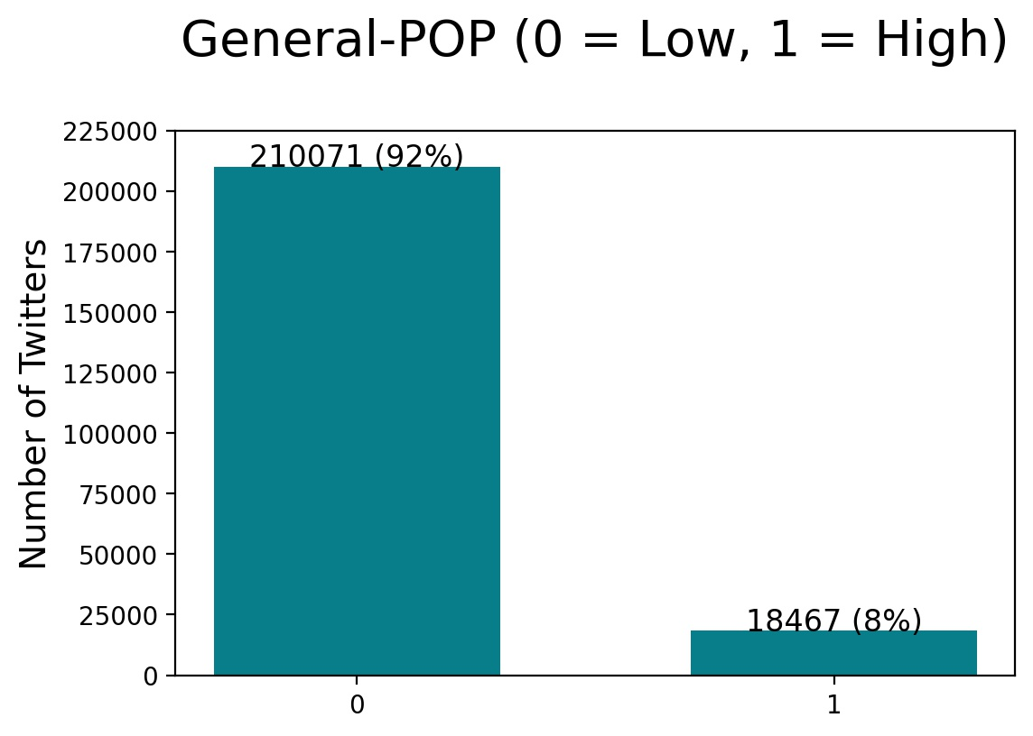
Data Prepossessing
How to define the popularity
Transform into categorical variable
Setting quantile to split the data
Combine the four response variables into one
Dealing with the imbalance of the data
SMOTE
Notes:
We changed our four continuous variables (retweets, likes, replies and quotes) into categorical variables by setting a threshold of upper 95th quantile to split data into two levels of diffusion: Low level and High Level. We used the “train test split” method to create a 70% train set and a 30% test set.
Then, we created a new response variable called General-POP (General Population) as our final response variable for model fitting. The criteria we interpret the metric of the General-POP variable is that if one of the original response variables is classified as high level, then we classify the General-POP as high level.
The 95th quantile splitting also brings the problem of the imbalance of the dataset, in which about 92% data are labeled as low level and only about 8% data are labeled as high level. In order to solve the problem of the imbalance, we implement the SMOTE(Synthetic Minority Over-sampling Technique) to over sample the minority group, the high level group.

Slide 7
Model
KNN
Random Forest
Gradient Boosting
Cat Boost
Notes:
There are four algorithms we used for fitting
KNN model
Random Forest model
Gradient Boosting model
Cat Boost model
Next slide will be explained by steven about the results of our models

Slide 8
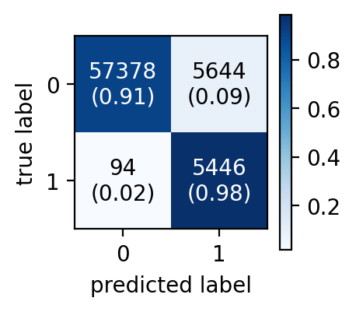
Result (KNN)
After SMOTE
k = 3
Accuracy = 91.63%
No hyperparameter tuning
Curse of dimensionality

Slide 9
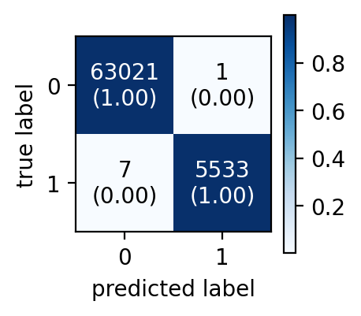
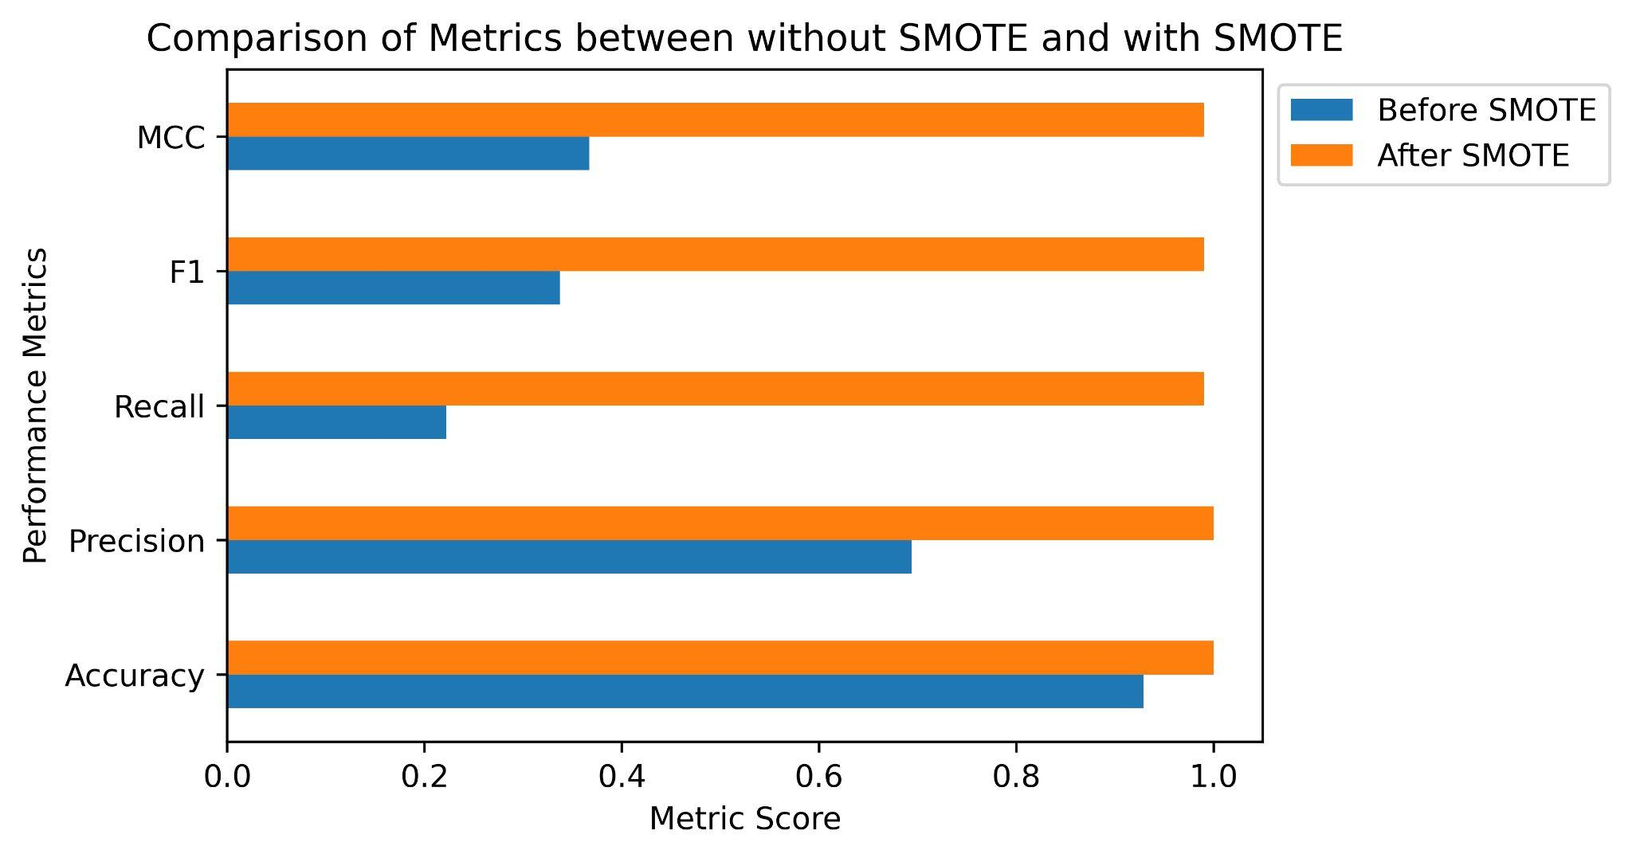
Result (Random Forest)
Notes:
Surprisingly, the random forest model with default setting and n_estimators = 100 has excellent accuracy of 99.99%. Through the confusion matrix, we could also find the problem of having low accuracy of predicting label 1 has been solved. More importantly, the number of false positives and false negatives is extremely low.

Slide 10
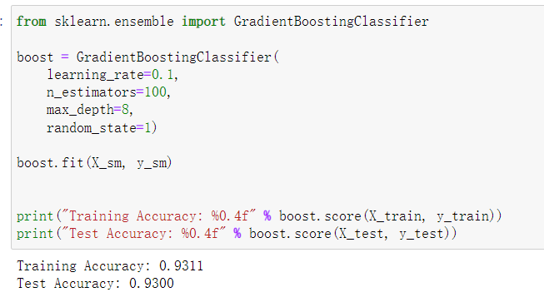
Result (Gradient Boosting)

Slide 11
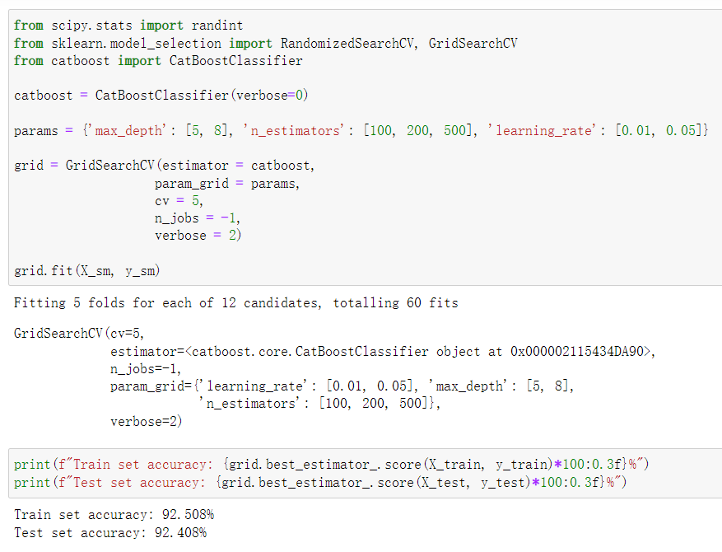
Result (CatBoost)

Slide 12
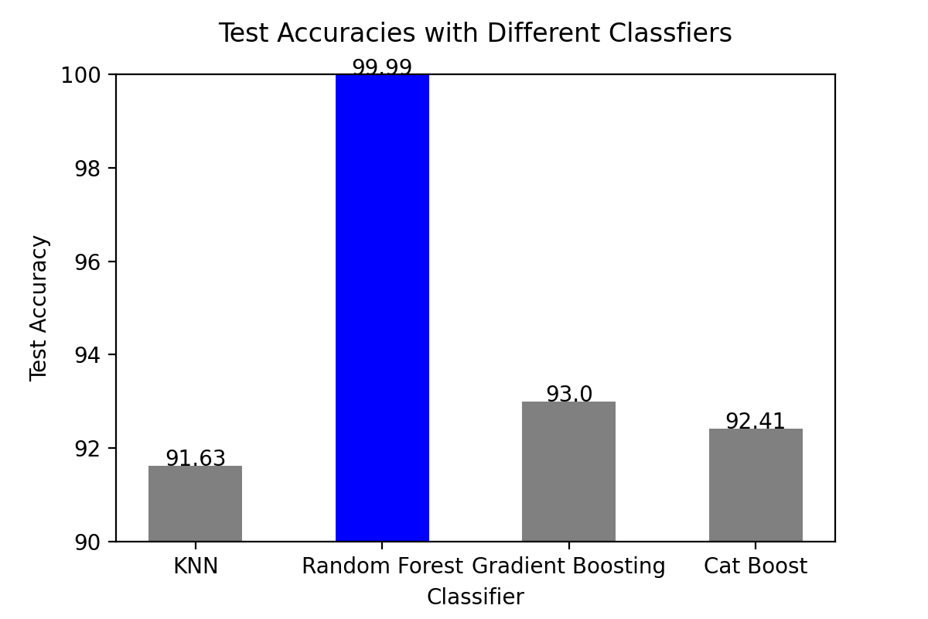
Model Comparison

Slide 13
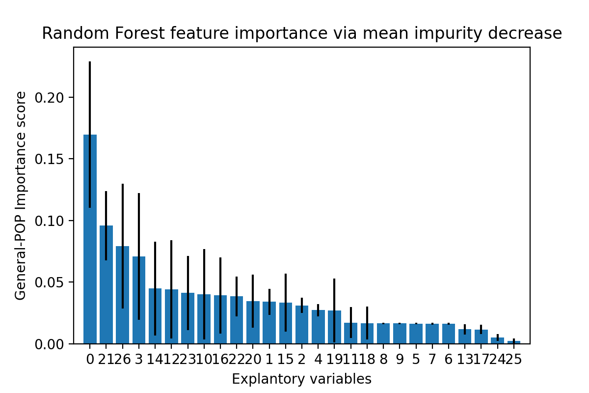
Top Five important Features to tweet popularity
Count of account followers
Count of embedded Urls
With media extension
Account verification status
Positive (emotion)
Notes:
Our Top five important features are listed on the left side.
Most of our important features are consistent with other professional researches. The importance are also easy to understand. Like the count of account follower. It is top rated because millions of followers mean that the tweet has broad influence in the society .
The number of Urls, we found that the feature positively leads to high popularity, but somehow this contradicts other studies. Which calls for further investigation.
Have a look at positive emotion, which represents how positive a tweet is. This one is a very interesting. Positive words are important for supporting people to going through the hard time in this pandemic and the tweet containing this positive sentiment is more likely to be seen by others.

Slide 14
Conclusion
Random Forest model performs the best (99.99% accuracy)
Theoretical implication: understand online information diffusion
Practical value: Build a better social media tool and popularity predictor
Notes:
To summarize
In the project, based on what our group members mentioned, Random Forest performs better than other models and achieved the top high accuracy of almost 100% and also quite high in (recall F1, precision and other score)
In this project we acknowledge that Machine learning is a good way for us to understand online information diffusion theoretically. And to put our findings into practice, we may help build a better social media tool as well as an accurate predictor of information popularity.
We may support public health departments, and campaign practitioners to understand the spreading of online information better, and help the public access more high-quality content.
This brings us to the end of our presentation.
I want to give credits to our group members, and many thanks to the guidance and teaching from Dr. Sebastian Raschka. Of course, we sincerely appreciate your attention. If you have any thoughts or questions, feel free to share in the peer review section. And that’s all for our presentation today.

Slide 15


Slide 16
STAT 451 Class Presentation
Thank you!
Machine Learning for evaluating the popularity of
COVID-19-Related Posts on Twitter Platform
Group 7: Feiyu Guo, Rowan Shi, Steven Yang, Zening Duan
Instructor: Dr. Sebastian Raschka

