Slide 1

What Keeps Us Awake at Night?
Are Patients Safe?
Will I be Fired because we Failed to get New Drug Approval?
Are Clinical Trials too Complex for Patients, Sites, and Study Teams to Manage?
Notes:
In this industry, what keeps us awake at night? [Pause 2 seconds]
I am going to share 3 things that kept me awake in the various roles I've had supporting clinical operations.
Are our patients safe? Would I want my own mother to take part in our clinical trial or use our product?
Will I get fired because I didn’t have the confidence to stand in front of inspectors and know that I could demonstrate compliance?
Have our clinical trials become too complex for patients, sites, and study teams to navigate? What problems are lurking that I know nothing about?

Slide 2
What if You Had the Power to
Keep your Patients Safe by Sending Right Information to Right Person at Right Time Anywhere in the World?
Remain Compliant despite Changing Regulations in Every Country?
Give Study Teams and Sites back 10 hours per Week to Spend with Patients?
Notes:
Imagine if you had the power to
Keep your patients safe by sending the right information to the right person at the right time anywhere in the world?
Remain compliant despite changing regulations in every country?
Give study teams and sites back 10 hours per week to spend with patients by removing administrative burden?
Well, now you do.

Slide 3


The Solution… WCG SafetyPortal
>125M Safety Letters Distributed since 2007
>60 Sponsors/CROs Supported since 2007
Automated Country Regulations for >110 Countries since 2017
Over 400 Compounds Supported since 2007
Integrated with CTMS, Safety Databases, eTMF, EDMS since 2017
$500M Saved for Our Clients since 2007
Supporting 600,000 Users Across the Industry since 2007
Making Global Harmonization Real in 2017
40% reduction in safety letters
99%+ sites compliant
$65m saved in 1 year
Notes:
I’m Steven Beales. Head of Safety Technology at WCG. This is a day I’ve been looking forward to for 1 and a half years. Every once in a while a solution comes along that changes everything Today, I introduce you to such a solution for Safety Reporting - WCG SafetyPortal.
You may be thinking a Portal? We have a portal. Not like this you don’t.
What we are showing you today is real, not conceptual. These results were achieved in 2017 at 1 of the 3 largest pharma companies in the world. 40% reduction in safety letters by using artificial intelligence. Over a 99% compliance rate for sites. And the figure that surprised us all – $65m saved in 1 year.

Slide 4
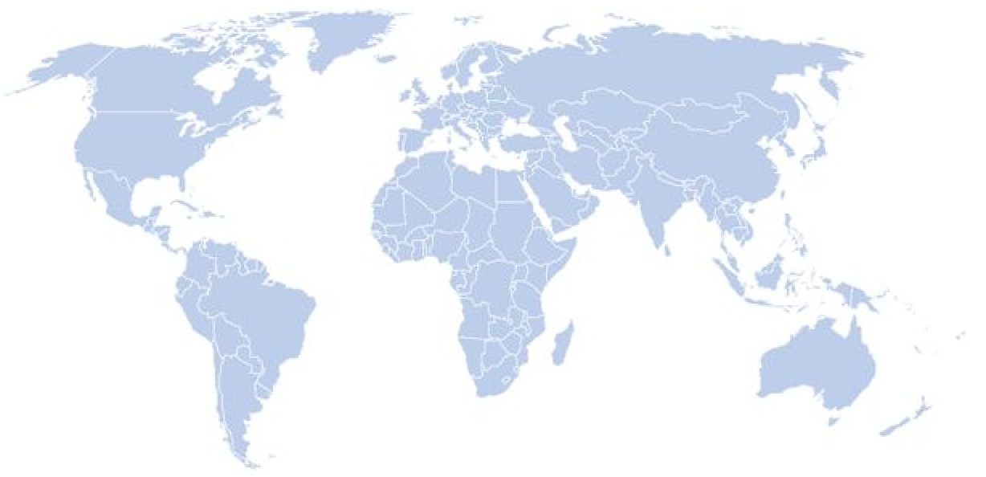
Why is Safety Reporting a Problem?
Clinical Trials are complex!
Multiple countries
IMP/IP
Reference Safety Information
Multicompound
Unclear Regulatory Environment
Global & local teams
Multiple partners
Multiple interpretations
Over distribution
Fragmented process
Marketing Status
Combinations
Lack of Global Harmonization
Unclear rules
Accountability
Consistency and application
We are drowning in information and data, not knowledge and wisdom.
Notes:
Why is Safety Reporting such a problem? We are drowning in information and data, not knowledge and wisdom.
We collect more inputs and signals without filtering and targeting actionable safety alerts directly to the point of care.
Our trials are more complex, more global, with fragmented processes and multiple partners.
Almost every country has its own regulatory framework. We uncovered over 40 different approaches to patient safety.
Rules are unclear. Accountability is unclear. Consistency is absent.
We turn on the firehose and point it at doctors because we lack precision systems.

Slide 5
SafetyPortal = Disruptive Innovation
Stopped Waiting for Someone Else to Solve Problem
Brought together 1 each of 3 largest Pharma, Biotech, CRO
Created AI-powered Global Safety Reference Model
#DPharm2018
Notes:
Why is WCG SafetyPortal a disruptive innovation? We stopped waiting for someone else to solve the problem. We brought together 1 each of the 3 largest pharmas, biotechs and CROs to create a global Safety Reference Model powered by the regulatory intelligence of over 110 countries.
We implemented technology to solve big data problems and developed a rules-based AI and cloud-based distribution network.
We are building a self-sustaining system – standardizing, eliminating steps, adding independent checks and applying lessons from data and analytics.

Slide 6
Patient Safety Matters…
Adverse Drug Reactions are 4th Leading Cause of Death in US
Annually #SAEs would Fill Every Seat in Fenway Park 60 times
Statistically 1 of Us in this Room will be Hospitalized this Year
Notes:
We are an industry of good people. But good people are fallible.
Adverse drug reactions are 4th leading cause of death in US after heart disease, cancer and lung disease.
Every year, we could fill Fenway Park 60 times with patients who have suffered an SAE. Statistically 1 of us in this room will end up in hospital this year.
Patient safety became my personal mission in 1991 when I lost a close friend. If we’d had this system in place at that time, he might still be alive. I am grateful to Roche-Genentech for inspiring SafetyPortal and WCG, for commercializing this technology so that everyone can share in the benefits. I urge you all to join us in building a safer world. Thank you for listening. I wish you all a peaceful night’s sleep.

Slide 7

Q+A

