Slide 1
Paper - Traumatic Brain Injury Detection Using Electrophysiological Methods (REVIEW)
By: Steven Cao

Slide 2
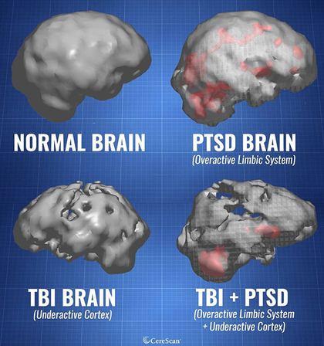
What is mTBI?
Definition
Mild traumatic brain injury (mTBI), or concussion, is the most common type of traumatic brain injury. With mTBI comes symptoms that include headaches, fatigue, depression, anxiety and irritability, as well as impaired cognitive function.
How it is caused?
A traumatic brain injury (TBI) occurs from sudden trauma which causes damage to the brain. TBI can happen when the head suddenly and violently hits an object or when an object pierces the skull and enters brain tissue.
Symptoms
Symptoms may include headache, confusion, lack of coordination, memory loss, nausea, vomiting, dizziness, ringing in the ears, sleepiness, and excessive fatigue.
What are the changes in the brain that makes the person suffer from mild TBI?
Mild TBI is caused by initial physical trauma that shears or compresses brain tissue.
Why do we want to use EEG as a way to diagnose mTBI?
It is anticipated that rapid and accurate mTBI detection would improve prognoses and minimize impacts to military operations; however, a technological gap exists, especially in field-based settings. EEG could help us diagnose mTBI.

Slide 3
The issue with mTBI
How much of an issue is mTBI?
Over 75% of the 266,000 brain injuries reported during U.S. military operations from 2000 to 2012 were classified as mTBI, thus underscoring mTBI as a major health issue in the U.S. military
The long-term effects of mTBI?
The effects of TBI can be significant and long-lasting. Fazel et al. (2014) compared mortality rates 6 months or more after injury against a control population. They found that TBI is associated with substantially elevated risks of premature mortality, particularly from suicide, injuries, and assaults. Similarly, TBI is a significant risk factor for neuropsychiatric disorders.
Conclusion: We need an rapid and accurate mTBI detection

Slide 4
A Promising Method
One promising avenue to detect mTBI is measurement of brain electrical activity with quantitative electroencephalography (qEEG), in which detection of altered patterning may indicate concussion.

Slide 5
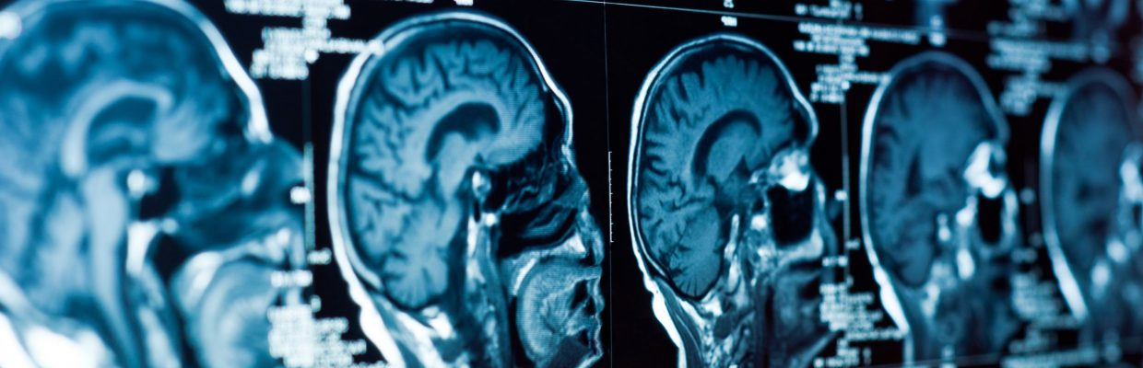
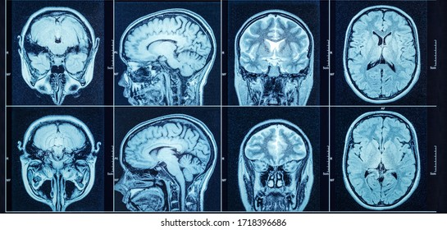
Comparing EEG to MRI & CT
EEG as a neuroimaging modality holds several advantages over more conventional medical approaches.
Computed tomography (CT) and MRI are current the “gold standards” for imaging assessment of neurophysiological trauma. These techniques provide excellent spatial resolution for easily identifying lesions; however, significant limitations of CT and MRI reduce the practical utility for mTBI detection. For instance, both approaches require very large and expensive equipment, special facilities for their use, and dedicated technicians for operation. CT uses small doses of radiation, which may carry potential risks for long-term side effects if patients are scanned often. MRI uses an extremely strong magnetic field(>1T), necessitating careful operating procedures. Perhaps most limiting for MRI is the contraindication of medical devices, implants, and any foreign ferrous metal objects in the patient’s body. Since service members may have metal fragments lodged in their bodies from the same injury event, this limitation is particularly difficult to reconcile for military use.
EEG is substantially more portable, less expensive, requires no special facilities, and, in most cases, can be applied by personnel with very minimal training. All of these characteristics contribute to a substantially higher level of fieldability and a broader operational effectiveness beyond dedicated medical centers.
CT scan
MRI Scan

Slide 6
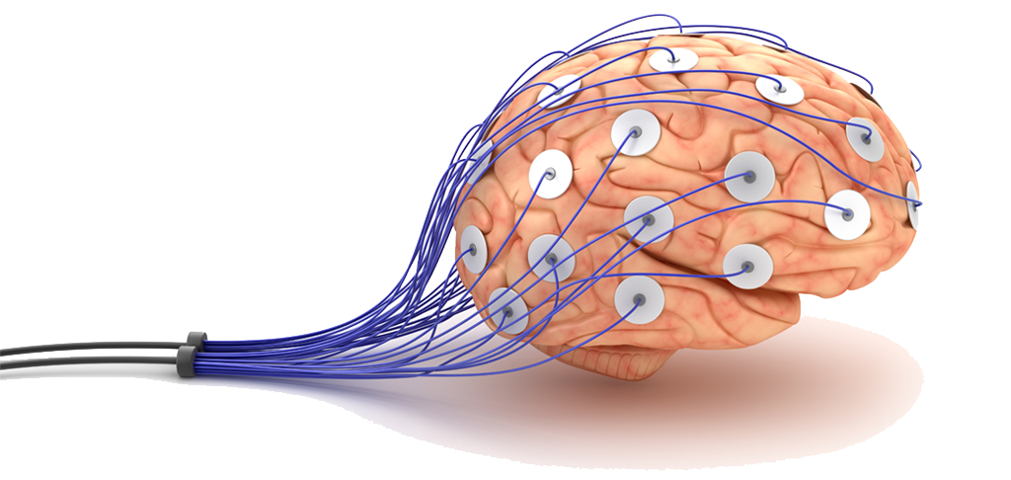
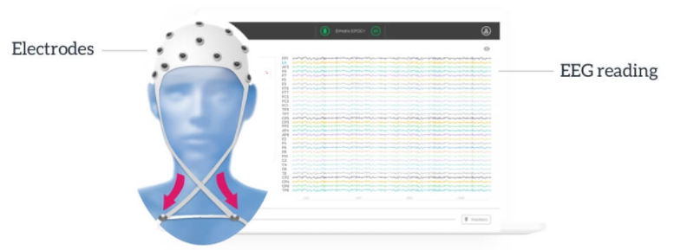
About EEG
What does the electroencephalogram do?
The electroencephalogram (EEG) records the electrical potential difference between brain electrical activities recorded between two electrodes (a single EEG channel). Multiple scalp electrodes (generally >20) are connected in various patterns called montages, resulting in a series of channels of EEG activity.
Multiple scalp electrodes

Slide 7
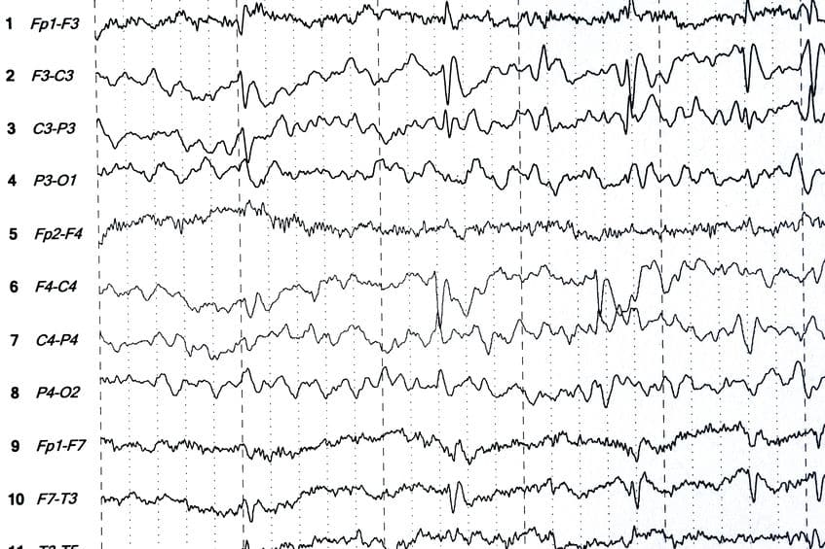
Example of EEG signals with various positions in the brain
Specific positions along the montages (electrode labeling)
Furthermore, electroencephalography (EEG) is the measurement of electrical patterns at the surface of the scalp which reflects cortical activity. These electrical patterns are commonly referred to as “brainwaves”.

Slide 8
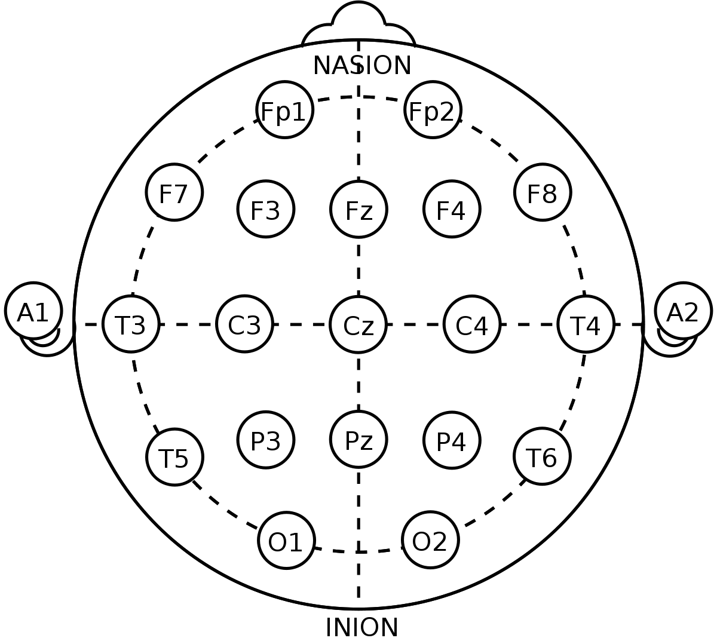
10-20 System: Electrode Placement
The names of the electrode sites use alphabetical abbreviations that identify the lobe or area of the brain which each electrode records from:
F = frontal
Fp = frontopolar
T = temporal
C = central
P = parietal
O = occipital
A = auricular (ear electrode)
The localization of the brain waves within the brain regions or lobes is further narrowed by adding electrodes, which are given numbers such as T3, T4, P3, P4. Even numbers identify electrode positions on the right side of the head, and odd numbers refer to the left side. The label "z" points to electrode sites in the midline of the head. For example, Cz refers to the midline central region of the head.
The 10–20 system or International 10–20 system is an internationally recognized method to describe and apply the location of scalp electrodes in the context of an EEG exam, polysomnography sleep study, or voluntary lab research.

Slide 9
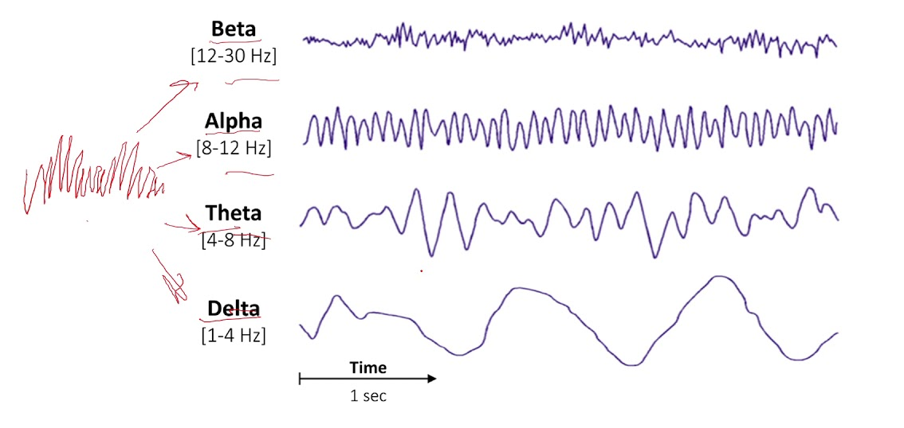
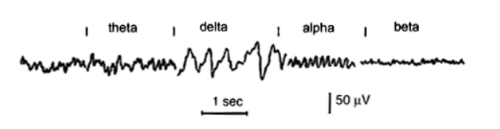
EEG signal
Classifications of an EEG signal
1. Alpha waves are related to relaxation and attention. They are present when you are awake with your eyes closed. They usually disappear when you open your eyes and pay attention to something.
2. Beta waves are normal in people who are awake. It doesn’t matter whether your eyes are open or closed. Certain drugs, such as sedatives, can influence these waves.
3. Theta waves are related to sleep. These slow waves are normal for all ages during sleep. They generally aren’t obvious when adults are awake.
4. Delta waves are also related to sleep. These waves are normal in adults who are in deep sleep and in young children.

Slide 10
How EEG data is created
How does an EEG work?
The billions of nerve cells in your brain produce very small electrical signals that form patterns called brain waves. During an EEG, small electrodes and wires are attached to your head. The electrodes detect your brain waves and the EEG machine amplifies the signals and records them in a wave pattern on graph paper or a computer screen
Who performs the test?
A technician can perform the test in the doctors office, a specially designed clinic, or in the hospital.
What happens during the test?
You will be asked to lie on a table or sit in a reclining chair. About 20 small electrodes will be attached to your head with washable glue. The technician may ask you to do several things during the test, such as asking you to open and close your eyes, breath deeply and rapidly (hyperventilation), or look at a flashing light. Most of the time you will just lie still with your eyes closed.

Slide 11
The process of collecting EEG data
1. The EEG data is collected using three EEG electrodes, each being the positive, negative and ground terminals respectively.
2. Since the signal measures in the unit of micro-volts it needs to be amplified using amplifier circuit. This circuit consists of five stages, namely, the Instrumentation Amplifier, 60 Hz Notch Filter, 31Hz Low Pass Filter, Gain Stage, and Clamper Circuit. Each of these stages contribute in their own way to amplify and also filter the noise from the EEG signal.
3. The EEG signal is observed on the cathode-ray oscilloscope and the data is collected on an Arduino Uno microcontroller using the Hyperterminal software.
4. The data is sampled at a sampling rate of 838 Hz. Any remaining noise from the signal can be removed by passing it through a digital low-pass filter, if required.
5. EEG data is collected from 10 people while they are made to concentrate on a particular thought. The subjects were asked to imagine moving an object towards the direction „Right‟ for the first 150 data sets collected and then the same for the direction „Left‟ for another 150 data sets. All the data was collected with complete supervision and without any kind of movement of the subject during the collection process

Slide 12
Tips on getting good EEG data
1. Run pilots
EEG experiments require careful preparation. You need to prepare the participants, spend some time on setting up the equipment and run initial tests.
2. “There is no substitute for clean data”
Clean data allows clean responses to your research questions! Always start with properly recorded data.
3. Make informed decisions
EEG data can be recorded and analyzed in a lot of different ways, and not only the processing steps themselves but also their sequence matters. All signal processing techniques alter the data to some extent and being aware of their impact on the data definitely helps to pick the right ones. By making sure that the methods of choice return the desired outcomes, you are able to maximize scientific research standards such as objectivity, reliability, and validity.
4. Attenuate or reject artifacts
EEG data contains relevant and irrelevant aspects. For example, one might be interested in event-related potentials time-locked to the onset of a specific visual stimulus. If the participant blinks at that very moment, the EEG might not reflect the cortical processes of seeing the stimulus on screen.

Slide 13
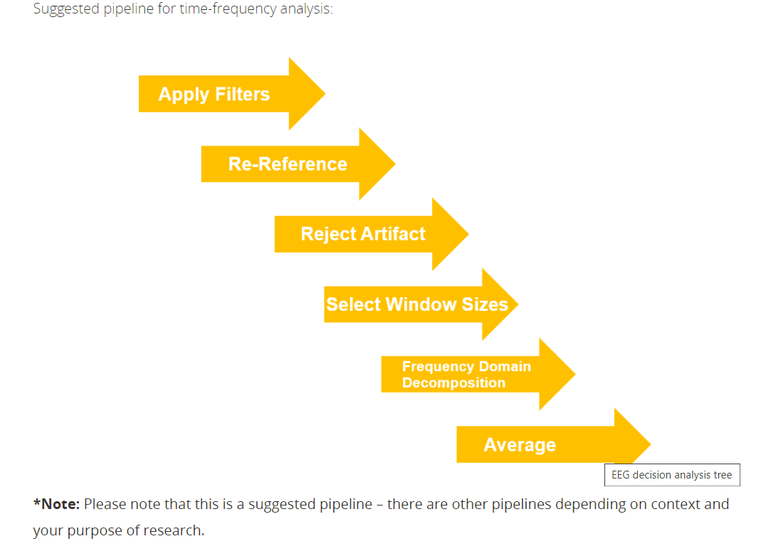

Slide 14
About the qEEG method
What is it?
Quantitative electroencephalography (QEEG) is a modern type of electroencephalography (EEG) analysis that involves recording digital EEG signals which are processed, transformed, and analyzed using complex mathematical algorithms.
Also called “brain mapping,” qEEG is a type of test that measures the electrical activity in the brain. In simple terms, the test measures brain waves the same way an electrocardiogram, or ECG, measures the heart's electrical activity.
How it works?
QEEG is noninvasive, painless, and safe to use. The electrodes in the cap that are placed on the scalp are like a “read-only” program that receives signals from the brain. The electrodes do not alter brain activity in any way; they simply reveal areas where brain wave activity is healthy, underactive, or overactive.

Slide 15
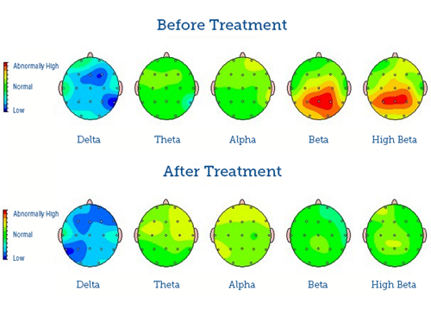
The qEEG test
Typically, the brain mapping test consists of 2 different parts: the recording of brainwaves and the creation of the multi-colored brain map.
Brainwave recording. The technician will record your brainwaves with your eyes open and closed. All you need to do is relax and sit still. Imagining yourself doing something relaxing, such as sitting on the beach sunbathing or getting a massage, can help you minimize movement and relax your muscles. The time needed to record brainwaves can vary, but usually, the process takes about 10 to 20 minutes.
Brain map creation. After the EEG technician has recorded your brainwaves, they will need to analyze the results of the qEEG. After they have completed a thorough analysis, the data is converted into a multi-colored brain map that they later review with you in person.
Methods of detecting mTBI
Quora, why use EEG for mTBI?
Brain tissue being compressed (image)
Where are the data come from?
When preprocessing data, knowing this, (how should you normalize)?
Example of an result using qEEG on a person who had ADHD, before treatment and after treatment

Slide 16
How are the brain maps are created using the data?
Quantitative Electroencephalography (qEEG) is a procedure that processes the recorded EEG activity from a multi-electrode recording using a computer. This multi-channel EEG data is processed with various algorithms, such as the “Fourier” classically, or in more modern applications “Wavelet” analysis). The digital data is statistically analyzed, sometimes comparing values with “normative” database reference values. The processed EEG is commonly converted into color maps of brain functioning called “Brain maps”.

Slide 17
Other Methods in EEG for detection of mTBI
Event-Related Potentials (ERPs)
event-related voltage changes in the ongoing EEG activity that are time-locked to sensory, motor, and cognitive events. ERPs can be used to identify and classify perceptual, memory and linguistic operations.
Advanced Signal Processing Technologies
Information Dynamics
Symbolic Dynamics
Graphy Theory

Slide 18
Methods in Machine Learning for mTBI detection
Rule-Based Algorithms: set of rules and conditions depending on which a decision is made on the category to which the input belongs to.
Decision-Trees
DT builds tree-structured models incrementally, as it breaks down the training dataset into smaller subsets
Random Forest
RF takes the majority vote of several decision trees’ prediction which are trained on different parts of the same dataset.
Support Vector Machine
SVM creates a hyperplane separating the classes by mapping data to a high dimensional feature space.
K-Nearest Neighbors
Based on feature similarity, KNN algorithm classify an object based on majority vote of its neighbors with the object being assigned to the class most common among its K-nearest neighbors
Neural Network
Convolutional Neural Network

Slide 19
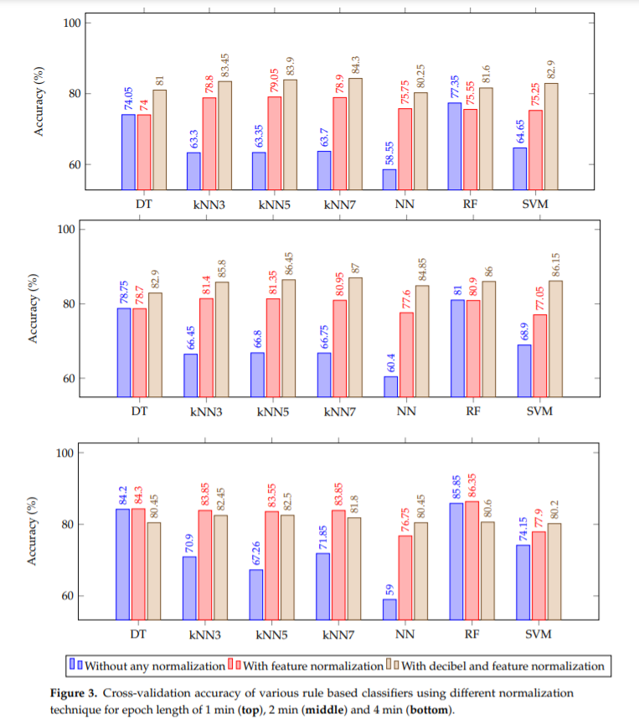
Results from the ML methods on mTBI detection

Slide 20
Interpretations of the qEEG method for detecting mTBI after reading the paper
qEEG provides, at best, an imperfect assessment of mTBI. The published literature does indicate, however, that it can be an important complement to other assessment procedures.
TBI is not a discrete (individually separate and distinct) clinical entity (concept used to define the nature of a disorder in order to facilitate diagnosis and intervention). Different injury events can initiate very different pathophysiological (the disordered physiological processes associated with disease or injury.) processes. It follows that, just as there is not a single test for cancer, there is not a single test for TBI.
qEEG measures are unlikely to discriminate (differentiate) between, for example, major depressive disorder, bipolar disorder, or TBI. The specificities observed in these clinical studies may well be lost in real world clinical practice.
In order to get the desired result in detecting mTBI, it requires acceptable test–retest reliability. To date, very few test–retest reliability studies have been published with qEEG data obtained from TBI patients. This is a particular concern because high variability is a known characteristic of the injured CNS.

Slide 21
