Slide 1
Indoor Localization with Bluetooth Low Energy Beacons
Rohan Gupta
Yi-Sung Chiu

Slide 2
Outline
Quick Review
Implementation Setup
Calibration
Localization
Performance Evaluation
Conclusion
Demonstration

Slide 3
Review: Localization Schemes
Quick Review
Implementation
Calibration
Localization
Localization
Evaluation
Conclusion
Phase One
Distance Estimation
Phase Two
Position Estimation
RSSI
AoA
ToA
TDoA
Trilateration
Triangulation
Multilateration

Slide 4
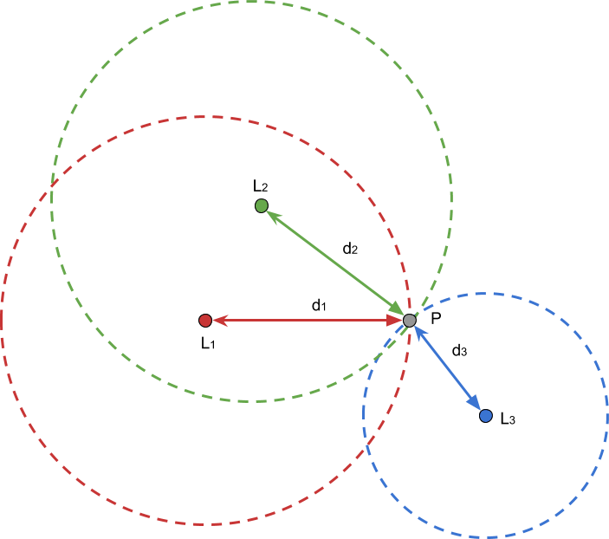
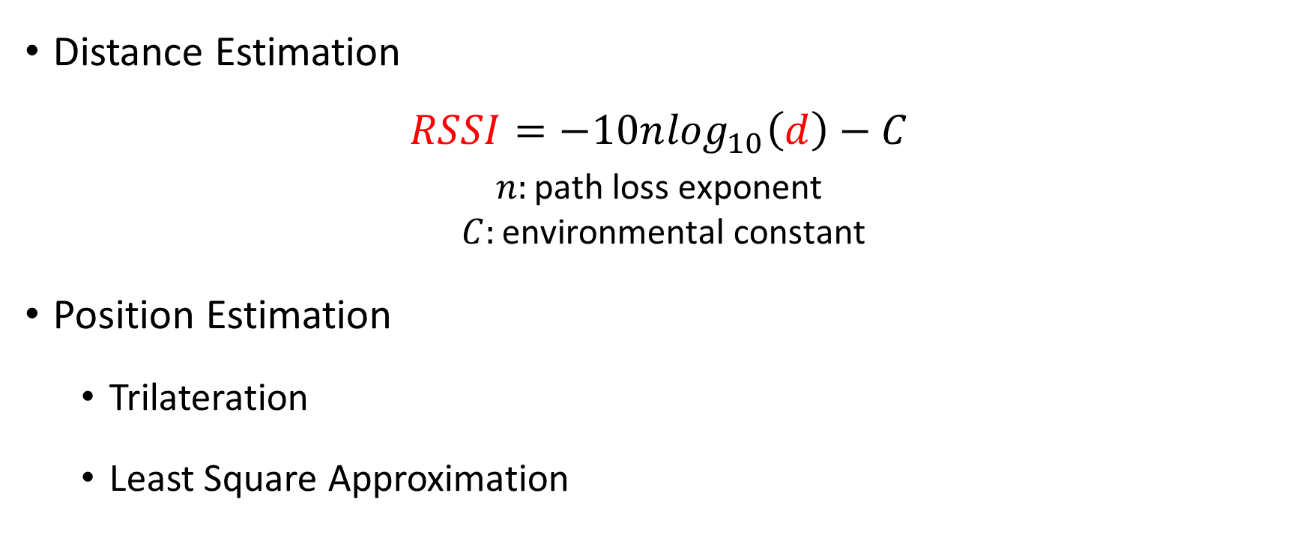
Review: RSSI-based Localization
Quick Review
Implementation
Calibration
Localization
Evaluation
Distance Estimation
$$RSSI=−10n\log_{10}\left(d\right)−C$$
$$n:\text{path} \text{loss} \text{exponent}$$
$$C:\text{environmental} \text{constant}$$
Position Estimation
Trilateration
Least Square Approximation
Conclusion

Slide 5


Review: RSSI-based Localization
Quick Review
Implementation
Calibration
Localization
Evaluation
Characteristics
Low accuracy
Low complexity
Power saving
No time synchronization
Conclusion

Slide 6
Implementation Setup
Quick Review
Implementation
Calibration
Localization
Calibration
Stage 1
Calibration
Stage 2
Localization
Stage 1
Localization
Stage 2
Evaluation
Conclusion
Fix beacons at known distance
Measure RSSI at receiver

Slide 7
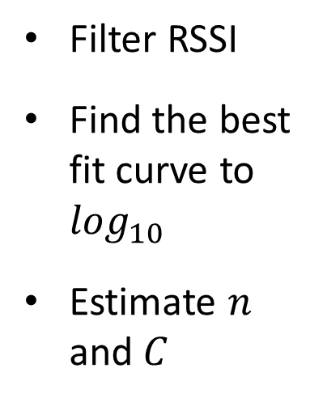
Implementation Setup
Quick Review
Implementation
Calibration
Localization
Calibration
Stage 1
Calibration
Stage 2
Localization
Stage 1
Localization
Stage 2
Evaluation
Conclusion
Filter RSSI
Find the best fit curve to $\log_{10}$
Estimate $n$ and $C$

Slide 8
Implementation Setup
Quick Review
Implementation
Calibration
Localization
Calibration
Stage 1
Calibration
Stage 2
Localization
Stage 1
Localization
Stage 2
Evaluation
Conclusion
Measure RSSI of target
Estimate distance with model

Slide 9
Implementation Setup
Quick Review
Implementation
Calibration
Localization
Calibration
Stage 1
Calibration
Stage 2
Localization
Stage 1
Localization
Stage 2
Evaluation
Conclusion
Heuristics
Trilateration

Slide 10
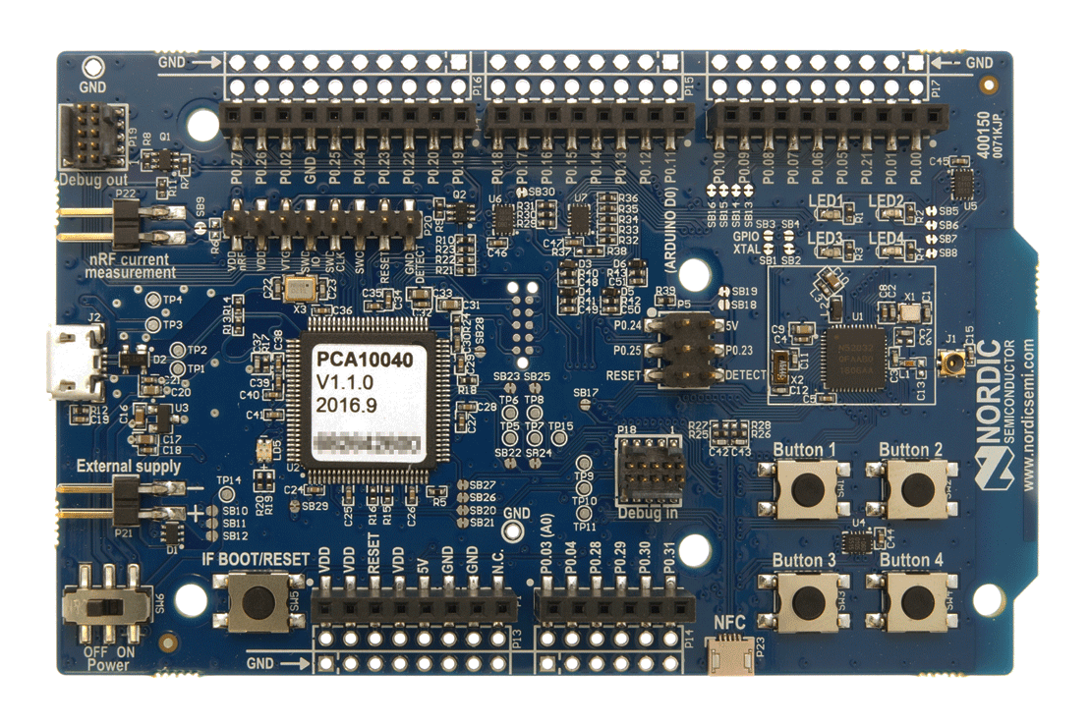


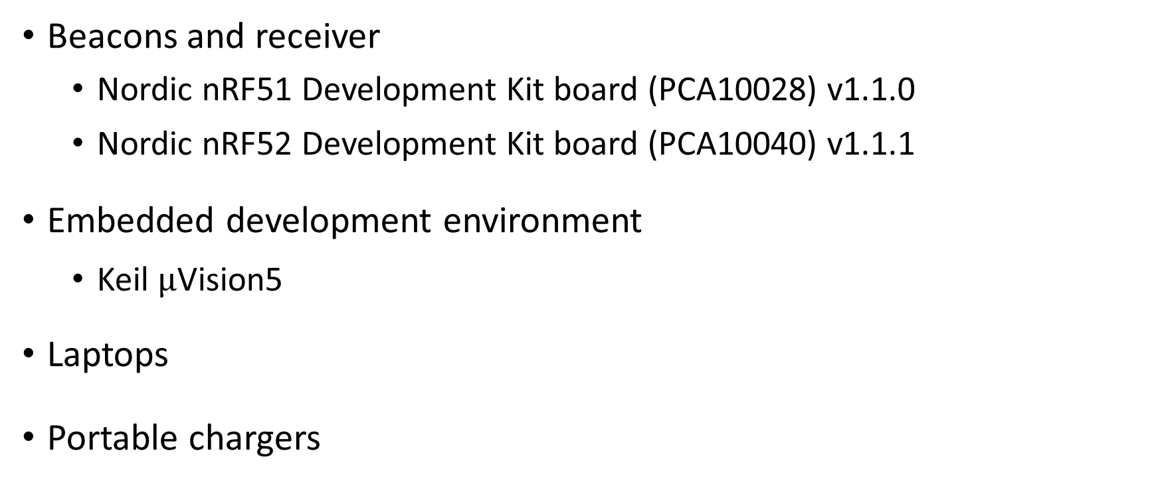
Implementation Setup
Quick Review
Implementation
Calibration
Localization
Beacons and receiver
Nordic nRF51 Development Kit board (PCA10028) v1.1.0
Nordic nRF52 Development Kit board (PCA10040) v1.1.1
Embedded development environment
Keil $μ$Vision5
Laptops
Portable chargers
Evaluation
Conclusion

Slide 11
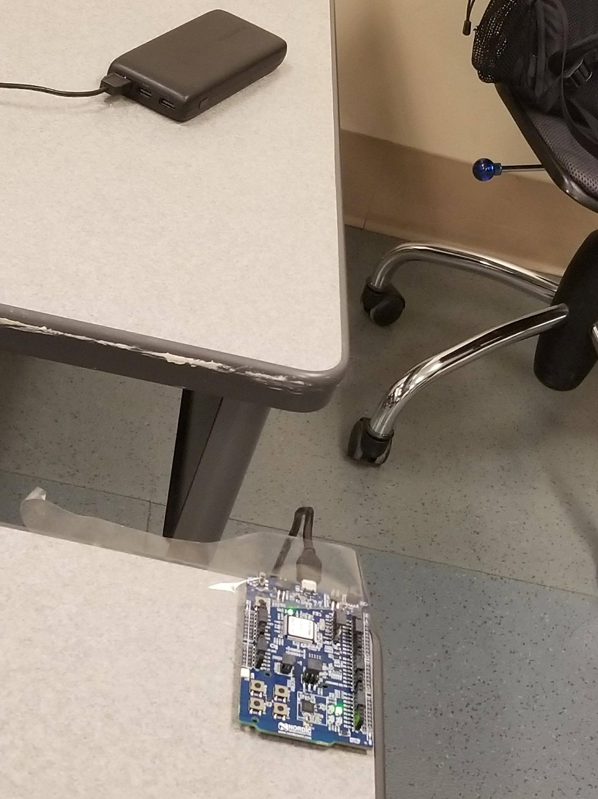
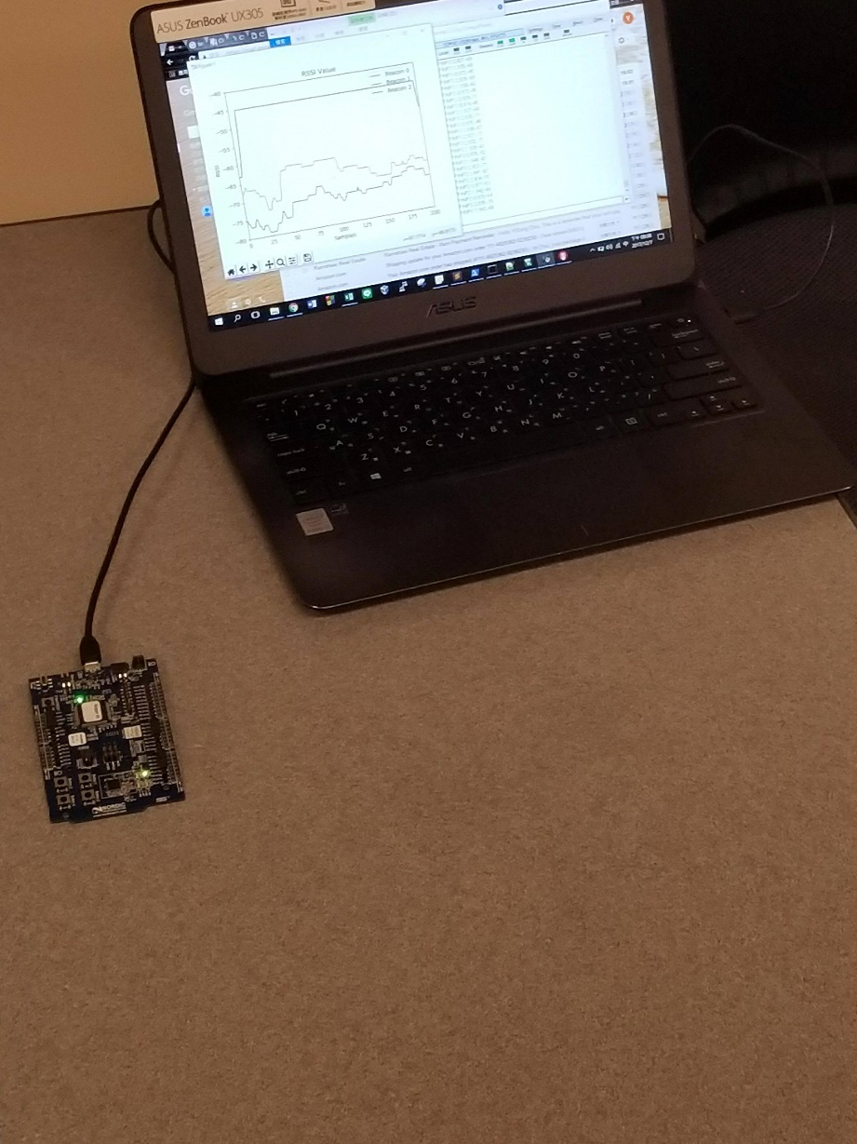
Implementation Setup
Quick Review
Implementation
Calibration
Localization
Evaluation
Conclusion
Portable Charger
Target
Beacon

Slide 12
Filter
Quick Review
Implementation
Calibration
Localization
RSSI samples can have variations in noisy environment
Filter type
Average filter
Median filter
Filter frame size
5, 10, 20 and 100
Evaluation
Conclusion

Slide 13
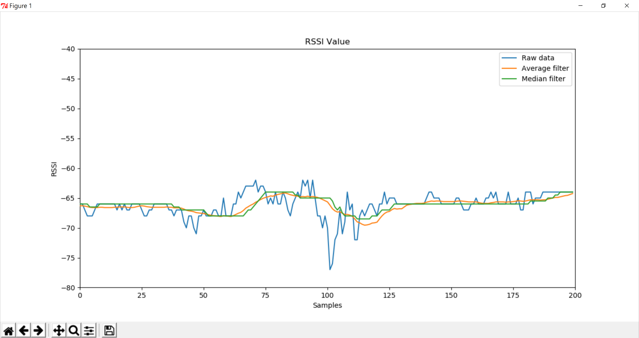
Filter Type
Quick Review
Implementation
Calibration
Localization
Evaluation
Conclusion

Slide 14
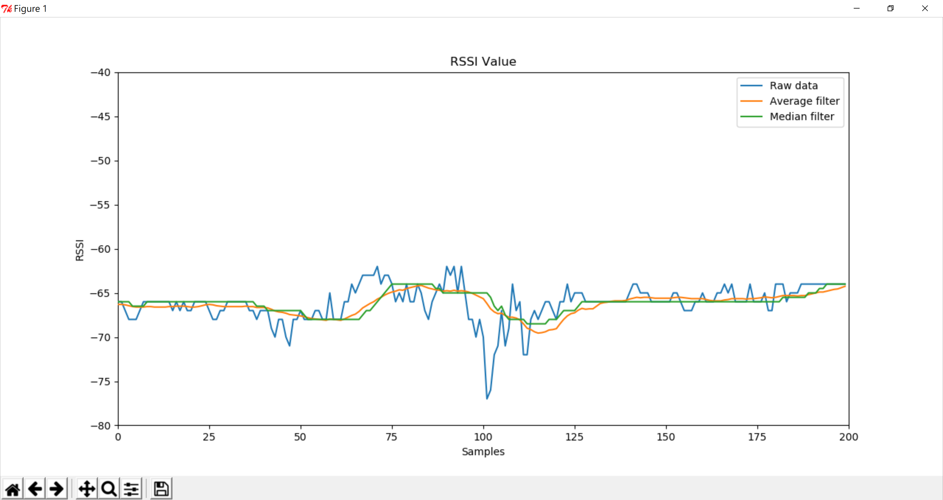
Filter Type
Quick Review
Implementation
M
Calibration
Localization
Evaluation
Conclusion
Median filter is less susceptible to dramatic variation

Slide 15
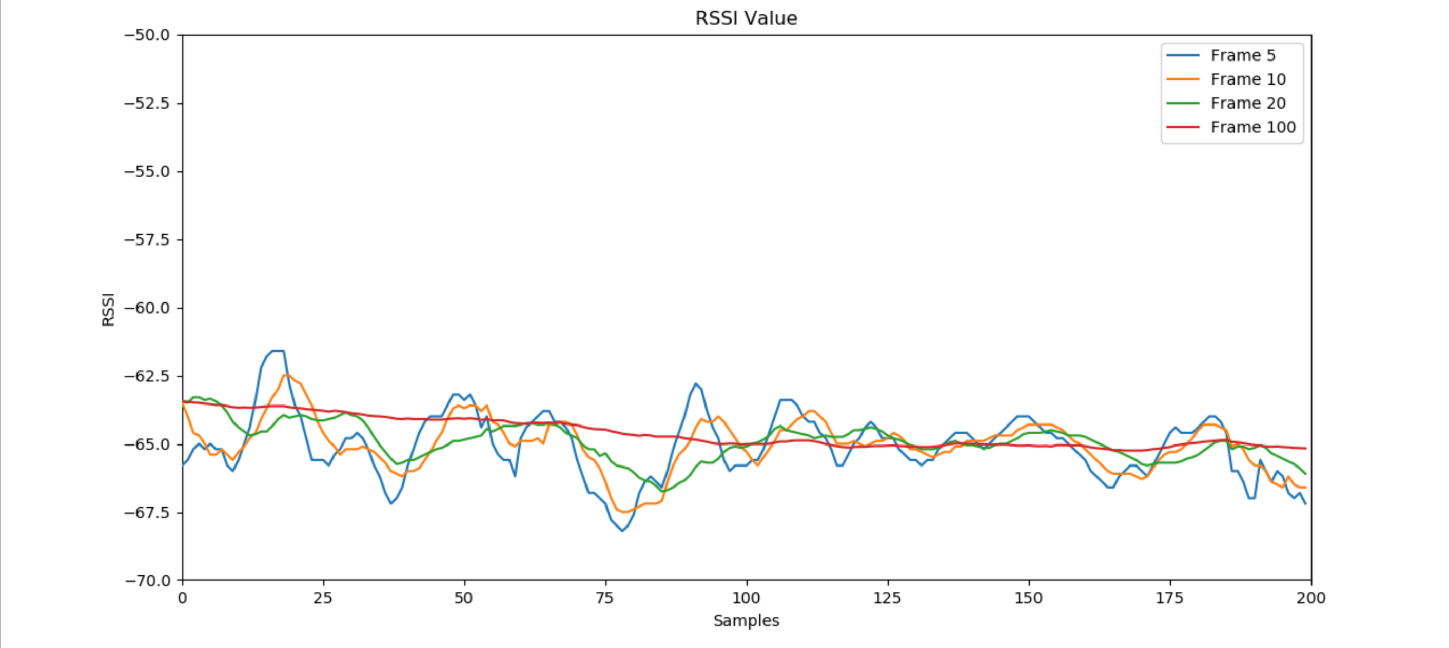
Filter Frame Size
Quick Review
Implementation
Calibration
Localization
Evaluation
Conclusion

Slide 16
Calibration
Quick Review
Implementation
Calibration
Localization
Evaluation
Three beacon and one receiver at known distance
Calibrate with the receiver at difference position
Beacon broadcasts advertisement in an interval of 100ms
Receiver measures RSSI values with filter
Sample three times at each position
Conclusion

Slide 17
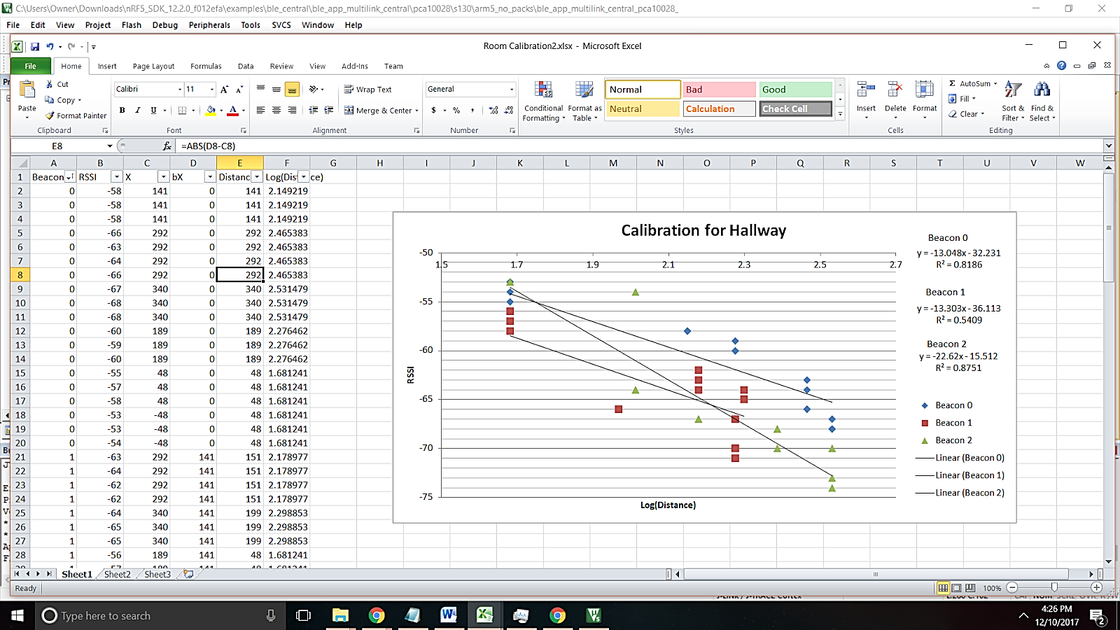
Calibration
Quick Review
Implementation
Calibration
Localization
Evaluation
Conclusion

Slide 18
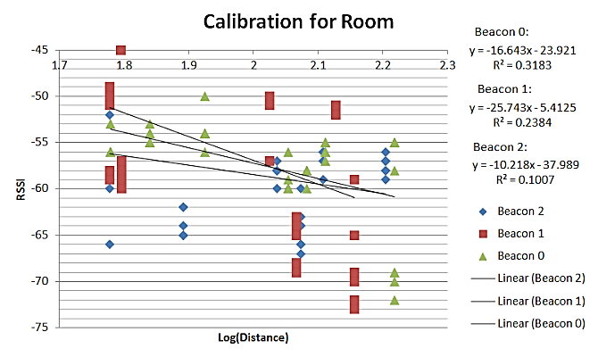
Calibration
Quick Review
Implementation
Calibration
Localization
Evaluation
Conclusion

Slide 19
Localization
Quick Review
Implementation
Calibration
Localization
Evaluation
Three beacons and one target
Beacons broadcast advertisement with their own identity
Target measures RSSI values with filter
Target estimates distance to each beacons and performs trilateration to locate itself
Target performs this localization procedure periodically in 1 seconds
Conclusion

Slide 20
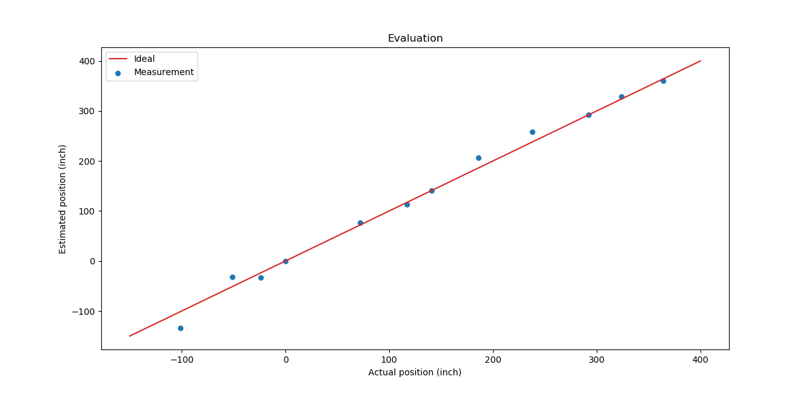
Performance Evaluation
Quick Review
Implementation
Calibration
Localization
Evaluation
Conclusion

Slide 21
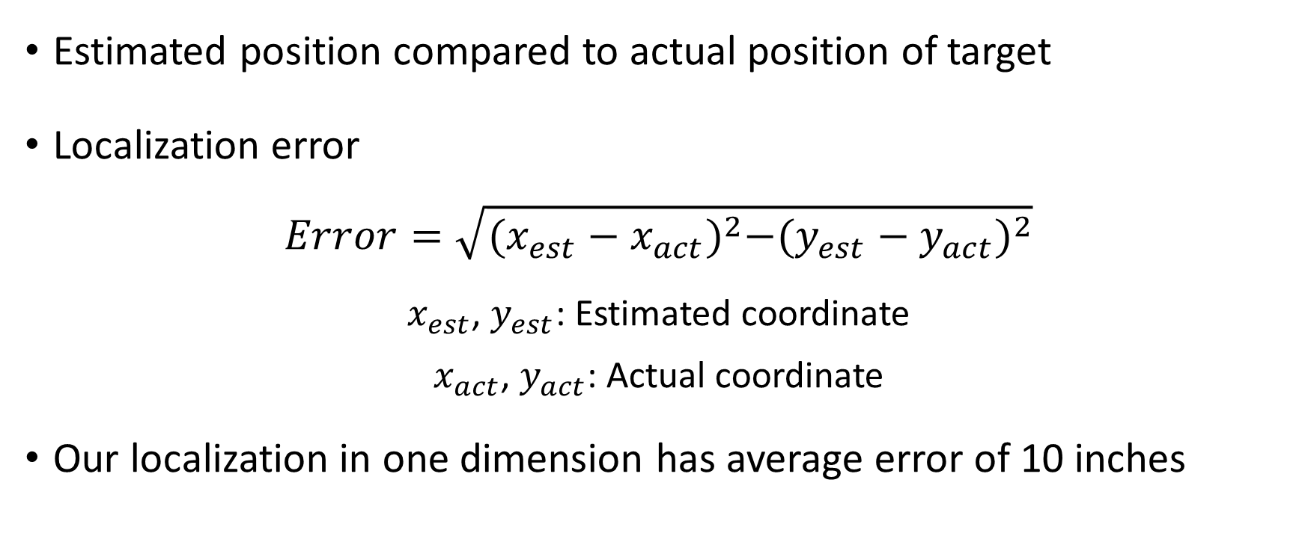
Performance Evaluation
Quick Review
Implementation
Calibration
Localization
Evaluation
Estimated position compared to actual position of target
Localization error
$$Error=\sqrt{{(x_{est}−x_{act})}^{2}−{(y_{est}−y_{act})}^{2}}$$
$x_{est}$, $y_{est}$: Estimated coordinate
$x_{act}$, $y_{act}$: Actual coordinate
Our localization in one dimension has average error of 10 inches
Conclusion

Slide 22
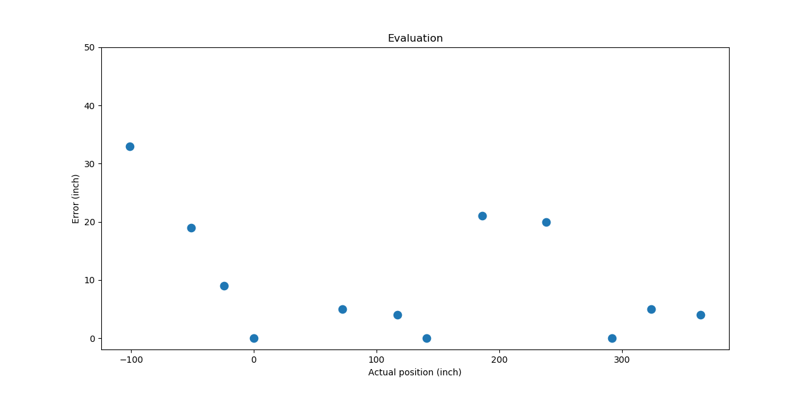
Performance Evaluation
Quick Review
Implementation
Calibration
Localization
Evaluation
Conclusion

Slide 23
Conclusion
Quick Review
Implementation
Calibration
Localization
Evaluation
Implement RSSI-based localization
Perform filter to reduce interference of noise
Median filter
Frame size 5
Experimental result shows our localization accuracy at 1D can be 10 inches
Conclusion

Slide 24
Demo

