Slide 1
SDN/OpenFlow/NFV Workshop

Slide 2
Yi-Sung Chiu
NCTU major in SDN/NFV
ONOS, free5GC contributor
Experience
Attended ONF brigade in 2018 and 2019

Slide 3
Agenda
Software-Defined Network (SDN)
Open vSwitch (OvS) and Mininet
Try Mininet/OvS Command
Custom Mininet Topology
Ryu and OpenFlow Rule
Run Ryu Built-in Application
Capture OpenFlow Packet
Install OpenFlow Rule with REST
Ryu Application
Path Service
Proxy ARP

Slide 4
Before We Start
Please make sure you run up our provided VM
Install the Github repository used for exercises in this workshop
https://github.com/stevenchiu30801/cht-workshop

Slide 5
Software-Defined Network (SDN)
Introduction

Slide 6
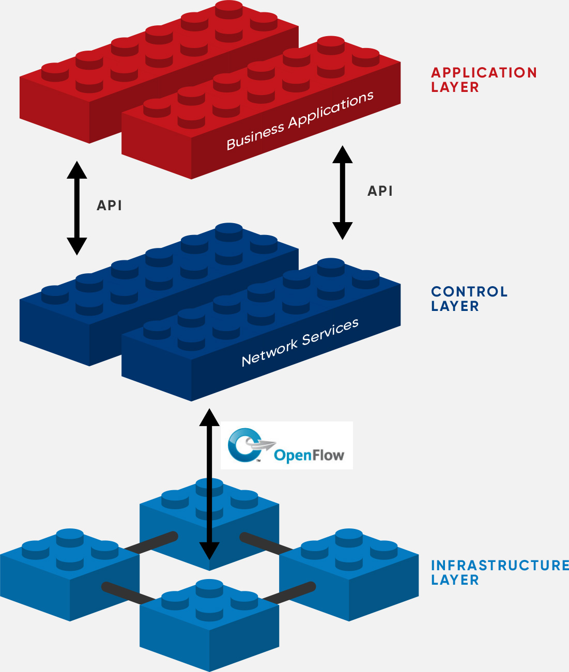
SDN Architecture
Network control become directly programmable
Network intelligence is (logically) centralized with a global view of network
Underlying infrastructure is abstracted for applications and network services

Slide 7
Open vSwitch (OvS) and Mininet
Introduction

Slide 8
Why Open vSwitch?
Hypervisors need to bridge traffic between VMs and with outside world
The built-in L2 switch (the Linux bridge) is used
In multi-server virtualization deployment, the Linux bridge is not well suited
Highly dynamic end-points
Maintenance of logical abstractions
(sometimes) Integration with or offloading to special purpose switching hardware
Notes:
The mobility of state/Responding to network dynamics
All network state should be easily identifiable and migratable between different hosts.
Configuration and live network state could be migrated easily with existence of OvS database.
Also, with the support of OpenFlow protocol, network control becomes directly programmable.

Slide 9

Open vSwitch (OvS)
A software-implemented virtual switch
Support many legacy network protocol
IPv6
Multiple tunneling protocols (GRE, VXLAN, etc.)
Etc.
Support latest OpenFlow protocol (version 1.5)

Slide 10
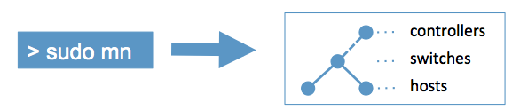
Mininet Overview
A network emulator which creates a virtual network on a single machine
Including virtual hosts, switches, controllers, and links
Provides a simple network testbed for developing SDN applications

Slide 11
How Mininet Works?
Host
Created with network namespace, a lightweight virtualization feature, to provide separated network environment
Switch
Created with Open vSwitch
All switches are placed in root namespace by default
Link
Use virtual Ethernet (veth) pairs
Controller
Use OpenFlow reference controller which implements a bridge/learning switch
Does not implement a spanning-tree protocol by default
Notes:
OpenFlow reference controller in Mininet
https://github.com/mininet/mininet/wiki/FAQ#why-does-my-controller-which-implements-an-ethernet-bridge-or-learning-switch-not-work-with-my-network-which-has-loops-in-it-i-cant-ping-anything
Mininet currently depends on the Linux kernel

Slide 12
Open vSwitch (OvS) and Mininet
Try Mininet/OvS Command

Slide 13
Run Mininet
Start a minimal topology
Change topology size and type
Cleanup Mininet
$ sudo mn
$ sudo mn --topo single,3 # single switch with three hosts attached
$ sudo mn --topo tree,2 # one switch connected to two edge switches and \
two hosts attached to each of edge switches
$ sudo mn -c

Slide 14
Mininet CLI Commands
Display Mininet CLI commands
Display nodes
Display links
mininet> help
mininet> nodes
mininet> net

Slide 15
Interact with Mininet Hosts and Switches (I)
Show network interface on host h1
Ping host h2 from host h1
Test connectivity between all hosts
mininet> h1 ifconfig
mininet> h1 ping -c 1 h2
mininet> pingall # This is a Mininet built-in command

Slide 16
Interact with Mininet Hosts and Switches (II)
Run a simple web server and client
XTerm Display
For more Mininet commands, Please refer to http://mininet.org/walkthrough/.
mininet> h1 python -m SimpleHTTPServer 80 &
mininet> h2 wget -O - h1
…
mininet> h1 kill %python
mininet> xterm h1 # This is a Mininet built-in command

Slide 17
It’s Your Turn
Start a Mininet topology
Display node and link information
Ping a host from another to check connectivity

Slide 18
OvS Commands
ovs-vsctl
Utility for querying and configuring ovs-vswitchd
http://www.openvswitch.org/support/dist-docs/ovs-vsctl.8.txt
ovs-ofctl
Administer OpenFlow switches
http://www.openvswitch.org/support/dist-docs/ovs-ofctl.8.txt
ovs-dpctl
Administer Open vSwitch datapaths
http://www.openvswitch.org/support/dist-docs/ovs-dpctl.8.txt
ovs-appctl
Utility for configuring running Open vSwitch daemons
http://www.openvswitch.org/support/dist-docs/ovs-appctl.8.txt
Notes:
Also refer to http://therandomsecurityguy.com/openvswitch-cheat-sheet/.

Slide 19
ovs-vsctl (I)
Print version information of Open vSwitch
Print a brief overview of switch database contents
Print a list of configured bridges and ports on a specific bridge
mininet> sh ovs-vsctl -V # Or `s1 ovs-vsctl -V`
mininet> sh ovs-vsctl show
mininet> sh ovs-vsctl list-br
mininet> sh ovs-vsctl list-ports <bridge> # e.g. `s1 ovs-vsctl list-ports s1`

Slide 20
ovs-vsctl (II)
Initialize Open vSwitch database
Create a new bridge and a new port on a specific bridge
Set one or more configured controllers and controller failure mode
mininet> sh ovs-vsctl init
mininet> sh ovs-vsctl add-br <bridge>
mininet> sh ovs-vsctl add-port <bridge> <port>
mininet> sh ovs-vsctl set-controller <bridge> <target…>
mininet> sh ovs-vsctl set-fail-mode <bridge> standalone|secure

Slide 21
ovs-ofctl (I)
Print information on switch flow tables and ports
Print all flow entries in switch’s tables
Add flow entries to switch’s table
mininet> sh ovs-ofctl show
mininet> sh ovs-ofctl [-O version] dump-flows <bridge> # e.g. `sh ovs-ofctl -O OpenFlow13 dump-flows s1`
mininet> sh ovs-ofctl add-flow <bridge> <flow>

Slide 22
It’s Your Turn
Start a minimal Mininet topology
Install a flow entry using normal non-OpenFlow pipeline and outputting
Check connectivity
Delete the flow entry
Install flow entries matching Ethernet destination address and output to port
mininet> sh ovs-ofctl add-flow s1 actions=normal
mininet> sh ovs-ofctl del-flows s1
mininet> sh ovs-ofctl add-flow s1 eth_dst=f6:db:e3:88:de:2c,actions=output:1

Slide 23
Questions
How to perform multicasting?
How about priority of flow entries?
How to drop packets?

Slide 24
Open vSwitch (OvS) and Mininet
Custom Mininet Topology

Slide 25
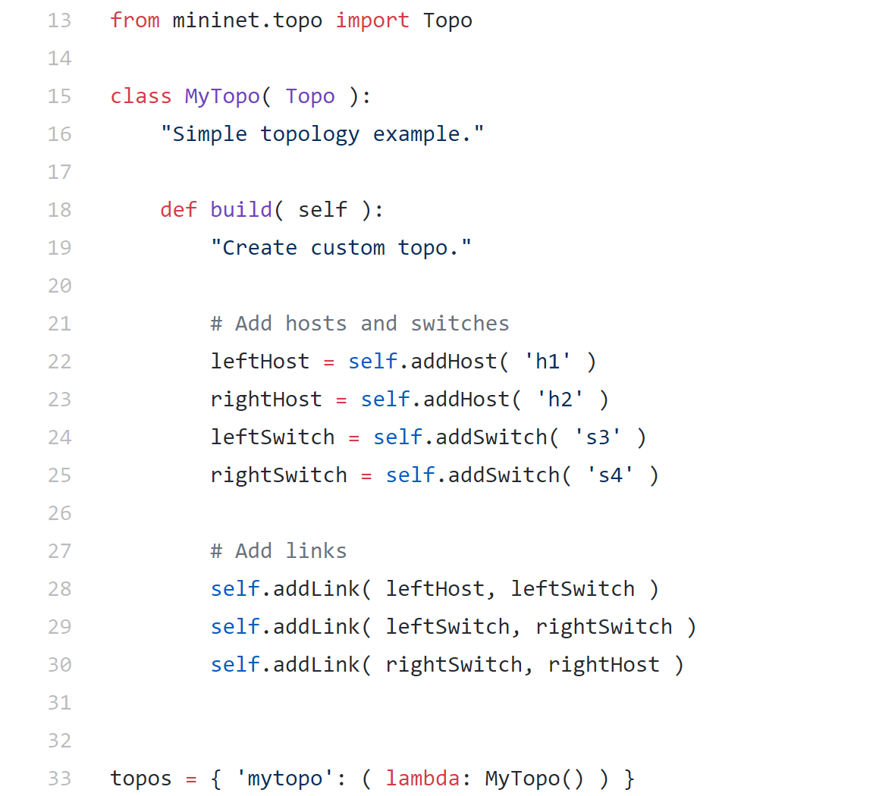

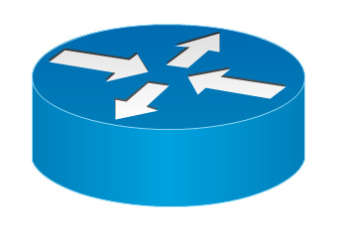
Custom Mininet Topology
self.addLink()
self.addHost()
self.addSwitch()

Slide 26
It’s Your Turn
Please check cht-workshop
Try to construct a 2x2 leaf-spine topology as follow
Spine Switch
Leaf Switch

Slide 27
Questions
Can all hosts reach to each other?
If not, why?

Slide 28
Ryu and OpenFlow Rule
Introduction

Slide 29
Ryu
SDN Framework
Python library for SDN
Apache v2 license
Features
OpenFlow
Version 1.0, 1.2, 1.3, 1.4
Parsing and building various protocols packets
IP, TCP, UDP, MPLS, OSPF, PBB, etc
BGP, VRRP, BFD, BMP…

Slide 30
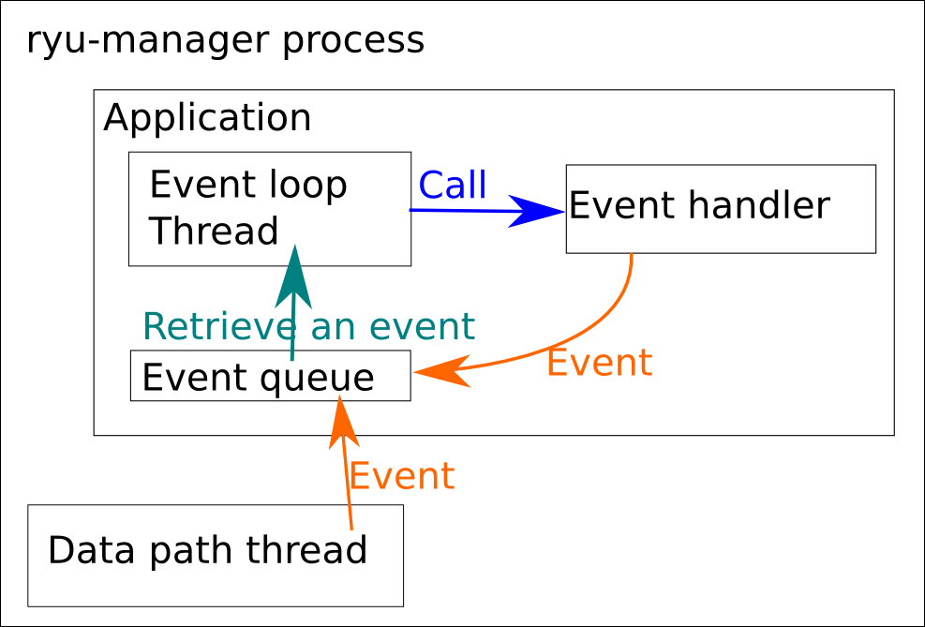
Ryu Architecture

Slide 31
OSI Layers
Physical
Data-Link
Network
Transport
Session
Presentation
Application

Slide 32
Each Layer Network Devices
Physical -> hub
Data-Link -> switch
Network -> router
Transport -> firewall
Session
Presentation
Application -> DPI, L7 firewall

Slide 33
OpenFlow Support Layer
Physical
Data-Link
Network
Transport
Session
Presentation
Application -> DPI, L7 firewall

Slide 34
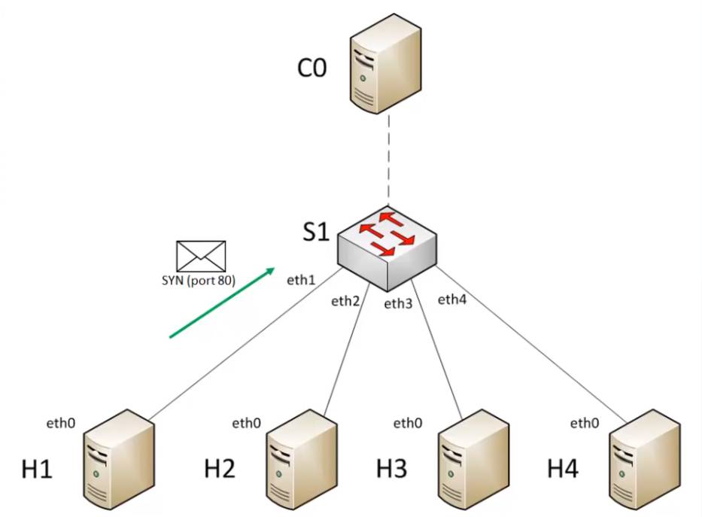
How OpenFlow Works?^{[5]}

Slide 35
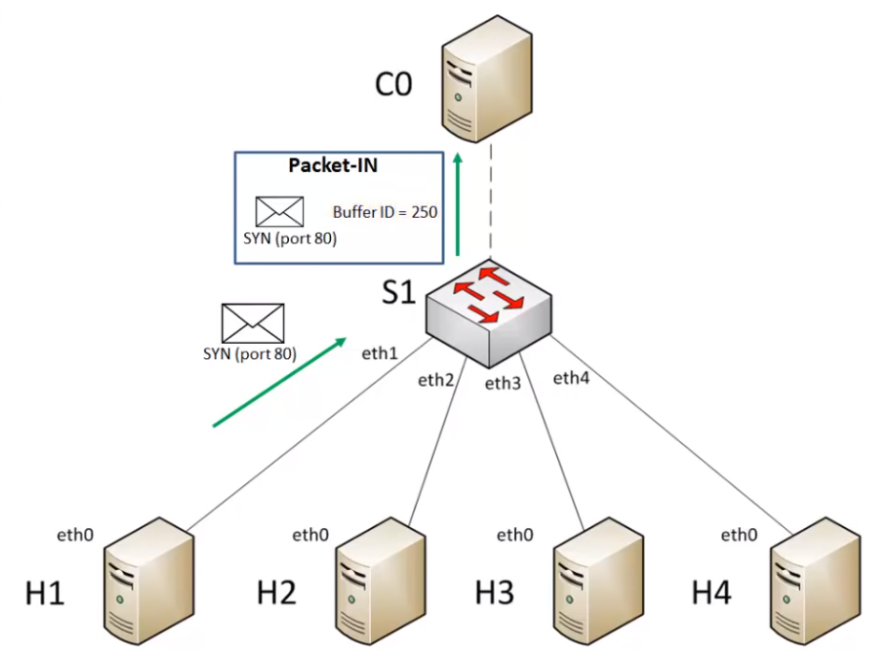
How OpenFlow Works?^{[5]}

Slide 36
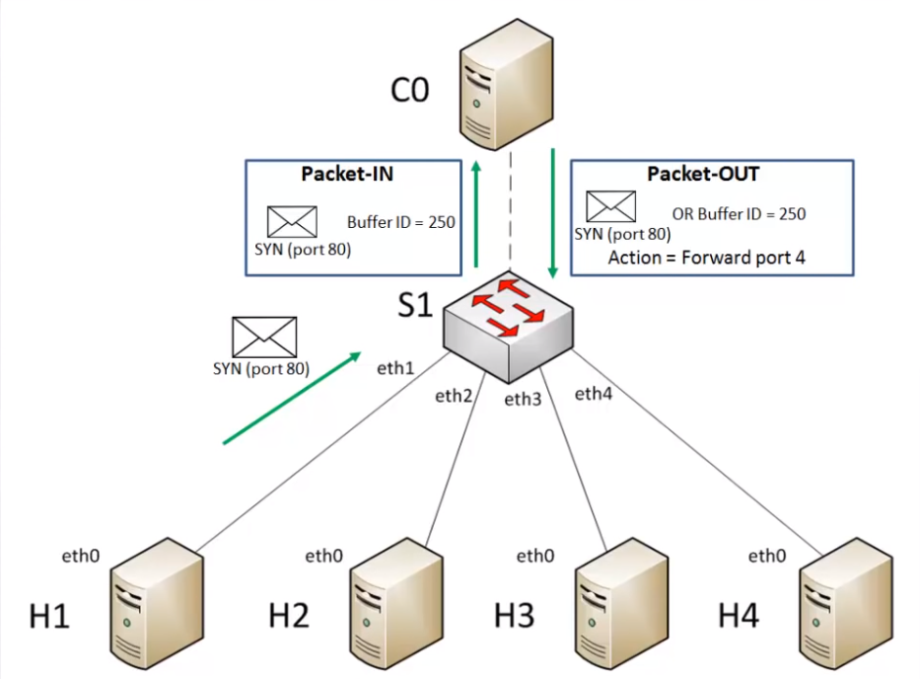
How OpenFlow Works?^{[5]}

Slide 37
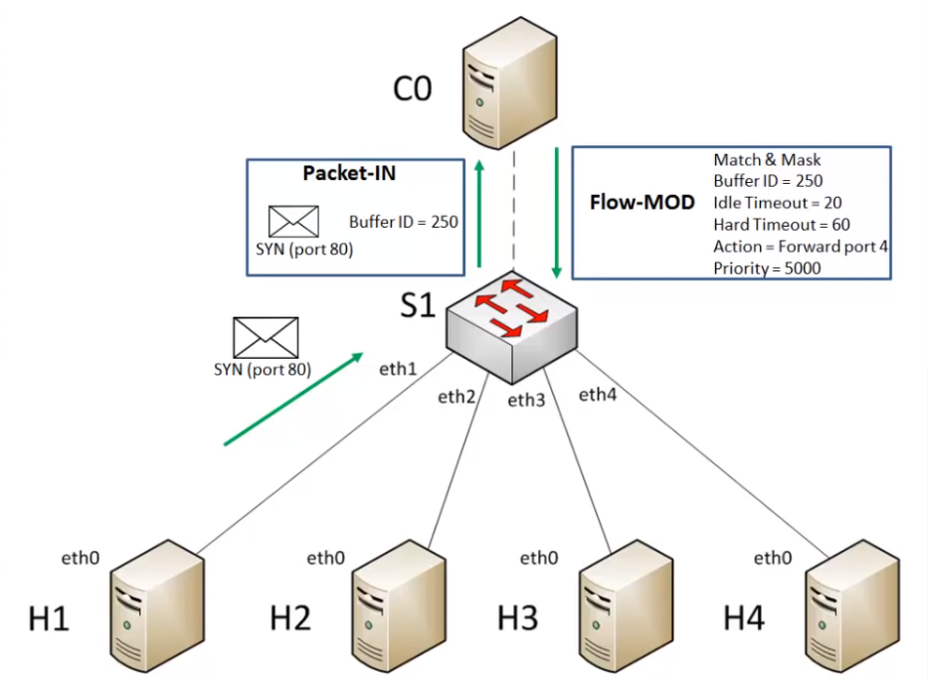
How OpenFlow Works?^{[5]}

Slide 38
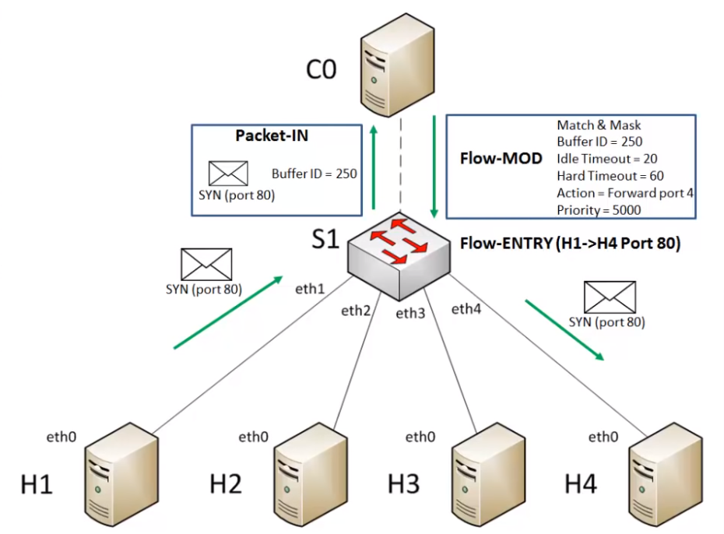
How OpenFlow Works?^{[5]}

Slide 39
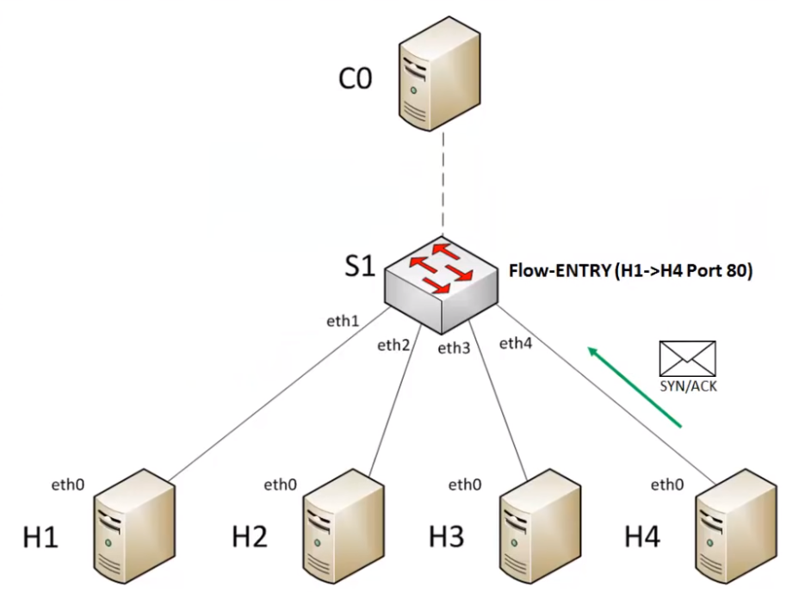
How OpenFlow Works?^{[5]}

Slide 40
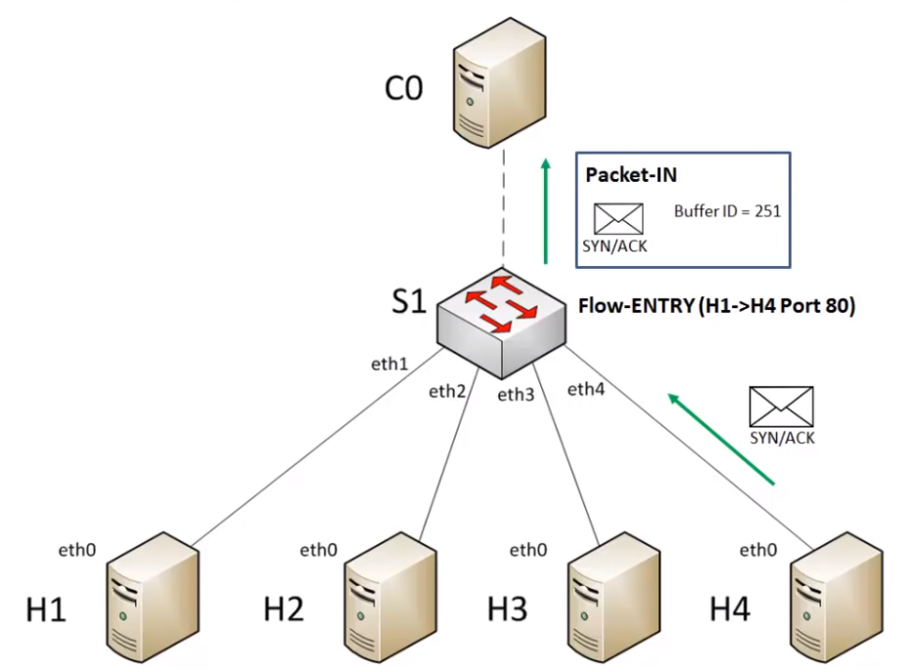
How OpenFlow Works?^{[5]}

Slide 41
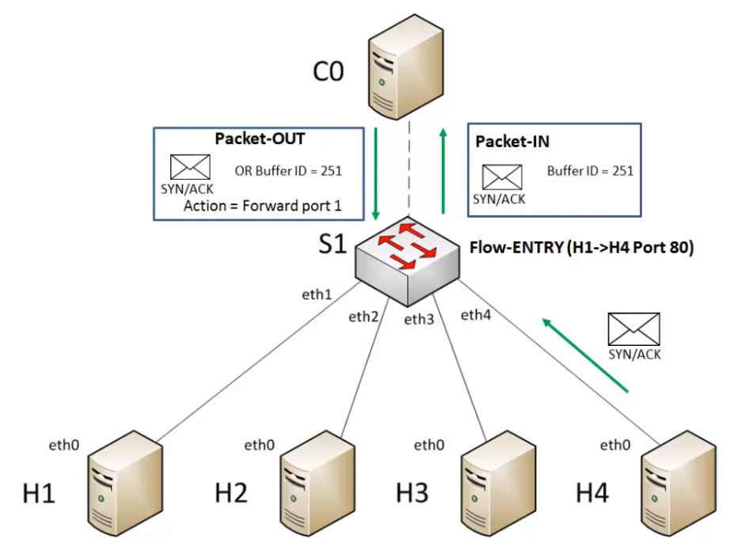
How OpenFlow Works?^{[5]}

Slide 42
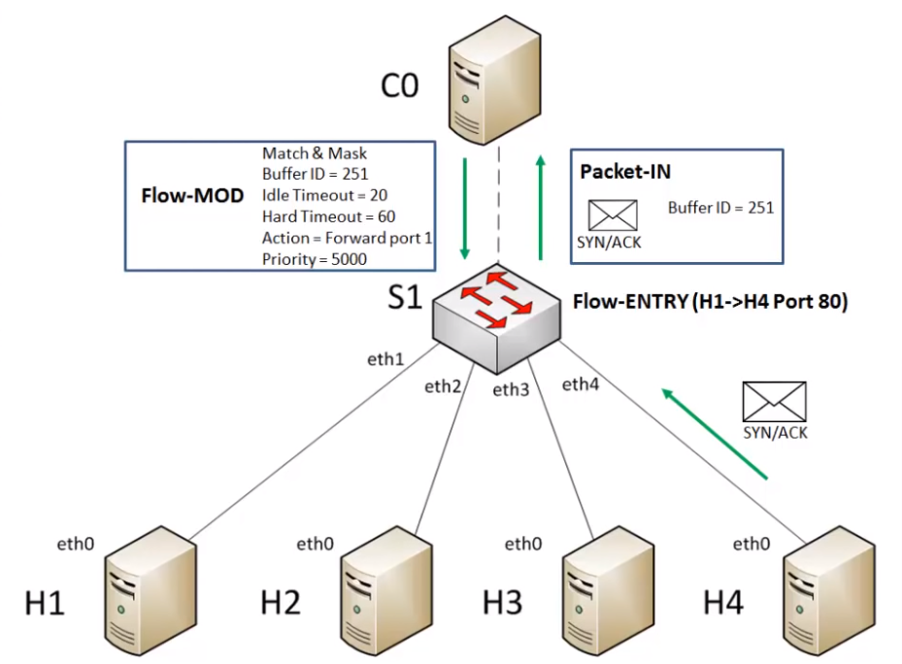
How OpenFlow Works?^{[5]}

Slide 43
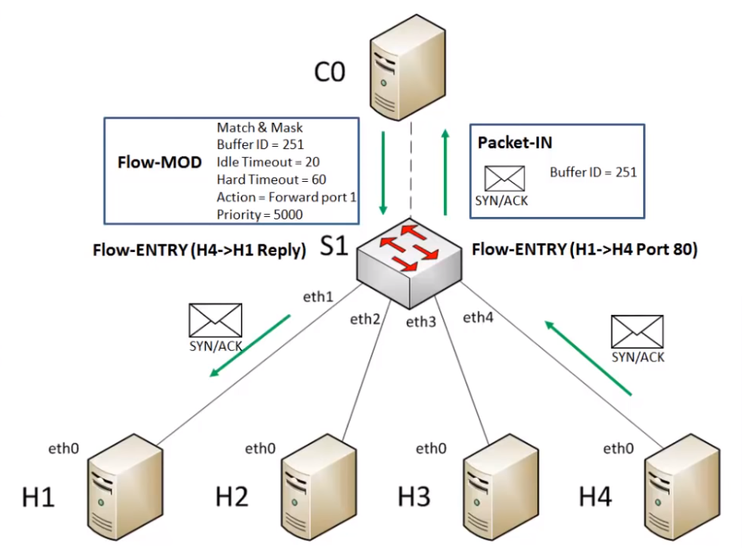
How OpenFlow Works?^{[5]}

Slide 44
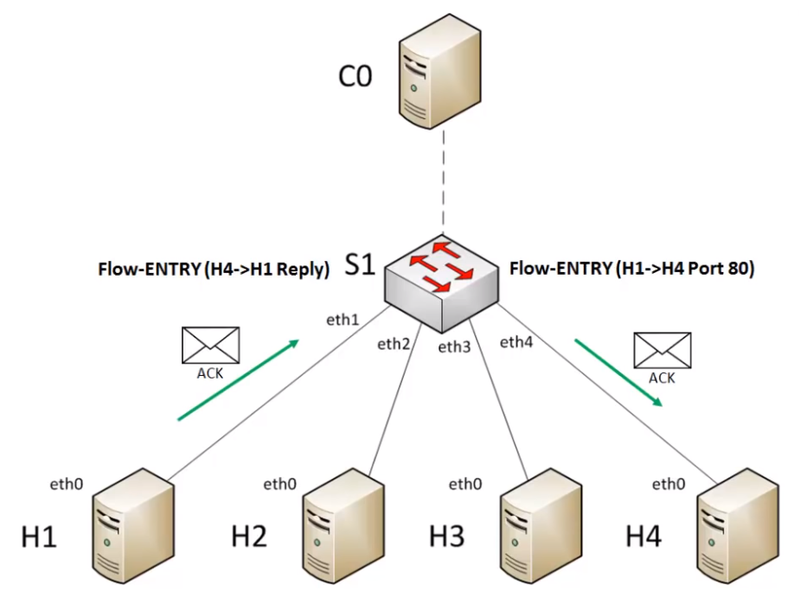
How OpenFlow Works?^{[5]}

Slide 45
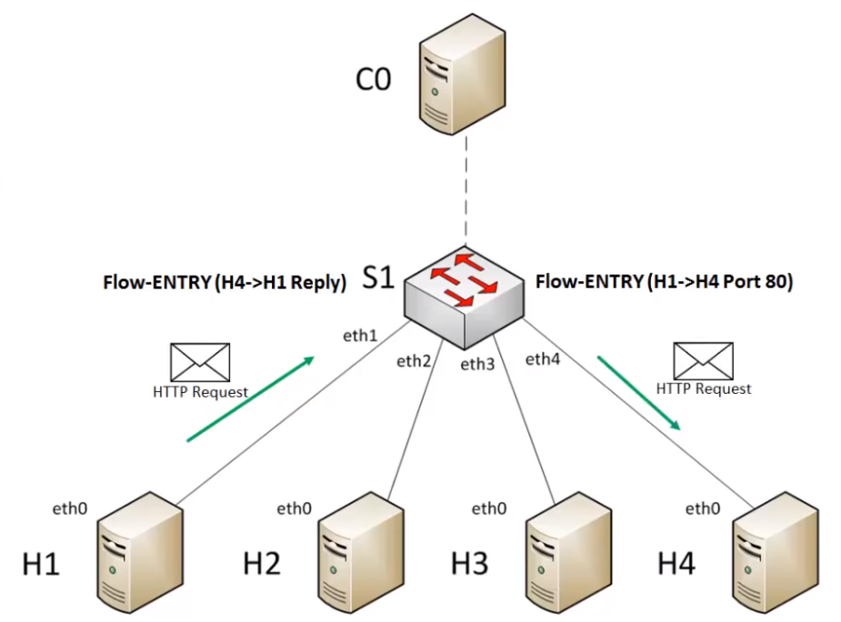
How OpenFlow Works?^{[5]}

Slide 46
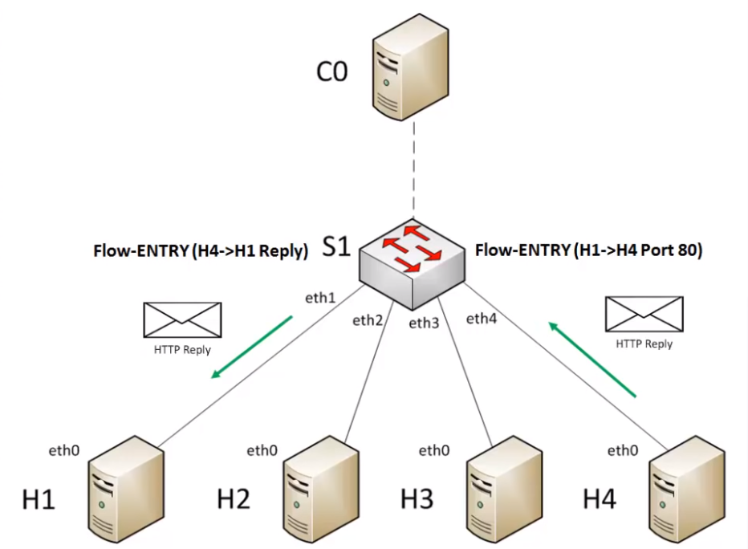
How OpenFlow Works?^{[5]}

Slide 47
OpenFlow Event
Controller to Switch messages
Features
Modify-State
Packet-out
Configuration, Read-State, Barrier, Role-Request, Asynochronous-Configuration
Switch to Controller Asynchronous Messages
Packet-In
Flow Removed
Port Status
Error
Switch to Controller Symmetric Messages
Hello
Echo Request / Reply
Experimenter

Slide 48
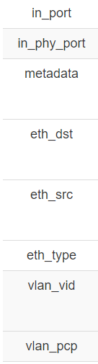
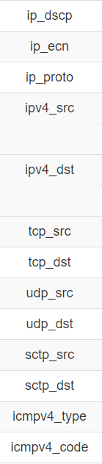
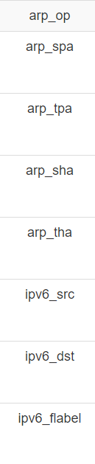
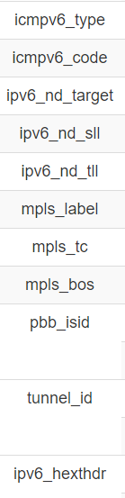
OpenFlow Match-field^{[6]}

Slide 49
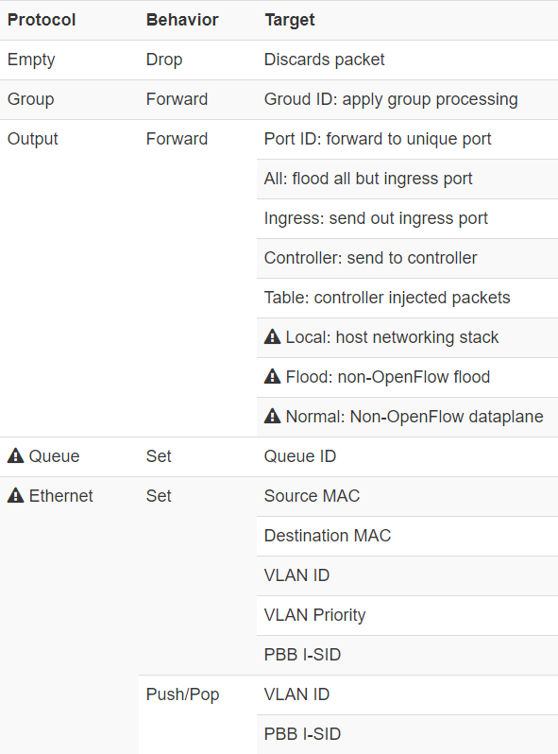
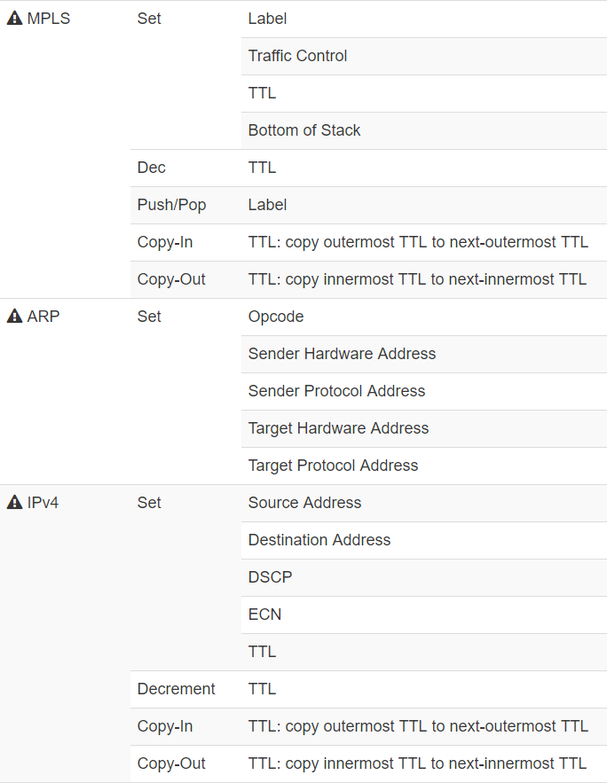
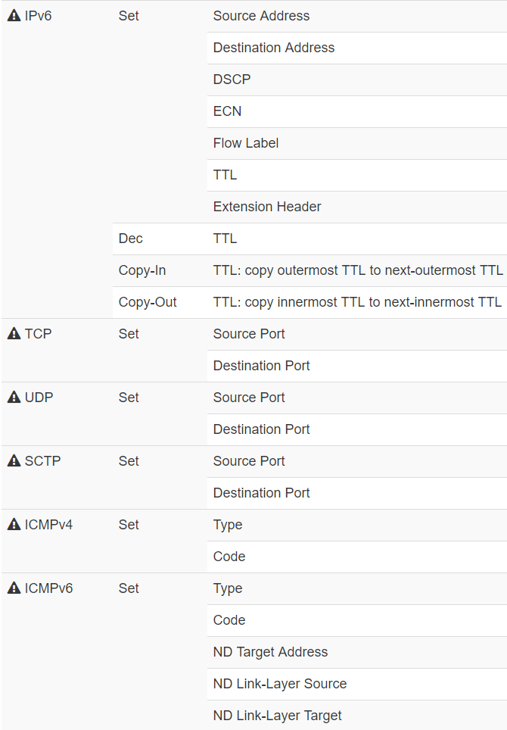
OpenFlow Actions ^{[6]}

Slide 50
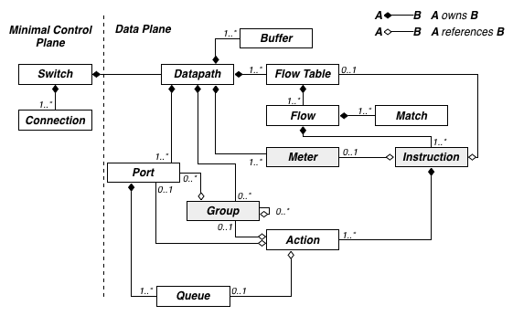
OpenFlow Other Functions
Group
Queue
Meter

Slide 51
Ryu and OpenFlow Rule
Run Ryu Built-in Application

Slide 52
Built-in Application
ryu.app.ofctl
Provides a convenient way to use OpenFlow messages synchronously.
Load Automatically
ryu.app.ofctl_rest
Provides REST APIs for retrieving the switch stats and Updating the switch stats.
Reference: https://ryu.readthedocs.io/en/latest/app/ofctl_rest.html
ryu.app.simple_switch_13
Performs MAC/source learning mechanism for packet forwarding.
ryu.app.gui_topology.gui_topology
Provides topology visualization.
Please add --observe-links flags to make Ryu discover links between devices
GUI can be access at http://<ryu-ip>:8080 on your web browser

Slide 53
It’s Your Turn (I)
Run Ryu built-in Simple Switch 13 application
Run a Mininet topology (without loop) and connect it to Ryu
Check if OvS in Mininet is connected to Ryu
Check connectivity
Dump flow entries on OvS and find details of match/action
$ ryu-manager ryu.app.simple_switch_13
$ sudo mn --controller=remote,ip=127.0.0.1,port=6653

Slide 54
It’s Your Turn (II)
Run Ryu built-in topology viewer application
Run a Mininet topology and connect it to Ryu
Check GUI on web browser
$ ryu-manager --observe-links ryu.app.gui_topology.gui_topology
$ sudo mn --topo=tree,2 --controller=remote,ip=127.0.0.1,port=6653

Slide 55
Ryu and OpenFlow Rule
Run OpenFlow in Real Switch

Slide 56
Pica8 OpenFlow Switch ^{[7]}
Porting the OpenVSwitch into the real switch with hardware ASIC accelerate.
Provides both L2/L3 legacy mode or OpenFlow mode
Use #picos_boot to switch
Some commands are different from mininet
Add Bridge
#ovs-vsctl add-br br0 -- set bridge br0 datapath_type=pica8
Add Ports
#ovs-vsctl add-port br0 ge-1/1/1 -- set interface ge-1/1/1 type=pica8
Set controller
#ovs-vsctl set-controller br0 tcp:192.168.100.1:6633

Slide 57
Ryu and OpenFlow Rule
Capture OpenFlow Packet

Slide 58
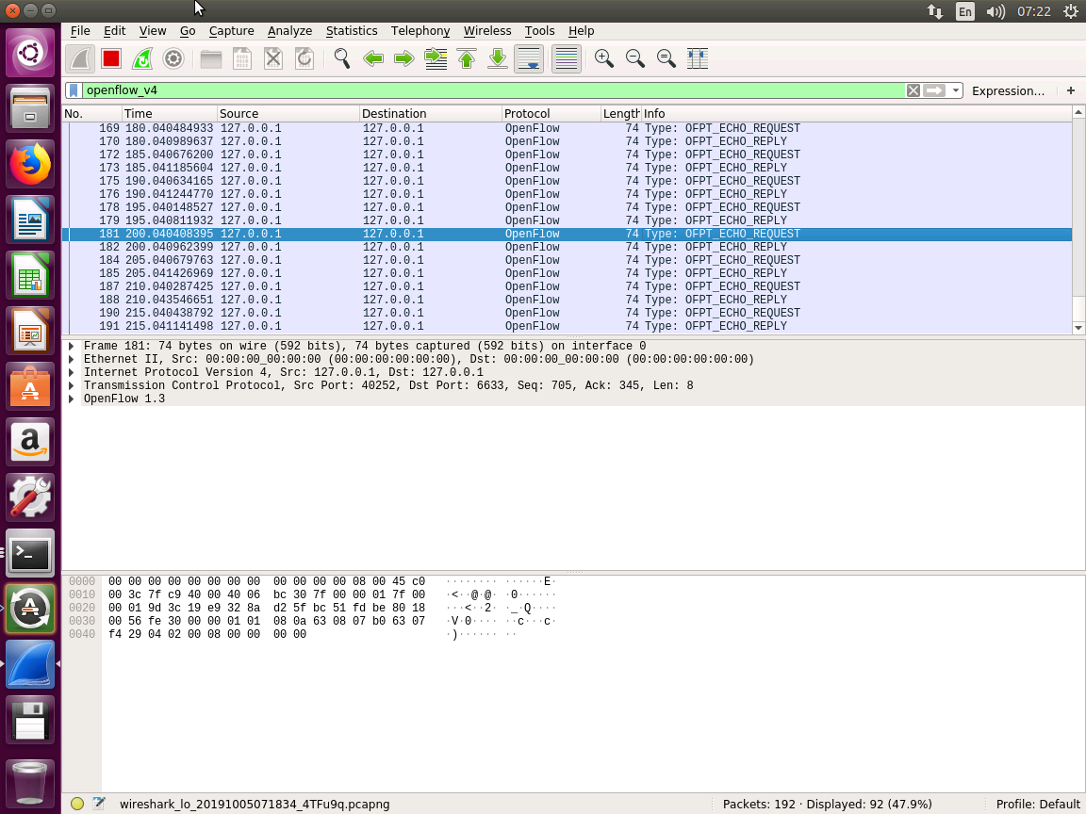

Slide 59
It’s Your Turn
Run Ryu built-in Simple Switch application
Run a Mininet topology (without loop) and connect it to Ryu
Open Wireshark and start to capture packets on loopback interface
Ping a host from another one
Observe OpenFlow packets captured by Wireshark

Slide 60
Ryu and OpenFlow Rule
Install OpenFlow Rule with REST

Slide 61
It’s Your Turn (I)
Run Ryu built-in REST API application
Run a minimal Mininet topology and connect it to Ryu
Check connectivity

Slide 62
It’s Your Turn (II)
Install flow entry with REST API
Check connectivity
Dump flow entries on OvS
$ curl -X POST http://localhost:8080/stats/flowentry/add -d '{ \
"dpid": 1, \
"priority": 1000, \
"actions": [ { "type": "OUTPUT", "port": "NORMAL" } ] \
}'

Slide 63
It’s Your Turn (III)
Delete flow entry with REST API
Check connectivity
Dump flow entries on OvS
$ curl -X POST http://localhost:8080/stats/flowentry/delete -d '{ \
"dpid": 1, \
"priority": 1000, \
"actions": [ { "type": "OUTPUT", "port": "NORMAL" } ] \
}'

Slide 64
It’s Your Turn (IV)
Install flow entry with REST API
Check connectivity
Dump flow entries on OvS
$ curl -X POST http://localhost:8080/stats/flowentry/add -d '{ \
"dpid": 1, \
"priority": 1000, \
"match": { \
"eth_dst": "f6:db:e3:88:de:2c" \
}, \
"actions": [ { "type": "OUTPUT", "port": 1 } ] \
}'

Slide 65
Ryu Application Practice
Path Service and Proxy ARP

Slide 66
It’s Your Turn
Please check cht-workshop
Path Service – detect a network topology and find path from host to host.
Proxy ARP – Implement proxy arp service in controller
Run your own application
$ ryu-manager <app-file-path>

Slide 67
Reference
[1] “Software-Defined Networking (SDN) Definition.” Open Networking Foundation. [Online]. Available: https://www.opennetworking.org/sdn-definition/
[2] “Why Open vSwitch?” Linux Foundation. [Oneline]. Available: https://github.com/openvswitch/ovs/blob/master/Documentation/intro/why-ovs.rst
[3] “Open vSwitch.” Linux Foundation. [Online]. Available: http://www.openvswitch.org/
[4] “Mininet.” Mininet Team. [Online]. Available: http://mininet.org/
[5] “Introduction to OpenFlow.” David Mahler. [Online]. Available: https://www.youtube.com/watch?v=l25Ukkmk6Sk&t=257s
[6] “SDN/OpenFlow/Flowprogrammable” Available: http://flowgrammable.org/sdn/openflow/
[7] “Pica8 PicOS Configuration Guide” Available: https://docs.pica8.com/display/PicOS21119sp/PICOS+2.11.19+Configuration+Guide

