Slide 1
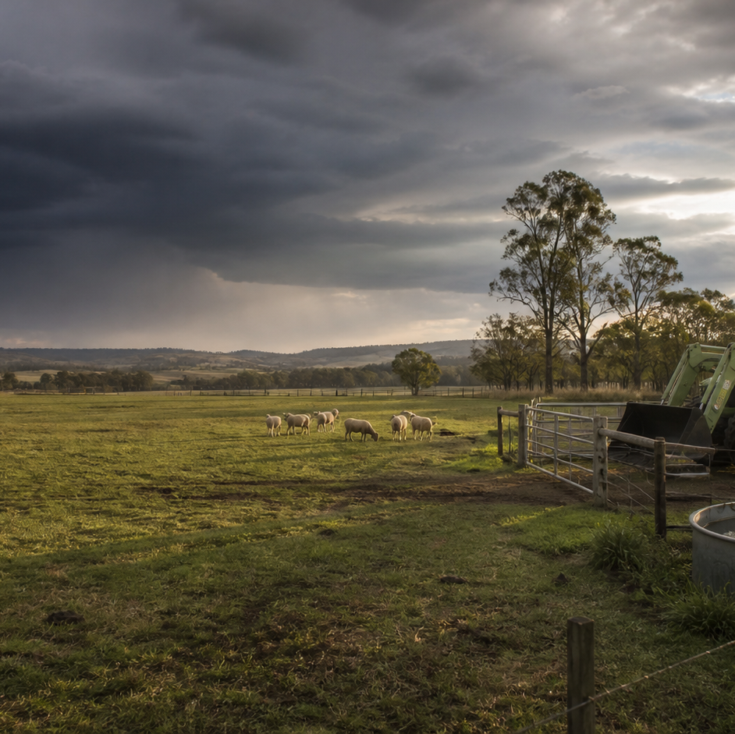
AHC20122 • CERTIFICATE II IN AGRICULTURE
Task 1 · WHS and farm readiness
Recognise farm hazards, reason about risk, choose controls within authority and communicate safety concerns before work begins.
LEARNING ROUTE
01 Farm safety roles and authority
02 Hazards, risks and changing conditions
03 Controls, PPE and residual risk
04 Consult, report and learn from incidents
Supplementary learning • current local sources and supervision control real work
Notes:
Open by connecting the task purpose to the four-module route. Ask students which module most clearly prepares them to notice evidence, make a source-led decision and report through authority.
Boundary: Supplementary learning is grounded in AHCWHS202 Release 1, current SafeWork NSW farming guidance and the authorised teacher-posted safety notes. The current workplace induction, risk process, emergency plan, supervisor directions and RTO assessment package remain controlling. Site responses are formative and do not demonstrate competency.
[Sources]
- Supplementary learning is grounded in AHCWHS202 Release 1, current SafeWork NSW farming guidance and the authorised teacher-posted safety notes. The current workplace induction, risk process, emergency plan, supervisor directions and RTO assessment package remain controlling. Site responses are formative and do not demonstrate competency.
- Course hero: Generated for this course using OpenAI ImageGen on 21 August 2026.
- Course data: work/pi/site-data/course.json

Slide 2
TASK 01 • PRIMARY INDUSTRIES
Farm safety roles and authority
NOTICE
• Safety is shared, but authority is not equal
• Know what is expected before work begins
A safe farm depends on people at every level noticing hazards, communicating clearly and following agreed controls. An induction explains the rules and hazards of a particular property or work area.
LOOK FOR
Connect the module's first four teaching ideas before students apply them to a fictional agricultural decision.
Use the map to connect the lesson ideas, then confirm any real procedure or decision through the current authorised source.
AHC20122 PRIMARY INDUSTRIES • TASK 1
2/10
Notes:
Teaching move (theory and visual): Use the module visual and the fictional worked example to move students from observation to a source-led decision. Ask students to name the evidence, the authority gap and the next safe communication step.
Misconception and help: Look for the response that identifies and closes the authority gap before work begins. Ask: What is unclear, and who is authorised to confirm it?
Applied action: Build an authority map. For a teacher-nominated fictional farm task, list the learner's role, the supervisor's role, one clarification point and one reportable change. Do not copy a local form or describe emergency steps.
Boundary: Supplementary learning is grounded in AHCWHS202 Release 1, current SafeWork NSW farming guidance and the authorised teacher-posted safety notes. The current workplace induction, risk process, emergency plan, supervisor directions and RTO assessment package remain controlling. Site responses are formative and do not demonstrate competency.
[Sources]
- Source basis: AHCWHS202 Release 1, SafeWork NSW First Steps to Farm Safety guidance on consultation, induction, worker responsibilities and records, plus authorised teacher-posted safety notes. Current local procedures and the RTO assessment package control real work.
- Visual visual-task-01-01: Generated locally from accepted Stage 05 module headings; no external image copied.
- Course visual manifest: work/pi/visuals/visual-manifest.json

Slide 3
TASK 01 • PRIMARY INDUSTRIES
Farm safety roles and authority: decide from evidence
FICTIONAL WORKPLACE EXAMPLE
CHECK YOUR DECISION
OBSERVE On a fictional training farm, Lee is asked to move supplies to a shed but sees a new washout across the usual track.
DECIDE Lee does not choose another route independently because property access is locally controlled.
ACT Lee pauses and tells the supervisor the exact location and visible condition.
RECORD Lee checks that the changed direction is understood and notes the hazard through the workplace's current reporting process.
A learner understands the task but does not know who can approve a changed route. What is the strongest response?
A Choose the route that looks shortest and mention it later.
B Pause and ask the designated supervisor who controls the access decision.
C Wait silently until another worker takes the lead.
HELP Ask: What is unclear, and who is authorised to confirm it?
AHC20122 PRIMARY INDUSTRIES • TASK 1
3/10
Notes:
Teaching move (worked example and formative check): Use the module visual and the fictional worked example to move students from observation to a source-led decision. Ask students to name the evidence, the authority gap and the next safe communication step. Misconception and help: Look for the response that identifies and closes the authority gap before work begins. Ask: What is unclear, and who is authorised to confirm it? Applied action: Build an authority map. For a teacher-nominated fictional farm task, list the learner's role, the supervisor's role, one clarification point and one reportable change. Do not copy a local form or describe emergency steps. Boundary: Supplementary learning is grounded in AHCWHS202 Release 1, current SafeWork NSW farming guidance and the authorised teacher-posted safety notes. The current workplace induction, risk process, emergency plan, supervisor directions and RTO assessment package remain controlling. Site responses are formative and do not demonstrate competency. [Sources] - Source basis: AHCWHS202 Release 1, SafeWork NSW First Steps to Farm Safety guidance on consultation, induction, worker responsibilities and records, plus authorised teacher-posted safety notes. Current local procedures and the RTO assessment package control real work. - Visual visual-task-01-01: Generated locally from accepted Stage 05 module headings; no external image copied. - Course visual manifest: work/pi/visuals/visual-manifest.json
Formative check answer: Pause and ask the designated supervisor who controls the access decision.
Correct feedback: You kept the decision with the person authorised to control local access.
Corrective feedback: Look for the response that identifies and closes the authority gap before work begins.
Full contextual example: Observed evidence: On a fictional training farm, Lee is asked to move supplies to a shed but sees a new washout across the usual track. Decision and reason: Lee does not choose another route independently because property access is locally controlled. Safe action: Lee pauses and tells the supervisor the exact location and visible condition. Result: The supervisor confirms a different authorised route and updates the team. Next check or record: Lee checks that the changed direction is understood and notes the hazard through the workplace's current reporting process.

Slide 4
TASK 01 • PRIMARY INDUSTRIES
Hazards, risks and changing conditions
NOTICE
• A hazard is not the same as risk
• Start with observable evidence
A hazard is a source or situation with the potential to cause harm. Strong hazard recognition describes what can be seen, heard, measured or reliably reported.
LOOK FOR
Connect the module's first four teaching ideas before students apply them to a fictional agricultural decision.
Use the map to connect the lesson ideas, then confirm any real procedure or decision through the current authorised source.
AHC20122 PRIMARY INDUSTRIES • TASK 1
4/10
Notes:
Teaching move (theory and visual): Use the module visual and the fictional worked example to move students from observation to a source-led decision. Ask students to name the evidence, the authority gap and the next safe communication step.
Misconception and help: Separate the source of potential harm from the chance and seriousness of exposure. Hazard equals potential source; risk equals possible harm in context.
Applied action: Write a four-part hazard story. Use a teacher-provided photograph or fictional scene. Record the hazard, exposure, possible harm and changed condition, then name the person or process that would confirm the next action.
Boundary: Supplementary learning is grounded in AHCWHS202 Release 1, current SafeWork NSW farming guidance and the authorised teacher-posted safety notes. The current workplace induction, risk process, emergency plan, supervisor directions and RTO assessment package remain controlling. Site responses are formative and do not demonstrate competency.
[Sources]
- Source basis: AHCWHS202 Release 1 and SafeWork NSW First Steps to Farm Safety guidance on identifying hazards, assessing likelihood and severity, monitoring changing farm conditions and reporting. The local risk matrix controls real ratings.
- Visual visual-task-01-02: Generated locally from accepted Stage 05 module headings; no external image copied.
- Course visual manifest: work/pi/visuals/visual-manifest.json

Slide 5
TASK 01 • PRIMARY INDUSTRIES
Hazards, risks and changing conditions: decide from evidence
FICTIONAL WORKPLACE EXAMPLE
CHECK YOUR DECISION
OBSERVE A fictional team planned to carry empty crates along a firm lane, but rain has made a section muddy and a delivery vehicle is now reversing nearby.
DECIDE The original exposure has changed because footing and vehicle movement now overlap.
ACT The learner pauses outside the affected area and reports both observations.
RECORD The learner records the changed conditions and the confirmed direction, without inventing a risk score.
Which statement correctly separates a hazard from risk?
A A moving vehicle is a hazard; the chance and seriousness of a collision depend on the people, route and conditions.
B A hazard and a risk are two names for the same completed injury.
C Risk means how much time a control will add to the job.
HELP Hazard equals potential source; risk equals possible harm in context.
AHC20122 PRIMARY INDUSTRIES • TASK 1
5/10
Notes:
Teaching move (worked example and formative check): Use the module visual and the fictional worked example to move students from observation to a source-led decision. Ask students to name the evidence, the authority gap and the next safe communication step. Misconception and help: Separate the source of potential harm from the chance and seriousness of exposure. Hazard equals potential source; risk equals possible harm in context. Applied action: Write a four-part hazard story. Use a teacher-provided photograph or fictional scene. Record the hazard, exposure, possible harm and changed condition, then name the person or process that would confirm the next action. Boundary: Supplementary learning is grounded in AHCWHS202 Release 1, current SafeWork NSW farming guidance and the authorised teacher-posted safety notes. The current workplace induction, risk process, emergency plan, supervisor directions and RTO assessment package remain controlling. Site responses are formative and do not demonstrate competency. [Sources] - Source basis: AHCWHS202 Release 1 and SafeWork NSW First Steps to Farm Safety guidance on identifying hazards, assessing likelihood and severity, monitoring changing farm conditions and reporting. The local risk matrix controls real ratings. - Visual visual-task-01-02: Generated locally from accepted Stage 05 module headings; no external image copied. - Course visual manifest: work/pi/visuals/visual-manifest.json
Formative check answer: A moving vehicle is a hazard; the chance and seriousness of a collision depend on the people, route and conditions.
Correct feedback: You identified the hazard and then considered how context shapes risk.
Corrective feedback: Separate the source of potential harm from the chance and seriousness of exposure.
Full contextual example: Observed evidence: A fictional team planned to carry empty crates along a firm lane, but rain has made a section muddy and a delivery vehicle is now reversing nearby. Decision and reason: The original exposure has changed because footing and vehicle movement now overlap. Safe action: The learner pauses outside the affected area and reports both observations. Result: The supervisor reviews the route and timing using the local risk process. Next check or record: The learner records the changed conditions and the confirmed direction, without inventing a risk score.

Slide 6
TASK 01 • PRIMARY INDUSTRIES
Controls, PPE and residual risk
NOTICE
• Controls change exposure
• Begin at the top of the hierarchy
A control is an action or condition intended to eliminate a hazard or reduce the chance or consequence of harm. Elimination removes the hazard from the task.
LOOK FOR
Connect the module's first four teaching ideas before students apply them to a fictional agricultural decision.
Use the map to connect the lesson ideas, then confirm any real procedure or decision through the current authorised source.
AHC20122 PRIMARY INDUSTRIES • TASK 1
6/10
Notes:
Teaching move (theory and visual): Use the module visual and the fictional worked example to move students from observation to a source-led decision. Ask students to name the evidence, the authority gap and the next safe communication step.
Misconception and help: Consider what PPE changes and what hazard remains around the wearer. Ask whether the option removes the hazard or mainly protects one person.
Applied action: Build a control comparison. For a fictional teacher-provided hazard, compare one higher-level and one lower-level control. Explain the intended effect and one sign that review is needed. Do not prescribe local PPE or alter equipment.
Boundary: Supplementary learning is grounded in AHCWHS202 Release 1, current SafeWork NSW farming guidance and the authorised teacher-posted safety notes. The current workplace induction, risk process, emergency plan, supervisor directions and RTO assessment package remain controlling. Site responses are formative and do not demonstrate competency.
[Sources]
- Source basis: AHCWHS202 Release 1 and SafeWork NSW First Steps to Farm Safety hierarchy-of-control and review guidance. The workplace risk process, procedures and supervisor approve real controls and PPE.
- Visual visual-task-01-03: Generated locally from accepted Stage 05 module headings; no external image copied.
- Course visual manifest: work/pi/visuals/visual-manifest.json

Slide 7
TASK 01 • PRIMARY INDUSTRIES
Controls, PPE and residual risk: decide from evidence
FICTIONAL WORKPLACE EXAMPLE
CHECK YOUR DECISION
OBSERVE A fictional store entrance opens directly into a shared vehicle area.
DECIDE A reminder sign alone still depends on every person seeing and following it.
ACT The learner reports the interaction and compares higher-level separation with administrative reminders for the supervisor's review.
RECORD The learner observes whether people and vehicles remain separated and reports any control failure.
Why is PPE usually not the first or only control considered?
A PPE is never useful on farms.
B PPE relies on the individual and does not remove the hazard from the work environment.
C PPE is only allowed after an incident.
HELP Ask whether the option removes the hazard or mainly protects one person.
AHC20122 PRIMARY INDUSTRIES • TASK 1
7/10
Notes:
Teaching move (worked example and formative check): Use the module visual and the fictional worked example to move students from observation to a source-led decision. Ask students to name the evidence, the authority gap and the next safe communication step. Misconception and help: Consider what PPE changes and what hazard remains around the wearer. Ask whether the option removes the hazard or mainly protects one person. Applied action: Build a control comparison. For a fictional teacher-provided hazard, compare one higher-level and one lower-level control. Explain the intended effect and one sign that review is needed. Do not prescribe local PPE or alter equipment. Boundary: Supplementary learning is grounded in AHCWHS202 Release 1, current SafeWork NSW farming guidance and the authorised teacher-posted safety notes. The current workplace induction, risk process, emergency plan, supervisor directions and RTO assessment package remain controlling. Site responses are formative and do not demonstrate competency. [Sources] - Source basis: AHCWHS202 Release 1 and SafeWork NSW First Steps to Farm Safety hierarchy-of-control and review guidance. The workplace risk process, procedures and supervisor approve real controls and PPE. - Visual visual-task-01-03: Generated locally from accepted Stage 05 module headings; no external image copied. - Course visual manifest: work/pi/visuals/visual-manifest.json
Formative check answer: PPE relies on the individual and does not remove the hazard from the work environment.
Correct feedback: You identified why PPE belongs within a wider hierarchy of control.
Corrective feedback: Consider what PPE changes and what hazard remains around the wearer.
Full contextual example: Observed evidence: A fictional store entrance opens directly into a shared vehicle area. Decision and reason: A reminder sign alone still depends on every person seeing and following it. Safe action: The learner reports the interaction and compares higher-level separation with administrative reminders for the supervisor's review. Result: The workplace selects an authorised combination that changes access and communication. Next check or record: The learner observes whether people and vehicles remain separated and reports any control failure.

Slide 8
TASK 01 • PRIMARY INDUSTRIES
Consult, report and learn from incidents
NOTICE
• Report hazards, near misses and incidents
• Give the first report useful facts
A hazard is a potential source of harm, a near miss is an event that could have caused harm, and an incident is an event that caused or had the potential to cause harm or loss. A first report should be prompt, concise and factual.
LOOK FOR
Connect the module's first four teaching ideas before students apply them to a fictional agricultural decision.
Use the map to connect the lesson ideas, then confirm any real procedure or decision through the current authorised source.
AHC20122 PRIMARY INDUSTRIES • TASK 1
8/10
Notes:
Teaching move (theory and visual): Use the module visual and the fictional worked example to move students from observation to a source-led decision. Ask students to name the evidence, the authority gap and the next safe communication step.
Misconception and help: Focus on what the event reveals about exposure and control reliability. No injury does not mean no learning.
Applied action: Rehearse a near-miss brief. Use a fictional teacher-nominated event. Prepare a 30-second factual verbal brief and a five-field written note. Do not enter real names, medical details or local emergency instructions.
Boundary: Supplementary learning is grounded in AHCWHS202 Release 1, current SafeWork NSW farming guidance and the authorised teacher-posted safety notes. The current workplace induction, risk process, emergency plan, supervisor directions and RTO assessment package remain controlling. Site responses are formative and do not demonstrate competency.
[Sources]
- Source basis: AHCWHS202 Release 1 and SafeWork NSW farm-safety guidance on reporting hazards, incidents and near misses, consultation, record keeping and reviewing controls. The current workplace process controls emergency, investigation and notification actions.
- Visual visual-task-01-04: Generated locally from accepted Stage 05 module headings; no external image copied.
- Course visual manifest: work/pi/visuals/visual-manifest.json

Slide 9
TASK 01 • PRIMARY INDUSTRIES
Consult, report and learn from incidents: decide from evidence
FICTIONAL WORKPLACE EXAMPLE
CHECK YOUR DECISION
OBSERVE In a fictional storage area, a light crate slides from a low stack and lands beside a worker without contact.
DECIDE No injury occurred, but the event shows that the storage control may not be reliable.
ACT The learner keeps outside the affected space and reports the time, location and observed movement through the current workplace channel.
RECORD The learner completes the requested factual note and checks the confirmed control before the next similar task.
A crate falls beside a worker but causes no injury. Why should it still be reported?
A It may reveal a failed control and an exposure that could cause harm next time.
B Every report automatically proves someone broke a rule.
C Only because the website requires a saved response.
HELP No injury does not mean no learning.
AHC20122 PRIMARY INDUSTRIES • TASK 1
9/10
Notes:
Teaching move (worked example and formative check): Use the module visual and the fictional worked example to move students from observation to a source-led decision. Ask students to name the evidence, the authority gap and the next safe communication step. Misconception and help: Focus on what the event reveals about exposure and control reliability. No injury does not mean no learning. Applied action: Rehearse a near-miss brief. Use a fictional teacher-nominated event. Prepare a 30-second factual verbal brief and a five-field written note. Do not enter real names, medical details or local emergency instructions. Boundary: Supplementary learning is grounded in AHCWHS202 Release 1, current SafeWork NSW farming guidance and the authorised teacher-posted safety notes. The current workplace induction, risk process, emergency plan, supervisor directions and RTO assessment package remain controlling. Site responses are formative and do not demonstrate competency. [Sources] - Source basis: AHCWHS202 Release 1 and SafeWork NSW farm-safety guidance on reporting hazards, incidents and near misses, consultation, record keeping and reviewing controls. The current workplace process controls emergency, investigation and notification actions. - Visual visual-task-01-04: Generated locally from accepted Stage 05 module headings; no external image copied. - Course visual manifest: work/pi/visuals/visual-manifest.json
Formative check answer: It may reveal a failed control and an exposure that could cause harm next time.
Correct feedback: You recognised the preventive value of near-miss reporting.
Corrective feedback: Focus on what the event reveals about exposure and control reliability.
Full contextual example: Observed evidence: In a fictional storage area, a light crate slides from a low stack and lands beside a worker without contact. Decision and reason: No injury occurred, but the event shows that the storage control may not be reliable. Safe action: The learner keeps outside the affected space and reports the time, location and observed movement through the current workplace channel. Result: The supervisor reviews the area and gives an authorised direction. Next check or record: The learner completes the requested factual note and checks the confirmed control before the next similar task.

Slide 10
CLOSE THE LOOP WITH EVIDENCE
Apply the task route — then check the boundary
01 Farm safety roles and authority
02 Hazards, risks and changing conditions
03 Controls, PPE and residual risk
04 Consult, report and learn from incidents
Build an authority map
For a teacher-nominated fictional farm task, list the learner's role, the supervisor's role, one clarification point and one reportable change.
Write a four-part hazard story
Use a teacher-provided photograph or fictional scene.
Build a control comparison
For a fictional teacher-provided hazard, compare one higher-level and one lower-level control.
Rehearse a near-miss brief
Use a fictional teacher-nominated event.
NEXT STEP Complete the teacher-nominated learning action. Use current local sources and supervision before any real practical decision. Website responses remain formative.
Notes:
Close with one retrieval question from each module, then direct students to the teacher-nominated learning action. Re-state that site work is formative and that current workplace and RTO processes control real practice and assessment.
Boundary: Supplementary learning is grounded in AHCWHS202 Release 1, current SafeWork NSW farming guidance and the authorised teacher-posted safety notes. The current workplace induction, risk process, emergency plan, supervisor directions and RTO assessment package remain controlling. Site responses are formative and do not demonstrate competency.
[Sources]
- Source basis: AHCWHS202 Release 1, SafeWork NSW First Steps to Farm Safety guidance on consultation, induction, worker responsibilities and records, plus authorised teacher-posted safety notes. Current local procedures and the RTO assessment package control real work.
- Source basis: AHCWHS202 Release 1 and SafeWork NSW First Steps to Farm Safety guidance on identifying hazards, assessing likelihood and severity, monitoring changing farm conditions and reporting. The local risk matrix controls real ratings.
- Source basis: AHCWHS202 Release 1 and SafeWork NSW First Steps to Farm Safety hierarchy-of-control and review guidance. The workplace risk process, procedures and supervisor approve real controls and PPE.
- Source basis: AHCWHS202 Release 1 and SafeWork NSW farm-safety guidance on reporting hazards, incidents and near misses, consultation, record keeping and reviewing controls. The current workplace process controls emergency, investigation and notification actions.

