Slide 1
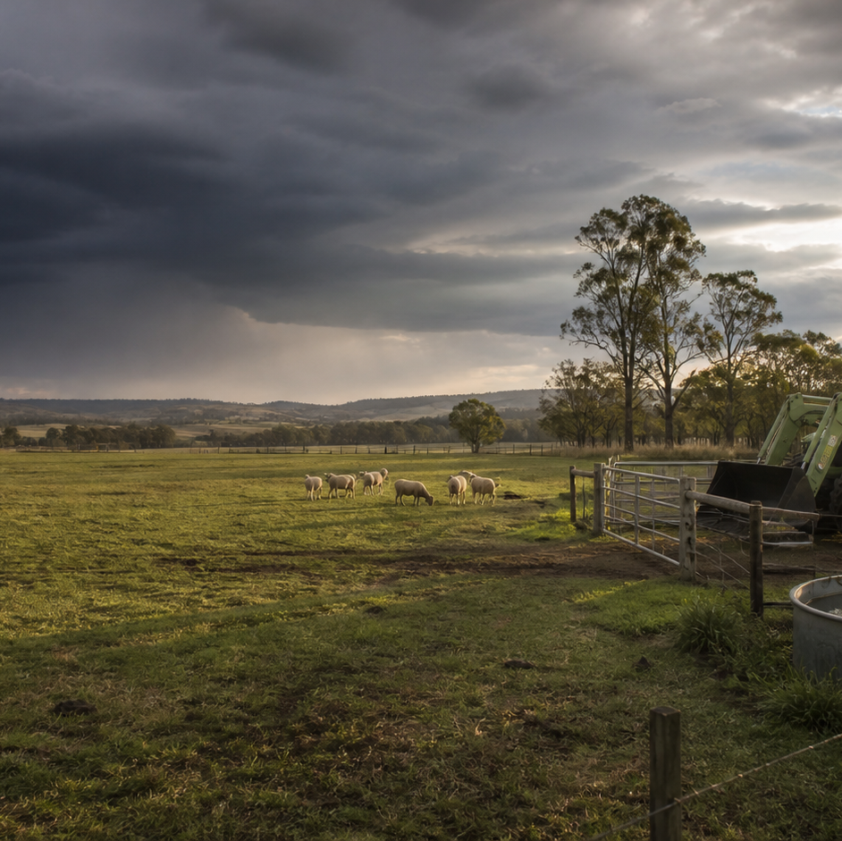
AHC20122 • CERTIFICATE II IN AGRICULTURE
Task 2 · Communicate and work effectively
Clarify instructions, organise routine work, complete useful workplace records and contribute respectfully to a team.
LEARNING ROUTE
01 Roles, instructions and scope of authority
02 Work plans, priorities and time
03 Workplace records and routine calculations
04 Teamwork, feedback and workplace issues
Supplementary learning • current local sources and supervision control real work
Notes:
Open by connecting the task purpose to the four-module route. Ask students which module most clearly prepares them to notice evidence, make a source-led decision and report through authority.
Boundary: Supplementary learning is grounded in AHCWRK212 Release 1, AHCWRK213 Release 1 and authorised teacher-posted working-in-industry notes used only for current concepts and original scenarios. Current workplace instructions, forms, employment sources, reporting channels, assessment tasks and assessor decisions remain controlling.
[Sources]
- Supplementary learning is grounded in AHCWRK212 Release 1, AHCWRK213 Release 1 and authorised teacher-posted working-in-industry notes used only for current concepts and original scenarios. Current workplace instructions, forms, employment sources, reporting channels, assessment tasks and assessor decisions remain controlling.
- Course hero: Generated for this course using OpenAI ImageGen on 21 August 2026.
- Course data: work/pi/site-data/course.json

Slide 2
TASK 02 • PRIMARY INDUSTRIES
Roles, instructions and scope of authority
NOTICE
• Instructions connect the team to the job
• Clarify before guessing
A workplace instruction communicates an expected outcome, boundaries and information needed for a task. Clarification is needed when the outcome, sequence, specification, timing, resources, safety control or reporting requirement is unclear.
LOOK FOR
Connect the module's first four teaching ideas before students apply them to a fictional agricultural decision.
Use the map to connect the lesson ideas, then confirm any real procedure or decision through the current authorised source.
AHC20122 PRIMARY INDUSTRIES • TASK 2
2/10
Notes:
Teaching move (theory and visual): Use the module visual and the fictional worked example to move students from observation to a source-led decision. Ask students to name the evidence, the authority gap and the next safe communication step.
Misconception and help: When controlling sources conflict, make the difference visible to the authorised person. State source one, source two and the exact decision required.
Applied action: Rehearse a clarification handover. Use a fictional teacher-provided instruction. In pairs, practise restating the known details, asking one precise question and confirming the final direction. Do not use a real workplace dispute or assessment answer.
Boundary: Supplementary learning is grounded in AHCWRK212 Release 1, AHCWRK213 Release 1 and authorised teacher-posted working-in-industry notes used only for current concepts and original scenarios. Current workplace instructions, forms, employment sources, reporting channels, assessment tasks and assessor decisions remain controlling.
[Sources]
- Source basis: AHCWRK212 and AHCWRK213 Release 1 requirements for confirming work, gathering information, clarifying instructions and communicating with supervisors. Teacher-posted working-in-industry notes informed topic breadth only.
- Visual visual-task-02-01: Generated locally from accepted Stage 05 module headings; no external image copied.
- Course visual manifest: work/pi/visuals/visual-manifest.json

Slide 3
TASK 02 • PRIMARY INDUSTRIES
Roles, instructions and scope of authority: decide from evidence
FICTIONAL WORKPLACE EXAMPLE
CHECK YOUR DECISION
OBSERVE In a fictional nursery store, Mina's verbal instruction says to prepare eight labelled trays, but the electronic schedule lists six.
DECIDE Guessing could create waste or leave the job incomplete, and Mina is not authorised to alter the order.
ACT Mina tells the supervisor the two figures and asks which current source controls.
RECORD Mina repeats the confirmed quantity and records the completed total in the authorised system.
A verbal instruction and the current schedule show different quantities. What is the strongest response?
A Use the larger number so the job cannot be short.
B Present both figures to the supervisor and ask which authorised source controls.
C Follow whichever instruction was received first.
HELP State source one, source two and the exact decision required.
AHC20122 PRIMARY INDUSTRIES • TASK 2
3/10
Notes:
Teaching move (worked example and formative check): Use the module visual and the fictional worked example to move students from observation to a source-led decision. Ask students to name the evidence, the authority gap and the next safe communication step. Misconception and help: When controlling sources conflict, make the difference visible to the authorised person. State source one, source two and the exact decision required. Applied action: Rehearse a clarification handover. Use a fictional teacher-provided instruction. In pairs, practise restating the known details, asking one precise question and confirming the final direction. Do not use a real workplace dispute or assessment answer. Boundary: Supplementary learning is grounded in AHCWRK212 Release 1, AHCWRK213 Release 1 and authorised teacher-posted working-in-industry notes used only for current concepts and original scenarios. Current workplace instructions, forms, employment sources, reporting channels, assessment tasks and assessor decisions remain controlling. [Sources] - Source basis: AHCWRK212 and AHCWRK213 Release 1 requirements for confirming work, gathering information, clarifying instructions and communicating with supervisors. Teacher-posted working-in-industry notes informed topic breadth only. - Visual visual-task-02-01: Generated locally from accepted Stage 05 module headings; no external image copied. - Course visual manifest: work/pi/visuals/visual-manifest.json
Formative check answer: Present both figures to the supervisor and ask which authorised source controls.
Correct feedback: You used source comparison and clarification instead of guessing.
Corrective feedback: When controlling sources conflict, make the difference visible to the authorised person.
Full contextual example: Observed evidence: In a fictional nursery store, Mina's verbal instruction says to prepare eight labelled trays, but the electronic schedule lists six. Decision and reason: Guessing could create waste or leave the job incomplete, and Mina is not authorised to alter the order. Safe action: Mina tells the supervisor the two figures and asks which current source controls. Result: The supervisor confirms that the schedule was not updated and directs eight trays. Next check or record: Mina repeats the confirmed quantity and records the completed total in the authorised system.

Slide 4
TASK 02 • PRIMARY INDUSTRIES
Work plans, priorities and time
NOTICE
• A work plan makes the brief visible
• Separate dependencies from preferences
A useful plan translates an expected outcome into tasks, sequence, resources, responsibilities, timing and checks. A dependency is something that must occur before another step can begin, such as receiving confirmed stock information before finalising a count.
LOOK FOR
Connect the module's first four teaching ideas before students apply them to a fictional agricultural decision.
Use the map to connect the lesson ideas, then confirm any real procedure or decision through the current authorised source.
AHC20122 PRIMARY INDUSTRIES • TASK 2
4/10
Notes:
Teaching move (theory and visual): Use the module visual and the fictional worked example to move students from observation to a source-led decision. Ask students to name the evidence, the authority gap and the next safe communication step.
Misconception and help: A dependency blocks or changes a later step; a preference mainly affects convenience. Ask: Can the next step be accurate without this?
Applied action: Plan a fictional 70-minute job. Turn a teacher-provided routine work brief into a one-page plan with tasks, time windows, roles and hold points. Use only fictional data and leave practical procedures to the teacher's authorised source.
Boundary: Supplementary learning is grounded in AHCWRK212 Release 1, AHCWRK213 Release 1 and authorised teacher-posted working-in-industry notes used only for current concepts and original scenarios. Current workplace instructions, forms, employment sources, reporting channels, assessment tasks and assessor decisions remain controlling.
[Sources]
- Source basis: AHCWRK212 Release 1 requirements for confirming work plans, schedules, timelines, materials, equipment and priorities, supported by AHCWRK213 communication and record requirements. Local schedules and methods remain controlling.
- Visual visual-task-02-02: Generated locally from accepted Stage 05 module headings; no external image copied.
- Course visual manifest: work/pi/visuals/visual-manifest.json

Slide 5
TASK 02 • PRIMARY INDUSTRIES
Work plans, priorities and time: decide from evidence
FICTIONAL WORKPLACE EXAMPLE
CHECK YOUR DECISION
OBSERVE A fictional team has 70 minutes to prepare labelled storage tubs, count unopened supplies and update a stock sheet. One count depends on the supervisor confirming which delivery is current.
DECIDE The team schedules independent preparation first and places the uncertain count behind a hold point.
ACT At the first checkpoint, the learner reports that confirmation is still missing.
RECORD The team records actual totals and finish times rather than copying estimates.
Which item is a dependency rather than a preference?
A Using the blue clipboard because it is easier to recognise.
B Confirming which delivery is current before recording its stock count.
C Completing two independent tidy-up tasks in a preferred order.
HELP Ask: Can the next step be accurate without this?
AHC20122 PRIMARY INDUSTRIES • TASK 2
5/10
Notes:
Teaching move (worked example and formative check): Use the module visual and the fictional worked example to move students from observation to a source-led decision. Ask students to name the evidence, the authority gap and the next safe communication step. Misconception and help: A dependency blocks or changes a later step; a preference mainly affects convenience. Ask: Can the next step be accurate without this? Applied action: Plan a fictional 70-minute job. Turn a teacher-provided routine work brief into a one-page plan with tasks, time windows, roles and hold points. Use only fictional data and leave practical procedures to the teacher's authorised source. Boundary: Supplementary learning is grounded in AHCWRK212 Release 1, AHCWRK213 Release 1 and authorised teacher-posted working-in-industry notes used only for current concepts and original scenarios. Current workplace instructions, forms, employment sources, reporting channels, assessment tasks and assessor decisions remain controlling. [Sources] - Source basis: AHCWRK212 Release 1 requirements for confirming work plans, schedules, timelines, materials, equipment and priorities, supported by AHCWRK213 communication and record requirements. Local schedules and methods remain controlling. - Visual visual-task-02-02: Generated locally from accepted Stage 05 module headings; no external image copied. - Course visual manifest: work/pi/visuals/visual-manifest.json
Formative check answer: Confirming which delivery is current before recording its stock count.
Correct feedback: You identified information that must be confirmed before the dependent task can be completed.
Corrective feedback: A dependency blocks or changes a later step; a preference mainly affects convenience.
Full contextual example: Observed evidence: A fictional team has 70 minutes to prepare labelled storage tubs, count unopened supplies and update a stock sheet. One count depends on the supervisor confirming which delivery is current. Decision and reason: The team schedules independent preparation first and places the uncertain count behind a hold point. Safe action: At the first checkpoint, the learner reports that confirmation is still missing. Result: The supervisor supplies the correct delivery reference and adjusts who completes the count. Next check or record: The team records actual totals and finish times rather than copying estimates.

Slide 6
TASK 02 • PRIMARY INDUSTRIES
Workplace records and routine calculations
NOTICE
• Records help the next decision
• Separate source data from calculated data
A workplace record preserves information so another authorised person can understand what occurred and act on it. Source data is directly observed or taken from an authorised document, such as a fictional count of 12 intact items.
LOOK FOR
Connect the module's first four teaching ideas before students apply them to a fictional agricultural decision.
Use the map to connect the lesson ideas, then confirm any real procedure or decision through the current authorised source.
AHC20122 PRIMARY INDUSTRIES • TASK 2
6/10
Notes:
Teaching move (theory and visual): Use the module visual and the fictional worked example to move students from observation to a source-led decision. Ask students to name the evidence, the authority gap and the next safe communication step.
Misconception and help: Check that every source value is included and the answer names what was counted. Add the four values, then write the unit beside the answer.
Applied action: Audit a fictional work record. Check a teacher-provided fictional record for one arithmetic error, one unit error and one unclear comment. Explain each correction without copying the controlled assessment template.
Boundary: Supplementary learning is grounded in AHCWRK212 Release 1, AHCWRK213 Release 1 and authorised teacher-posted working-in-industry notes used only for current concepts and original scenarios. Current workplace instructions, forms, employment sources, reporting channels, assessment tasks and assessor decisions remain controlling.
[Sources]
- Source basis: AHCWRK213 Release 1 requirements for accurate records, routine calculations, error correction and reporting, supported by AHCWRK212 quality-of-own-work expectations. Current workplace forms and correction processes remain controlling.
- Visual visual-task-02-03: Generated locally from accepted Stage 05 module headings; no external image copied.
- Course visual manifest: work/pi/visuals/visual-manifest.json

Slide 7
TASK 02 • PRIMARY INDUSTRIES
Workplace records and routine calculations: decide from evidence
FICTIONAL WORKPLACE EXAMPLE
CHECK YOUR DECISION
OBSERVE A fictional count sheet lists four bins with 18, 17, 20 and 19 sealed items, while the total box says 75.
DECIDE The source entries add to 74, so either a bin count or the total is wrong.
ACT The learner repeats the arithmetic and checks the original bin observations rather than changing a figure to make it balance.
RECORD The correction is made through the authorised process with the source check visible.
Four fictional groups contain 12, 15, 9 and 14 items. What total should be recorded?
A 40 items
B 50 items
C 50 groups
HELP Add the four values, then write the unit beside the answer.
AHC20122 PRIMARY INDUSTRIES • TASK 2
7/10
Notes:
Teaching move (worked example and formative check): Use the module visual and the fictional worked example to move students from observation to a source-led decision. Ask students to name the evidence, the authority gap and the next safe communication step. Misconception and help: Check that every source value is included and the answer names what was counted. Add the four values, then write the unit beside the answer. Applied action: Audit a fictional work record. Check a teacher-provided fictional record for one arithmetic error, one unit error and one unclear comment. Explain each correction without copying the controlled assessment template. Boundary: Supplementary learning is grounded in AHCWRK212 Release 1, AHCWRK213 Release 1 and authorised teacher-posted working-in-industry notes used only for current concepts and original scenarios. Current workplace instructions, forms, employment sources, reporting channels, assessment tasks and assessor decisions remain controlling. [Sources] - Source basis: AHCWRK213 Release 1 requirements for accurate records, routine calculations, error correction and reporting, supported by AHCWRK212 quality-of-own-work expectations. Current workplace forms and correction processes remain controlling. - Visual visual-task-02-03: Generated locally from accepted Stage 05 module headings; no external image copied. - Course visual manifest: work/pi/visuals/visual-manifest.json
Formative check answer: 50 items
Correct feedback: You calculated the total and recorded the correct unit.
Corrective feedback: Check that every source value is included and the answer names what was counted.
Full contextual example: Observed evidence: A fictional count sheet lists four bins with 18, 17, 20 and 19 sealed items, while the total box says 75. Decision and reason: The source entries add to 74, so either a bin count or the total is wrong. Safe action: The learner repeats the arithmetic and checks the original bin observations rather than changing a figure to make it balance. Result: The second bin is confirmed as 18, giving a supported total of 75. Next check or record: The correction is made through the authorised process with the source check visible.

Slide 8
TASK 02 • PRIMARY INDUSTRIES
Teamwork, feedback and workplace issues
NOTICE
• Productive teams share an outcome
• Respectful communication is observable
A team is more than people working near one another. Respect is shown by using an appropriate tone, listening without interruption, acknowledging contributions and discussing the work rather than attacking the person.
LOOK FOR
Connect the module's first four teaching ideas before students apply them to a fictional agricultural decision.
Use the map to connect the lesson ideas, then confirm any real procedure or decision through the current authorised source.
AHC20122 PRIMARY INDUSTRIES • TASK 2
8/10
Notes:
Teaching move (theory and visual): Use the module visual and the fictional worked example to move students from observation to a source-led decision. Ask students to name the evidence, the authority gap and the next safe communication step.
Misconception and help: Useful feedback describes an observable action and the next required step. Use: I observed; this affects; please do or confirm.
Applied action: Run a fictional handover huddle. In a small group, use fictional roles to identify one handover gap, give evidence-based feedback and record an action, owner, timing and check. Do not use real colleague conduct or personal information.
Boundary: Supplementary learning is grounded in AHCWRK212 Release 1, AHCWRK213 Release 1 and authorised teacher-posted working-in-industry notes used only for current concepts and original scenarios. Current workplace instructions, forms, employment sources, reporting channels, assessment tasks and assessor decisions remain controlling.
[Sources]
- Source basis: AHCWRK212 Release 1 teamwork, feedback, conflict, meetings and inclusive-work requirements, together with AHCWRK213 Release 1 meeting and communication requirements. Teacher-posted notes informed concept breadth; current workplace policies control conduct matters.
- Visual visual-task-02-04: Generated locally from accepted Stage 05 module headings; no external image copied.
- Course visual manifest: work/pi/visuals/visual-manifest.json

Slide 9
TASK 02 • PRIMARY INDUSTRIES
Teamwork, feedback and workplace issues: decide from evidence
FICTIONAL WORKPLACE EXAMPLE
CHECK YOUR DECISION
OBSERVE In a fictional produce store, Sam expects Jo to enter the final count while Jo believes Sam owns that step, so the record remains blank.
DECIDE The issue is an unclear handover, not proof that either person is lazy.
ACT Sam states the shared deadline, shows the blank field and asks to confirm responsibility.
RECORD Both confirm completion through the normal channel and note the clearer handover for next time.
Which kind of workplace feedback is most useful for improving work?
A You're always careless with records.
B The final count field was blank at handover; please complete it and ask me to verify the total before 2 pm.
C Try to do a better job next time.
HELP Use: I observed; this affects; please do or confirm.
AHC20122 PRIMARY INDUSTRIES • TASK 2
9/10
Notes:
Teaching move (worked example and formative check): Use the module visual and the fictional worked example to move students from observation to a source-led decision. Ask students to name the evidence, the authority gap and the next safe communication step. Misconception and help: Useful feedback describes an observable action and the next required step. Use: I observed; this affects; please do or confirm. Applied action: Run a fictional handover huddle. In a small group, use fictional roles to identify one handover gap, give evidence-based feedback and record an action, owner, timing and check. Do not use real colleague conduct or personal information. Boundary: Supplementary learning is grounded in AHCWRK212 Release 1, AHCWRK213 Release 1 and authorised teacher-posted working-in-industry notes used only for current concepts and original scenarios. Current workplace instructions, forms, employment sources, reporting channels, assessment tasks and assessor decisions remain controlling. [Sources] - Source basis: AHCWRK212 Release 1 teamwork, feedback, conflict, meetings and inclusive-work requirements, together with AHCWRK213 Release 1 meeting and communication requirements. Teacher-posted notes informed concept breadth; current workplace policies control conduct matters. - Visual visual-task-02-04: Generated locally from accepted Stage 05 module headings; no external image copied. - Course visual manifest: work/pi/visuals/visual-manifest.json
Formative check answer: The final count field was blank at handover; please complete it and ask me to verify the total before 2 pm.
Correct feedback: You selected feedback that is specific, respectful and actionable.
Corrective feedback: Useful feedback describes an observable action and the next required step.
Full contextual example: Observed evidence: In a fictional produce store, Sam expects Jo to enter the final count while Jo believes Sam owns that step, so the record remains blank. Decision and reason: The issue is an unclear handover, not proof that either person is lazy. Safe action: Sam states the shared deadline, shows the blank field and asks to confirm responsibility. Result: The team checks the plan and the supervisor assigns the entry to Jo and the verification to Sam. Next check or record: Both confirm completion through the normal channel and note the clearer handover for next time.

Slide 10
CLOSE THE LOOP WITH EVIDENCE
Apply the task route — then check the boundary
01 Roles, instructions and scope of authority
02 Work plans, priorities and time
03 Workplace records and routine calculations
04 Teamwork, feedback and workplace issues
Rehearse a clarification handover
Use a fictional teacher-provided instruction.
Plan a fictional 70-minute job
Turn a teacher-provided routine work brief into a one-page plan with tasks, time windows, roles and hold points.
Audit a fictional work record
Check a teacher-provided fictional record for one arithmetic error, one unit error and one unclear comment.
Run a fictional handover huddle
In a small group, use fictional roles to identify one handover gap, give evidence-based feedback and record an action, owner, timing and check.
NEXT STEP Complete the teacher-nominated learning action. Use current local sources and supervision before any real practical decision. Website responses remain formative.
Notes:
Close with one retrieval question from each module, then direct students to the teacher-nominated learning action. Re-state that site work is formative and that current workplace and RTO processes control real practice and assessment.
Boundary: Supplementary learning is grounded in AHCWRK212 Release 1, AHCWRK213 Release 1 and authorised teacher-posted working-in-industry notes used only for current concepts and original scenarios. Current workplace instructions, forms, employment sources, reporting channels, assessment tasks and assessor decisions remain controlling.
[Sources]
- Source basis: AHCWRK212 and AHCWRK213 Release 1 requirements for confirming work, gathering information, clarifying instructions and communicating with supervisors. Teacher-posted working-in-industry notes informed topic breadth only.
- Source basis: AHCWRK212 Release 1 requirements for confirming work plans, schedules, timelines, materials, equipment and priorities, supported by AHCWRK213 communication and record requirements. Local schedules and methods remain controlling.
- Source basis: AHCWRK213 Release 1 requirements for accurate records, routine calculations, error correction and reporting, supported by AHCWRK212 quality-of-own-work expectations. Current workplace forms and correction processes remain controlling.
- Source basis: AHCWRK212 Release 1 teamwork, feedback, conflict, meetings and inclusive-work requirements, together with AHCWRK213 Release 1 meeting and communication requirements. Teacher-posted notes informed concept breadth; current workplace policies control conduct matters.

