Slide 1
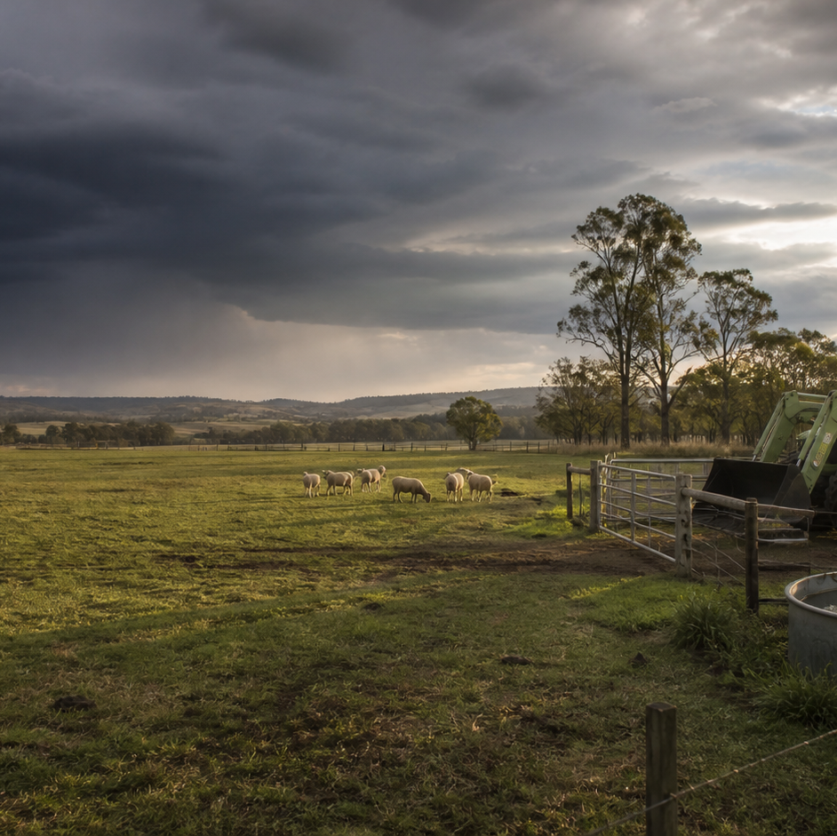
AHC20122 • CERTIFICATE II IN AGRICULTURE
Task 3 · Operate tractors
Prepare for supervised tractor work by matching task, machine, terrain and conditions, then documenting checks and concerns.
LEARNING ROUTE
01 Match task, tractor, terrain and authority
02 Pre-start inspection and defect decisions
03 Farm traffic, attachments and exclusion zones
04 Usage records, handover and review
Supplementary learning • current local sources and supervision control real work
Notes:
Open by connecting the task purpose to the four-module route. Ask students which module most clearly prepares them to notice evidence, make a source-led decision and report through authority.
Boundary: This is supplementary decision-literacy learning grounded in AHCMOM202 Release 1 and SafeWork NSW farm-safety guidance. It does not teach tractor operation, controls, settings, starting, manoeuvring, shutdown, servicing or attachment procedures. Only trained, authorised and supervised people may operate tractors using the current manufacturer instructions, local SOP, induction and teacher demonstration.
[Sources]
- This is supplementary decision-literacy learning grounded in AHCMOM202 Release 1 and SafeWork NSW farm-safety guidance. It does not teach tractor operation, controls, settings, starting, manoeuvring, shutdown, servicing or attachment procedures. Only trained, authorised and supervised people may operate tractors using the current manufacturer instructions, local SOP, induction and teacher demonstration.
- Course hero: Generated for this course using OpenAI ImageGen on 21 August 2026.
- Course data: work/pi/site-data/course.json

Slide 2
TASK 03 • PRIMARY INDUSTRIES
Match task, tractor, terrain and authority
NOTICE
• A tractor decision begins before operation
• Define the task outcome and boundaries
Tractor work is an interaction between the job, machine, any equipment, people, terrain and current conditions. A clear brief identifies the intended work, location, timing, people involved and the authorised machine and equipment.
LOOK FOR
Connect the module's first four teaching ideas before students apply them to a fictional agricultural decision.
Use the map to connect the lesson ideas, then confirm any real procedure or decision through the current authorised source.
AHC20122 PRIMARY INDUSTRIES • TASK 3
2/10
Notes:
Teaching move (theory and visual): Use the module visual and the fictional worked example to move students from observation to a source-led decision. Ask students to name the evidence, the authority gap and the next safe communication step.
Misconception and help: The task, machine, terrain, conditions and authority must remain aligned. If one part of the confirmed combination changes, refer it.
Applied action: Complete a readiness match table. Use a fictional teacher-provided brief and image. Sort evidence into Confirmed match, Mismatch and Unconfirmed, then write a concise supervisor referral. Do not describe how to operate the tractor.
Boundary: This is supplementary decision-literacy learning grounded in AHCMOM202 Release 1 and SafeWork NSW farm-safety guidance. It does not teach tractor operation, controls, settings, starting, manoeuvring, shutdown, servicing or attachment procedures. Only trained, authorised and supervised people may operate tractors using the current manufacturer instructions, local SOP, induction and teacher demonstration.
[Sources]
- Source basis: AHCMOM202 Release 1 application and preparation requirements, together with SafeWork NSW farm guidance on induction, training, supervision and changing terrain. Current manufacturer instructions, workplace procedures and supervisor directions control all operation.
- Visual visual-task-03-01: Generated locally from accepted Stage 05 module headings; no external image copied.
- Course visual manifest: work/pi/visuals/visual-manifest.json

Slide 3
TASK 03 • PRIMARY INDUSTRIES
Match task, tractor, terrain and authority: decide from evidence
FICTIONAL WORKPLACE EXAMPLE
CHECK YOUR DECISION
OBSERVE A fictional tractor task was confirmed for a level, firm paddock, but overnight rain has left soft ruts near the access point and livestock are now in the adjoining lane.
DECIDE The task-machine-terrain combination no longer matches the brief.
ACT The learner stays outside the work area and reports the location, surface change and livestock movement.
RECORD The learner records the changed conditions and decision, not an operating solution.
A tractor was authorised for one paddock, but the job is moved to a different property area. What is the strongest response?
A Continue because the tractor itself has not changed.
B Pause and have the changed location and conditions confirmed through the authorised process.
C Ask another learner whether the new area looks suitable.
HELP If one part of the confirmed combination changes, refer it.
AHC20122 PRIMARY INDUSTRIES • TASK 3
3/10
Notes:
Teaching move (worked example and formative check): Use the module visual and the fictional worked example to move students from observation to a source-led decision. Ask students to name the evidence, the authority gap and the next safe communication step. Misconception and help: The task, machine, terrain, conditions and authority must remain aligned. If one part of the confirmed combination changes, refer it. Applied action: Complete a readiness match table. Use a fictional teacher-provided brief and image. Sort evidence into Confirmed match, Mismatch and Unconfirmed, then write a concise supervisor referral. Do not describe how to operate the tractor. Boundary: This is supplementary decision-literacy learning grounded in AHCMOM202 Release 1 and SafeWork NSW farm-safety guidance. It does not teach tractor operation, controls, settings, starting, manoeuvring, shutdown, servicing or attachment procedures. Only trained, authorised and supervised people may operate tractors using the current manufacturer instructions, local SOP, induction and teacher demonstration. [Sources] - Source basis: AHCMOM202 Release 1 application and preparation requirements, together with SafeWork NSW farm guidance on induction, training, supervision and changing terrain. Current manufacturer instructions, workplace procedures and supervisor directions control all operation. - Visual visual-task-03-01: Generated locally from accepted Stage 05 module headings; no external image copied. - Course visual manifest: work/pi/visuals/visual-manifest.json
Formative check answer: Pause and have the changed location and conditions confirmed through the authorised process.
Correct feedback: You treated the location change as a new readiness decision.
Corrective feedback: The task, machine, terrain, conditions and authority must remain aligned.
Full contextual example: Observed evidence: A fictional tractor task was confirmed for a level, firm paddock, but overnight rain has left soft ruts near the access point and livestock are now in the adjoining lane. Decision and reason: The task-machine-terrain combination no longer matches the brief. Safe action: The learner stays outside the work area and reports the location, surface change and livestock movement. Result: The supervisor postpones the activity pending an authorised review. Next check or record: The learner records the changed conditions and decision, not an operating solution.

Slide 4
TASK 03 • PRIMARY INDUSTRIES
Pre-start inspection and defect decisions
NOTICE
• A pre-start tests readiness, not memory
• Use the exact machine identity
The purpose of a pre-start is to compare the actual machine and planned task with the current authorised checklist and information before use. Records and manuals must relate to the tractor and equipment actually nominated for the job.
LOOK FOR
Connect the module's first four teaching ideas before students apply them to a fictional agricultural decision.
Use the map to connect the lesson ideas, then confirm any real procedure or decision through the current authorised source.
AHC20122 PRIMARY INDUSTRIES • TASK 3
4/10
Notes:
Teaching move (theory and visual): Use the module visual and the fictional worked example to move students from observation to a source-led decision. Ask students to name the evidence, the authority gap and the next safe communication step.
Misconception and help: The lesson focuses on evidence and decision points, not operation or repair. Actual machine plus current authorised checklist equals readiness evidence.
Applied action: Classify fictional inspection findings. Sort teacher-provided fictional findings into Confirmed, Abnormal and Unconfirmed. Write a factual referral for one item. Do not touch, operate, test or repair equipment as part of this website activity.
Boundary: This is supplementary decision-literacy learning grounded in AHCMOM202 Release 1 and SafeWork NSW farm-safety guidance. It does not teach tractor operation, controls, settings, starting, manoeuvring, shutdown, servicing or attachment procedures. Only trained, authorised and supervised people may operate tractors using the current manufacturer instructions, local SOP, induction and teacher demonstration.
[Sources]
- Source basis: AHCMOM202 Release 1 requirements for pre-operational checks, reporting faults and maintaining use records, plus SafeWork NSW guidance on training, supervision and machinery risk. Exact inspection and exclusion procedures remain local-authority content.
- Visual visual-task-03-02: Generated locally from accepted Stage 05 module headings; no external image copied.
- Course visual manifest: work/pi/visuals/visual-manifest.json

Slide 5
TASK 03 • PRIMARY INDUSTRIES
Pre-start inspection and defect decisions: decide from evidence
FICTIONAL WORKPLACE EXAMPLE
CHECK YOUR DECISION
OBSERVE During a fictional teacher-led inspection, Casey sees fresh fluid on the ground under the nominated tractor and cannot identify its source.
DECIDE The condition is abnormal and cannot be accepted by guesswork.
ACT Casey does not operate or investigate moving parts; they report the exact location and observation.
RECORD Casey marks the status as referred and records the supervisor's direction in the current system.
What is the purpose of a tractor pre-start in this lesson?
A To memorise a universal operating sequence for every tractor.
B To compare actual readiness evidence with the current authorised source before use.
C To practise repairs before a supervisor arrives.
HELP Actual machine plus current authorised checklist equals readiness evidence.
AHC20122 PRIMARY INDUSTRIES • TASK 3
5/10
Notes:
Teaching move (worked example and formative check): Use the module visual and the fictional worked example to move students from observation to a source-led decision. Ask students to name the evidence, the authority gap and the next safe communication step. Misconception and help: The lesson focuses on evidence and decision points, not operation or repair. Actual machine plus current authorised checklist equals readiness evidence. Applied action: Classify fictional inspection findings. Sort teacher-provided fictional findings into Confirmed, Abnormal and Unconfirmed. Write a factual referral for one item. Do not touch, operate, test or repair equipment as part of this website activity. Boundary: This is supplementary decision-literacy learning grounded in AHCMOM202 Release 1 and SafeWork NSW farm-safety guidance. It does not teach tractor operation, controls, settings, starting, manoeuvring, shutdown, servicing or attachment procedures. Only trained, authorised and supervised people may operate tractors using the current manufacturer instructions, local SOP, induction and teacher demonstration. [Sources] - Source basis: AHCMOM202 Release 1 requirements for pre-operational checks, reporting faults and maintaining use records, plus SafeWork NSW guidance on training, supervision and machinery risk. Exact inspection and exclusion procedures remain local-authority content. - Visual visual-task-03-02: Generated locally from accepted Stage 05 module headings; no external image copied. - Course visual manifest: work/pi/visuals/visual-manifest.json
Formative check answer: To compare actual readiness evidence with the current authorised source before use.
Correct feedback: You identified the pre-start as a source-led readiness check.
Corrective feedback: The lesson focuses on evidence and decision points, not operation or repair.
Full contextual example: Observed evidence: During a fictional teacher-led inspection, Casey sees fresh fluid on the ground under the nominated tractor and cannot identify its source. Decision and reason: The condition is abnormal and cannot be accepted by guesswork. Safe action: Casey does not operate or investigate moving parts; they report the exact location and observation. Result: The supervisor excludes the tractor from the planned task pending an authorised check. Next check or record: Casey marks the status as referred and records the supervisor's direction in the current system.

Slide 6
TASK 03 • PRIMARY INDUSTRIES
Farm traffic, attachments and exclusion zones
NOTICE
• Shared work areas create interacting paths
• Blind spots are a planning problem
Farm traffic risk grows when people, tractors, other vehicles, livestock and deliveries need the same space. A person outside a machine may assume they are visible, while the operator may not be able to confirm their position.
LOOK FOR
Connect the module's first four teaching ideas before students apply them to a fictional agricultural decision.
Use the map to connect the lesson ideas, then confirm any real procedure or decision through the current authorised source.
AHC20122 PRIMARY INDUSTRIES • TASK 3
6/10
Notes:
Teaching move (theory and visual): Use the module visual and the fictional worked example to move students from observation to a source-led decision. Ask students to name the evidence, the authority gap and the next safe communication step.
Misconception and help: Consider what changes around the machine even before operation begins. Machine plus equipment must be treated as one matched configuration.
Applied action: Audit a fictional traffic map. Mark path crossings, possible blind areas and one changed activity on a fictional map. Write a supervisor referral. Do not design hand signals or instruct any machine movement.
Boundary: This is supplementary decision-literacy learning grounded in AHCMOM202 Release 1 and SafeWork NSW farm-safety guidance. It does not teach tractor operation, controls, settings, starting, manoeuvring, shutdown, servicing or attachment procedures. Only trained, authorised and supervised people may operate tractors using the current manufacturer instructions, local SOP, induction and teacher demonstration.
[Sources]
- Source basis: AHCMOM202 Release 1 requirements to recognise risk to self and others and match attached equipment to authorised limits, supported by SafeWork NSW machinery and farm-traffic risk principles. Local traffic and operating procedures control all movements.
- Visual visual-task-03-03: Generated locally from accepted Stage 05 module headings; no external image copied.
- Course visual manifest: work/pi/visuals/visual-manifest.json

Slide 7
TASK 03 • PRIMARY INDUSTRIES
Farm traffic, attachments and exclusion zones: decide from evidence
FICTIONAL WORKPLACE EXAMPLE
CHECK YOUR DECISION
OBSERVE A fictional delivery arrives earlier than planned and its route crosses a marked tractor work area.
DECIDE Two authorised activities now have overlapping paths, so the original separation cannot be assumed effective.
ACT The learner stays outside the area and reports the timing and route conflict to the supervisor.
RECORD The learner confirms the communicated change and notes the reason for the delay, without giving movement directions.
Why should a new attachment trigger review of the work plan?
A It can change dimensions, visibility, capacity and the work area around the tractor.
B Every attachment is operated in exactly the same way.
C It allows a learner to choose new settings from memory.
HELP Machine plus equipment must be treated as one matched configuration.
AHC20122 PRIMARY INDUSTRIES • TASK 3
7/10
Notes:
Teaching move (worked example and formative check): Use the module visual and the fictional worked example to move students from observation to a source-led decision. Ask students to name the evidence, the authority gap and the next safe communication step. Misconception and help: Consider what changes around the machine even before operation begins. Machine plus equipment must be treated as one matched configuration. Applied action: Audit a fictional traffic map. Mark path crossings, possible blind areas and one changed activity on a fictional map. Write a supervisor referral. Do not design hand signals or instruct any machine movement. Boundary: This is supplementary decision-literacy learning grounded in AHCMOM202 Release 1 and SafeWork NSW farm-safety guidance. It does not teach tractor operation, controls, settings, starting, manoeuvring, shutdown, servicing or attachment procedures. Only trained, authorised and supervised people may operate tractors using the current manufacturer instructions, local SOP, induction and teacher demonstration. [Sources] - Source basis: AHCMOM202 Release 1 requirements to recognise risk to self and others and match attached equipment to authorised limits, supported by SafeWork NSW machinery and farm-traffic risk principles. Local traffic and operating procedures control all movements. - Visual visual-task-03-03: Generated locally from accepted Stage 05 module headings; no external image copied. - Course visual manifest: work/pi/visuals/visual-manifest.json
Formative check answer: It can change dimensions, visibility, capacity and the work area around the tractor.
Correct feedback: You recognised the attachment as a change to the whole work system.
Corrective feedback: Consider what changes around the machine even before operation begins.
Full contextual example: Observed evidence: A fictional delivery arrives earlier than planned and its route crosses a marked tractor work area. Decision and reason: Two authorised activities now have overlapping paths, so the original separation cannot be assumed effective. Safe action: The learner stays outside the area and reports the timing and route conflict to the supervisor. Result: The supervisor coordinates a revised traffic arrangement through the workplace plan. Next check or record: The learner confirms the communicated change and notes the reason for the delay, without giving movement directions.

Slide 8
TASK 03 • PRIMARY INDUSTRIES
Usage records, handover and review
NOTICE
• A usage record connects people and time
• Record what the source supports
A machine may pass between operators, tasks, locations and maintenance roles. Values should come from the authorised machine display, job record or direct observation as the workplace procedure allows.
LOOK FOR
Connect the module's first four teaching ideas before students apply them to a fictional agricultural decision.
Use the map to connect the lesson ideas, then confirm any real procedure or decision through the current authorised source.
AHC20122 PRIMARY INDUSTRIES • TASK 3
8/10
Notes:
Teaching move (theory and visual): Use the module visual and the fictional worked example to move students from observation to a source-led decision. Ask students to name the evidence, the authority gap and the next safe communication step.
Misconception and help: A missing source value must remain visibly unconfirmed. Unknown recorded honestly is better than a number guessed confidently.
Applied action: Audit a fictional machine handover. Compare a fictional usage entry, defect note and handover message. Identify missing or conflicting information and draft a corrected handover. Do not enter real machine, farm or worker details.
Boundary: This is supplementary decision-literacy learning grounded in AHCMOM202 Release 1 and SafeWork NSW farm-safety guidance. It does not teach tractor operation, controls, settings, starting, manoeuvring, shutdown, servicing or attachment procedures. Only trained, authorised and supervised people may operate tractors using the current manufacturer instructions, local SOP, induction and teacher demonstration.
[Sources]
- Source basis: AHCMOM202 Release 1 requirements for reporting faults, damage and irregular performance and maintaining tractor and equipment use records. Current workplace and RTO systems control operating logs, maintenance and assessment evidence.
- Visual visual-task-03-04: Generated locally from accepted Stage 05 module headings; no external image copied.
- Course visual manifest: work/pi/visuals/visual-manifest.json

Slide 9
TASK 03 • PRIMARY INDUSTRIES
Usage records, handover and review: decide from evidence
FICTIONAL WORKPLACE EXAMPLE
CHECK YOUR DECISION
OBSERVE A fictional usage log lists Tractor F07 as available, but a same-day defect note for F07 says 'referred—status pending'.
DECIDE The two current records conflict, and a learner cannot decide that the availability entry overrides the defect status.
ACT The learner does not use the machine and presents both records to the supervisor.
RECORD The learner verifies that the handover now shows the same status in each relevant system.
A required usage value was not captured. What is the most reliable response?
A Copy the previous value because the machine was used only briefly.
B Estimate a realistic value and mark it as exact.
C Record the value as unconfirmed through the current process and report the gap.
HELP Unknown recorded honestly is better than a number guessed confidently.
AHC20122 PRIMARY INDUSTRIES • TASK 3
9/10
Notes:
Teaching move (worked example and formative check): Use the module visual and the fictional worked example to move students from observation to a source-led decision. Ask students to name the evidence, the authority gap and the next safe communication step. Misconception and help: A missing source value must remain visibly unconfirmed. Unknown recorded honestly is better than a number guessed confidently. Applied action: Audit a fictional machine handover. Compare a fictional usage entry, defect note and handover message. Identify missing or conflicting information and draft a corrected handover. Do not enter real machine, farm or worker details. Boundary: This is supplementary decision-literacy learning grounded in AHCMOM202 Release 1 and SafeWork NSW farm-safety guidance. It does not teach tractor operation, controls, settings, starting, manoeuvring, shutdown, servicing or attachment procedures. Only trained, authorised and supervised people may operate tractors using the current manufacturer instructions, local SOP, induction and teacher demonstration. [Sources] - Source basis: AHCMOM202 Release 1 requirements for reporting faults, damage and irregular performance and maintaining tractor and equipment use records. Current workplace and RTO systems control operating logs, maintenance and assessment evidence. - Visual visual-task-03-04: Generated locally from accepted Stage 05 module headings; no external image copied. - Course visual manifest: work/pi/visuals/visual-manifest.json
Formative check answer: Record the value as unconfirmed through the current process and report the gap.
Correct feedback: You preserved record integrity instead of filling the gap with invented data.
Corrective feedback: A missing source value must remain visibly unconfirmed.
Full contextual example: Observed evidence: A fictional usage log lists Tractor F07 as available, but a same-day defect note for F07 says 'referred—status pending'. Decision and reason: The two current records conflict, and a learner cannot decide that the availability entry overrides the defect status. Safe action: The learner does not use the machine and presents both records to the supervisor. Result: The supervisor confirms the machine remains excluded and corrects the authorised status. Next check or record: The learner verifies that the handover now shows the same status in each relevant system.

Slide 10
CLOSE THE LOOP WITH EVIDENCE
Apply the task route — then check the boundary
01 Match task, tractor, terrain and authority
02 Pre-start inspection and defect decisions
03 Farm traffic, attachments and exclusion zones
04 Usage records, handover and review
Complete a readiness match table
Use a fictional teacher-provided brief and image.
Classify fictional inspection findings
Sort teacher-provided fictional findings into Confirmed, Abnormal and Unconfirmed.
Audit a fictional traffic map
Mark path crossings, possible blind areas and one changed activity on a fictional map.
Audit a fictional machine handover
Compare a fictional usage entry, defect note and handover message.
NEXT STEP Complete the teacher-nominated learning action. Use current local sources and supervision before any real practical decision. Website responses remain formative.
Notes:
Close with one retrieval question from each module, then direct students to the teacher-nominated learning action. Re-state that site work is formative and that current workplace and RTO processes control real practice and assessment.
Boundary: This is supplementary decision-literacy learning grounded in AHCMOM202 Release 1 and SafeWork NSW farm-safety guidance. It does not teach tractor operation, controls, settings, starting, manoeuvring, shutdown, servicing or attachment procedures. Only trained, authorised and supervised people may operate tractors using the current manufacturer instructions, local SOP, induction and teacher demonstration.
[Sources]
- Source basis: AHCMOM202 Release 1 application and preparation requirements, together with SafeWork NSW farm guidance on induction, training, supervision and changing terrain. Current manufacturer instructions, workplace procedures and supervisor directions control all operation.
- Source basis: AHCMOM202 Release 1 requirements for pre-operational checks, reporting faults and maintaining use records, plus SafeWork NSW guidance on training, supervision and machinery risk. Exact inspection and exclusion procedures remain local-authority content.
- Source basis: AHCMOM202 Release 1 requirements to recognise risk to self and others and match attached equipment to authorised limits, supported by SafeWork NSW machinery and farm-traffic risk principles. Local traffic and operating procedures control all movements.
- Source basis: AHCMOM202 Release 1 requirements for reporting faults, damage and irregular performance and maintaining tractor and equipment use records. Current workplace and RTO systems control operating logs, maintenance and assessment evidence.

