Slide 1
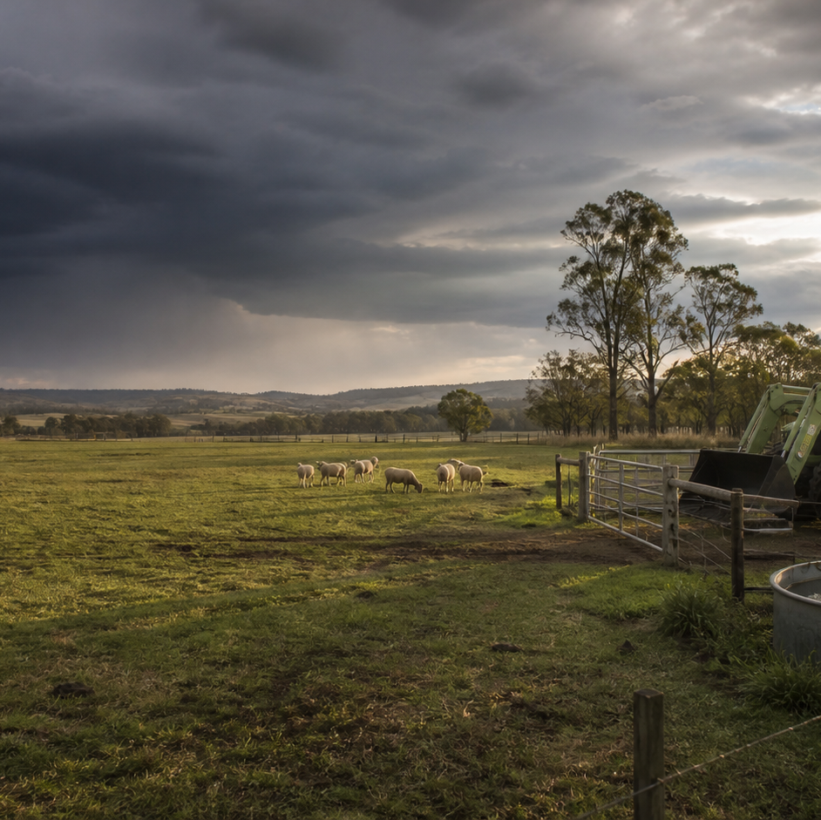
AHC20122 • CERTIFICATE II IN AGRICULTURE
Task 4 · Biosecurity
Recognise contamination pathways, inspect machinery and equipment, plan a controlled clean-down and keep traceable records.
LEARNING ROUTE
01 Biosecurity pathways and zones
02 Inspect machinery, tools and equipment
03 Build a clean-down work plan
04 Records, release checks and escalation
Supplementary learning • current local sources and supervision control real work
Notes:
Open by connecting the task purpose to the four-module route. Ask students which module most clearly prepares them to notice evidence, make a source-led decision and report through authority.
Boundary: Supplementary learning is grounded in AHCBIO203 Release 1 and the authorised course map. It teaches pathways, observation, planning fields, record literacy and escalation only. The current property biosecurity plan, workplace procedure, manufacturer information and supervisor control entry, isolation, inspection access, clean-down location, products, PPE, infection controls, cleaning steps, waste handling and release decisions.
[Sources]
- Supplementary learning is grounded in AHCBIO203 Release 1 and the authorised course map. It teaches pathways, observation, planning fields, record literacy and escalation only. The current property biosecurity plan, workplace procedure, manufacturer information and supervisor control entry, isolation, inspection access, clean-down location, products, PPE, infection controls, cleaning steps, waste handling and release decisions.
- Course hero: Generated for this course using OpenAI ImageGen on 21 August 2026.
- Course data: work/pi/site-data/course.json

Slide 2
TASK 04 • PRIMARY INDUSTRIES
Biosecurity pathways and zones
NOTICE
• Biosecurity manages movement of risk
• Map source, carrier and destination
Biosecurity protects properties, production systems, animals, plants and environments by reducing the movement and establishment of pests, diseases and unwanted material. A pathway explanation has at least three parts: where material may come from, what may carry it and where it could be transferred.
LOOK FOR
Connect the module's first four teaching ideas before students apply them to a fictional agricultural decision.
Use the map to connect the lesson ideas, then confirm any real procedure or decision through the current authorised source.
AHC20122 PRIMARY INDUSTRIES • TASK 4
2/10
Notes:
Teaching move (theory and visual): Use the module visual and the fictional worked example to move students from observation to a source-led decision. Ask students to name the evidence, the authority gap and the next safe communication step.
Misconception and help: Look for source, carrier and destination linked by a plausible movement. From where, carried by what, to where?
Applied action: Draw a fictional pathway map. Use a teacher-provided fictional farm scene. Draw one pathway with source, carrier, contact point and destination, then add where authorised confirmation is required. Do not prescribe entry or cleaning actions.
Boundary: Supplementary learning is grounded in AHCBIO203 Release 1 and the authorised course map. It teaches pathways, observation, planning fields, record literacy and escalation only. The current property biosecurity plan, workplace procedure, manufacturer information and supervisor control entry, isolation, inspection access, clean-down location, products, PPE, infection controls, cleaning steps, waste handling and release decisions.
[Sources]
- Source basis: AHCBIO203 Release 1 purpose and inspection/reporting requirements. The current property biosecurity plan controls zones, entry, threat status and all response actions.
- Visual visual-task-04-01: Generated locally from accepted Stage 05 module headings; no external image copied.
- Course visual manifest: work/pi/visuals/visual-manifest.json

Slide 3
TASK 04 • PRIMARY INDUSTRIES
Biosecurity pathways and zones: decide from evidence
FICTIONAL WORKPLACE EXAMPLE
CHECK YOUR DECISION
OBSERVE A fictional contractor vehicle arrives from another property with dried plant material visible near an exterior wheel area, and its booked entry zone is unclear.
DECIDE The vehicle may connect an outside source to a property destination, while the local access decision is unconfirmed.
ACT The learner does not direct entry or attempt cleaning; they report the observation and booking gap to the supervisor.
RECORD The learner records the factual observation and confirmed status in the nominated system.
Which description contains a complete biosecurity pathway?
A Mud is dirty and should be removed.
B Soil from an outside paddock may be carried on a vehicle to a property work area.
C Every vehicle from another property is contaminated.
HELP From where, carried by what, to where?
AHC20122 PRIMARY INDUSTRIES • TASK 4
3/10
Notes:
Teaching move (worked example and formative check): Use the module visual and the fictional worked example to move students from observation to a source-led decision. Ask students to name the evidence, the authority gap and the next safe communication step. Misconception and help: Look for source, carrier and destination linked by a plausible movement. From where, carried by what, to where? Applied action: Draw a fictional pathway map. Use a teacher-provided fictional farm scene. Draw one pathway with source, carrier, contact point and destination, then add where authorised confirmation is required. Do not prescribe entry or cleaning actions. Boundary: Supplementary learning is grounded in AHCBIO203 Release 1 and the authorised course map. It teaches pathways, observation, planning fields, record literacy and escalation only. The current property biosecurity plan, workplace procedure, manufacturer information and supervisor control entry, isolation, inspection access, clean-down location, products, PPE, infection controls, cleaning steps, waste handling and release decisions. [Sources] - Source basis: AHCBIO203 Release 1 purpose and inspection/reporting requirements. The current property biosecurity plan controls zones, entry, threat status and all response actions. - Visual visual-task-04-01: Generated locally from accepted Stage 05 module headings; no external image copied. - Course visual manifest: work/pi/visuals/visual-manifest.json
Formative check answer: Soil from an outside paddock may be carried on a vehicle to a property work area.
Correct feedback: You traced a possible movement pathway without overclaiming certainty.
Corrective feedback: Look for source, carrier and destination linked by a plausible movement.
Full contextual example: Observed evidence: A fictional contractor vehicle arrives from another property with dried plant material visible near an exterior wheel area, and its booked entry zone is unclear. Decision and reason: The vehicle may connect an outside source to a property destination, while the local access decision is unconfirmed. Safe action: The learner does not direct entry or attempt cleaning; they report the observation and booking gap to the supervisor. Result: The supervisor applies the property biosecurity plan and gives an authorised direction. Next check or record: The learner records the factual observation and confirmed status in the nominated system.

Slide 4
TASK 04 • PRIMARY INDUSTRIES
Inspect machinery, tools and equipment
NOTICE
• Inspection asks whether evidence needs action
• Confirm identity and inspection authority
Biosecurity inspection looks for observable material or condition that may contribute to movement of a threat. The item, previous use, destination and applicable procedure must be correctly matched.
LOOK FOR
Connect the module's first four teaching ideas before students apply them to a fictional agricultural decision.
Use the map to connect the lesson ideas, then confirm any real procedure or decision through the current authorised source.
AHC20122 PRIMARY INDUSTRIES • TASK 4
4/10
Notes:
Teaching move (theory and visual): Use the module visual and the fictional worked example to move students from observation to a source-led decision. Ask students to name the evidence, the authority gap and the next safe communication step.
Misconception and help: The checklist guides questions; it does not authorise physical access or release. Coverage tells what needs confirmation, not how to reach it.
Applied action: Complete an image-only inspection audit. Use a teacher-supplied fictional or de-identified image. Annotate visible evidence and observation limits only. Do not inspect, touch, open or clean physical equipment for this website activity.
Boundary: Supplementary learning is grounded in AHCBIO203 Release 1 and the authorised course map. It teaches pathways, observation, planning fields, record literacy and escalation only. The current property biosecurity plan, workplace procedure, manufacturer information and supervisor control entry, isolation, inspection access, clean-down location, products, PPE, infection controls, cleaning steps, waste handling and release decisions.
[Sources]
- Source basis: AHCBIO203 Release 1 inspection, equipment-fault reporting and documentation requirements. The unit's physical inspection work remains subject to current workplace procedures, safety controls and supervision and is not taught here.
- Visual visual-task-04-02: Generated locally from accepted Stage 05 module headings; no external image copied.
- Course visual manifest: work/pi/visuals/visual-manifest.json

Slide 5
TASK 04 • PRIMARY INDUSTRIES
Inspect machinery, tools and equipment: decide from evidence
FICTIONAL WORKPLACE EXAMPLE
CHECK YOUR DECISION
OBSERVE In a fictional inspection photograph, dry soil and seed-like material are visible on an external lower surface, while a nearby cover appears damaged.
DECIDE The material and damage both require authorised review, and the image cannot confirm areas behind the cover.
ACT The learner annotates only the visible locations and reports the inaccessible area and damage.
RECORD The learner records visible, inaccessible and referred categories without naming a threat or opening the cover.
What does a coverage category do in this lesson?
A It prompts what kinds of areas need confirmation without giving a physical inspection procedure.
B It authorises the learner to remove any guard that blocks the view.
C It proves the item is clean when most boxes are ticked.
HELP Coverage tells what needs confirmation, not how to reach it.
AHC20122 PRIMARY INDUSTRIES • TASK 4
5/10
Notes:
Teaching move (worked example and formative check): Use the module visual and the fictional worked example to move students from observation to a source-led decision. Ask students to name the evidence, the authority gap and the next safe communication step. Misconception and help: The checklist guides questions; it does not authorise physical access or release. Coverage tells what needs confirmation, not how to reach it. Applied action: Complete an image-only inspection audit. Use a teacher-supplied fictional or de-identified image. Annotate visible evidence and observation limits only. Do not inspect, touch, open or clean physical equipment for this website activity. Boundary: Supplementary learning is grounded in AHCBIO203 Release 1 and the authorised course map. It teaches pathways, observation, planning fields, record literacy and escalation only. The current property biosecurity plan, workplace procedure, manufacturer information and supervisor control entry, isolation, inspection access, clean-down location, products, PPE, infection controls, cleaning steps, waste handling and release decisions. [Sources] - Source basis: AHCBIO203 Release 1 inspection, equipment-fault reporting and documentation requirements. The unit's physical inspection work remains subject to current workplace procedures, safety controls and supervision and is not taught here. - Visual visual-task-04-02: Generated locally from accepted Stage 05 module headings; no external image copied. - Course visual manifest: work/pi/visuals/visual-manifest.json
Formative check answer: It prompts what kinds of areas need confirmation without giving a physical inspection procedure.
Correct feedback: You used categories for evidence coverage, not as operating permission.
Corrective feedback: The checklist guides questions; it does not authorise physical access or release.
Full contextual example: Observed evidence: In a fictional inspection photograph, dry soil and seed-like material are visible on an external lower surface, while a nearby cover appears damaged. Decision and reason: The material and damage both require authorised review, and the image cannot confirm areas behind the cover. Safe action: The learner annotates only the visible locations and reports the inaccessible area and damage. Result: The supervisor decides the equipment status and next controlled action. Next check or record: The learner records visible, inaccessible and referred categories without naming a threat or opening the cover.

Slide 6
TASK 04 • PRIMARY INDUSTRIES
Build a clean-down work plan
NOTICE
• A plan organises authority before action
• Start with identity and source fields
A clean-down work plan should make the task identity, purpose, responsibilities, controlling procedure and unresolved decisions visible. The plan needs the item or equipment identity, previous work context, intended destination and current property procedure.
LOOK FOR
Connect the module's first four teaching ideas before students apply them to a fictional agricultural decision.
Use the map to connect the lesson ideas, then confirm any real procedure or decision through the current authorised source.
AHC20122 PRIMARY INDUSTRIES • TASK 4
6/10
Notes:
Teaching move (theory and visual): Use the module visual and the fictional worked example to move students from observation to a source-led decision. Ask students to name the evidence, the authority gap and the next safe communication step.
Misconception and help: The plan must be tied to the current property procedure and approved location. Ask which source and which authorised place control this exact item.
Applied action: Audit a source-controlled plan. Review a fictional planning card and highlight missing identity, source, role, location, escalation and authority fields. Do not fill any practical step from memory or another property.
Boundary: Supplementary learning is grounded in AHCBIO203 Release 1 and the authorised course map. It teaches pathways, observation, planning fields, record literacy and escalation only. The current property biosecurity plan, workplace procedure, manufacturer information and supervisor control entry, isolation, inspection access, clean-down location, products, PPE, infection controls, cleaning steps, waste handling and release decisions.
[Sources]
- Source basis: AHCBIO203 Release 1 preparation, supervisor-confirmation, workplace-procedure and reporting requirements. Exact tools, products, PPE, infection controls, locations, cleaning and waste procedures remain controlled local content.
- Visual visual-task-04-03: Generated locally from accepted Stage 05 module headings; no external image copied.
- Course visual manifest: work/pi/visuals/visual-manifest.json

Slide 7
TASK 04 • PRIMARY INDUSTRIES
Build a clean-down work plan: decide from evidence
FICTIONAL WORKPLACE EXAMPLE
CHECK YOUR DECISION
OBSERVE A fictional planning card names a support vehicle and destination but leaves the controlling biosecurity procedure and authorised location blank.
DECIDE The task cannot progress because two property-specific controls are unknown.
ACT The learner marks both fields 'confirmation required' and sends a concise query to the supervisor.
RECORD The learner updates the source and location fields but does not add cleaning steps from memory.
Which pair of fields must be confirmed before a source-controlled clean-down plan can progress?
A The learner's preferred product and quickest method.
B The current property procedure and authorised work location.
C A generic internet checklist and another farm's zone map.
HELP Ask which source and which authorised place control this exact item.
AHC20122 PRIMARY INDUSTRIES • TASK 4
7/10
Notes:
Teaching move (worked example and formative check): Use the module visual and the fictional worked example to move students from observation to a source-led decision. Ask students to name the evidence, the authority gap and the next safe communication step. Misconception and help: The plan must be tied to the current property procedure and approved location. Ask which source and which authorised place control this exact item. Applied action: Audit a source-controlled plan. Review a fictional planning card and highlight missing identity, source, role, location, escalation and authority fields. Do not fill any practical step from memory or another property. Boundary: Supplementary learning is grounded in AHCBIO203 Release 1 and the authorised course map. It teaches pathways, observation, planning fields, record literacy and escalation only. The current property biosecurity plan, workplace procedure, manufacturer information and supervisor control entry, isolation, inspection access, clean-down location, products, PPE, infection controls, cleaning steps, waste handling and release decisions. [Sources] - Source basis: AHCBIO203 Release 1 preparation, supervisor-confirmation, workplace-procedure and reporting requirements. Exact tools, products, PPE, infection controls, locations, cleaning and waste procedures remain controlled local content. - Visual visual-task-04-03: Generated locally from accepted Stage 05 module headings; no external image copied. - Course visual manifest: work/pi/visuals/visual-manifest.json
Formative check answer: The current property procedure and authorised work location.
Correct feedback: You identified two local-authority gates before action.
Corrective feedback: The plan must be tied to the current property procedure and approved location.
Full contextual example: Observed evidence: A fictional planning card names a support vehicle and destination but leaves the controlling biosecurity procedure and authorised location blank. Decision and reason: The task cannot progress because two property-specific controls are unknown. Safe action: The learner marks both fields 'confirmation required' and sends a concise query to the supervisor. Result: The supervisor points to the current procedure and nominates the approved work location. Next check or record: The learner updates the source and location fields but does not add cleaning steps from memory.

Slide 8
TASK 04 • PRIMARY INDUSTRIES
Records, release checks and escalation
NOTICE
• A biosecurity record preserves the decision trail
• Use clear status language
An inspection or work record links the item, date, task context, observations, authorised activity, unresolved findings and people notified. Records should clearly distinguish observed, action recorded, referred, pending confirmation and authorised final status.
LOOK FOR
Connect the module's first four teaching ideas before students apply them to a fictional agricultural decision.
Use the map to connect the lesson ideas, then confirm any real procedure or decision through the current authorised source.
AHC20122 PRIMARY INDUSTRIES • TASK 4
8/10
Notes:
Teaching move (theory and visual): Use the module visual and the fictional worked example to move students from observation to a source-led decision. Ask students to name the evidence, the authority gap and the next safe communication step.
Misconception and help: Do not turn a completed activity into an assumed release. No authorised status means status unconfirmed.
Applied action: Reconcile a fictional biosecurity record set. Compare fictional inspection, activity and movement records. Identify missing or conflicting status and draft an escalation. Do not use real property, vehicle, worker or assessor information.
Boundary: Supplementary learning is grounded in AHCBIO203 Release 1 and the authorised course map. It teaches pathways, observation, planning fields, record literacy and escalation only. The current property biosecurity plan, workplace procedure, manufacturer information and supervisor control entry, isolation, inspection access, clean-down location, products, PPE, infection controls, cleaning steps, waste handling and release decisions.
[Sources]
- Source basis: AHCBIO203 Release 1 requirements for recording cleaning history, documenting inspection results and delivering reports. Current property procedures and authorised roles control release criteria and final status.
- Visual visual-task-04-04: Generated locally from accepted Stage 05 module headings; no external image copied.
- Course visual manifest: work/pi/visuals/visual-manifest.json

Slide 9
TASK 04 • PRIMARY INDUSTRIES
Records, release checks and escalation: decide from evidence
FICTIONAL WORKPLACE EXAMPLE
CHECK YOUR DECISION
OBSERVE A fictional record shows an activity entry and a supervisor name, but one required inspection area is marked 'not accessible' and the final-status field is blank.
DECIDE The record does not support an assumption that the item is released.
ACT The learner highlights the unresolved area and asks the authorised supervisor to confirm the next controlled action and status.
RECORD The learner checks that the pending status is visible in the handover and does not add release criteria.
A record says activity completed but the final-status field is blank. What can the learner conclude?
A The item is automatically released.
B The status remains unconfirmed and must be referred.
C The learner should add the status that seems most likely.
HELP No authorised status means status unconfirmed.
AHC20122 PRIMARY INDUSTRIES • TASK 4
9/10
Notes:
Teaching move (worked example and formative check): Use the module visual and the fictional worked example to move students from observation to a source-led decision. Ask students to name the evidence, the authority gap and the next safe communication step. Misconception and help: Do not turn a completed activity into an assumed release. No authorised status means status unconfirmed. Applied action: Reconcile a fictional biosecurity record set. Compare fictional inspection, activity and movement records. Identify missing or conflicting status and draft an escalation. Do not use real property, vehicle, worker or assessor information. Boundary: Supplementary learning is grounded in AHCBIO203 Release 1 and the authorised course map. It teaches pathways, observation, planning fields, record literacy and escalation only. The current property biosecurity plan, workplace procedure, manufacturer information and supervisor control entry, isolation, inspection access, clean-down location, products, PPE, infection controls, cleaning steps, waste handling and release decisions. [Sources] - Source basis: AHCBIO203 Release 1 requirements for recording cleaning history, documenting inspection results and delivering reports. Current property procedures and authorised roles control release criteria and final status. - Visual visual-task-04-04: Generated locally from accepted Stage 05 module headings; no external image copied. - Course visual manifest: work/pi/visuals/visual-manifest.json
Formative check answer: The status remains unconfirmed and must be referred.
Correct feedback: You kept the item pending until the authorised status is recorded.
Corrective feedback: Do not turn a completed activity into an assumed release.
Full contextual example: Observed evidence: A fictional record shows an activity entry and a supervisor name, but one required inspection area is marked 'not accessible' and the final-status field is blank. Decision and reason: The record does not support an assumption that the item is released. Safe action: The learner highlights the unresolved area and asks the authorised supervisor to confirm the next controlled action and status. Result: The supervisor records that the item remains pending. Next check or record: The learner checks that the pending status is visible in the handover and does not add release criteria.

Slide 10
CLOSE THE LOOP WITH EVIDENCE
Apply the task route — then check the boundary
01 Biosecurity pathways and zones
02 Inspect machinery, tools and equipment
03 Build a clean-down work plan
04 Records, release checks and escalation
Draw a fictional pathway map
Use a teacher-provided fictional farm scene.
Complete an image-only inspection audit
Use a teacher-supplied fictional or de-identified image.
Audit a source-controlled plan
Review a fictional planning card and highlight missing identity, source, role, location, escalation and authority fields.
Reconcile a fictional biosecurity record set
Compare fictional inspection, activity and movement records.
NEXT STEP Complete the teacher-nominated learning action. Use current local sources and supervision before any real practical decision. Website responses remain formative.
Notes:
Close with one retrieval question from each module, then direct students to the teacher-nominated learning action. Re-state that site work is formative and that current workplace and RTO processes control real practice and assessment.
Boundary: Supplementary learning is grounded in AHCBIO203 Release 1 and the authorised course map. It teaches pathways, observation, planning fields, record literacy and escalation only. The current property biosecurity plan, workplace procedure, manufacturer information and supervisor control entry, isolation, inspection access, clean-down location, products, PPE, infection controls, cleaning steps, waste handling and release decisions.
[Sources]
- Source basis: AHCBIO203 Release 1 purpose and inspection/reporting requirements. The current property biosecurity plan controls zones, entry, threat status and all response actions.
- Source basis: AHCBIO203 Release 1 inspection, equipment-fault reporting and documentation requirements. The unit's physical inspection work remains subject to current workplace procedures, safety controls and supervision and is not taught here.
- Source basis: AHCBIO203 Release 1 preparation, supervisor-confirmation, workplace-procedure and reporting requirements. Exact tools, products, PPE, infection controls, locations, cleaning and waste procedures remain controlled local content.
- Source basis: AHCBIO203 Release 1 requirements for recording cleaning history, documenting inspection results and delivering reports. Current property procedures and authorised roles control release criteria and final status.

