Slide 1
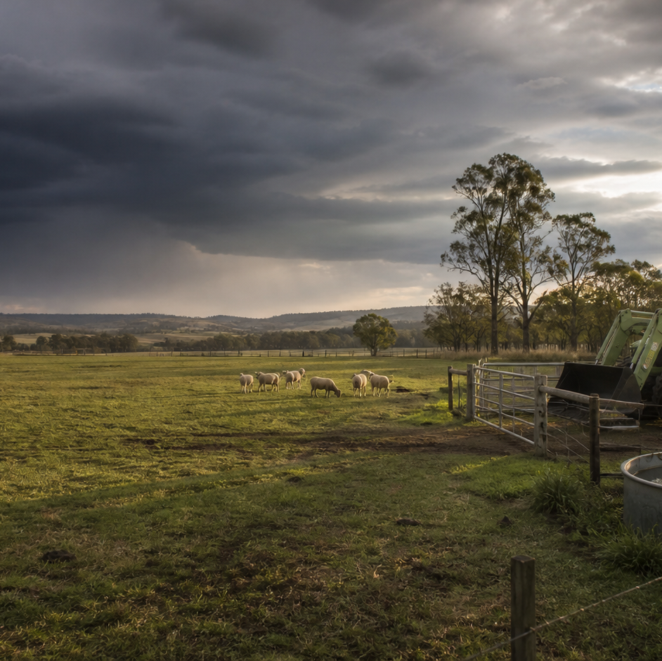
AHC20122 • CERTIFICATE II IN AGRICULTURE
Task 5 · Handle and observe livestock
Read livestock behaviour, plan roles and movement, observe condition and communicate changes during supervised work.
LEARNING ROUTE
01 Read livestock behaviour and the environment
02 Plan roles for a supervised livestock movement
03 Observe condition and report change
04 Handling records and post-task review
Supplementary learning • current local sources and supervision control real work
Notes:
Open by connecting the task purpose to the four-module route. Ask students which module most clearly prepares them to notice evidence, make a source-led decision and report through authority.
Boundary: Supplementary learning is grounded in AHCLSK224 Release 1, AHCLSK223 Release 1 and the authorised teacher-posted livestock focus-area resource. Inclusion of AHCLSK223 in the signed TAS remains Teacher/RTO to confirm. Current animal welfare requirements, workplace procedures, the livestock plan, facilities, teacher demonstrations, supervision and RTO assessment package control real work. This site teaches observation, planning, communication and record literacy only; it does not teach species-specific movement, handling, restraint or intervention techniques and does not demonstrate competency.
[Sources]
- Supplementary learning is grounded in AHCLSK224 Release 1, AHCLSK223 Release 1 and the authorised teacher-posted livestock focus-area resource. Inclusion of AHCLSK223 in the signed TAS remains Teacher/RTO to confirm. Current animal welfare requirements, workplace procedures, the livestock plan, facilities, teacher demonstrations, supervision and RTO assessment package control real work. This site teaches observation, planning, communication and record literacy only; it does not teach species-specific movement, handling, restraint or intervention techniques and does not demonstrate competency.
- Course hero: Generated for this course using OpenAI ImageGen on 21 August 2026.
- Course data: work/pi/site-data/course.json

Slide 2
TASK 05 • PRIMARY INDUSTRIES
Read livestock behaviour and the environment
NOTICE
• Observation begins before the task
• Build a normal reference
Livestock observation starts from a position and distance approved for the workplace, before anyone attempts to influence movement. The word normal is meaningful only when it is connected to a known group, time and situation.
LOOK FOR
Connect the module's first four teaching ideas before students apply them to a fictional agricultural decision.
Use the map to connect the lesson ideas, then confirm any real procedure or decision through the current authorised source.
AHC20122 PRIMARY INDUSTRIES • TASK 5
2/10
Notes:
Teaching move (theory and visual): Use the module visual and the fictional worked example to move students from observation to a source-led decision. Ask students to name the evidence, the authority gap and the next safe communication step.
Misconception and help: Choose language that another observer could verify without accepting a guess about motive or illness. Look for who or what, the visible cue, frequency and context.
Applied action: Build a behaviour observation grid. From a teacher-approved image or fictional scene, record group pattern, one individual difference, two environmental features and the question you would refer to a supervisor. Do not enter a livestock area or propose a movement technique.
Boundary: Supplementary learning is grounded in AHCLSK224 Release 1, AHCLSK223 Release 1 and the authorised teacher-posted livestock focus-area resource. Inclusion of AHCLSK223 in the signed TAS remains Teacher/RTO to confirm. Current animal welfare requirements, workplace procedures, the livestock plan, facilities, teacher demonstrations, supervision and RTO assessment package control real work. This site teaches observation, planning, communication and record literacy only; it does not teach species-specific movement, handling, restraint or intervention techniques and does not demonstrate competency.
[Sources]
- Source basis: AHCLSK223 Release 1 and AHCLSK224 Release 1 requirements to observe livestock behaviour, report abnormalities and work under supervisor instructions, supported by the authorised livestock focus-area resource. Current species guidance, local facilities, workplace procedures and teacher supervision control real observation and handling.
- Visual visual-task-05-01: Generated locally from accepted Stage 05 module headings; no external image copied.
- Course visual manifest: work/pi/visuals/visual-manifest.json

Slide 3
TASK 05 • PRIMARY INDUSTRIES
Read livestock behaviour and the environment: decide from evidence
FICTIONAL WORKPLACE EXAMPLE
CHECK YOUR DECISION
OBSERVE On fictional Riverbend Farm, Maya watches a group from the teacher-approved observation point and notes that most animals continue facing the feed area while one repeatedly turns towards a flapping sheet beside the lane.
DECIDE Maya does not label the animal aggressive or attempt to move it because the visible cue and environmental change need authorised interpretation.
ACT She reports the animal identifier, repeated head turns, location and flapping material.
RECORD Maya records only the observable pattern and the direction received.
Which statement is the strongest objective livestock observation?
A The animal is difficult and wants to cause trouble.
B Animal 14 turned towards the flapping sheet four times while the rest remained facing the feed area.
C The whole group probably has a disease.
HELP Look for who or what, the visible cue, frequency and context.
AHC20122 PRIMARY INDUSTRIES • TASK 5
3/10
Notes:
Teaching move (worked example and formative check): Use the module visual and the fictional worked example to move students from observation to a source-led decision. Ask students to name the evidence, the authority gap and the next safe communication step. Misconception and help: Choose language that another observer could verify without accepting a guess about motive or illness. Look for who or what, the visible cue, frequency and context. Applied action: Build a behaviour observation grid. From a teacher-approved image or fictional scene, record group pattern, one individual difference, two environmental features and the question you would refer to a supervisor. Do not enter a livestock area or propose a movement technique. Boundary: Supplementary learning is grounded in AHCLSK224 Release 1, AHCLSK223 Release 1 and the authorised teacher-posted livestock focus-area resource. Inclusion of AHCLSK223 in the signed TAS remains Teacher/RTO to confirm. Current animal welfare requirements, workplace procedures, the livestock plan, facilities, teacher demonstrations, supervision and RTO assessment package control real work. This site teaches observation, planning, communication and record literacy only; it does not teach species-specific movement, handling, restraint or intervention techniques and does not demonstrate competency. [Sources] - Source basis: AHCLSK223 Release 1 and AHCLSK224 Release 1 requirements to observe livestock behaviour, report abnormalities and work under supervisor instructions, supported by the authorised livestock focus-area resource. Current species guidance, local facilities, workplace procedures and teacher supervision control real observation and handling. - Visual visual-task-05-01: Generated locally from accepted Stage 05 module headings; no external image copied. - Course visual manifest: work/pi/visuals/visual-manifest.json
Formative check answer: Animal 14 turned towards the flapping sheet four times while the rest remained facing the feed area.
Correct feedback: You selected a specific observation that an authorised person can review.
Corrective feedback: Choose language that another observer could verify without accepting a guess about motive or illness.
Full contextual example: Observed evidence: On fictional Riverbend Farm, Maya watches a group from the teacher-approved observation point and notes that most animals continue facing the feed area while one repeatedly turns towards a flapping sheet beside the lane. Decision and reason: Maya does not label the animal aggressive or attempt to move it because the visible cue and environmental change need authorised interpretation. Safe action: She reports the animal identifier, repeated head turns, location and flapping material. Result: The supervisor reviews the scene and confirms the next step. Next check or record: Maya records only the observable pattern and the direction received.

Slide 4
TASK 05 • PRIMARY INDUSTRIES
Plan roles for a supervised livestock movement
NOTICE
• Start with the authorised purpose
• Make each role visible
A movement plan begins with a clear purpose, identified animals and an approved destination. Every participant needs a defined role, location, communication method and decision limit.
LOOK FOR
Connect the module's first four teaching ideas before students apply them to a fictional agricultural decision.
Use the map to connect the lesson ideas, then confirm any real procedure or decision through the current authorised source.
AHC20122 PRIMARY INDUSTRIES • TASK 5
4/10
Notes:
Teaching move (theory and visual): Use the module visual and the fictional worked example to move students from observation to a source-led decision. Ask students to name the evidence, the authority gap and the next safe communication step.
Misconception and help: A learner should not resolve a route or destination conflict through personal preference. Compare the sources, name the mismatch and refer it.
Applied action: Audit a fictional movement brief. Review a teacher-provided fictional plan and highlight the purpose, identifiers, roles, route, communication, stop conditions and completion check. Mark any conflict as requiring supervisor confirmation rather than fixing it yourself.
Boundary: Supplementary learning is grounded in AHCLSK224 Release 1, AHCLSK223 Release 1 and the authorised teacher-posted livestock focus-area resource. Inclusion of AHCLSK223 in the signed TAS remains Teacher/RTO to confirm. Current animal welfare requirements, workplace procedures, the livestock plan, facilities, teacher demonstrations, supervision and RTO assessment package control real work. This site teaches observation, planning, communication and record literacy only; it does not teach species-specific movement, handling, restraint or intervention techniques and does not demonstrate competency.
[Sources]
- Source basis: AHCLSK224 Release 1 preparation, communication, facility, access-route, tally and reporting requirements, with AHCLSK223 Release 1 clarification and affected-worker communication. Current workplace procedures, approved facilities, livestock plan, teacher demonstration and supervision control actual movement.
- Visual visual-task-05-02: Generated locally from accepted Stage 05 module headings; no external image copied.
- Course visual manifest: work/pi/visuals/visual-manifest.json

Slide 5
TASK 05 • PRIMARY INDUSTRIES
Plan roles for a supervised livestock movement: decide from evidence
FICTIONAL WORKPLACE EXAMPLE
CHECK YOUR DECISION
OBSERVE At fictional Wattle Creek Training Farm, a supervisor briefs three learners to observe the relocation of a numbered group between two designated areas. Plan reading: Priya notices that the written destination says North Holding Area while the whiteboard…
DECIDE She does not choose either destination because the inconsistency changes the route and facility plan.
ACT Priya reads back the two conflicting entries and asks the supervisor to confirm and update the team.
RECORD Priya notes the confirmed destination and her observation role.
Two authorised planning sources name different destinations. What is the strongest learner response?
A Choose the destination that appears easier to reach.
B Identify the conflict and ask the coordinating supervisor to confirm the current plan.
C Start the task and resolve the difference if it becomes a problem.
HELP Compare the sources, name the mismatch and refer it.
AHC20122 PRIMARY INDUSTRIES • TASK 5
5/10
Notes:
Teaching move (worked example and formative check): Use the module visual and the fictional worked example to move students from observation to a source-led decision. Ask students to name the evidence, the authority gap and the next safe communication step. Misconception and help: A learner should not resolve a route or destination conflict through personal preference. Compare the sources, name the mismatch and refer it. Applied action: Audit a fictional movement brief. Review a teacher-provided fictional plan and highlight the purpose, identifiers, roles, route, communication, stop conditions and completion check. Mark any conflict as requiring supervisor confirmation rather than fixing it yourself. Boundary: Supplementary learning is grounded in AHCLSK224 Release 1, AHCLSK223 Release 1 and the authorised teacher-posted livestock focus-area resource. Inclusion of AHCLSK223 in the signed TAS remains Teacher/RTO to confirm. Current animal welfare requirements, workplace procedures, the livestock plan, facilities, teacher demonstrations, supervision and RTO assessment package control real work. This site teaches observation, planning, communication and record literacy only; it does not teach species-specific movement, handling, restraint or intervention techniques and does not demonstrate competency. [Sources] - Source basis: AHCLSK224 Release 1 preparation, communication, facility, access-route, tally and reporting requirements, with AHCLSK223 Release 1 clarification and affected-worker communication. Current workplace procedures, approved facilities, livestock plan, teacher demonstration and supervision control actual movement. - Visual visual-task-05-02: Generated locally from accepted Stage 05 module headings; no external image copied. - Course visual manifest: work/pi/visuals/visual-manifest.json
Formative check answer: Identify the conflict and ask the coordinating supervisor to confirm the current plan.
Correct feedback: You treated source agreement as a precondition for a clear team plan.
Corrective feedback: A learner should not resolve a route or destination conflict through personal preference.
Full contextual example: Plan context: At fictional Wattle Creek Training Farm, a supervisor briefs three learners to observe the relocation of a numbered group between two designated areas. Plan reading: Priya notices that the written destination says North Holding Area while the whiteboard says East Holding Area. Decision and reason: She does not choose either destination because the inconsistency changes the route and facility plan. Safe action: Priya reads back the two conflicting entries and asks the supervisor to confirm and update the team. Result: The supervisor corrects the board and rechecks roles. Next check or record: Priya notes the confirmed destination and her observation role.

Slide 6
TASK 05 • PRIMARY INDUSTRIES
Observe condition and report change
NOTICE
• Use a repeatable observation frame
• Separate what is seen from what it might mean
A repeatable frame helps an observer notice change without wandering between unrelated impressions. Observation describes direct evidence such as uneven movement, repeated separation from the group or a visible change in coat condition.
LOOK FOR
Connect the module's first four teaching ideas before students apply them to a fictional agricultural decision.
Use the map to connect the lesson ideas, then confirm any real procedure or decision through the current authorised source.
AHC20122 PRIMARY INDUSTRIES • TASK 5
6/10
Notes:
Teaching move (theory and visual): Use the module visual and the fictional worked example to move students from observation to a source-led decision. Ask students to name the evidence, the authority gap and the next safe communication step.
Misconception and help: Remove diagnosis, treatment and motive; retain the visible pattern and context. Ask whether a camera or timed record could capture the statement.
Applied action: Separate evidence from interpretation. Sort twelve teacher-provided fictional statements into observation, context, interpretation and authorised decision. Rewrite any diagnosis or motive claim as a reportable observation without adding new facts.
Boundary: Supplementary learning is grounded in AHCLSK224 Release 1, AHCLSK223 Release 1 and the authorised teacher-posted livestock focus-area resource. Inclusion of AHCLSK223 in the signed TAS remains Teacher/RTO to confirm. Current animal welfare requirements, workplace procedures, the livestock plan, facilities, teacher demonstrations, supervision and RTO assessment package control real work. This site teaches observation, planning, communication and record literacy only; it does not teach species-specific movement, handling, restraint or intervention techniques and does not demonstrate competency.
[Sources]
- Source basis: AHCLSK223 Release 1 livestock-check and reporting requirements, AHCLSK224 Release 1 behaviour monitoring, and the authorised livestock focus-area emphasis on normal, abnormal and changed behaviour. Current workplace procedures and authorised animal-health expertise control diagnosis and response.
- Visual visual-task-05-03: Generated locally from accepted Stage 05 module headings; no external image copied.
- Course visual manifest: work/pi/visuals/visual-manifest.json

Slide 7
TASK 05 • PRIMARY INDUSTRIES
Observe condition and report change: decide from evidence
FICTIONAL WORKPLACE EXAMPLE
CHECK YOUR DECISION
OBSERVE At fictional Ironbark Farm, Noah compares two approved observation sheets and sees that animal B17 was recorded near the group throughout the morning check but remained apart during three intervals in the afternoon check. The afternoon temperature and…
DECIDE Noah cannot diagnose the cause or conclude that the condition worsened because the contexts are not identical.
ACT He reports the identifier, repeated separation and contextual differences.
RECORD Noah enters the facts and leaves the diagnosis and intervention fields to authorised staff.
Which entry keeps observation separate from diagnosis?
A Animal B17 has an infection and needs medicine.
B Animal B17 remained apart from the group during three recorded intervals.
C Animal B17 is lazy and dislikes the others.
HELP Ask whether a camera or timed record could capture the statement.
AHC20122 PRIMARY INDUSTRIES • TASK 5
7/10
Notes:
Teaching move (worked example and formative check): Use the module visual and the fictional worked example to move students from observation to a source-led decision. Ask students to name the evidence, the authority gap and the next safe communication step. Misconception and help: Remove diagnosis, treatment and motive; retain the visible pattern and context. Ask whether a camera or timed record could capture the statement. Applied action: Separate evidence from interpretation. Sort twelve teacher-provided fictional statements into observation, context, interpretation and authorised decision. Rewrite any diagnosis or motive claim as a reportable observation without adding new facts. Boundary: Supplementary learning is grounded in AHCLSK224 Release 1, AHCLSK223 Release 1 and the authorised teacher-posted livestock focus-area resource. Inclusion of AHCLSK223 in the signed TAS remains Teacher/RTO to confirm. Current animal welfare requirements, workplace procedures, the livestock plan, facilities, teacher demonstrations, supervision and RTO assessment package control real work. This site teaches observation, planning, communication and record literacy only; it does not teach species-specific movement, handling, restraint or intervention techniques and does not demonstrate competency. [Sources] - Source basis: AHCLSK223 Release 1 livestock-check and reporting requirements, AHCLSK224 Release 1 behaviour monitoring, and the authorised livestock focus-area emphasis on normal, abnormal and changed behaviour. Current workplace procedures and authorised animal-health expertise control diagnosis and response. - Visual visual-task-05-03: Generated locally from accepted Stage 05 module headings; no external image copied. - Course visual manifest: work/pi/visuals/visual-manifest.json
Formative check answer: Animal B17 remained apart from the group during three recorded intervals.
Correct feedback: You chose an observation that supports authorised review without overclaiming.
Corrective feedback: Remove diagnosis, treatment and motive; retain the visible pattern and context.
Full contextual example: Observed evidence: At fictional Ironbark Farm, Noah compares two approved observation sheets and sees that animal B17 was recorded near the group throughout the morning check but remained apart during three intervals in the afternoon check. The afternoon temperature and observation location also differ. Decision and reason: Noah cannot diagnose the cause or conclude that the condition worsened because the contexts are not identical. Safe action: He reports the identifier, repeated separation and contextual differences. Result: The supervisor decides the follow-up. Next check or record: Noah enters the facts and leaves the diagnosis and intervention fields to authorised staff.

Slide 8
TASK 05 • PRIMARY INDUSTRIES
Handling records and post-task review
NOTICE
• A record tells the task story
• Reconcile numbers and identifiers
A handling record connects the authorised purpose, animals, people, time, place, conditions and confirmed outcome. Counts or tallies should be compared with the authorised starting information and confirmed destination record.
LOOK FOR
Connect the module's first four teaching ideas before students apply them to a fictional agricultural decision.
Use the map to connect the lesson ideas, then confirm any real procedure or decision through the current authorised source.
AHC20122 PRIMARY INDUSTRIES • TASK 5
8/10
Notes:
Teaching move (theory and visual): Use the module visual and the fictional worked example to move students from observation to a source-led decision. Ask students to name the evidence, the authority gap and the next safe communication step.
Misconception and help: Do not hide or erase a discrepancy; record it and keep the correction authorised. Preserve evidence first, then reconcile through the current process.
Applied action: Reconcile a handling record. Use a fictional teacher-provided plan, tally and outcome note. Mark matching data, preserve differences and prepare a three-point post-task brief for the authorised reviewer. Do not invent missing identifiers or repair directions.
Boundary: Supplementary learning is grounded in AHCLSK224 Release 1, AHCLSK223 Release 1 and the authorised teacher-posted livestock focus-area resource. Inclusion of AHCLSK223 in the signed TAS remains Teacher/RTO to confirm. Current animal welfare requirements, workplace procedures, the livestock plan, facilities, teacher demonstrations, supervision and RTO assessment package control real work. This site teaches observation, planning, communication and record literacy only; it does not teach species-specific movement, handling, restraint or intervention techniques and does not demonstrate competency.
[Sources]
- Source basis: AHCLSK224 Release 1 tally, completion, maintenance-reporting and outcome-reporting requirements, with AHCLSK223 Release 1 observation and communication principles. Current enterprise records, correction procedures, livestock plan and RTO package remain authoritative.
- Visual visual-task-05-04: Generated locally from accepted Stage 05 module headings; no external image copied.
- Course visual manifest: work/pi/visuals/visual-manifest.json

Slide 9
TASK 05 • PRIMARY INDUSTRIES
Handling records and post-task review: decide from evidence
FICTIONAL WORKPLACE EXAMPLE
CHECK YOUR DECISION
OBSERVE At fictional Banksia Agricultural Centre, the plan lists 18 animals moving to Holding Area C, but the destination tally shows 17 and one identifier line is blank. A gate latch was also reported as difficult to secure after…
DECIDE Elena does not change 17 to 18 or insert a guessed identifier because that would hide the discrepancy.
ACT She preserves both tallies, marks the identifier as unresolved and reports the latch's visible condition and location.
RECORD Elena records the confirmed correction with traceability.
A destination tally differs from the authorised starting count. What should the learner record?
A Change the smaller number so both records look complete.
B Preserve both values, identify the mismatch and report it through the authorised path.
C Delete both counts because neither can now be trusted.
HELP Preserve evidence first, then reconcile through the current process.
AHC20122 PRIMARY INDUSTRIES • TASK 5
9/10
Notes:
Teaching move (worked example and formative check): Use the module visual and the fictional worked example to move students from observation to a source-led decision. Ask students to name the evidence, the authority gap and the next safe communication step. Misconception and help: Do not hide or erase a discrepancy; record it and keep the correction authorised. Preserve evidence first, then reconcile through the current process. Applied action: Reconcile a handling record. Use a fictional teacher-provided plan, tally and outcome note. Mark matching data, preserve differences and prepare a three-point post-task brief for the authorised reviewer. Do not invent missing identifiers or repair directions. Boundary: Supplementary learning is grounded in AHCLSK224 Release 1, AHCLSK223 Release 1 and the authorised teacher-posted livestock focus-area resource. Inclusion of AHCLSK223 in the signed TAS remains Teacher/RTO to confirm. Current animal welfare requirements, workplace procedures, the livestock plan, facilities, teacher demonstrations, supervision and RTO assessment package control real work. This site teaches observation, planning, communication and record literacy only; it does not teach species-specific movement, handling, restraint or intervention techniques and does not demonstrate competency. [Sources] - Source basis: AHCLSK224 Release 1 tally, completion, maintenance-reporting and outcome-reporting requirements, with AHCLSK223 Release 1 observation and communication principles. Current enterprise records, correction procedures, livestock plan and RTO package remain authoritative. - Visual visual-task-05-04: Generated locally from accepted Stage 05 module headings; no external image copied. - Course visual manifest: work/pi/visuals/visual-manifest.json
Formative check answer: Preserve both values, identify the mismatch and report it through the authorised path.
Correct feedback: You protected the integrity of the record and referred the unresolved difference.
Corrective feedback: Do not hide or erase a discrepancy; record it and keep the correction authorised.
Full contextual example: Record context: At fictional Banksia Agricultural Centre, the plan lists 18 animals moving to Holding Area C, but the destination tally shows 17 and one identifier line is blank. A gate latch was also reported as difficult to secure after the task. Decision and reason: Elena does not change 17 to 18 or insert a guessed identifier because that would hide the discrepancy. Safe action: She preserves both tallies, marks the identifier as unresolved and reports the latch's visible condition and location. Result: The supervisor reconciles the count and allocates facility follow-up. Next check or record: Elena records the confirmed correction with traceability.

Slide 10
CLOSE THE LOOP WITH EVIDENCE
Apply the task route — then check the boundary
01 Read livestock behaviour and the environment
02 Plan roles for a supervised livestock movement
03 Observe condition and report change
04 Handling records and post-task review
Build a behaviour observation grid
From a teacher-approved image or fictional scene, record group pattern, one individual difference, two environmental features and the question you would refer to a supervisor.
Audit a fictional movement brief
Review a teacher-provided fictional plan and highlight the purpose, identifiers, roles, route, communication, stop conditions and completion check.
Separate evidence from interpretation
Sort twelve teacher-provided fictional statements into observation, context, interpretation and authorised decision.
Reconcile a handling record
Use a fictional teacher-provided plan, tally and outcome note.
NEXT STEP Complete the teacher-nominated learning action. Use current local sources and supervision before any real practical decision. Website responses remain formative.
Notes:
Close with one retrieval question from each module, then direct students to the teacher-nominated learning action. Re-state that site work is formative and that current workplace and RTO processes control real practice and assessment.
Boundary: Supplementary learning is grounded in AHCLSK224 Release 1, AHCLSK223 Release 1 and the authorised teacher-posted livestock focus-area resource. Inclusion of AHCLSK223 in the signed TAS remains Teacher/RTO to confirm. Current animal welfare requirements, workplace procedures, the livestock plan, facilities, teacher demonstrations, supervision and RTO assessment package control real work. This site teaches observation, planning, communication and record literacy only; it does not teach species-specific movement, handling, restraint or intervention techniques and does not demonstrate competency.
[Sources]
- Source basis: AHCLSK223 Release 1 and AHCLSK224 Release 1 requirements to observe livestock behaviour, report abnormalities and work under supervisor instructions, supported by the authorised livestock focus-area resource. Current species guidance, local facilities, workplace procedures and teacher supervision control real observation and handling.
- Source basis: AHCLSK224 Release 1 preparation, communication, facility, access-route, tally and reporting requirements, with AHCLSK223 Release 1 clarification and affected-worker communication. Current workplace procedures, approved facilities, livestock plan, teacher demonstration and supervision control actual movement.
- Source basis: AHCLSK223 Release 1 livestock-check and reporting requirements, AHCLSK224 Release 1 behaviour monitoring, and the authorised livestock focus-area emphasis on normal, abnormal and changed behaviour. Current workplace procedures and authorised animal-health expertise control diagnosis and response.
- Source basis: AHCLSK224 Release 1 tally, completion, maintenance-reporting and outcome-reporting requirements, with AHCLSK223 Release 1 observation and communication principles. Current enterprise records, correction procedures, livestock plan and RTO package remain authoritative.

