Slide 1
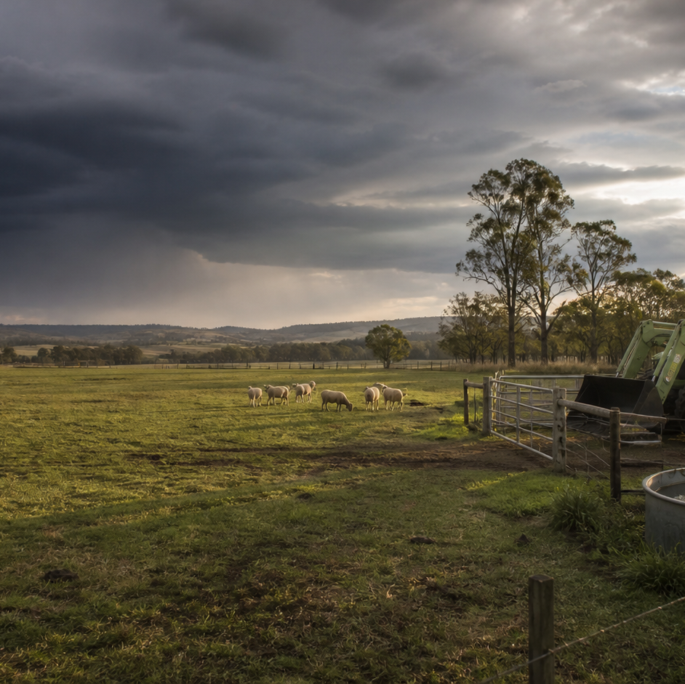
AHC20122 • CERTIFICATE II IN AGRICULTURE
Task 7 · Feed livestock
Use observations, feed-quality evidence, supervised planning and clear records to support livestock feeding work.
LEARNING ROUTE
01 Livestock needs and condition evidence
02 Feed quality, storage and contamination
03 Rehearse feeding-plan calculations
04 Feed records, response and review
Supplementary learning • current local sources and supervision control real work
Notes:
Open by connecting the task purpose to the four-module route. Ask students which module most clearly prepares them to notice evidence, make a source-led decision and report through authority.
Boundary: Supplementary learning is grounded in AHCLSK229 Release 1 and the authorised livestock focus-area resource. Inclusion of AHCLSK229 in the signed TAS remains Teacher/RTO to confirm. The approved feeding plan, current livestock information, feed and water specifications, workplace procedures, supervisor or veterinary direction, teacher demonstrations and RTO assessment package control real work. This site teaches observation, source reading, fictional arithmetic and record review only; it provides no ration, feed-rate, supplement, medicated-feed, species requirement or clinical advice and does not demonstrate competency.
[Sources]
- Supplementary learning is grounded in AHCLSK229 Release 1 and the authorised livestock focus-area resource. Inclusion of AHCLSK229 in the signed TAS remains Teacher/RTO to confirm. The approved feeding plan, current livestock information, feed and water specifications, workplace procedures, supervisor or veterinary direction, teacher demonstrations and RTO assessment package control real work. This site teaches observation, source reading, fictional arithmetic and record review only; it provides no ration, feed-rate, supplement, medicated-feed, species requirement or clinical advice and does not demonstrate competency.
- Course hero: Generated for this course using OpenAI ImageGen on 21 August 2026.
- Course data: work/pi/site-data/course.json

Slide 2
TASK 07 • PRIMARY INDUSTRIES
Livestock needs and condition evidence
NOTICE
• Feeding decisions begin with an authorised plan
• Identity and production context matter
AHCLSK229 requires feed and feed supplements to be prepared and provided according to a feeding plan. A feeding record needs the correct animal or group identifier, life-stage or production context used by the enterprise, date and current plan revision.
LOOK FOR
Connect the module's first four teaching ideas before students apply them to a fictional agricultural decision.
Use the map to connect the lesson ideas, then confirm any real procedure or decision through the current authorised source.
AHC20122 PRIMARY INDUSTRIES • TASK 7
2/10
Notes:
Teaching move (theory and visual): Use the module visual and the fictional worked example to move students from observation to a source-led decision. Ask students to name the evidence, the authority gap and the next safe communication step.
Misconception and help: The website teaches plan literacy; only current approved sources control feeding work. Choose the source tied to the real group, revision and supervisor.
Applied action: Audit the inputs to a feeding plan. Using fictional teacher-provided records, match group identity, plan revision, condition entry and environment note. Flag any mismatch and write the question an authorised supervisor must answer. Do not design or alter a feeding plan.
Boundary: Supplementary learning is grounded in AHCLSK229 Release 1 and the authorised livestock focus-area resource. Inclusion of AHCLSK229 in the signed TAS remains Teacher/RTO to confirm. The approved feeding plan, current livestock information, feed and water specifications, workplace procedures, supervisor or veterinary direction, teacher demonstrations and RTO assessment package control real work. This site teaches observation, source reading, fictional arithmetic and record review only; it provides no ration, feed-rate, supplement, medicated-feed, species requirement or clinical advice and does not demonstrate competency.
[Sources]
- Source basis: AHCLSK229 Release 1 preparation requirements for condition, health, feed, water and the approved feeding plan, supported by authorised livestock focus-area concepts. Current livestock expertise, enterprise plans and supervisor directions control every real requirement and adjustment.
- Visual visual-task-07-01: Generated locally from accepted Stage 05 module headings; no external image copied.
- Course visual manifest: work/pi/visuals/visual-manifest.json

Slide 3
TASK 07 • PRIMARY INDUSTRIES
Livestock needs and condition evidence: decide from evidence
FICTIONAL WORKPLACE EXAMPLE
CHECK YOUR DECISION
OBSERVE At fictional Stringybark Farm, the approved classroom record for group L4 references Feeding Plan revision 3, but the workboard lists revision 2. The latest authorised condition sheet also contains a new environmental note.
DECIDE Riley cannot choose a version or adjust any quantity because plan currency and the effect of the new information require authorised review.
ACT Riley identifies the group, two revisions and dated condition note to the supervisor.
RECORD Riley records the confirmed revision and leaves every feeding instruction unchanged.
Which source controls what a real livestock group is provided?
A The current approved feeding plan and authorised workplace direction.
B A quantity remembered from a classroom example.
C The learner's personal estimate after looking at the group.
HELP Choose the source tied to the real group, revision and supervisor.
AHC20122 PRIMARY INDUSTRIES • TASK 7
3/10
Notes:
Teaching move (worked example and formative check): Use the module visual and the fictional worked example to move students from observation to a source-led decision. Ask students to name the evidence, the authority gap and the next safe communication step. Misconception and help: The website teaches plan literacy; only current approved sources control feeding work. Choose the source tied to the real group, revision and supervisor. Applied action: Audit the inputs to a feeding plan. Using fictional teacher-provided records, match group identity, plan revision, condition entry and environment note. Flag any mismatch and write the question an authorised supervisor must answer. Do not design or alter a feeding plan. Boundary: Supplementary learning is grounded in AHCLSK229 Release 1 and the authorised livestock focus-area resource. Inclusion of AHCLSK229 in the signed TAS remains Teacher/RTO to confirm. The approved feeding plan, current livestock information, feed and water specifications, workplace procedures, supervisor or veterinary direction, teacher demonstrations and RTO assessment package control real work. This site teaches observation, source reading, fictional arithmetic and record review only; it provides no ration, feed-rate, supplement, medicated-feed, species requirement or clinical advice and does not demonstrate competency. [Sources] - Source basis: AHCLSK229 Release 1 preparation requirements for condition, health, feed, water and the approved feeding plan, supported by authorised livestock focus-area concepts. Current livestock expertise, enterprise plans and supervisor directions control every real requirement and adjustment. - Visual visual-task-07-01: Generated locally from accepted Stage 05 module headings; no external image copied. - Course visual manifest: work/pi/visuals/visual-manifest.json
Formative check answer: The current approved feeding plan and authorised workplace direction.
Correct feedback: You selected the source with authority for the actual group and conditions.
Corrective feedback: The website teaches plan literacy; only current approved sources control feeding work.
Full contextual example: Plan evidence: At fictional Stringybark Farm, the approved classroom record for group L4 references Feeding Plan revision 3, but the workboard lists revision 2. The latest authorised condition sheet also contains a new environmental note. Decision and reason: Riley cannot choose a version or adjust any quantity because plan currency and the effect of the new information require authorised review. Safe action: Riley identifies the group, two revisions and dated condition note to the supervisor. Result: The supervisor confirms the current plan. Next check or record: Riley records the confirmed revision and leaves every feeding instruction unchanged.

Slide 4
TASK 07 • PRIMARY INDUSTRIES
Feed quality, storage and contamination
NOTICE
• Quality is checked against a source
• Describe visible concerns precisely
Feed quality cannot be decided from a single visual impression. Useful observations identify where the material was found, which lot or container is involved and what can be seen, smelled or reliably measured under the authorised check.
LOOK FOR
Connect the module's first four teaching ideas before students apply them to a fictional agricultural decision.
Use the map to connect the lesson ideas, then confirm any real procedure or decision through the current authorised source.
AHC20122 PRIMARY INDUSTRIES • TASK 7
4/10
Notes:
Teaching move (theory and visual): Use the module visual and the fictional worked example to move students from observation to a source-led decision. Ask students to name the evidence, the authority gap and the next safe communication step.
Misconception and help: Name the item, visible concern and missing evidence without predicting harm. Describe what a second person could locate and verify.
Applied action: Audit a fictional store record. Compare a fictional package label, lot list, location card and storage log. Mark matching evidence and one unresolved concern, then write a concise supervisor report. Do not advise use, testing, cleaning, disposal or substitution.
Boundary: Supplementary learning is grounded in AHCLSK229 Release 1 and the authorised livestock focus-area resource. Inclusion of AHCLSK229 in the signed TAS remains Teacher/RTO to confirm. The approved feeding plan, current livestock information, feed and water specifications, workplace procedures, supervisor or veterinary direction, teacher demonstrations and RTO assessment package control real work. This site teaches observation, source reading, fictional arithmetic and record review only; it provides no ration, feed-rate, supplement, medicated-feed, species requirement or clinical advice and does not demonstrate competency.
[Sources]
- Source basis: AHCLSK229 Release 1 requirements to check feed, maintain safe work and storage areas, minimise waste, follow biosecurity policy and report abnormalities. Current plan, supplier information, workplace acceptance criteria and supervisor direction control material status and response.
- Visual visual-task-07-02: Generated locally from accepted Stage 05 module headings; no external image copied.
- Course visual manifest: work/pi/visuals/visual-manifest.json

Slide 5
TASK 07 • PRIMARY INDUSTRIES
Feed quality, storage and contamination: decide from evidence
FICTIONAL WORKPLACE EXAMPLE
CHECK YOUR DECISION
OBSERVE In fictional Cedar Ridge Store, Amira finds two sealed containers labelled Material Q from the same recorded lot. One outer package has a water stain and the storage log has no condition entry after a roof leak report.
DECIDE Amira cannot label the contents safe or contaminated from the outer stain alone.
ACT She does not use or relocate the containers, records the identifiers, location, visible stain and missing check, and notifies the supervisor.
RECORD Amira records the confirmed status without suggesting disposal or replacement.
Which observation best describes a possible feed-quality concern?
A The feed is poisonous and will make every animal ill.
B Container Q17 has a water stain on the outer package and no post-leak condition entry in the log.
C The store feels dodgy today.
HELP Describe what a second person could locate and verify.
AHC20122 PRIMARY INDUSTRIES • TASK 7
5/10
Notes:
Teaching move (worked example and formative check): Use the module visual and the fictional worked example to move students from observation to a source-led decision. Ask students to name the evidence, the authority gap and the next safe communication step. Misconception and help: Name the item, visible concern and missing evidence without predicting harm. Describe what a second person could locate and verify. Applied action: Audit a fictional store record. Compare a fictional package label, lot list, location card and storage log. Mark matching evidence and one unresolved concern, then write a concise supervisor report. Do not advise use, testing, cleaning, disposal or substitution. Boundary: Supplementary learning is grounded in AHCLSK229 Release 1 and the authorised livestock focus-area resource. Inclusion of AHCLSK229 in the signed TAS remains Teacher/RTO to confirm. The approved feeding plan, current livestock information, feed and water specifications, workplace procedures, supervisor or veterinary direction, teacher demonstrations and RTO assessment package control real work. This site teaches observation, source reading, fictional arithmetic and record review only; it provides no ration, feed-rate, supplement, medicated-feed, species requirement or clinical advice and does not demonstrate competency. [Sources] - Source basis: AHCLSK229 Release 1 requirements to check feed, maintain safe work and storage areas, minimise waste, follow biosecurity policy and report abnormalities. Current plan, supplier information, workplace acceptance criteria and supervisor direction control material status and response. - Visual visual-task-07-02: Generated locally from accepted Stage 05 module headings; no external image copied. - Course visual manifest: work/pi/visuals/visual-manifest.json
Formative check answer: Container Q17 has a water stain on the outer package and no post-leak condition entry in the log.
Correct feedback: You selected evidence that supports review without declaring material status.
Corrective feedback: Name the item, visible concern and missing evidence without predicting harm.
Full contextual example: Observed evidence: In fictional Cedar Ridge Store, Amira finds two sealed containers labelled Material Q from the same recorded lot. One outer package has a water stain and the storage log has no condition entry after a roof leak report. Decision and reason: Amira cannot label the contents safe or contaminated from the outer stain alone. Safe action: She does not use or relocate the containers, records the identifiers, location, visible stain and missing check, and notifies the supervisor. Result: The authorised reviewer checks the current sources. Next check or record: Amira records the confirmed status without suggesting disposal or replacement.

Slide 6
TASK 07 • PRIMARY INDUSTRIES
Rehearse feeding-plan calculations
NOTICE
• Calculate from the authorised value
• Write units at every step
Numeracy in AHCLSK229 supports measuring and recording weights and volumes. A number without its unit cannot be checked reliably.
LOOK FOR
Connect the module's first four teaching ideas before students apply them to a fictional agricultural decision.
Use the map to connect the lesson ideas, then confirm any real procedure or decision through the current authorised source.
AHC20122 PRIMARY INDUSTRIES • TASK 7
6/10
Notes:
Teaching move (theory and visual): Use the module visual and the fictional worked example to move students from observation to a source-led decision. Ask students to name the evidence, the authority gap and the next safe communication step.
Misconception and help: Calculation checks an authorised input; it does not invent one. Find the current source before choosing an operation.
Applied action: Check a fictional quantity record. Complete three calculations using fictional inert training material. Retain units, show working and flag one unreasonable result for teacher review. Do not use livestock requirements or propose any feed quantity.
Boundary: Supplementary learning is grounded in AHCLSK229 Release 1 and the authorised livestock focus-area resource. Inclusion of AHCLSK229 in the signed TAS remains Teacher/RTO to confirm. The approved feeding plan, current livestock information, feed and water specifications, workplace procedures, supervisor or veterinary direction, teacher demonstrations and RTO assessment package control real work. This site teaches observation, source reading, fictional arithmetic and record review only; it provides no ration, feed-rate, supplement, medicated-feed, species requirement or clinical advice and does not demonstrate competency.
[Sources]
- Source basis: AHCLSK229 Release 1 foundation numeracy for measuring and recording feed weights and volumes, applied only to fictional inert-material calculations. The current approved feeding plan and supervisor control all real quantities, rates, conversions and adjustments.
- Visual visual-task-07-03: Generated locally from accepted Stage 05 module headings; no external image copied.
- Course visual manifest: work/pi/visuals/visual-manifest.json

Slide 7
TASK 07 • PRIMARY INDUSTRIES
Rehearse feeding-plan calculations: decide from evidence
FICTIONAL WORKPLACE EXAMPLE
CHECK YOUR DECISION
OBSERVE Training Plan F states that four practice stations each receive 12 kilograms of inert training material, so Meena writes 4 stations × 12 kilograms per station = 48 kilograms. The practice supply record shows 46 kilograms.
DECIDE The arithmetic difference is 2 kilograms, but Meena cannot call it a livestock shortfall or alter any real feed amount because the example is not a ration and the record context is incomplete.
ACT She labels both values and the difference.
RECORD Meena checks that every figure retains its unit and source label.
Where does an input quantity for a real feeding calculation come from?
A The current approved plan for the identified livestock and task.
B The largest quantity used in any classroom example.
C A rough estimate based only on group size.
HELP Find the current source before choosing an operation.
AHC20122 PRIMARY INDUSTRIES • TASK 7
7/10
Notes:
Teaching move (worked example and formative check): Use the module visual and the fictional worked example to move students from observation to a source-led decision. Ask students to name the evidence, the authority gap and the next safe communication step. Misconception and help: Calculation checks an authorised input; it does not invent one. Find the current source before choosing an operation. Applied action: Check a fictional quantity record. Complete three calculations using fictional inert training material. Retain units, show working and flag one unreasonable result for teacher review. Do not use livestock requirements or propose any feed quantity. Boundary: Supplementary learning is grounded in AHCLSK229 Release 1 and the authorised livestock focus-area resource. Inclusion of AHCLSK229 in the signed TAS remains Teacher/RTO to confirm. The approved feeding plan, current livestock information, feed and water specifications, workplace procedures, supervisor or veterinary direction, teacher demonstrations and RTO assessment package control real work. This site teaches observation, source reading, fictional arithmetic and record review only; it provides no ration, feed-rate, supplement, medicated-feed, species requirement or clinical advice and does not demonstrate competency. [Sources] - Source basis: AHCLSK229 Release 1 foundation numeracy for measuring and recording feed weights and volumes, applied only to fictional inert-material calculations. The current approved feeding plan and supervisor control all real quantities, rates, conversions and adjustments. - Visual visual-task-07-03: Generated locally from accepted Stage 05 module headings; no external image copied. - Course visual manifest: work/pi/visuals/visual-manifest.json
Formative check answer: The current approved plan for the identified livestock and task.
Correct feedback: You identified the approved plan as the controlled input source.
Corrective feedback: Calculation checks an authorised input; it does not invent one.
Full contextual example: Fictional worksheet: Training Plan F states that four practice stations each receive 12 kilograms of inert training material, so Meena writes 4 stations × 12 kilograms per station = 48 kilograms. The practice supply record shows 46 kilograms. Decision and reason: The arithmetic difference is 2 kilograms, but Meena cannot call it a livestock shortfall or alter any real feed amount because the example is not a ration and the record context is incomplete. Safe action: She labels both values and the difference. Result: The teacher reviews the calculation. Next check or record: Meena checks that every figure retains its unit and source label.

Slide 8
TASK 07 • PRIMARY INDUSTRIES
Feed records, response and review
NOTICE
• Records connect plan and outcome
• Record variations without inventing causes
A feeding record should identify the current plan, livestock group, date, authorised task, recorded quantities and person responsible for each entry. AHCLSK229 includes recording variations in eating and drinking patterns and reporting feeding abnormalities.
LOOK FOR
Connect the module's first four teaching ideas before students apply them to a fictional agricultural decision.
Use the map to connect the lesson ideas, then confirm any real procedure or decision through the current authorised source.
AHC20122 PRIMARY INDUSTRIES • TASK 7
8/10
Notes:
Teaching move (theory and visual): Use the module visual and the fictional worked example to move students from observation to a source-led decision. Ask students to name the evidence, the authority gap and the next safe communication step.
Misconception and help: Keep the group, count and timing; remove cause and response claims. What changed, when, and for which identified group?
Applied action: Prepare a post-task record brief. Annotate a fictional plan and outcome record, mark one missing value and one changed observation, then draft three answer-neutral review questions. Do not fill the gap or suggest any feeding change.
Boundary: Supplementary learning is grounded in AHCLSK229 Release 1 and the authorised livestock focus-area resource. Inclusion of AHCLSK229 in the signed TAS remains Teacher/RTO to confirm. The approved feeding plan, current livestock information, feed and water specifications, workplace procedures, supervisor or veterinary direction, teacher demonstrations and RTO assessment package control real work. This site teaches observation, source reading, fictional arithmetic and record review only; it provides no ration, feed-rate, supplement, medicated-feed, species requirement or clinical advice and does not demonstrate competency.
[Sources]
- Source basis: AHCLSK229 Release 1 requirements to monitor feeding, record variations and abnormalities, maintain records and report outcomes. Current enterprise records, approved feeding plan, livestock expertise and supervisor direction control interpretation and follow-up.
- Visual visual-task-07-04: Generated locally from accepted Stage 05 module headings; no external image copied.
- Course visual manifest: work/pi/visuals/visual-manifest.json

Slide 9
TASK 07 • PRIMARY INDUSTRIES
Feed records, response and review: decide from evidence
FICTIONAL WORKPLACE EXAMPLE
CHECK YOUR DECISION
OBSERVE At fictional Kurrajong Farm, group M2 is linked to approved Plan 7. The supplied record contains the correct date and unit but one station field is blank, while the observation note says two animals arrived after the recorded…
DECIDE Zoe cannot calculate the missing supply, decide whether the animals missed feed or alter the next task.
ACT She preserves the blank, reports the late-arrival observation and identifies the matching plan.
RECORD Zoe enters the confirmed clarification without inventing a value or feeding response.
Which entry best records a variation in livestock behaviour?
A Two animals from group M2 arrived after the recorded observation period.
B The animals were late because they do not like the feed.
C The group needs a different ration tomorrow.
HELP What changed, when, and for which identified group?
AHC20122 PRIMARY INDUSTRIES • TASK 7
9/10
Notes:
Teaching move (worked example and formative check): Use the module visual and the fictional worked example to move students from observation to a source-led decision. Ask students to name the evidence, the authority gap and the next safe communication step. Misconception and help: Keep the group, count and timing; remove cause and response claims. What changed, when, and for which identified group? Applied action: Prepare a post-task record brief. Annotate a fictional plan and outcome record, mark one missing value and one changed observation, then draft three answer-neutral review questions. Do not fill the gap or suggest any feeding change. Boundary: Supplementary learning is grounded in AHCLSK229 Release 1 and the authorised livestock focus-area resource. Inclusion of AHCLSK229 in the signed TAS remains Teacher/RTO to confirm. The approved feeding plan, current livestock information, feed and water specifications, workplace procedures, supervisor or veterinary direction, teacher demonstrations and RTO assessment package control real work. This site teaches observation, source reading, fictional arithmetic and record review only; it provides no ration, feed-rate, supplement, medicated-feed, species requirement or clinical advice and does not demonstrate competency. [Sources] - Source basis: AHCLSK229 Release 1 requirements to monitor feeding, record variations and abnormalities, maintain records and report outcomes. Current enterprise records, approved feeding plan, livestock expertise and supervisor direction control interpretation and follow-up. - Visual visual-task-07-04: Generated locally from accepted Stage 05 module headings; no external image copied. - Course visual manifest: work/pi/visuals/visual-manifest.json
Formative check answer: Two animals from group M2 arrived after the recorded observation period.
Correct feedback: You selected a reportable variation without interpretation or advice.
Corrective feedback: Keep the group, count and timing; remove cause and response claims.
Full contextual example: Record evidence: At fictional Kurrajong Farm, group M2 is linked to approved Plan 7. The supplied record contains the correct date and unit but one station field is blank, while the observation note says two animals arrived after the recorded period. Decision and reason: Zoe cannot calculate the missing supply, decide whether the animals missed feed or alter the next task. Safe action: She preserves the blank, reports the late-arrival observation and identifies the matching plan. Result: The supervisor reviews timing and records. Next check or record: Zoe enters the confirmed clarification without inventing a value or feeding response.

Slide 10
CLOSE THE LOOP WITH EVIDENCE
Apply the task route — then check the boundary
01 Livestock needs and condition evidence
02 Feed quality, storage and contamination
03 Rehearse feeding-plan calculations
04 Feed records, response and review
Audit the inputs to a feeding plan
Using fictional teacher-provided records, match group identity, plan revision, condition entry and environment note.
Audit a fictional store record
Compare a fictional package label, lot list, location card and storage log.
Check a fictional quantity record
Complete three calculations using fictional inert training material.
Prepare a post-task record brief
Annotate a fictional plan and outcome record, mark one missing value and one changed observation, then draft three answer-neutral review questions.
NEXT STEP Complete the teacher-nominated learning action. Use current local sources and supervision before any real practical decision. Website responses remain formative.
Notes:
Close with one retrieval question from each module, then direct students to the teacher-nominated learning action. Re-state that site work is formative and that current workplace and RTO processes control real practice and assessment.
Boundary: Supplementary learning is grounded in AHCLSK229 Release 1 and the authorised livestock focus-area resource. Inclusion of AHCLSK229 in the signed TAS remains Teacher/RTO to confirm. The approved feeding plan, current livestock information, feed and water specifications, workplace procedures, supervisor or veterinary direction, teacher demonstrations and RTO assessment package control real work. This site teaches observation, source reading, fictional arithmetic and record review only; it provides no ration, feed-rate, supplement, medicated-feed, species requirement or clinical advice and does not demonstrate competency.
[Sources]
- Source basis: AHCLSK229 Release 1 preparation requirements for condition, health, feed, water and the approved feeding plan, supported by authorised livestock focus-area concepts. Current livestock expertise, enterprise plans and supervisor directions control every real requirement and adjustment.
- Source basis: AHCLSK229 Release 1 requirements to check feed, maintain safe work and storage areas, minimise waste, follow biosecurity policy and report abnormalities. Current plan, supplier information, workplace acceptance criteria and supervisor direction control material status and response.
- Source basis: AHCLSK229 Release 1 foundation numeracy for measuring and recording feed weights and volumes, applied only to fictional inert-material calculations. The current approved feeding plan and supervisor control all real quantities, rates, conversions and adjustments.
- Source basis: AHCLSK229 Release 1 requirements to monitor feeding, record variations and abnormalities, maintain records and report outcomes. Current enterprise records, approved feeding plan, livestock expertise and supervisor direction control interpretation and follow-up.

