Slide 1
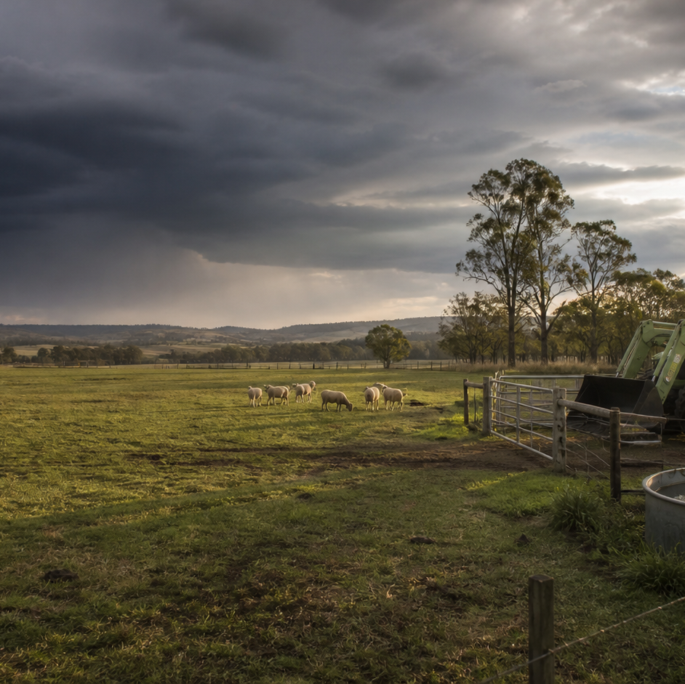
AHC20122 • CERTIFICATE II IN AGRICULTURE
Task 8 · Identify and mark livestock
Understand traceability, plan a supervised identification task and reconcile physical identification with workplace records.
LEARNING ROUTE
01 Why identification and traceability matter
02 Choose the authorised identification source
03 Plan a supervised marking task
04 Reconcile identification records
Supplementary learning • current local sources and supervision control real work
Notes:
Open by connecting the task purpose to the four-module route. Ask students which module most clearly prepares them to notice evidence, make a source-led decision and report through authority.
Boundary: Supplementary learning is grounded in AHCLSK225 Release 1 and the authorised livestock focus-area resource. Inclusion of AHCLSK225 in the signed TAS remains Teacher/RTO to confirm. Current enterprise instructions, regulatory sources, approved devices and materials, animal welfare requirements, facilities, teacher demonstrations, supervision and RTO assessment package control real work. This site supports traceability, source selection, work-plan literacy and record reconciliation only; it provides no device-specific marking, restraint, animal movement, application or preventative-treatment technique and does not demonstrate competency.
[Sources]
- Supplementary learning is grounded in AHCLSK225 Release 1 and the authorised livestock focus-area resource. Inclusion of AHCLSK225 in the signed TAS remains Teacher/RTO to confirm. Current enterprise instructions, regulatory sources, approved devices and materials, animal welfare requirements, facilities, teacher demonstrations, supervision and RTO assessment package control real work. This site supports traceability, source selection, work-plan literacy and record reconciliation only; it provides no device-specific marking, restraint, animal movement, application or preventative-treatment technique and does not demonstrate competency.
- Course hero: Generated for this course using OpenAI ImageGen on 21 August 2026.
- Course data: work/pi/site-data/course.json

Slide 2
TASK 08 • PRIMARY INDUSTRIES
Why identification and traceability matter
NOTICE
• Identification connects the animal to information
• Traceability follows a chain
Livestock identification gives an enterprise a consistent way to connect an animal or group with authorised records. A traceability chain links source identity, animal or group, recorded event, date, location, responsible person and outcome.
LOOK FOR
Connect the module's first four teaching ideas before students apply them to a fictional agricultural decision.
Use the map to connect the lesson ideas, then confirm any real procedure or decision through the current authorised source.
AHC20122 PRIMARY INDUSTRIES • TASK 8
2/10
Notes:
Teaching move (theory and visual): Use the module visual and the fictional worked example to move students from observation to a source-led decision. Ask students to name the evidence, the authority gap and the next safe communication step.
Misconception and help: Trace the identifier into the records, dates, locations and events it connects. Ask what information another authorised person could retrieve from the identifier.
Applied action: Build a fictional traceability chain. Match invented identifier cards with fictional observation, movement and enterprise records. Leave one deliberate conflict unresolved and write the authorised reconciliation question. Do not use real records or discuss marking technique.
Boundary: Supplementary learning is grounded in AHCLSK225 Release 1 and the authorised livestock focus-area resource. Inclusion of AHCLSK225 in the signed TAS remains Teacher/RTO to confirm. Current enterprise instructions, regulatory sources, approved devices and materials, animal welfare requirements, facilities, teacher demonstrations, supervision and RTO assessment package control real work. This site supports traceability, source selection, work-plan literacy and record reconciliation only; it provides no device-specific marking, restraint, animal movement, application or preventative-treatment technique and does not demonstrate competency.
[Sources]
- Source basis: AHCLSK225 Release 1 identification, tally and recording requirements, supported by authorised livestock focus-area concepts about the purpose and importance of accurate identification. Current enterprise and regulatory systems control legal identity and records.
- Visual visual-task-08-01: Generated locally from accepted Stage 05 module headings; no external image copied.
- Course visual manifest: work/pi/visuals/visual-manifest.json

Slide 3
TASK 08 • PRIMARY INDUSTRIES
Why identification and traceability matter: decide from evidence
FICTIONAL WORKPLACE EXAMPLE
CHECK YOUR DECISION
OBSERVE At fictional Snowgum Farm, observation record L-204 and movement record L-204 refer to the same group and dates, but a treatment-index entry says L-240.
DECIDE Harper cannot decide that L-240 is a typing error because both identifiers may exist.
ACT Harper preserves all three entries, highlights the conflict and reports it to the record custodian.
RECORD Harper records the confirmed relationship using the enterprise correction process without altering the original evidence.
Why is an identifier alone not a complete traceability system?
A It must connect consistently with authorised registers and event records.
B Every identifier automatically contains all legal and health information.
C Identifiers are only decorative marks used during classroom work.
HELP Ask what information another authorised person could retrieve from the identifier.
AHC20122 PRIMARY INDUSTRIES • TASK 8
3/10
Notes:
Teaching move (worked example and formative check): Use the module visual and the fictional worked example to move students from observation to a source-led decision. Ask students to name the evidence, the authority gap and the next safe communication step. Misconception and help: Trace the identifier into the records, dates, locations and events it connects. Ask what information another authorised person could retrieve from the identifier. Applied action: Build a fictional traceability chain. Match invented identifier cards with fictional observation, movement and enterprise records. Leave one deliberate conflict unresolved and write the authorised reconciliation question. Do not use real records or discuss marking technique. Boundary: Supplementary learning is grounded in AHCLSK225 Release 1 and the authorised livestock focus-area resource. Inclusion of AHCLSK225 in the signed TAS remains Teacher/RTO to confirm. Current enterprise instructions, regulatory sources, approved devices and materials, animal welfare requirements, facilities, teacher demonstrations, supervision and RTO assessment package control real work. This site supports traceability, source selection, work-plan literacy and record reconciliation only; it provides no device-specific marking, restraint, animal movement, application or preventative-treatment technique and does not demonstrate competency. [Sources] - Source basis: AHCLSK225 Release 1 identification, tally and recording requirements, supported by authorised livestock focus-area concepts about the purpose and importance of accurate identification. Current enterprise and regulatory systems control legal identity and records. - Visual visual-task-08-01: Generated locally from accepted Stage 05 module headings; no external image copied. - Course visual manifest: work/pi/visuals/visual-manifest.json
Formative check answer: It must connect consistently with authorised registers and event records.
Correct feedback: You recognised identification as one link in a wider information system.
Corrective feedback: Trace the identifier into the records, dates, locations and events it connects.
Full contextual example: Traceability evidence: At fictional Snowgum Farm, observation record L-204 and movement record L-204 refer to the same group and dates, but a treatment-index entry says L-240. Decision and reason: Harper cannot decide that L-240 is a typing error because both identifiers may exist. Safe action: Harper preserves all three entries, highlights the conflict and reports it to the record custodian. Result: The authorised person checks the source register. Next check or record: Harper records the confirmed relationship using the enterprise correction process without altering the original evidence.

Slide 4
TASK 08 • PRIMARY INDUSTRIES
Choose the authorised identification source
NOTICE
• Different sources control different questions
• Check identity, currency and scope
Regulatory sources may define legal identification and movement obligations, while enterprise procedures define local records and roles. Before relying on a source, record its title, issuing authority, version or date, intended species or task, access status and location.
LOOK FOR
Connect the module's first four teaching ideas before students apply them to a fictional agricultural decision.
Use the map to connect the lesson ideas, then confirm any real procedure or decision through the current authorised source.
AHC20122 PRIMARY INDUSTRIES • TASK 8
4/10
Notes:
Teaching move (theory and visual): Use the module visual and the fictional worked example to move students from observation to a source-led decision. Ask students to name the evidence, the authority gap and the next safe communication step.
Misconception and help: Choose the current source tied to the actual enterprise roles and systems. Match the authority domain to the question being asked.
Applied action: Build a source authority card set. Classify fictional source cards as regulatory, enterprise, device, training or assessment. Add issuer, currency, scope and one question each can answer. Mark ambiguous cards for Teacher/RTO confirmation.
Boundary: Supplementary learning is grounded in AHCLSK225 Release 1 and the authorised livestock focus-area resource. Inclusion of AHCLSK225 in the signed TAS remains Teacher/RTO to confirm. Current enterprise instructions, regulatory sources, approved devices and materials, animal welfare requirements, facilities, teacher demonstrations, supervision and RTO assessment package control real work. This site supports traceability, source selection, work-plan literacy and record reconciliation only; it provides no device-specific marking, restraint, animal movement, application or preventative-treatment technique and does not demonstrate competency.
[Sources]
- Source basis: AHCLSK225 Release 1 requirements to work under supervisor instructions, workplace procedures and applicable legislation, with the senior VET authority hierarchy. Current regulatory, enterprise, device, training and RTO sources control only their respective domains.
- Visual visual-task-08-02: Generated locally from accepted Stage 05 module headings; no external image copied.
- Course visual manifest: work/pi/visuals/visual-manifest.json

Slide 5
TASK 08 • PRIMARY INDUSTRIES
Choose the authorised identification source: decide from evidence
FICTIONAL WORKPLACE EXAMPLE
CHECK YOUR DECISION
OBSERVE In a fictional lesson, Document A is an undated enterprise worksheet, while Document B is a current authority-issued overview for a different species. Both mention identification, but neither clearly controls the planned class task.
DECIDE Jalen cannot transfer Document B's species requirement or assume Document A is current.
ACT He records each source's issuer, date gap and scope mismatch and asks the teacher to identify the current enterprise and regulatory sources.
RECORD Jalen updates the source register, not the practical instructions.
Which source most directly controls local identification roles and record workflow?
A The current authorised enterprise procedure and supervisor direction.
B An undated worksheet from an unknown property.
C A fictional diagram made for this lesson.
HELP Match the authority domain to the question being asked.
AHC20122 PRIMARY INDUSTRIES • TASK 8
5/10
Notes:
Teaching move (worked example and formative check): Use the module visual and the fictional worked example to move students from observation to a source-led decision. Ask students to name the evidence, the authority gap and the next safe communication step. Misconception and help: Choose the current source tied to the actual enterprise roles and systems. Match the authority domain to the question being asked. Applied action: Build a source authority card set. Classify fictional source cards as regulatory, enterprise, device, training or assessment. Add issuer, currency, scope and one question each can answer. Mark ambiguous cards for Teacher/RTO confirmation. Boundary: Supplementary learning is grounded in AHCLSK225 Release 1 and the authorised livestock focus-area resource. Inclusion of AHCLSK225 in the signed TAS remains Teacher/RTO to confirm. Current enterprise instructions, regulatory sources, approved devices and materials, animal welfare requirements, facilities, teacher demonstrations, supervision and RTO assessment package control real work. This site supports traceability, source selection, work-plan literacy and record reconciliation only; it provides no device-specific marking, restraint, animal movement, application or preventative-treatment technique and does not demonstrate competency. [Sources] - Source basis: AHCLSK225 Release 1 requirements to work under supervisor instructions, workplace procedures and applicable legislation, with the senior VET authority hierarchy. Current regulatory, enterprise, device, training and RTO sources control only their respective domains. - Visual visual-task-08-02: Generated locally from accepted Stage 05 module headings; no external image copied. - Course visual manifest: work/pi/visuals/visual-manifest.json
Formative check answer: The current authorised enterprise procedure and supervisor direction.
Correct feedback: You matched the local-workflow question with a current local authority.
Corrective feedback: Choose the current source tied to the actual enterprise roles and systems.
Full contextual example: Source evidence: In a fictional lesson, Document A is an undated enterprise worksheet, while Document B is a current authority-issued overview for a different species. Both mention identification, but neither clearly controls the planned class task. Decision and reason: Jalen cannot transfer Document B's species requirement or assume Document A is current. Safe action: He records each source's issuer, date gap and scope mismatch and asks the teacher to identify the current enterprise and regulatory sources. Result: The task remains on hold until confirmed. Next check or record: Jalen updates the source register, not the practical instructions.

Slide 6
TASK 08 • PRIMARY INDUSTRIES
Plan a supervised marking task
NOTICE
• The plan starts with scope and authority
• Prepare information about animals and sequence
A marking work plan identifies the authorised purpose, animals, current source, supervisor and limits of each participant's role. Planning fields can include group identity, number, source register, destination, order of work and record checkpoints.
LOOK FOR
Connect the module's first four teaching ideas before students apply them to a fictional agricultural decision.
Use the map to connect the lesson ideas, then confirm any real procedure or decision through the current authorised source.
AHC20122 PRIMARY INDUSTRIES • TASK 8
6/10
Notes:
Teaching move (theory and visual): Use the module visual and the fictional worked example to move students from observation to a source-led decision. Ask students to name the evidence, the authority gap and the next safe communication step.
Misconception and help: The plan clarifies sources, roles and checkpoints; it does not expose technique or assessor tools. Choose information needed before the supervised demonstration begins.
Applied action: Run a desk-based readiness review. Audit a fictional marking plan against source, role, identity, facility, equipment and record cards. Flag every mismatch for the supervisor. Do not demonstrate or describe any practical livestock action.
Boundary: Supplementary learning is grounded in AHCLSK225 Release 1 and the authorised livestock focus-area resource. Inclusion of AHCLSK225 in the signed TAS remains Teacher/RTO to confirm. Current enterprise instructions, regulatory sources, approved devices and materials, animal welfare requirements, facilities, teacher demonstrations, supervision and RTO assessment package control real work. This site supports traceability, source selection, work-plan literacy and record reconciliation only; it provides no device-specific marking, restraint, animal movement, application or preventative-treatment technique and does not demonstrate competency.
[Sources]
- Source basis: AHCLSK225 Release 1 preparation, equipment, facility, WHS, identification, tally, welfare-monitoring and reporting requirements. Current local procedures, regulatory sources, approved materials, teacher demonstration and direct supervision control the practical technique.
- Visual visual-task-08-03: Generated locally from accepted Stage 05 module headings; no external image copied.
- Course visual manifest: work/pi/visuals/visual-manifest.json

Slide 7
TASK 08 • PRIMARY INDUSTRIES
Plan a supervised marking task: decide from evidence
FICTIONAL WORKPLACE EXAMPLE
CHECK YOUR DECISION
OBSERVE At fictional Wallaby Plains Centre, the marking plan identifies group P6, Facility Two and Device List revision 5. The equipment sign-out sheet refers to revision 4, and the assigned record checker is absent from the briefing.
DECIDE Ana does not substitute a device or absorb the missing role because both source currency and accountability are unresolved.
ACT She reports the two plan gaps before work.
RECORD Ana updates the plan fields only after authorised confirmation.
Which item belongs in a supervised marking work plan?
A Current source revisions, defined roles, record checkpoints and observable stop conditions.
B An improvised device choice made by the learner.
C A copied assessor observation checklist with expected answers.
HELP Choose information needed before the supervised demonstration begins.
AHC20122 PRIMARY INDUSTRIES • TASK 8
7/10
Notes:
Teaching move (worked example and formative check): Use the module visual and the fictional worked example to move students from observation to a source-led decision. Ask students to name the evidence, the authority gap and the next safe communication step. Misconception and help: The plan clarifies sources, roles and checkpoints; it does not expose technique or assessor tools. Choose information needed before the supervised demonstration begins. Applied action: Run a desk-based readiness review. Audit a fictional marking plan against source, role, identity, facility, equipment and record cards. Flag every mismatch for the supervisor. Do not demonstrate or describe any practical livestock action. Boundary: Supplementary learning is grounded in AHCLSK225 Release 1 and the authorised livestock focus-area resource. Inclusion of AHCLSK225 in the signed TAS remains Teacher/RTO to confirm. Current enterprise instructions, regulatory sources, approved devices and materials, animal welfare requirements, facilities, teacher demonstrations, supervision and RTO assessment package control real work. This site supports traceability, source selection, work-plan literacy and record reconciliation only; it provides no device-specific marking, restraint, animal movement, application or preventative-treatment technique and does not demonstrate competency. [Sources] - Source basis: AHCLSK225 Release 1 preparation, equipment, facility, WHS, identification, tally, welfare-monitoring and reporting requirements. Current local procedures, regulatory sources, approved materials, teacher demonstration and direct supervision control the practical technique. - Visual visual-task-08-03: Generated locally from accepted Stage 05 module headings; no external image copied. - Course visual manifest: work/pi/visuals/visual-manifest.json
Formative check answer: Current source revisions, defined roles, record checkpoints and observable stop conditions.
Correct feedback: You selected planning information within the supplementary-learning boundary.
Corrective feedback: The plan clarifies sources, roles and checkpoints; it does not expose technique or assessor tools.
Full contextual example: Plan evidence: At fictional Wallaby Plains Centre, the marking plan identifies group P6, Facility Two and Device List revision 5. The equipment sign-out sheet refers to revision 4, and the assigned record checker is absent from the briefing. Decision and reason: Ana does not substitute a device or absorb the missing role because both source currency and accountability are unresolved. Safe action: She reports the two plan gaps before work. Result: The supervisor confirms the current list and reallocates the record role. Next check or record: Ana updates the plan fields only after authorised confirmation.

Slide 8
TASK 08 • PRIMARY INDUSTRIES
Reconcile identification records
NOTICE
• Reconciliation compares controlled sources
• Classify the discrepancy
Identification reconciliation compares the planned list, observed or recorded identifiers, tally and authorised register. A discrepancy may be missing, duplicated, unreadable, transposed, linked to the wrong event or recorded in a different format.
LOOK FOR
Connect the module's first four teaching ideas before students apply them to a fictional agricultural decision.
Use the map to connect the lesson ideas, then confirm any real procedure or decision through the current authorised source.
AHC20122 PRIMARY INDUSTRIES • TASK 8
8/10
Notes:
Teaching move (theory and visual): Use the module visual and the fictional worked example to move students from observation to a source-led decision. Ask students to name the evidence, the authority gap and the next safe communication step.
Misconception and help: A matching count can still contain the wrong identities. Compare every identifier, then compare the total.
Applied action: Reconcile two fictional registers. Compare two invented identifier lists and tally sheets. Highlight matches, duplicates, missing entries and format differences, then draft an authorised correction request without changing either source.
Boundary: Supplementary learning is grounded in AHCLSK225 Release 1 and the authorised livestock focus-area resource. Inclusion of AHCLSK225 in the signed TAS remains Teacher/RTO to confirm. Current enterprise instructions, regulatory sources, approved devices and materials, animal welfare requirements, facilities, teacher demonstrations, supervision and RTO assessment package control real work. This site supports traceability, source selection, work-plan literacy and record reconciliation only; it provides no device-specific marking, restraint, animal movement, application or preventative-treatment technique and does not demonstrate competency.
[Sources]
- Source basis: AHCLSK225 Release 1 tally, record, outcome-reporting and completion requirements, supported by livestock identification traceability concepts. Current regulatory and enterprise registers, record custodians and correction procedures control real reconciliation.
- Visual visual-task-08-04: Generated locally from accepted Stage 05 module headings; no external image copied.
- Course visual manifest: work/pi/visuals/visual-manifest.json

Slide 9
TASK 08 • PRIMARY INDUSTRIES
Reconcile identification records: decide from evidence
FICTIONAL WORKPLACE EXAMPLE
CHECK YOUR DECISION
OBSERVE In a fictional register, the planned list contains P31, P32, P33 and P34. The event sheet contains P31, P32, P32 and P34, so both totals equal four.
DECIDE Chen recognises that the equal total hides one duplicate and one missing identifier; he cannot replace the second P32 with P33 without source evidence.
ACT He marks the duplicate and missing pair and reports both records to the custodian.
RECORD Chen records the authorised correction with its reason and date.
Two lists each total four animals, but one identifier is duplicated. What follows?
A The records reconcile because the totals are equal.
B Individual entries and totals must both be checked before reconciliation.
C Delete the duplicate and leave the total at three.
HELP Compare every identifier, then compare the total.
AHC20122 PRIMARY INDUSTRIES • TASK 8
9/10
Notes:
Teaching move (worked example and formative check): Use the module visual and the fictional worked example to move students from observation to a source-led decision. Ask students to name the evidence, the authority gap and the next safe communication step. Misconception and help: A matching count can still contain the wrong identities. Compare every identifier, then compare the total. Applied action: Reconcile two fictional registers. Compare two invented identifier lists and tally sheets. Highlight matches, duplicates, missing entries and format differences, then draft an authorised correction request without changing either source. Boundary: Supplementary learning is grounded in AHCLSK225 Release 1 and the authorised livestock focus-area resource. Inclusion of AHCLSK225 in the signed TAS remains Teacher/RTO to confirm. Current enterprise instructions, regulatory sources, approved devices and materials, animal welfare requirements, facilities, teacher demonstrations, supervision and RTO assessment package control real work. This site supports traceability, source selection, work-plan literacy and record reconciliation only; it provides no device-specific marking, restraint, animal movement, application or preventative-treatment technique and does not demonstrate competency. [Sources] - Source basis: AHCLSK225 Release 1 tally, record, outcome-reporting and completion requirements, supported by livestock identification traceability concepts. Current regulatory and enterprise registers, record custodians and correction procedures control real reconciliation. - Visual visual-task-08-04: Generated locally from accepted Stage 05 module headings; no external image copied. - Course visual manifest: work/pi/visuals/visual-manifest.json
Formative check answer: Individual entries and totals must both be checked before reconciliation.
Correct feedback: You recognised why both record-level and total checks are required.
Corrective feedback: A matching count can still contain the wrong identities.
Full contextual example: Record evidence: In a fictional register, the planned list contains P31, P32, P33 and P34. The event sheet contains P31, P32, P32 and P34, so both totals equal four. Decision and reason: Chen recognises that the equal total hides one duplicate and one missing identifier; he cannot replace the second P32 with P33 without source evidence. Safe action: He marks the duplicate and missing pair and reports both records to the custodian. Result: The authorised register and source event are checked. Next check or record: Chen records the authorised correction with its reason and date.

Slide 10
CLOSE THE LOOP WITH EVIDENCE
Apply the task route — then check the boundary
01 Why identification and traceability matter
02 Choose the authorised identification source
03 Plan a supervised marking task
04 Reconcile identification records
Build a fictional traceability chain
Match invented identifier cards with fictional observation, movement and enterprise records.
Build a source authority card set
Classify fictional source cards as regulatory, enterprise, device, training or assessment.
Run a desk-based readiness review
Audit a fictional marking plan against source, role, identity, facility, equipment and record cards.
Reconcile two fictional registers
Compare two invented identifier lists and tally sheets.
NEXT STEP Complete the teacher-nominated learning action. Use current local sources and supervision before any real practical decision. Website responses remain formative.
Notes:
Close with one retrieval question from each module, then direct students to the teacher-nominated learning action. Re-state that site work is formative and that current workplace and RTO processes control real practice and assessment.
Boundary: Supplementary learning is grounded in AHCLSK225 Release 1 and the authorised livestock focus-area resource. Inclusion of AHCLSK225 in the signed TAS remains Teacher/RTO to confirm. Current enterprise instructions, regulatory sources, approved devices and materials, animal welfare requirements, facilities, teacher demonstrations, supervision and RTO assessment package control real work. This site supports traceability, source selection, work-plan literacy and record reconciliation only; it provides no device-specific marking, restraint, animal movement, application or preventative-treatment technique and does not demonstrate competency.
[Sources]
- Source basis: AHCLSK225 Release 1 identification, tally and recording requirements, supported by authorised livestock focus-area concepts about the purpose and importance of accurate identification. Current enterprise and regulatory systems control legal identity and records.
- Source basis: AHCLSK225 Release 1 requirements to work under supervisor instructions, workplace procedures and applicable legislation, with the senior VET authority hierarchy. Current regulatory, enterprise, device, training and RTO sources control only their respective domains.
- Source basis: AHCLSK225 Release 1 preparation, equipment, facility, WHS, identification, tally, welfare-monitoring and reporting requirements. Current local procedures, regulatory sources, approved materials, teacher demonstration and direct supervision control the practical technique.
- Source basis: AHCLSK225 Release 1 tally, record, outcome-reporting and completion requirements, supported by livestock identification traceability concepts. Current regulatory and enterprise registers, record custodians and correction procedures control real reconciliation.

