Slide 1
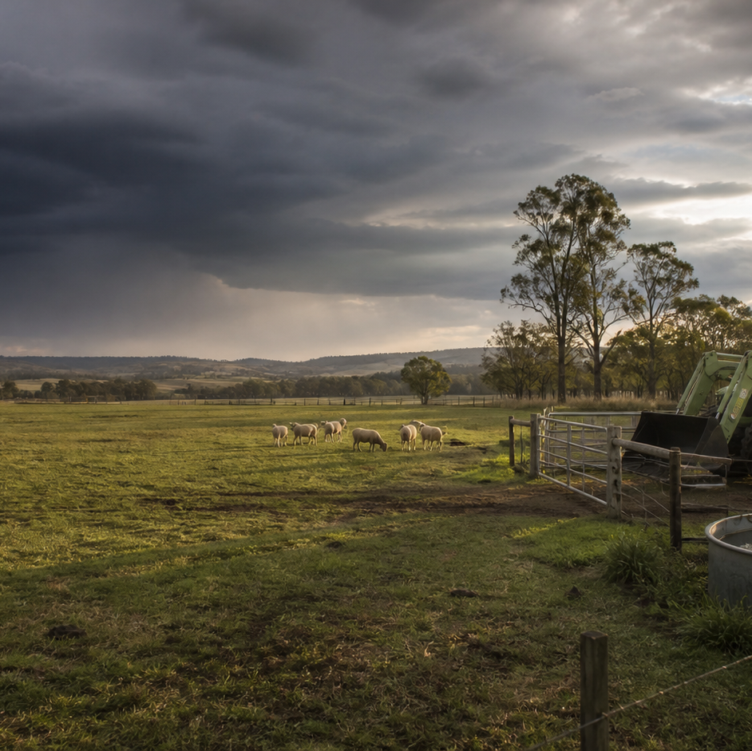
AHC20122 • CERTIFICATE II IN AGRICULTURE
Task 9 · Weather
Observe weather, judge source quality, interpret forecasts and warnings, and communicate task-related decisions.
LEARNING ROUTE
01 Weather, climate and farm observations
02 Instruments, sources and data quality
03 Read forecasts, warnings and synoptic patterns
04 Weather decisions, contingencies and reporting
Supplementary learning • current local sources and supervision control real work
Notes:
Open by connecting the task purpose to the four-module route. Ask students which module most clearly prepares them to notice evidence, make a source-led decision and report through authority.
Boundary: Supplementary learning is grounded in AHCWRK210 Release 1, the NESA Weather focus area and authorised teacher-posted weather notes. Every scenario is fictional and dated. Current Bureau of Meteorology information, emergency advice, the workplace contingency plan and supervisor directions control real decisions. Site responses are formative and do not demonstrate competency.
[Sources]
- Supplementary learning is grounded in AHCWRK210 Release 1, the NESA Weather focus area and authorised teacher-posted weather notes. Every scenario is fictional and dated. Current Bureau of Meteorology information, emergency advice, the workplace contingency plan and supervisor directions control real decisions. Site responses are formative and do not demonstrate competency.
- Course hero: Generated for this course using OpenAI ImageGen on 21 August 2026.
- Course data: work/pi/site-data/course.json

Slide 2
TASK 09 • PRIMARY INDUSTRIES
Weather, climate and farm observations
NOTICE
• Weather describes short-term atmospheric conditions
• Climate describes longer-term patterns
Weather is the condition of the atmosphere at a particular place and time. Climate summarises patterns, averages and variation over a long period for a region or season.
LOOK FOR
Connect the module's first four teaching ideas before students apply them to a fictional agricultural decision.
Use the map to connect the lesson ideas, then confirm any real procedure or decision through the current authorised source.
AHC20122 PRIMARY INDUSTRIES • TASK 9
2/10
Notes:
Teaching move (theory and visual): Use the module visual and the fictional worked example to move students from observation to a source-led decision. Ask students to name the evidence, the authority gap and the next safe communication step.
Misconception and help: Look at whether the statement concerns a particular time or a long-term regional pattern. Weather is what is happening or expected soon; climate is the longer pattern.
Applied action: Build a dated weather observation card. Use a teacher-supplied fictional photograph and saved forecast excerpt. Record the location, time, four observable elements, one possible task effect and the clarification needed. Do not treat the saved forecast as current advice.
Boundary: Supplementary learning is grounded in AHCWRK210 Release 1, the NESA Weather focus area and authorised teacher-posted weather notes. Every scenario is fictional and dated. Current Bureau of Meteorology information, emergency advice, the workplace contingency plan and supervisor directions control real decisions. Site responses are formative and do not demonstrate competency.
[Sources]
- Source basis: AHCWRK210 Release 1 requirements for checking weather and climate information, recognising change and reporting likely work impacts; NESA Weather focus-area concepts; authorised teacher-posted weather notes. Current Bureau of Meteorology information and the local plan control real decisions.
- Visual visual-task-09-01: Generated locally from accepted Stage 05 module headings; no external image copied.
- Course visual manifest: work/pi/visuals/visual-manifest.json

Slide 3
TASK 09 • PRIMARY INDUSTRIES
Weather, climate and farm observations: decide from evidence
FICTIONAL WORKPLACE EXAMPLE
CHECK YOUR DECISION
OBSERVE On 14 September 2026 at 8:10 am, a fictional training property records 7 °C, steady light rain and a wet laneway, while the saved class forecast issued at 5:00 am indicates rain easing later.
DECIDE Priya does not declare the lane safe or unsafe from the forecast alone because the local surface condition has changed.
ACT She reports the time, location, observed surface and forecast issue time to the supervisor.
RECORD Priya records the confirmed change and checks the current Bureau update before the next review point.
Which statement correctly distinguishes weather from climate?
A Weather is a short-term condition at a place and time; climate summarises longer-term patterns.
B Weather describes a region for decades; climate describes this afternoon.
C Weather and climate are interchangeable whenever farm work is discussed.
HELP Weather is what is happening or expected soon; climate is the longer pattern.
AHC20122 PRIMARY INDUSTRIES • TASK 9
3/10
Notes:
Teaching move (worked example and formative check): Use the module visual and the fictional worked example to move students from observation to a source-led decision. Ask students to name the evidence, the authority gap and the next safe communication step. Misconception and help: Look at whether the statement concerns a particular time or a long-term regional pattern. Weather is what is happening or expected soon; climate is the longer pattern. Applied action: Build a dated weather observation card. Use a teacher-supplied fictional photograph and saved forecast excerpt. Record the location, time, four observable elements, one possible task effect and the clarification needed. Do not treat the saved forecast as current advice. Boundary: Supplementary learning is grounded in AHCWRK210 Release 1, the NESA Weather focus area and authorised teacher-posted weather notes. Every scenario is fictional and dated. Current Bureau of Meteorology information, emergency advice, the workplace contingency plan and supervisor directions control real decisions. Site responses are formative and do not demonstrate competency. [Sources] - Source basis: AHCWRK210 Release 1 requirements for checking weather and climate information, recognising change and reporting likely work impacts; NESA Weather focus-area concepts; authorised teacher-posted weather notes. Current Bureau of Meteorology information and the local plan control real decisions. - Visual visual-task-09-01: Generated locally from accepted Stage 05 module headings; no external image copied. - Course visual manifest: work/pi/visuals/visual-manifest.json
Formative check answer: Weather is a short-term condition at a place and time; climate summarises longer-term patterns.
Correct feedback: You identified the different time scales without treating either source as a guarantee.
Corrective feedback: Look at whether the statement concerns a particular time or a long-term regional pattern.
Full contextual example: Observed evidence: On 14 September 2026 at 8:10 am, a fictional training property records 7 °C, steady light rain and a wet laneway, while the saved class forecast issued at 5:00 am indicates rain easing later. Decision and reason: Priya does not declare the lane safe or unsafe from the forecast alone because the local surface condition has changed. Safe action: She reports the time, location, observed surface and forecast issue time to the supervisor. Result: The supervisor changes the morning schedule using the property's contingency plan. Next check or record: Priya records the confirmed change and checks the current Bureau update before the next review point.

Slide 4
TASK 09 • PRIMARY INDUSTRIES
Instruments, sources and data quality
NOTICE
• Match the element, instrument and unit
• Measurement needs context
A thermometer measures temperature, a rain gauge measures rainfall, an anemometer measures wind speed, a wind vane indicates direction, a barometer measures atmospheric pressure and a humidity sensor measures relative humidity. A reading is affected by where, when and how it was collected.
LOOK FOR
Connect the module's first four teaching ideas before students apply them to a fictional agricultural decision.
Use the map to connect the lesson ideas, then confirm any real procedure or decision through the current authorised source.
AHC20122 PRIMARY INDUSTRIES • TASK 9
4/10
Notes:
Teaching move (theory and visual): Use the module visual and the fictional worked example to move students from observation to a source-led decision. Ask students to name the evidence, the authority gap and the next safe communication step.
Misconception and help: Return to the instrument list and match each instrument with the physical quantity it measures. Rainfall is collected; pressure presses; wind speed turns an anemometer.
Applied action: Audit a fictional weather dataset. Use the supplied dated dataset to identify missing units, timestamps, locations and source names. Mark entries for clarification without changing their values or treating them as current weather advice.
Boundary: Supplementary learning is grounded in AHCWRK210 Release 1, the NESA Weather focus area and authorised teacher-posted weather notes. Every scenario is fictional and dated. Current Bureau of Meteorology information, emergency advice, the workplace contingency plan and supervisor directions control real decisions. Site responses are formative and do not demonstrate competency.
[Sources]
- Source basis: AHCWRK210 Release 1 preparation, equipment, information-checking and record requirements; NESA Weather focus-area concepts; Bureau of Meteorology authority for current Australian forecasts and warnings. Local instrument use follows current supervisor and manufacturer directions.
- Visual visual-task-09-02: Generated locally from accepted Stage 05 module headings; no external image copied.
- Course visual manifest: work/pi/visuals/visual-manifest.json

Slide 5
TASK 09 • PRIMARY INDUSTRIES
Instruments, sources and data quality: decide from evidence
FICTIONAL WORKPLACE EXAMPLE
CHECK YOUR DECISION
OBSERVE At 3:30 pm on 22 October 2026, a fictional class dataset shows a yard sensor reading of 41 °C, a nearby shaded manual display of 31 °C and a Bureau observation of 30.6 °C issued at 3:00 pm.
DECIDE Jordan does not delete the 41 °C reading or use it as proof of the whole property's temperature because the sources differ in siting and method.
ACT Jordan records each source, location and timestamp and reports the discrepancy.
RECORD The original reading remains traceable with a note explaining why it was questioned.
Which weather instrument and measurement pairing is correct?
A Rain gauge — rainfall depth
B Barometer — wind direction
C Anemometer — relative humidity
HELP Rainfall is collected; pressure presses; wind speed turns an anemometer.
AHC20122 PRIMARY INDUSTRIES • TASK 9
5/10
Notes:
Teaching move (worked example and formative check): Use the module visual and the fictional worked example to move students from observation to a source-led decision. Ask students to name the evidence, the authority gap and the next safe communication step. Misconception and help: Return to the instrument list and match each instrument with the physical quantity it measures. Rainfall is collected; pressure presses; wind speed turns an anemometer. Applied action: Audit a fictional weather dataset. Use the supplied dated dataset to identify missing units, timestamps, locations and source names. Mark entries for clarification without changing their values or treating them as current weather advice. Boundary: Supplementary learning is grounded in AHCWRK210 Release 1, the NESA Weather focus area and authorised teacher-posted weather notes. Every scenario is fictional and dated. Current Bureau of Meteorology information, emergency advice, the workplace contingency plan and supervisor directions control real decisions. Site responses are formative and do not demonstrate competency. [Sources] - Source basis: AHCWRK210 Release 1 preparation, equipment, information-checking and record requirements; NESA Weather focus-area concepts; Bureau of Meteorology authority for current Australian forecasts and warnings. Local instrument use follows current supervisor and manufacturer directions. - Visual visual-task-09-02: Generated locally from accepted Stage 05 module headings; no external image copied. - Course visual manifest: work/pi/visuals/visual-manifest.json
Formative check answer: Rain gauge — rainfall depth
Correct feedback: You matched the weather element to the correct instrument.
Corrective feedback: Return to the instrument list and match each instrument with the physical quantity it measures.
Full contextual example: Observed evidence: At 3:30 pm on 22 October 2026, a fictional class dataset shows a yard sensor reading of 41 °C, a nearby shaded manual display of 31 °C and a Bureau observation of 30.6 °C issued at 3:00 pm. Decision and reason: Jordan does not delete the 41 °C reading or use it as proof of the whole property's temperature because the sources differ in siting and method. Safe action: Jordan records each source, location and timestamp and reports the discrepancy. Result: The supervisor marks the yard sensor for an authorised condition check and uses current confirmed information for the work review. Next check or record: The original reading remains traceable with a note explaining why it was questioned.

Slide 6
TASK 09 • PRIMARY INDUSTRIES
Read forecasts, warnings and synoptic patterns
NOTICE
• Read the forecast frame before the headline
• Warnings and forecasts have different jobs
A forecast has a location, issue time, valid period and update cycle. A routine forecast describes expected conditions, while a warning identifies hazardous weather that may threaten life or property.
LOOK FOR
Connect the module's first four teaching ideas before students apply them to a fictional agricultural decision.
Use the map to connect the lesson ideas, then confirm any real procedure or decision through the current authorised source.
AHC20122 PRIMARY INDUSTRIES • TASK 9
6/10
Notes:
Teaching move (theory and visual): Use the module visual and the fictional worked example to move students from observation to a source-led decision. Ask students to name the evidence, the authority gap and the next safe communication step.
Misconception and help: Before interpreting any condition, establish where and when the forecast applies. Ask: issued when, valid when and for where?
Applied action: Annotate a fictional weather briefing board. Mark the issue time, valid period, location, warning boundary, chart analysis time and next-update point on teacher-supplied saved examples. Write one evidence-based sentence and one limitation for each.
Boundary: Supplementary learning is grounded in AHCWRK210 Release 1, the NESA Weather focus area and authorised teacher-posted weather notes. Every scenario is fictional and dated. Current Bureau of Meteorology information, emergency advice, the workplace contingency plan and supervisor directions control real decisions. Site responses are formative and do not demonstrate competency.
[Sources]
- Source basis: AHCWRK210 Release 1 requirements to check information, recognise change, anticipate work impact and access updates; NESA Weather focus-area interpretation; authorised teacher-posted weather notes. Live Bureau products and the workplace plan control real action.
- Visual visual-task-09-03: Generated locally from accepted Stage 05 module headings; no external image copied.
- Course visual manifest: work/pi/visuals/visual-manifest.json

Slide 7
TASK 09 • PRIMARY INDUSTRIES
Read forecasts, warnings and synoptic patterns: decide from evidence
FICTIONAL WORKPLACE EXAMPLE
CHECK YOUR DECISION
OBSERVE A fictional learning pack saved at 9:00 am on 3 November 2026 contains a district forecast valid for that day, a warning issued at 8:35 am for an adjacent area and three radar frames ending at 8:50 am.
DECIDE Alex does not claim the warning applies to the farm or that the radar proves arrival time, because boundaries and movement must be checked.
ACT Alex identifies the farm's district, issue times and valid periods and takes the exact uncertainty to the supervisor.
RECORD Alex records the confirmed schedule change and the time of the live source used, not the saved class images.
What should be checked first when opening a forecast?
A Location, issue time and valid period.
B Only the largest number on the page.
C Whether the forecast supports the preferred work plan.
HELP Ask: issued when, valid when and for where?
AHC20122 PRIMARY INDUSTRIES • TASK 9
7/10
Notes:
Teaching move (worked example and formative check): Use the module visual and the fictional worked example to move students from observation to a source-led decision. Ask students to name the evidence, the authority gap and the next safe communication step. Misconception and help: Before interpreting any condition, establish where and when the forecast applies. Ask: issued when, valid when and for where? Applied action: Annotate a fictional weather briefing board. Mark the issue time, valid period, location, warning boundary, chart analysis time and next-update point on teacher-supplied saved examples. Write one evidence-based sentence and one limitation for each. Boundary: Supplementary learning is grounded in AHCWRK210 Release 1, the NESA Weather focus area and authorised teacher-posted weather notes. Every scenario is fictional and dated. Current Bureau of Meteorology information, emergency advice, the workplace contingency plan and supervisor directions control real decisions. Site responses are formative and do not demonstrate competency. [Sources] - Source basis: AHCWRK210 Release 1 requirements to check information, recognise change, anticipate work impact and access updates; NESA Weather focus-area interpretation; authorised teacher-posted weather notes. Live Bureau products and the workplace plan control real action. - Visual visual-task-09-03: Generated locally from accepted Stage 05 module headings; no external image copied. - Course visual manifest: work/pi/visuals/visual-manifest.json
Formative check answer: Location, issue time and valid period.
Correct feedback: You checked the frame that gives the forecast meaning.
Corrective feedback: Before interpreting any condition, establish where and when the forecast applies.
Full contextual example: Observed evidence: A fictional learning pack saved at 9:00 am on 3 November 2026 contains a district forecast valid for that day, a warning issued at 8:35 am for an adjacent area and three radar frames ending at 8:50 am. Decision and reason: Alex does not claim the warning applies to the farm or that the radar proves arrival time, because boundaries and movement must be checked. Safe action: Alex identifies the farm's district, issue times and valid periods and takes the exact uncertainty to the supervisor. Result: The supervisor checks the live Bureau service and applies the local contingency plan. Next check or record: Alex records the confirmed schedule change and the time of the live source used, not the saved class images.

Slide 8
TASK 09 • PRIMARY INDUSTRIES
Weather decisions, contingencies and reporting
NOTICE
• Connect weather to task exposure
• Contingencies are authorised alternatives
Weather matters through its interaction with a task, people, animals, access, equipment, materials and timing. A contingency is a planned alternative if stated conditions affect the original job.
LOOK FOR
Connect the module's first four teaching ideas before students apply them to a fictional agricultural decision.
Use the map to connect the lesson ideas, then confirm any real procedure or decision through the current authorised source.
AHC20122 PRIMARY INDUSTRIES • TASK 9
8/10
Notes:
Teaching move (theory and visual): Use the module visual and the fictional worked example to move students from observation to a source-led decision. Ask students to name the evidence, the authority gap and the next safe communication step.
Misconception and help: Name the task, exposed people or resources and the possible effect. Condition plus task exposure leads to a reportable impact.
Applied action: Run a fictional weather schedule review. Use a teacher-provided dated schedule and saved weather update. Mark exposed tasks, draft one report to the supervisor and record the confirmed fictional change. Do not create a real emergency threshold or instruction.
Boundary: Supplementary learning is grounded in AHCWRK210 Release 1, the NESA Weather focus area and authorised teacher-posted weather notes. Every scenario is fictional and dated. Current Bureau of Meteorology information, emergency advice, the workplace contingency plan and supervisor directions control real decisions. Site responses are formative and do not demonstrate competency.
[Sources]
- Source basis: AHCWRK210 Release 1 requirements to discuss preventative action, adjust work, monitor updates and complete records; NESA Weather focus-area task-impact concepts; authorised teacher-posted weather notes. Current Bureau and workplace sources control real contingencies.
- Visual visual-task-09-04: Generated locally from accepted Stage 05 module headings; no external image copied.
- Course visual manifest: work/pi/visuals/visual-manifest.json

Slide 9
TASK 09 • PRIMARY INDUSTRIES
Weather decisions, contingencies and reporting: decide from evidence
FICTIONAL WORKPLACE EXAMPLE
CHECK YOUR DECISION
OBSERVE At 11:40 am on 19 January 2027, a fictional orchard class is scheduled to move empty bins at 1:00 pm. A saved teaching forecast issued at 5:00 am shows increasing afternoon heat, while a class observation shows the…
DECIDE Mia does not set her own temperature threshold or substitute a new task.
ACT She reports the source times, local observation, exposed route and scheduled work to the supervisor.
RECORD Mia records the confirmed change, who was told and the current source used.
What makes a weather impact statement useful?
A It links a current condition to a specific task exposure and possible consequence.
B It says the weather is terrible without naming the task.
C It invents one rule that applies to every property.
HELP Condition plus task exposure leads to a reportable impact.
AHC20122 PRIMARY INDUSTRIES • TASK 9
9/10
Notes:
Teaching move (worked example and formative check): Use the module visual and the fictional worked example to move students from observation to a source-led decision. Ask students to name the evidence, the authority gap and the next safe communication step. Misconception and help: Name the task, exposed people or resources and the possible effect. Condition plus task exposure leads to a reportable impact. Applied action: Run a fictional weather schedule review. Use a teacher-provided dated schedule and saved weather update. Mark exposed tasks, draft one report to the supervisor and record the confirmed fictional change. Do not create a real emergency threshold or instruction. Boundary: Supplementary learning is grounded in AHCWRK210 Release 1, the NESA Weather focus area and authorised teacher-posted weather notes. Every scenario is fictional and dated. Current Bureau of Meteorology information, emergency advice, the workplace contingency plan and supervisor directions control real decisions. Site responses are formative and do not demonstrate competency. [Sources] - Source basis: AHCWRK210 Release 1 requirements to discuss preventative action, adjust work, monitor updates and complete records; NESA Weather focus-area task-impact concepts; authorised teacher-posted weather notes. Current Bureau and workplace sources control real contingencies. - Visual visual-task-09-04: Generated locally from accepted Stage 05 module headings; no external image copied. - Course visual manifest: work/pi/visuals/visual-manifest.json
Formative check answer: It links a current condition to a specific task exposure and possible consequence.
Correct feedback: You connected evidence to the actual work question.
Corrective feedback: Name the task, exposed people or resources and the possible effect.
Full contextual example: Observed evidence: At 11:40 am on 19 January 2027, a fictional orchard class is scheduled to move empty bins at 1:00 pm. A saved teaching forecast issued at 5:00 am shows increasing afternoon heat, while a class observation shows the unshaded route is already warmer than the morning. Decision and reason: Mia does not set her own temperature threshold or substitute a new task. Safe action: She reports the source times, local observation, exposed route and scheduled work to the supervisor. Result: After checking current Bureau information and the workplace plan, the supervisor moves the activity to an authorised sheltered learning task and sets a new review time. Next check or record: Mia records the confirmed change, who was told and the current source used.

Slide 10
CLOSE THE LOOP WITH EVIDENCE
Apply the task route — then check the boundary
01 Weather, climate and farm observations
02 Instruments, sources and data quality
03 Read forecasts, warnings and synoptic patterns
04 Weather decisions, contingencies and reporting
Build a dated weather observation card
Use a teacher-supplied fictional photograph and saved forecast excerpt.
Audit a fictional weather dataset
Use the supplied dated dataset to identify missing units, timestamps, locations and source names.
Annotate a fictional weather briefing board
Mark the issue time, valid period, location, warning boundary, chart analysis time and next-update point on teacher-supplied saved examples.
Run a fictional weather schedule review
Use a teacher-provided dated schedule and saved weather update.
NEXT STEP Complete the teacher-nominated learning action. Use current local sources and supervision before any real practical decision. Website responses remain formative.
Notes:
Close with one retrieval question from each module, then direct students to the teacher-nominated learning action. Re-state that site work is formative and that current workplace and RTO processes control real practice and assessment.
Boundary: Supplementary learning is grounded in AHCWRK210 Release 1, the NESA Weather focus area and authorised teacher-posted weather notes. Every scenario is fictional and dated. Current Bureau of Meteorology information, emergency advice, the workplace contingency plan and supervisor directions control real decisions. Site responses are formative and do not demonstrate competency.
[Sources]
- Source basis: AHCWRK210 Release 1 requirements for checking weather and climate information, recognising change and reporting likely work impacts; NESA Weather focus-area concepts; authorised teacher-posted weather notes. Current Bureau of Meteorology information and the local plan control real decisions.
- Source basis: AHCWRK210 Release 1 preparation, equipment, information-checking and record requirements; NESA Weather focus-area concepts; Bureau of Meteorology authority for current Australian forecasts and warnings. Local instrument use follows current supervisor and manufacturer directions.
- Source basis: AHCWRK210 Release 1 requirements to check information, recognise change, anticipate work impact and access updates; NESA Weather focus-area interpretation; authorised teacher-posted weather notes. Live Bureau products and the workplace plan control real action.
- Source basis: AHCWRK210 Release 1 requirements to discuss preventative action, adjust work, monitor updates and complete records; NESA Weather focus-area task-impact concepts; authorised teacher-posted weather notes. Current Bureau and workplace sources control real contingencies.

