Slide 1
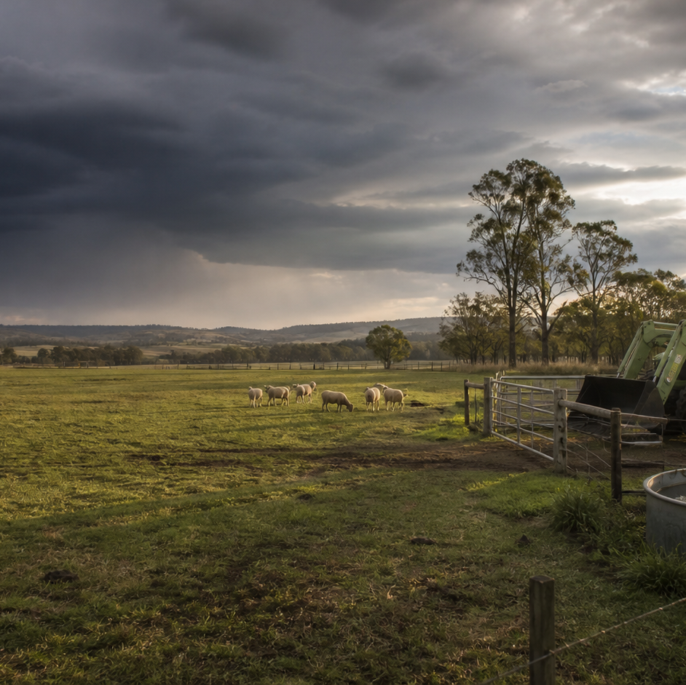
AHC20122 • CERTIFICATE II IN AGRICULTURE
Task 10 · Chemicals and weeds
Find and interpret the authorised source, recognise weeds and control options, reason about off-target risk and complete planning records.
LEARNING ROUTE
01 Authority, labels, SDS and the chemical register
02 Recognise weeds and compare control approaches
03 Weather, off-target movement and neighbours
04 Plan, calculate, record and report safely
Supplementary learning • current local sources and supervision control real work
Notes:
Open by connecting the task purpose to the four-module route. Ask students which module most clearly prepares them to notice evidence, make a source-led decision and report through authority.
Boundary: Supplementary learning is grounded in AHCCHM201 Release 1, the NESA Chemicals focus area and authorised teacher-posted chemicals notes. AHCPMG201 inclusion in the signed TAS remains Teacher/RTO to confirm. The site teaches source literacy, plant-observation records, broad control-option reasoning, off-target pathways and non-operational planning only. The current registered label, SDS, workplace chemical register, local procedures, current weather information, equipment instructions and supervisor control every real chemical task. Site responses are formative and do not demonstrate competency.
[Sources]
- Supplementary learning is grounded in AHCCHM201 Release 1, the NESA Chemicals focus area and authorised teacher-posted chemicals notes. AHCPMG201 inclusion in the signed TAS remains Teacher/RTO to confirm. The site teaches source literacy, plant-observation records, broad control-option reasoning, off-target pathways and non-operational planning only. The current registered label, SDS, workplace chemical register, local procedures, current weather information, equipment instructions and supervisor control every real chemical task. Site responses are formative and do not demonstrate competency.
- Course hero: Generated for this course using OpenAI ImageGen on 21 August 2026.
- Course data: work/pi/site-data/course.json

Slide 2
TASK 10 • PRIMARY INDUSTRIES
Authority, labels, SDS and the chemical register
NOTICE
• Begin with exact product identity
• The registered label controls product use
Chemical information is product-specific. The current registered label is the controlling product source for authorised uses, restrictions and directions.
LOOK FOR
Connect the module's first four teaching ideas before students apply them to a fictional agricultural decision.
Use the map to connect the lesson ideas, then confirm any real procedure or decision through the current authorised source.
AHC20122 PRIMARY INDUSTRIES • TASK 10
2/10
Notes:
Teaching move (theory and visual): Use the module visual and the fictional worked example to move students from observation to a source-led decision. Ask students to name the evidence, the authority gap and the next safe communication step.
Misconception and help: Look for the current document legally connected to the exact product. Identity first, then the current registered source.
Applied action: Build a source-authority matrix. Use a fictional teacher-prepared document set. Place each source beside the question it controls, circle mismatched identity or missing currency details and draft one concise referral. Do not reproduce or interpret operational directions.
Boundary: Supplementary learning is grounded in AHCCHM201 Release 1, the NESA Chemicals focus area and authorised teacher-posted chemicals notes. AHCPMG201 inclusion in the signed TAS remains Teacher/RTO to confirm. The site teaches source literacy, plant-observation records, broad control-option reasoning, off-target pathways and non-operational planning only. The current registered label, SDS, workplace chemical register, local procedures, current weather information, equipment instructions and supervisor control every real chemical task. Site responses are formative and do not demonstrate competency.
[Sources]
- Source basis: AHCCHM201 Release 1 source and supervision requirements, the NESA Chemicals focus area and authorised teacher-posted chemicals notes. The current registered label, matched SDS, workplace register, local procedures and supervisor control every real task.
- Visual visual-task-10-01: Generated locally from accepted Stage 05 module headings; no external image copied.
- Course visual manifest: work/pi/visuals/visual-manifest.json

Slide 3
TASK 10 • PRIMARY INDUSTRIES
Authority, labels, SDS and the chemical register: decide from evidence
FICTIONAL WORKPLACE EXAMPLE
CHECK YOUR DECISION
OBSERVE In a fictional source pack dated 12 February 2027, Kai finds a container image labelled Field Product Q, an SDS for Field Product Q, a register entry for Field Product R and an undated classroom summary.
DECIDE Kai does not combine the documents because the register identity conflicts and the summary has no currency evidence.
ACT Kai records the exact mismatch and refers the pack to the supervisor without proposing product use.
RECORD Kai notes which source answered identity, product-use and hazard-information questions, while leaving all real directions to the current documents.
Which source controls a product-specific use question?
A The current registered label matched to the exact product.
B An undated classroom slide with a similar product name.
C A worker's memory of what was used last season.
HELP Identity first, then the current registered source.
AHC20122 PRIMARY INDUSTRIES • TASK 10
3/10
Notes:
Teaching move (worked example and formative check): Use the module visual and the fictional worked example to move students from observation to a source-led decision. Ask students to name the evidence, the authority gap and the next safe communication step. Misconception and help: Look for the current document legally connected to the exact product. Identity first, then the current registered source. Applied action: Build a source-authority matrix. Use a fictional teacher-prepared document set. Place each source beside the question it controls, circle mismatched identity or missing currency details and draft one concise referral. Do not reproduce or interpret operational directions. Boundary: Supplementary learning is grounded in AHCCHM201 Release 1, the NESA Chemicals focus area and authorised teacher-posted chemicals notes. AHCPMG201 inclusion in the signed TAS remains Teacher/RTO to confirm. The site teaches source literacy, plant-observation records, broad control-option reasoning, off-target pathways and non-operational planning only. The current registered label, SDS, workplace chemical register, local procedures, current weather information, equipment instructions and supervisor control every real chemical task. Site responses are formative and do not demonstrate competency. [Sources] - Source basis: AHCCHM201 Release 1 source and supervision requirements, the NESA Chemicals focus area and authorised teacher-posted chemicals notes. The current registered label, matched SDS, workplace register, local procedures and supervisor control every real task. - Visual visual-task-10-01: Generated locally from accepted Stage 05 module headings; no external image copied. - Course visual manifest: work/pi/visuals/visual-manifest.json
Formative check answer: The current registered label matched to the exact product.
Correct feedback: You matched the product-use question to the controlling source.
Corrective feedback: Look for the current document legally connected to the exact product.
Full contextual example: Observed evidence: In a fictional source pack dated 12 February 2027, Kai finds a container image labelled Field Product Q, an SDS for Field Product Q, a register entry for Field Product R and an undated classroom summary. Decision and reason: Kai does not combine the documents because the register identity conflicts and the summary has no currency evidence. Safe action: Kai records the exact mismatch and refers the pack to the supervisor without proposing product use. Result: The supervisor confirms that the wrong register page was supplied and retrieves the current authorised record. Next check or record: Kai notes which source answered identity, product-use and hazard-information questions, while leaving all real directions to the current documents.

Slide 4
TASK 10 • PRIMARY INDUSTRIES
Recognise weeds and compare control approaches
NOTICE
• A weed is defined by context and authority
• Describe features before naming the plant
A weed is a plant growing where it is unwanted or creating an identified agricultural, environmental or workplace problem. Useful observations may include growth form, leaf arrangement and shape, stem features, flowers or seed structures, growth stage, distribution and surrounding land use.
LOOK FOR
Connect the module's first four teaching ideas before students apply them to a fictional agricultural decision.
Use the map to connect the lesson ideas, then confirm any real procedure or decision through the current authorised source.
AHC20122 PRIMARY INDUSTRIES • TASK 10
4/10
Notes:
Teaching move (theory and visual): Use the module visual and the fictional worked example to move students from observation to a source-led decision. Ask students to name the evidence, the authority gap and the next safe communication step.
Misconception and help: When diagnostic features are missing, record what is known and identify the next source check. Describe first; name only when the evidence and authority support it.
Applied action: Complete a fictional occurrence and source card. Annotate supplied privacy-safe plant images, match visible features to authorised identification cards and mark the confidence gap. Add strategy-level questions for the supervisor; do not propose a product or work method.
Boundary: Supplementary learning is grounded in AHCCHM201 Release 1, the NESA Chemicals focus area and authorised teacher-posted chemicals notes. AHCPMG201 inclusion in the signed TAS remains Teacher/RTO to confirm. The site teaches source literacy, plant-observation records, broad control-option reasoning, off-target pathways and non-operational planning only. The current registered label, SDS, workplace chemical register, local procedures, current weather information, equipment instructions and supervisor control every real chemical task. Site responses are formative and do not demonstrate competency.
[Sources]
- Source basis: AHCPMG201 Release 1 concepts for recognising and recording weed occurrence and discussing control options under supervision, plus the NESA Chemicals focus area. AHCPMG201 inclusion in the signed TAS remains Teacher/RTO to confirm; all local identity status and management decisions require authorised sources.
- Visual visual-task-10-02: Generated locally from accepted Stage 05 module headings; no external image copied.
- Course visual manifest: work/pi/visuals/visual-manifest.json

Slide 5
TASK 10 • PRIMARY INDUSTRIES
Recognise weeds and compare control approaches: decide from evidence
FICTIONAL WORKPLACE EXAMPLE
CHECK YOUR DECISION
OBSERVE On 8 March 2027, a fictional training map shows twelve similar rosette plants near a drainage line. The supplied photographs show leaf shape but no flowers, and two authorised identification cards remain possible matches.
DECIDE Noah does not name the plant or recommend a treatment because identity and nearby sensitivity remain unresolved.
ACT He records the observable features, extent, date and privacy-safe map zone and asks the supervisor what additional identification evidence is required.
RECORD Noah updates the occurrence record with the confirmed identity source and leaves the control decision blank until authorised.
A plant photograph lacks flowers and two authorised matches remain possible. What is the strongest conclusion?
A Choose the name that is more common in the district.
B Record the observed features and seek the additional evidence or expert confirmation required.
C Treat both possible species as identical for planning.
HELP Describe first; name only when the evidence and authority support it.
AHC20122 PRIMARY INDUSTRIES • TASK 10
5/10
Notes:
Teaching move (worked example and formative check): Use the module visual and the fictional worked example to move students from observation to a source-led decision. Ask students to name the evidence, the authority gap and the next safe communication step. Misconception and help: When diagnostic features are missing, record what is known and identify the next source check. Describe first; name only when the evidence and authority support it. Applied action: Complete a fictional occurrence and source card. Annotate supplied privacy-safe plant images, match visible features to authorised identification cards and mark the confidence gap. Add strategy-level questions for the supervisor; do not propose a product or work method. Boundary: Supplementary learning is grounded in AHCCHM201 Release 1, the NESA Chemicals focus area and authorised teacher-posted chemicals notes. AHCPMG201 inclusion in the signed TAS remains Teacher/RTO to confirm. The site teaches source literacy, plant-observation records, broad control-option reasoning, off-target pathways and non-operational planning only. The current registered label, SDS, workplace chemical register, local procedures, current weather information, equipment instructions and supervisor control every real chemical task. Site responses are formative and do not demonstrate competency. [Sources] - Source basis: AHCPMG201 Release 1 concepts for recognising and recording weed occurrence and discussing control options under supervision, plus the NESA Chemicals focus area. AHCPMG201 inclusion in the signed TAS remains Teacher/RTO to confirm; all local identity status and management decisions require authorised sources. - Visual visual-task-10-02: Generated locally from accepted Stage 05 module headings; no external image copied. - Course visual manifest: work/pi/visuals/visual-manifest.json
Formative check answer: Record the observed features and seek the additional evidence or expert confirmation required.
Correct feedback: You kept the identification claim within the available evidence.
Corrective feedback: When diagnostic features are missing, record what is known and identify the next source check.
Full contextual example: Observed evidence: On 8 March 2027, a fictional training map shows twelve similar rosette plants near a drainage line. The supplied photographs show leaf shape but no flowers, and two authorised identification cards remain possible matches. Decision and reason: Noah does not name the plant or recommend a treatment because identity and nearby sensitivity remain unresolved. Safe action: He records the observable features, extent, date and privacy-safe map zone and asks the supervisor what additional identification evidence is required. Result: The supervisor schedules an authorised identification check before any management option is considered. Next check or record: Noah updates the occurrence record with the confirmed identity source and leaves the control decision blank until authorised.

Slide 6
TASK 10 • PRIMARY INDUSTRIES
Weather, off-target movement and neighbours
NOTICE
• Off-target movement is a pathway problem
• Weather information must match the task time and place
Off-target movement means material reaches somewhere outside the intended area. Wind, temperature, humidity and changing conditions may affect a chemical task, but a learning site must not set universal limits.
LOOK FOR
Connect the module's first four teaching ideas before students apply them to a fictional agricultural decision.
Use the map to connect the lesson ideas, then confirm any real procedure or decision through the current authorised source.
AHC20122 PRIMARY INDUSTRIES • TASK 10
6/10
Notes:
Teaching move (theory and visual): Use the module visual and the fictional worked example to move students from observation to a source-led decision. Ask students to name the evidence, the authority gap and the next safe communication step.
Misconception and help: Identify what could move, how it could move and what could be affected. Source → pathway → receptor.
Applied action: Mark a fictional off-target pathway map. On a privacy-safe map, draw arrows from possible source zones to sensitive receptors, attach source timestamps and circle any changed condition requiring review. Do not add product, equipment or operating instructions.
Boundary: Supplementary learning is grounded in AHCCHM201 Release 1, the NESA Chemicals focus area and authorised teacher-posted chemicals notes. AHCPMG201 inclusion in the signed TAS remains Teacher/RTO to confirm. The site teaches source literacy, plant-observation records, broad control-option reasoning, off-target pathways and non-operational planning only. The current registered label, SDS, workplace chemical register, local procedures, current weather information, equipment instructions and supervisor control every real chemical task. Site responses are formative and do not demonstrate competency.
[Sources]
- Source basis: AHCCHM201 Release 1 requirements to assess meteorological conditions, minimise risk to others and the environment, cease when conditions are unsuitable and complete records; NESA Chemicals focus-area concepts. Exact limits and responses come only from current product and workplace sources.
- Visual visual-task-10-03: Generated locally from accepted Stage 05 module headings; no external image copied.
- Course visual manifest: work/pi/visuals/visual-manifest.json

Slide 7
TASK 10 • PRIMARY INDUSTRIES
Weather, off-target movement and neighbours: decide from evidence
FICTIONAL WORKPLACE EXAMPLE
CHECK YOUR DECISION
OBSERVE At 9:25 am on 27 March 2027, a fictional planning scenario shows the work area beside Zone C, where a school bus is now parked unexpectedly. The saved forecast in the class pack is three hours old and…
DECIDE Amira cannot confirm that the approved plan still protects the new receptor or that conditions remain suitable.
ACT She marks the task at the hold point and reports the bus location, source age and observed change to the supervisor.
RECORD Amira records the changed condition and authorisation outcome without inventing a weather limit or product adjustment.
Which description best explains off-target risk?
A A source can move along a pathway and affect a person, place or thing outside the intended area.
B Only visible damage inside the work area matters.
C Any wind automatically identifies the correct workplace response.
HELP Source → pathway → receptor.
AHC20122 PRIMARY INDUSTRIES • TASK 10
7/10
Notes:
Teaching move (worked example and formative check): Use the module visual and the fictional worked example to move students from observation to a source-led decision. Ask students to name the evidence, the authority gap and the next safe communication step. Misconception and help: Identify what could move, how it could move and what could be affected. Source → pathway → receptor. Applied action: Mark a fictional off-target pathway map. On a privacy-safe map, draw arrows from possible source zones to sensitive receptors, attach source timestamps and circle any changed condition requiring review. Do not add product, equipment or operating instructions. Boundary: Supplementary learning is grounded in AHCCHM201 Release 1, the NESA Chemicals focus area and authorised teacher-posted chemicals notes. AHCPMG201 inclusion in the signed TAS remains Teacher/RTO to confirm. The site teaches source literacy, plant-observation records, broad control-option reasoning, off-target pathways and non-operational planning only. The current registered label, SDS, workplace chemical register, local procedures, current weather information, equipment instructions and supervisor control every real chemical task. Site responses are formative and do not demonstrate competency. [Sources] - Source basis: AHCCHM201 Release 1 requirements to assess meteorological conditions, minimise risk to others and the environment, cease when conditions are unsuitable and complete records; NESA Chemicals focus-area concepts. Exact limits and responses come only from current product and workplace sources. - Visual visual-task-10-03: Generated locally from accepted Stage 05 module headings; no external image copied. - Course visual manifest: work/pi/visuals/visual-manifest.json
Formative check answer: A source can move along a pathway and affect a person, place or thing outside the intended area.
Correct feedback: You traced the pathway beyond the immediate task area.
Corrective feedback: Identify what could move, how it could move and what could be affected.
Full contextual example: Observed evidence: At 9:25 am on 27 March 2027, a fictional planning scenario shows the work area beside Zone C, where a school bus is now parked unexpectedly. The saved forecast in the class pack is three hours old and a windsock image indicates a changed direction, but no verified current reading is supplied. Decision and reason: Amira cannot confirm that the approved plan still protects the new receptor or that conditions remain suitable. Safe action: She marks the task at the hold point and reports the bus location, source age and observed change to the supervisor. Result: The supervisor checks current sources and the controlled local plan before deciding what happens next. Next check or record: Amira records the changed condition and authorisation outcome without inventing a weather limit or product adjustment.

Slide 8
TASK 10 • PRIMARY INDUSTRIES
Plan, calculate, record and report safely
NOTICE
• A plan is a chain of verified decisions
• Use arithmetic to find inconsistencies, not create directions
A source-led chemical plan identifies the authorised task purpose, exact product source, work area, sensitive surroundings, current information checks, responsibilities, hold points and record destination. Routine numeracy can help check whether a supplied fictional plan is internally consistent.
LOOK FOR
Connect the module's first four teaching ideas before students apply them to a fictional agricultural decision.
Use the map to connect the lesson ideas, then confirm any real procedure or decision through the current authorised source.
AHC20122 PRIMARY INDUSTRIES • TASK 10
8/10
Notes:
Teaching move (theory and visual): Use the module visual and the fictional worked example to move students from observation to a source-led decision. Ask students to name the evidence, the authority gap and the next safe communication step.
Misconception and help: Keep the original evidence, show the check and refer the correction. Add the three like units, then compare rather than overwrite.
Applied action: Audit a source-led fictional plan. Use a teacher-supplied non-operational sheet. Mark source links, check one area total, circle missing authority and draft the handover. Do not derive any product quantity or fill any operational field.
Boundary: Supplementary learning is grounded in AHCCHM201 Release 1, the NESA Chemicals focus area and authorised teacher-posted chemicals notes. AHCPMG201 inclusion in the signed TAS remains Teacher/RTO to confirm. The site teaches source literacy, plant-observation records, broad control-option reasoning, off-target pathways and non-operational planning only. The current registered label, SDS, workplace chemical register, local procedures, current weather information, equipment instructions and supervisor control every real chemical task. Site responses are formative and do not demonstrate competency.
[Sources]
- Source basis: AHCCHM201 Release 1 planning, source, weather, supervision and record concepts; NESA Chemicals focus-area numeracy and documentation concepts; authorised teacher-posted chemicals notes. No website calculation or plan controls a real chemical task.
- Visual visual-task-10-04: Generated locally from accepted Stage 05 module headings; no external image copied.
- Course visual manifest: work/pi/visuals/visual-manifest.json

Slide 9
TASK 10 • PRIMARY INDUSTRIES
Plan, calculate, record and report safely: decide from evidence
FICTIONAL WORKPLACE EXAMPLE
CHECK YOUR DECISION
OBSERVE A fictional planning sheet dated 4 April 2027 lists three training zones of 0.8 ha each but shows a total of 2.6 ha. Product fields are intentionally blank and the source card is marked classroom rehearsal only.
DECIDE Elena identifies that the areas total 2.4 ha and does not use either figure to derive any chemical quantity.
ACT She preserves the original figures, shows the addition and flags the total for supervisor review.
RECORD Elena records the corrected fictional area with the confirmation note and leaves every operational field linked to its authorised source.
A fictional sheet lists 0.8 ha, 0.8 ha and 0.8 ha but states a total of 2.6 ha. What is the strongest response?
A Change the largest zone until the total matches.
B Show that the listed areas total 2.4 ha, preserve the original entry and refer the mismatch.
C Use 2.6 ha because totals are always more reliable than line items.
HELP Add the three like units, then compare rather than overwrite.
AHC20122 PRIMARY INDUSTRIES • TASK 10
9/10
Notes:
Teaching move (worked example and formative check): Use the module visual and the fictional worked example to move students from observation to a source-led decision. Ask students to name the evidence, the authority gap and the next safe communication step. Misconception and help: Keep the original evidence, show the check and refer the correction. Add the three like units, then compare rather than overwrite. Applied action: Audit a source-led fictional plan. Use a teacher-supplied non-operational sheet. Mark source links, check one area total, circle missing authority and draft the handover. Do not derive any product quantity or fill any operational field. Boundary: Supplementary learning is grounded in AHCCHM201 Release 1, the NESA Chemicals focus area and authorised teacher-posted chemicals notes. AHCPMG201 inclusion in the signed TAS remains Teacher/RTO to confirm. The site teaches source literacy, plant-observation records, broad control-option reasoning, off-target pathways and non-operational planning only. The current registered label, SDS, workplace chemical register, local procedures, current weather information, equipment instructions and supervisor control every real chemical task. Site responses are formative and do not demonstrate competency. [Sources] - Source basis: AHCCHM201 Release 1 planning, source, weather, supervision and record concepts; NESA Chemicals focus-area numeracy and documentation concepts; authorised teacher-posted chemicals notes. No website calculation or plan controls a real chemical task. - Visual visual-task-10-04: Generated locally from accepted Stage 05 module headings; no external image copied. - Course visual manifest: work/pi/visuals/visual-manifest.json
Formative check answer: Show that the listed areas total 2.4 ha, preserve the original entry and refer the mismatch.
Correct feedback: You used numeracy to identify a problem without turning it into an operational calculation.
Corrective feedback: Keep the original evidence, show the check and refer the correction.
Full contextual example: Observed evidence: A fictional planning sheet dated 4 April 2027 lists three training zones of 0.8 ha each but shows a total of 2.6 ha. Product fields are intentionally blank and the source card is marked classroom rehearsal only. Decision and reason: Elena identifies that the areas total 2.4 ha and does not use either figure to derive any chemical quantity. Safe action: She preserves the original figures, shows the addition and flags the total for supervisor review. Result: The supervisor confirms a transcription error in the fictional sheet and explains where the real authorised plan would control product-specific information. Next check or record: Elena records the corrected fictional area with the confirmation note and leaves every operational field linked to its authorised source.

Slide 10
CLOSE THE LOOP WITH EVIDENCE
Apply the task route — then check the boundary
01 Authority, labels, SDS and the chemical register
02 Recognise weeds and compare control approaches
03 Weather, off-target movement and neighbours
04 Plan, calculate, record and report safely
Build a source-authority matrix
Use a fictional teacher-prepared document set.
Complete a fictional occurrence and source card
Annotate supplied privacy-safe plant images, match visible features to authorised identification cards and mark the confidence gap.
Mark a fictional off-target pathway map
On a privacy-safe map, draw arrows from possible source zones to sensitive receptors, attach source timestamps and circle any changed condition requiring review.
Audit a source-led fictional plan
Use a teacher-supplied non-operational sheet.
NEXT STEP Complete the teacher-nominated learning action. Use current local sources and supervision before any real practical decision. Website responses remain formative.
Notes:
Close with one retrieval question from each module, then direct students to the teacher-nominated learning action. Re-state that site work is formative and that current workplace and RTO processes control real practice and assessment.
Boundary: Supplementary learning is grounded in AHCCHM201 Release 1, the NESA Chemicals focus area and authorised teacher-posted chemicals notes. AHCPMG201 inclusion in the signed TAS remains Teacher/RTO to confirm. The site teaches source literacy, plant-observation records, broad control-option reasoning, off-target pathways and non-operational planning only. The current registered label, SDS, workplace chemical register, local procedures, current weather information, equipment instructions and supervisor control every real chemical task. Site responses are formative and do not demonstrate competency.
[Sources]
- Source basis: AHCCHM201 Release 1 source and supervision requirements, the NESA Chemicals focus area and authorised teacher-posted chemicals notes. The current registered label, matched SDS, workplace register, local procedures and supervisor control every real task.
- Source basis: AHCPMG201 Release 1 concepts for recognising and recording weed occurrence and discussing control options under supervision, plus the NESA Chemicals focus area. AHCPMG201 inclusion in the signed TAS remains Teacher/RTO to confirm; all local identity status and management decisions require authorised sources.
- Source basis: AHCCHM201 Release 1 requirements to assess meteorological conditions, minimise risk to others and the environment, cease when conditions are unsuitable and complete records; NESA Chemicals focus-area concepts. Exact limits and responses come only from current product and workplace sources.
- Source basis: AHCCHM201 Release 1 planning, source, weather, supervision and record concepts; NESA Chemicals focus-area numeracy and documentation concepts; authorised teacher-posted chemicals notes. No website calculation or plan controls a real chemical task.

