Slide 1
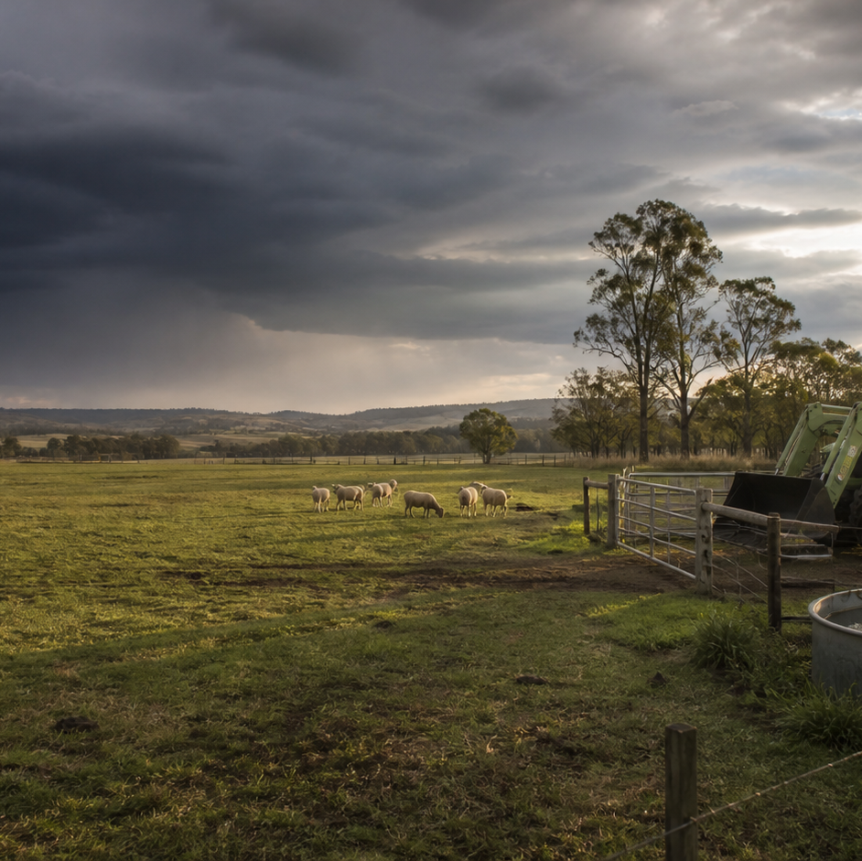
AHC20122 • CERTIFICATE II IN AGRICULTURE
Task 11 · Environmentally sustainable work
Recognise environmental pathways, measure resource use, report incidents and propose practical improvements within authority.
LEARNING ROUTE
01 Environmental hazards and pathways
02 Protect soil, water, habitat and resources
03 Measure resource use before improving it
04 Report an incident and propose improvement
Supplementary learning • current local sources and supervision control real work
Notes:
Open by connecting the task purpose to the four-module route. Ask students which module most clearly prepares them to notice evidence, make a source-led decision and report through authority.
Boundary: Supplementary learning is grounded in AHCWRK211 Release 1, the NESA Sustainability focus area and authorised teacher-posted sustainability notes. The site teaches environmental pathways, factual reporting, resource measurement and improvement reasoning with fictional data. Current workplace procedures, legal notification requirements, incident response, waste handling, environmental limits and property-specific controls remain controlled by authorised local sources and the supervisor. Site responses are formative and do not demonstrate competency.
[Sources]
- Supplementary learning is grounded in AHCWRK211 Release 1, the NESA Sustainability focus area and authorised teacher-posted sustainability notes. The site teaches environmental pathways, factual reporting, resource measurement and improvement reasoning with fictional data. Current workplace procedures, legal notification requirements, incident response, waste handling, environmental limits and property-specific controls remain controlled by authorised local sources and the supervisor. Site responses are formative and do not demonstrate competency.
- Course hero: Generated for this course using OpenAI ImageGen on 21 August 2026.
- Course data: work/pi/site-data/course.json

Slide 2
TASK 11 • PRIMARY INDUSTRIES
Environmental hazards and pathways
NOTICE
• Sustainability joins present work to future capacity
• Separate hazard, pathway, receptor and impact
Environmentally sustainable work aims to meet present needs while protecting the systems and resources needed later. An environmental hazard is a source or situation with potential to cause harm.
LOOK FOR
Connect the module's first four teaching ideas before students apply them to a fictional agricultural decision.
Use the map to connect the lesson ideas, then confirm any real procedure or decision through the current authorised source.
AHC20122 PRIMARY INDUSTRIES • TASK 11
2/10
Notes:
Teaching move (theory and visual): Use the module visual and the fictional worked example to move students from observation to a source-led decision. Ask students to name the evidence, the authority gap and the next safe communication step.
Misconception and help: Follow the chain and identify what receives the possible movement. Source moves along a pathway towards a receptor.
Applied action: Build a fictional pathway map. Annotate a teacher-provided privacy-safe farm scene with two source–pathway–receptor chains, one changed condition and one supervisor referral. Do not propose a local response procedure.
Boundary: Supplementary learning is grounded in AHCWRK211 Release 1, the NESA Sustainability focus area and authorised teacher-posted sustainability notes. The site teaches environmental pathways, factual reporting, resource measurement and improvement reasoning with fictional data. Current workplace procedures, legal notification requirements, incident response, waste handling, environmental limits and property-specific controls remain controlled by authorised local sources and the supervisor. Site responses are formative and do not demonstrate competency.
[Sources]
- Source basis: AHCWRK211 Release 1 requirements to identify and report environmental hazards and follow workplace practices, plus the NESA Sustainability focus area and authorised teacher-posted sustainability notes. Local response and notification remain controlled.
- Visual visual-task-11-01: Generated locally from accepted Stage 05 module headings; no external image copied.
- Course visual manifest: work/pi/visuals/visual-manifest.json

Slide 3
TASK 11 • PRIMARY INDUSTRIES
Environmental hazards and pathways: decide from evidence
FICTIONAL WORKPLACE EXAMPLE
CHECK YOUR DECISION
OBSERVE On 16 May 2027, a fictional training map shows a stockpile of fine soil uphill from a shallow flow path, with rain forecast in the saved class scenario and a dam marked downslope.
DECIDE Ben identifies a possible soil–runoff–dam pathway but does not claim that contamination has occurred or redesign the site.
ACT He reports the location, visible condition, map relationship and source time to the supervisor.
RECORD Ben records the observation, receptor and confirmed control owner, then notes the later inspection result without inventing environmental measurements.
In the chain loose soil → runoff → dam → increased sediment, what is the dam?
A The receptor that could be affected.
B The original hazard source.
C The evidence that impact has already occurred.
HELP Source moves along a pathway towards a receptor.
AHC20122 PRIMARY INDUSTRIES • TASK 11
3/10
Notes:
Teaching move (worked example and formative check): Use the module visual and the fictional worked example to move students from observation to a source-led decision. Ask students to name the evidence, the authority gap and the next safe communication step. Misconception and help: Follow the chain and identify what receives the possible movement. Source moves along a pathway towards a receptor. Applied action: Build a fictional pathway map. Annotate a teacher-provided privacy-safe farm scene with two source–pathway–receptor chains, one changed condition and one supervisor referral. Do not propose a local response procedure. Boundary: Supplementary learning is grounded in AHCWRK211 Release 1, the NESA Sustainability focus area and authorised teacher-posted sustainability notes. The site teaches environmental pathways, factual reporting, resource measurement and improvement reasoning with fictional data. Current workplace procedures, legal notification requirements, incident response, waste handling, environmental limits and property-specific controls remain controlled by authorised local sources and the supervisor. Site responses are formative and do not demonstrate competency. [Sources] - Source basis: AHCWRK211 Release 1 requirements to identify and report environmental hazards and follow workplace practices, plus the NESA Sustainability focus area and authorised teacher-posted sustainability notes. Local response and notification remain controlled. - Visual visual-task-11-01: Generated locally from accepted Stage 05 module headings; no external image copied. - Course visual manifest: work/pi/visuals/visual-manifest.json
Formative check answer: The receptor that could be affected.
Correct feedback: You correctly distinguished the receptor from the source and impact.
Corrective feedback: Follow the chain and identify what receives the possible movement.
Full contextual example: Observed evidence: On 16 May 2027, a fictional training map shows a stockpile of fine soil uphill from a shallow flow path, with rain forecast in the saved class scenario and a dam marked downslope. Decision and reason: Ben identifies a possible soil–runoff–dam pathway but does not claim that contamination has occurred or redesign the site. Safe action: He reports the location, visible condition, map relationship and source time to the supervisor. Result: The supervisor checks the current property plan and confirms the authorised work response. Next check or record: Ben records the observation, receptor and confirmed control owner, then notes the later inspection result without inventing environmental measurements.

Slide 4
TASK 11 • PRIMARY INDUSTRIES
Protect soil, water, habitat and resources
NOTICE
• Prevention acts before the pathway opens
• Soil protection supports productivity and water quality
Prevention changes the source, location, timing or exposure before environmental harm develops. Soil structure, ground cover and stable surfaces affect infiltration, erosion, compaction and the movement of sediment.
LOOK FOR
Connect the module's first four teaching ideas before students apply them to a fictional agricultural decision.
Use the map to connect the lesson ideas, then confirm any real procedure or decision through the current authorised source.
AHC20122 PRIMARY INDUSTRIES • TASK 11
4/10
Notes:
Teaching move (theory and visual): Use the module visual and the fictional worked example to move students from observation to a source-led decision. Ask students to name the evidence, the authority gap and the next safe communication step.
Misconception and help: Compare preventing movement with trying to address its effects later. Earlier in the chain is usually easier to control.
Applied action: Compare two fictional prevention options. Use a privacy-safe farm scene and teacher-supplied option cards. Complete a comparison of pathway, receptor, likely benefit, limitation and monitoring question. Do not write a property procedure.
Boundary: Supplementary learning is grounded in AHCWRK211 Release 1, the NESA Sustainability focus area and authorised teacher-posted sustainability notes. The site teaches environmental pathways, factual reporting, resource measurement and improvement reasoning with fictional data. Current workplace procedures, legal notification requirements, incident response, waste handling, environmental limits and property-specific controls remain controlled by authorised local sources and the supervisor. Site responses are formative and do not demonstrate competency.
[Sources]
- Source basis: AHCWRK211 Release 1 environmental practice and improvement requirements, the NESA Sustainability focus area and authorised teacher-posted sustainability notes. Property-specific soil, water, habitat and waste controls remain authorised locally.
- Visual visual-task-11-02: Generated locally from accepted Stage 05 module headings; no external image copied.
- Course visual manifest: work/pi/visuals/visual-manifest.json

Slide 5
TASK 11 • PRIMARY INDUSTRIES
Protect soil, water, habitat and resources: decide from evidence
FICTIONAL WORKPLACE EXAMPLE
CHECK YOUR DECISION
OBSERVE A fictional job brief dated 2 June 2027 proposes storing clean packaging beside a shed for one week. The map shows the space crosses a vegetated drainage edge used as a movement corridor after rain.
DECIDE Sienna compares the convenience of the location with possible obstruction, litter movement and habitat disturbance but does not select a new site herself.
ACT She presents two prevention-focused questions to the supervisor: whether an authorised existing storage zone can be used and how the corridor boundary is identified in the property plan.
RECORD Sienna records the agreed location and a later observable check for escaped packaging, without inventing waste-handling rules.
Why is prevention often stronger than responding after movement occurs?
A It can remove or reduce the source–pathway connection before a receptor is affected.
B It guarantees that no monitoring is needed.
C It lets a learner ignore the workplace plan.
HELP Earlier in the chain is usually easier to control.
AHC20122 PRIMARY INDUSTRIES • TASK 11
5/10
Notes:
Teaching move (worked example and formative check): Use the module visual and the fictional worked example to move students from observation to a source-led decision. Ask students to name the evidence, the authority gap and the next safe communication step. Misconception and help: Compare preventing movement with trying to address its effects later. Earlier in the chain is usually easier to control. Applied action: Compare two fictional prevention options. Use a privacy-safe farm scene and teacher-supplied option cards. Complete a comparison of pathway, receptor, likely benefit, limitation and monitoring question. Do not write a property procedure. Boundary: Supplementary learning is grounded in AHCWRK211 Release 1, the NESA Sustainability focus area and authorised teacher-posted sustainability notes. The site teaches environmental pathways, factual reporting, resource measurement and improvement reasoning with fictional data. Current workplace procedures, legal notification requirements, incident response, waste handling, environmental limits and property-specific controls remain controlled by authorised local sources and the supervisor. Site responses are formative and do not demonstrate competency. [Sources] - Source basis: AHCWRK211 Release 1 environmental practice and improvement requirements, the NESA Sustainability focus area and authorised teacher-posted sustainability notes. Property-specific soil, water, habitat and waste controls remain authorised locally. - Visual visual-task-11-02: Generated locally from accepted Stage 05 module headings; no external image copied. - Course visual manifest: work/pi/visuals/visual-manifest.json
Formative check answer: It can remove or reduce the source–pathway connection before a receptor is affected.
Correct feedback: You identified the advantage of acting before the pathway is active.
Corrective feedback: Compare preventing movement with trying to address its effects later.
Full contextual example: Observed evidence: A fictional job brief dated 2 June 2027 proposes storing clean packaging beside a shed for one week. The map shows the space crosses a vegetated drainage edge used as a movement corridor after rain. Decision and reason: Sienna compares the convenience of the location with possible obstruction, litter movement and habitat disturbance but does not select a new site herself. Safe action: She presents two prevention-focused questions to the supervisor: whether an authorised existing storage zone can be used and how the corridor boundary is identified in the property plan. Result: The supervisor confirms the controlled storage location. Next check or record: Sienna records the agreed location and a later observable check for escaped packaging, without inventing waste-handling rules.

Slide 6
TASK 11 • PRIMARY INDUSTRIES
Measure resource use before improving it
NOTICE
• Define the resource and work boundary
• Choose a consistent measure
Resources can include water, energy, fuel, materials, stock, time, infrastructure and consumables. Resource use can be recorded as a total, a count or a normalised figure such as litres per cleaned crate or kilowatt-hours per operating day.
LOOK FOR
Connect the module's first four teaching ideas before students apply them to a fictional agricultural decision.
Use the map to connect the lesson ideas, then confirm any real procedure or decision through the current authorised source.
AHC20122 PRIMARY INDUSTRIES • TASK 11
6/10
Notes:
Teaching move (theory and visual): Use the module visual and the fictional worked example to move students from observation to a source-led decision. Ask students to name the evidence, the authority gap and the next safe communication step.
Misconception and help: Name the resource, activity, place and period before using the number. Measure what, where, during what work and for how long?
Applied action: Build a fictional resource baseline. Calculate totals and one per-output ratio from a supplied dataset, mark any comparability gap and draft a supervisor-reviewed improvement question. Do not access real meters or equipment.
Boundary: Supplementary learning is grounded in AHCWRK211 Release 1, the NESA Sustainability focus area and authorised teacher-posted sustainability notes. The site teaches environmental pathways, factual reporting, resource measurement and improvement reasoning with fictional data. Current workplace procedures, legal notification requirements, incident response, waste handling, environmental limits and property-specific controls remain controlled by authorised local sources and the supervisor. Site responses are formative and do not demonstrate competency.
[Sources]
- Source basis: AHCWRK211 Release 1 requirements to identify, measure, record and file resource use and seek improvements with a supervisor; NESA Sustainability focus-area resource-efficiency concepts; authorised teacher-posted sustainability notes.
- Visual visual-task-11-03: Generated locally from accepted Stage 05 module headings; no external image copied.
- Course visual manifest: work/pi/visuals/visual-manifest.json

Slide 7
TASK 11 • PRIMARY INDUSTRIES
Measure resource use before improving it: decide from evidence
FICTIONAL WORKPLACE EXAMPLE
CHECK YOUR DECISION
OBSERVE A fictional wash-area record dated 1–5 June 2027 shows 4,800 L used for 120 reusable crates in the baseline period and 4,200 L for 120 crates after a supervisor-approved workflow change.
DECIDE Arlo calculates 40 L per crate before and 35 L per crate after, a reduction of 5 L per crate, but does not claim the change caused the result from one comparison alone.
ACT He checks that the task boundary, crate count and recording method match and reports one missing weather note.
RECORD Arlo records the method limitation and the agreed monitoring period.
Why define the task boundary before measuring resource use?
A So the data represents the work area, period and activity being compared.
B So every resource can be reported with the same unit.
C So one day's value proves the annual trend.
HELP Measure what, where, during what work and for how long?
AHC20122 PRIMARY INDUSTRIES • TASK 11
7/10
Notes:
Teaching move (worked example and formative check): Use the module visual and the fictional worked example to move students from observation to a source-led decision. Ask students to name the evidence, the authority gap and the next safe communication step. Misconception and help: Name the resource, activity, place and period before using the number. Measure what, where, during what work and for how long? Applied action: Build a fictional resource baseline. Calculate totals and one per-output ratio from a supplied dataset, mark any comparability gap and draft a supervisor-reviewed improvement question. Do not access real meters or equipment. Boundary: Supplementary learning is grounded in AHCWRK211 Release 1, the NESA Sustainability focus area and authorised teacher-posted sustainability notes. The site teaches environmental pathways, factual reporting, resource measurement and improvement reasoning with fictional data. Current workplace procedures, legal notification requirements, incident response, waste handling, environmental limits and property-specific controls remain controlled by authorised local sources and the supervisor. Site responses are formative and do not demonstrate competency. [Sources] - Source basis: AHCWRK211 Release 1 requirements to identify, measure, record and file resource use and seek improvements with a supervisor; NESA Sustainability focus-area resource-efficiency concepts; authorised teacher-posted sustainability notes. - Visual visual-task-11-03: Generated locally from accepted Stage 05 module headings; no external image copied. - Course visual manifest: work/pi/visuals/visual-manifest.json
Formative check answer: So the data represents the work area, period and activity being compared.
Correct feedback: You established what the measurement actually represents.
Corrective feedback: Name the resource, activity, place and period before using the number.
Full contextual example: Observed evidence: A fictional wash-area record dated 1–5 June 2027 shows 4,800 L used for 120 reusable crates in the baseline period and 4,200 L for 120 crates after a supervisor-approved workflow change. Decision and reason: Arlo calculates 40 L per crate before and 35 L per crate after, a reduction of 5 L per crate, but does not claim the change caused the result from one comparison alone. Safe action: He checks that the task boundary, crate count and recording method match and reports one missing weather note. Result: The supervisor requests another comparable period before deciding whether to retain the change. Next check or record: Arlo records the method limitation and the agreed monitoring period.

Slide 8
TASK 11 • PRIMARY INDUSTRIES
Report an incident and propose improvement
NOTICE
• Recognise events, issues and trends
• Protect first, but only through authorised direction
An environmental event is a specific occurrence, an issue is a condition needing attention and a trend is a pattern across comparable observations. When an unexpected environmental condition is observed, the learner keeps outside the affected area, avoids disturbing evidence and reports through the current workplace channel.
LOOK FOR
Connect the module's first four teaching ideas before students apply them to a fictional agricultural decision.
Use the map to connect the lesson ideas, then confirm any real procedure or decision through the current authorised source.
AHC20122 PRIMARY INDUSTRIES • TASK 11
8/10
Notes:
Teaching move (theory and visual): Use the module visual and the fictional worked example to move students from observation to a source-led decision. Ask students to name the evidence, the authority gap and the next safe communication step.
Misconception and help: Record what can be observed now and refer what cannot be established. When, where, what seen, where moving, task status, who told.
Applied action: Separate report, review and improvement. Use a fictional environmental event card. Complete a factual first-report panel, an evidence-needed panel and a measurable improvement panel. Do not write a property response or external notification procedure.
Boundary: Supplementary learning is grounded in AHCWRK211 Release 1, the NESA Sustainability focus area and authorised teacher-posted sustainability notes. The site teaches environmental pathways, factual reporting, resource measurement and improvement reasoning with fictional data. Current workplace procedures, legal notification requirements, incident response, waste handling, environmental limits and property-specific controls remain controlled by authorised local sources and the supervisor. Site responses are formative and do not demonstrate competency.
[Sources]
- Source basis: AHCWRK211 Release 1 requirements to report hazards, breaches or possible breaches, follow workplace practices and suggest improvements; NESA Sustainability focus-area reporting concepts. Current local and regulatory sources control all real response and notification.
- Visual visual-task-11-04: Generated locally from accepted Stage 05 module headings; no external image copied.
- Course visual manifest: work/pi/visuals/visual-manifest.json

Slide 9
TASK 11 • PRIMARY INDUSTRIES
Report an incident and propose improvement: decide from evidence
FICTIONAL WORKPLACE EXAMPLE
CHECK YOUR DECISION
OBSERVE At 1:15 pm on 18 July 2027, a fictional training scene shows unusually cloudy water entering a marked drainage point beside a recently used wash area. The source is not visible.
DECIDE Grace records an environmental concern but does not identify the substance, cause or legal status from appearance.
ACT She remains outside the marked area and reports the time, location, colour change, flow direction and current task status through the fictional supervisor channel.
RECORD Grace completes only the factual fields she can verify and later contributes observations to a separate cause-review discussion.
What is the strongest first report of cloudy water at a fictional drainage point?
A Name the contaminant and responsible person from appearance.
B Record time, location, observable change, flow direction, task status and person notified.
C Wait until visible harm occurs so the report is definite.
HELP When, where, what seen, where moving, task status, who told.
AHC20122 PRIMARY INDUSTRIES • TASK 11
9/10
Notes:
Teaching move (worked example and formative check): Use the module visual and the fictional worked example to move students from observation to a source-led decision. Ask students to name the evidence, the authority gap and the next safe communication step. Misconception and help: Record what can be observed now and refer what cannot be established. When, where, what seen, where moving, task status, who told. Applied action: Separate report, review and improvement. Use a fictional environmental event card. Complete a factual first-report panel, an evidence-needed panel and a measurable improvement panel. Do not write a property response or external notification procedure. Boundary: Supplementary learning is grounded in AHCWRK211 Release 1, the NESA Sustainability focus area and authorised teacher-posted sustainability notes. The site teaches environmental pathways, factual reporting, resource measurement and improvement reasoning with fictional data. Current workplace procedures, legal notification requirements, incident response, waste handling, environmental limits and property-specific controls remain controlled by authorised local sources and the supervisor. Site responses are formative and do not demonstrate competency. [Sources] - Source basis: AHCWRK211 Release 1 requirements to report hazards, breaches or possible breaches, follow workplace practices and suggest improvements; NESA Sustainability focus-area reporting concepts. Current local and regulatory sources control all real response and notification. - Visual visual-task-11-04: Generated locally from accepted Stage 05 module headings; no external image copied. - Course visual manifest: work/pi/visuals/visual-manifest.json
Formative check answer: Record time, location, observable change, flow direction, task status and person notified.
Correct feedback: You selected a prompt factual report without unsupported conclusions.
Corrective feedback: Record what can be observed now and refer what cannot be established.
Full contextual example: Observed evidence: At 1:15 pm on 18 July 2027, a fictional training scene shows unusually cloudy water entering a marked drainage point beside a recently used wash area. The source is not visible. Decision and reason: Grace records an environmental concern but does not identify the substance, cause or legal status from appearance. Safe action: She remains outside the marked area and reports the time, location, colour change, flow direction and current task status through the fictional supervisor channel. Result: The supervisor applies the authorised property process and controls all further action. Next check or record: Grace completes only the factual fields she can verify and later contributes observations to a separate cause-review discussion.

Slide 10
CLOSE THE LOOP WITH EVIDENCE
Apply the task route — then check the boundary
01 Environmental hazards and pathways
02 Protect soil, water, habitat and resources
03 Measure resource use before improving it
04 Report an incident and propose improvement
Build a fictional pathway map
Annotate a teacher-provided privacy-safe farm scene with two source–pathway–receptor chains, one changed condition and one supervisor referral.
Compare two fictional prevention options
Use a privacy-safe farm scene and teacher-supplied option cards.
Build a fictional resource baseline
Calculate totals and one per-output ratio from a supplied dataset, mark any comparability gap and draft a supervisor-reviewed improvement question.
Separate report, review and improvement
Use a fictional environmental event card.
NEXT STEP Complete the teacher-nominated learning action. Use current local sources and supervision before any real practical decision. Website responses remain formative.
Notes:
Close with one retrieval question from each module, then direct students to the teacher-nominated learning action. Re-state that site work is formative and that current workplace and RTO processes control real practice and assessment.
Boundary: Supplementary learning is grounded in AHCWRK211 Release 1, the NESA Sustainability focus area and authorised teacher-posted sustainability notes. The site teaches environmental pathways, factual reporting, resource measurement and improvement reasoning with fictional data. Current workplace procedures, legal notification requirements, incident response, waste handling, environmental limits and property-specific controls remain controlled by authorised local sources and the supervisor. Site responses are formative and do not demonstrate competency.
[Sources]
- Source basis: AHCWRK211 Release 1 requirements to identify and report environmental hazards and follow workplace practices, plus the NESA Sustainability focus area and authorised teacher-posted sustainability notes. Local response and notification remain controlled.
- Source basis: AHCWRK211 Release 1 environmental practice and improvement requirements, the NESA Sustainability focus area and authorised teacher-posted sustainability notes. Property-specific soil, water, habitat and waste controls remain authorised locally.
- Source basis: AHCWRK211 Release 1 requirements to identify, measure, record and file resource use and seek improvements with a supervisor; NESA Sustainability focus-area resource-efficiency concepts; authorised teacher-posted sustainability notes.
- Source basis: AHCWRK211 Release 1 requirements to report hazards, breaches or possible breaches, follow workplace practices and suggest improvements; NESA Sustainability focus-area reporting concepts. Current local and regulatory sources control all real response and notification.

