Slide 1
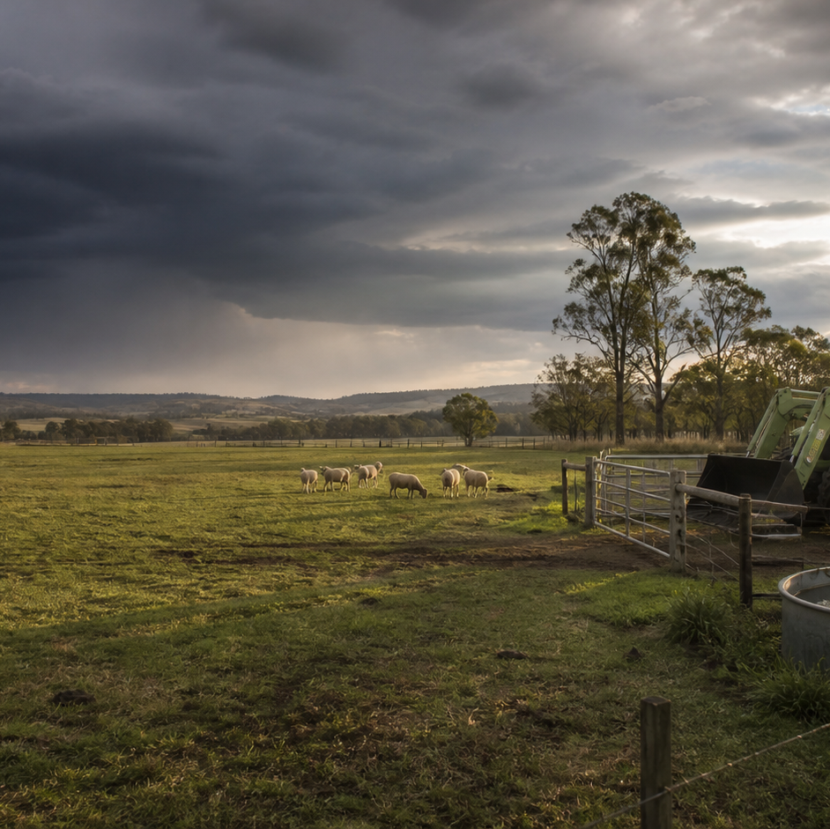
AHC20122 • CERTIFICATE II IN AGRICULTURE
Task 12 · Farm fencing
Read a fencing brief, plan resources and sequence, recognise hazards, and evaluate work against specifications.
LEARNING ROUTE
01 Fence purpose, specifications and site constraints
02 Materials, tools and risk planning
03 Work sequence, communication and quality checks
04 Inspection, maintenance report and handover
Supplementary learning • current local sources and supervision control real work
Notes:
Open by connecting the task purpose to the four-module route. Ask students which module most clearly prepares them to notice evidence, make a source-led decision and report through authority.
Boundary: Supplementary learning is grounded in AHCINF206 Release 1 and controlled student-package titles recorded in the source manifest. The site teaches fictional brief and specification reading, resource-list checking, hazard and authority planning, observable quality reasoning, inspection records and handover only. Site services, practical resources, plant, stored-energy work, construction, repair and acceptance criteria require the current authorised plan, local procedures, manufacturer information, teacher demonstration and direct supervision. Site responses are formative and do not demonstrate competency.
[Sources]
- Supplementary learning is grounded in AHCINF206 Release 1 and controlled student-package titles recorded in the source manifest. The site teaches fictional brief and specification reading, resource-list checking, hazard and authority planning, observable quality reasoning, inspection records and handover only. Site services, practical resources, plant, stored-energy work, construction, repair and acceptance criteria require the current authorised plan, local procedures, manufacturer information, teacher demonstration and direct supervision. Site responses are formative and do not demonstrate competency.
- Course hero: Generated for this course using OpenAI ImageGen on 21 August 2026.
- Course data: work/pi/site-data/course.json

Slide 2
TASK 12 • PRIMARY INDUSTRIES
Fence purpose, specifications and site constraints
NOTICE
• Purpose determines the performance question
• Read the whole document set
A fencing brief begins with what the boundary or enclosure must achieve, such as separating stock groups, defining access, protecting an area or marking a property division. A job may be described across a brief, plan, site map, material schedule, risk documentation and manufacturer information.
LOOK FOR
Connect the module's first four teaching ideas before students apply them to a fictional agricultural decision.
Use the map to connect the lesson ideas, then confirm any real procedure or decision through the current authorised source.
AHC20122 PRIMARY INDUSTRIES • TASK 12
2/10
Notes:
Teaching move (theory and visual): Use the module visual and the fictional worked example to move students from observation to a source-led decision. Ask students to name the evidence, the authority gap and the next safe communication step.
Misconception and help: When drawings disagree, identify both versions and refer the design decision. Plan identity and currency come before site action.
Applied action: Mark up a fictional fencing brief. Annotate the supplied privacy-safe brief and drawing with source identity, dimension totals, material categories, constraints and supervisor questions. Do not produce a method or alter the design.
Boundary: Supplementary learning is grounded in AHCINF206 Release 1 and controlled student-package titles recorded in the source manifest. The site teaches fictional brief and specification reading, resource-list checking, hazard and authority planning, observable quality reasoning, inspection records and handover only. Site services, practical resources, plant, stored-energy work, construction, repair and acceptance criteria require the current authorised plan, local procedures, manufacturer information, teacher demonstration and direct supervision. Site responses are formative and do not demonstrate competency.
[Sources]
- Source basis: AHCINF206 Release 1 requirements to confirm work instructions and prepare for supervised fencing work. The current local plan, site verification, student package and teacher direction control every real design and practical decision.
- Visual visual-task-12-01: Generated locally from accepted Stage 05 module headings; no external image copied.
- Course visual manifest: work/pi/visuals/visual-manifest.json

Slide 3
TASK 12 • PRIMARY INDUSTRIES
Fence purpose, specifications and site constraints: decide from evidence
FICTIONAL WORKPLACE EXAMPLE
CHECK YOUR DECISION
OBSERVE A fictional brief dated 7 August 2027 states an overall fence line of 230 m, while the current sketch lists segments of 80 m, 75 m and 70 m, totalling 225 m. A second undated sketch shows a…
DECIDE Lewis cannot decide which dimension or gate position is intended because the document set conflicts.
ACT He preserves both sketches, shows the 5 m difference and asks the supervisor to confirm the current plan.
RECORD Lewis records the drawing identifier, confirmed overall length and unresolved site-verification hold point without creating a construction method.
Two fencing plans show different gate positions. What is the strongest response?
A Choose the position that appears easiest to reach.
B Record the conflict and ask the supervisor which identified plan is current.
C Average the two positions and mark a new one between them.
HELP Plan identity and currency come before site action.
AHC20122 PRIMARY INDUSTRIES • TASK 12
3/10
Notes:
Teaching move (worked example and formative check): Use the module visual and the fictional worked example to move students from observation to a source-led decision. Ask students to name the evidence, the authority gap and the next safe communication step. Misconception and help: When drawings disagree, identify both versions and refer the design decision. Plan identity and currency come before site action. Applied action: Mark up a fictional fencing brief. Annotate the supplied privacy-safe brief and drawing with source identity, dimension totals, material categories, constraints and supervisor questions. Do not produce a method or alter the design. Boundary: Supplementary learning is grounded in AHCINF206 Release 1 and controlled student-package titles recorded in the source manifest. The site teaches fictional brief and specification reading, resource-list checking, hazard and authority planning, observable quality reasoning, inspection records and handover only. Site services, practical resources, plant, stored-energy work, construction, repair and acceptance criteria require the current authorised plan, local procedures, manufacturer information, teacher demonstration and direct supervision. Site responses are formative and do not demonstrate competency. [Sources] - Source basis: AHCINF206 Release 1 requirements to confirm work instructions and prepare for supervised fencing work. The current local plan, site verification, student package and teacher direction control every real design and practical decision. - Visual visual-task-12-01: Generated locally from accepted Stage 05 module headings; no external image copied. - Course visual manifest: work/pi/visuals/visual-manifest.json
Formative check answer: Record the conflict and ask the supervisor which identified plan is current.
Correct feedback: You used document control rather than convenience to resolve the conflict.
Corrective feedback: When drawings disagree, identify both versions and refer the design decision.
Full contextual example: Observed evidence: A fictional brief dated 7 August 2027 states an overall fence line of 230 m, while the current sketch lists segments of 80 m, 75 m and 70 m, totalling 225 m. A second undated sketch shows a different gate position. Decision and reason: Lewis cannot decide which dimension or gate position is intended because the document set conflicts. Safe action: He preserves both sketches, shows the 5 m difference and asks the supervisor to confirm the current plan. Result: The supervisor withdraws the undated sketch and issues a corrected authorised drawing. Next check or record: Lewis records the drawing identifier, confirmed overall length and unresolved site-verification hold point without creating a construction method.

Slide 4
TASK 12 • PRIMARY INDUSTRIES
Materials, tools and risk planning
NOTICE
• Use the authorised resource schedule
• Connect each resource to a documented purpose
A resource schedule identifies the materials, equipment categories, quantities and document references approved for the job. Every listed resource should have a traceable relationship to a specified part of the job.
LOOK FOR
Connect the module's first four teaching ideas before students apply them to a fictional agricultural decision.
Use the map to connect the lesson ideas, then confirm any real procedure or decision through the current authorised source.
AHC20122 PRIMARY INDUSTRIES • TASK 12
4/10
Notes:
Teaching move (theory and visual): Use the module visual and the fictional worked example to move students from observation to a source-led decision. Ask students to name the evidence, the authority gap and the next safe communication step.
Misconception and help: Record conflict and prevent the plan relying on an unverified resource. Unknown status is not ready status.
Applied action: Audit a fictional resource-and-risk board. Match supplied identifiers to the brief, mark status conflicts, place hazard-category cards beside planning stages and draft the supervisor questions. Do not inspect or direct practical resources.
Boundary: Supplementary learning is grounded in AHCINF206 Release 1 and controlled student-package titles recorded in the source manifest. The site teaches fictional brief and specification reading, resource-list checking, hazard and authority planning, observable quality reasoning, inspection records and handover only. Site services, practical resources, plant, stored-energy work, construction, repair and acceptance criteria require the current authorised plan, local procedures, manufacturer information, teacher demonstration and direct supervision. Site responses are formative and do not demonstrate competency.
[Sources]
- Source basis: AHCINF206 Release 1 preparation, hazard reporting, resource and faulty-item concepts. The current local risk process, manufacturer information, practical demonstration and supervisor control every real resource and work decision.
- Visual visual-task-12-02: Generated locally from accepted Stage 05 module headings; no external image copied.
- Course visual manifest: work/pi/visuals/visual-manifest.json

Slide 5
TASK 12 • PRIMARY INDUSTRIES
Materials, tools and risk planning: decide from evidence
FICTIONAL WORKPLACE EXAMPLE
CHECK YOUR DECISION
OBSERVE A fictional resource schedule dated 11 August 2027 lists twelve material bundles and five equipment identifiers. Identifier EQ-04 appears as verified on the issue list but status unknown on the current condition register.
DECIDE Taylor does not resolve the conflict by looking at the item or substituting EQ-05, because suitability and substitution remain authorised decisions.
ACT Taylor marks EQ-04 unavailable for planning and reports both record entries to the supervisor.
RECORD Taylor records the confirmed status and updated document version without providing equipment-check or use instructions.
A resource status differs between two current-looking records. What is the strongest planning response?
A Use the item if it appears undamaged.
B Mark it unavailable, preserve both entries and refer the conflict.
C Substitute the nearest identifier without changing the plan.
HELP Unknown status is not ready status.
AHC20122 PRIMARY INDUSTRIES • TASK 12
5/10
Notes:
Teaching move (worked example and formative check): Use the module visual and the fictional worked example to move students from observation to a source-led decision. Ask students to name the evidence, the authority gap and the next safe communication step. Misconception and help: Record conflict and prevent the plan relying on an unverified resource. Unknown status is not ready status. Applied action: Audit a fictional resource-and-risk board. Match supplied identifiers to the brief, mark status conflicts, place hazard-category cards beside planning stages and draft the supervisor questions. Do not inspect or direct practical resources. Boundary: Supplementary learning is grounded in AHCINF206 Release 1 and controlled student-package titles recorded in the source manifest. The site teaches fictional brief and specification reading, resource-list checking, hazard and authority planning, observable quality reasoning, inspection records and handover only. Site services, practical resources, plant, stored-energy work, construction, repair and acceptance criteria require the current authorised plan, local procedures, manufacturer information, teacher demonstration and direct supervision. Site responses are formative and do not demonstrate competency. [Sources] - Source basis: AHCINF206 Release 1 preparation, hazard reporting, resource and faulty-item concepts. The current local risk process, manufacturer information, practical demonstration and supervisor control every real resource and work decision. - Visual visual-task-12-02: Generated locally from accepted Stage 05 module headings; no external image copied. - Course visual manifest: work/pi/visuals/visual-manifest.json
Formative check answer: Mark it unavailable, preserve both entries and refer the conflict.
Correct feedback: You treated conflicting status as a genuine hold point.
Corrective feedback: Record conflict and prevent the plan relying on an unverified resource.
Full contextual example: Observed evidence: A fictional resource schedule dated 11 August 2027 lists twelve material bundles and five equipment identifiers. Identifier EQ-04 appears as verified on the issue list but status unknown on the current condition register. Decision and reason: Taylor does not resolve the conflict by looking at the item or substituting EQ-05, because suitability and substitution remain authorised decisions. Safe action: Taylor marks EQ-04 unavailable for planning and reports both record entries to the supervisor. Result: The supervisor corrects the issue list and revises the fictional schedule. Next check or record: Taylor records the confirmed status and updated document version without providing equipment-check or use instructions.

Slide 6
TASK 12 • PRIMARY INDUSTRIES
Work sequence, communication and quality checks
NOTICE
• Sequence decisions, not physical technique
• Place hold points before irreversible change
A safe planning sequence moves through confirm brief, verify current site information, reconcile resources, review hazards and roles, obtain supervisor release, complete supervised work stages, check specifications and close records. A hold point requires confirmation before the job crosses a significant boundary, such as relying on an unverified line, entering a changed area, accepting a substituted material or…
LOOK FOR
Connect the module's first four teaching ideas before students apply them to a fictional agricultural decision.
Use the map to connect the lesson ideas, then confirm any real procedure or decision through the current authorised source.
AHC20122 PRIMARY INDUSTRIES • TASK 12
6/10
Notes:
Teaching move (theory and visual): Use the module visual and the fictional worked example to move students from observation to a source-led decision. Ask students to name the evidence, the authority gap and the next safe communication step.
Misconception and help: Identify the earliest stage where the unresolved fact would be relied on. Stop before commitment, not after.
Applied action: Arrange a fencing decision sequence. Order teacher-supplied decision cards from brief to close-out, insert hold points and attach each quality check to its source. Exclude all practical-method cards.
Boundary: Supplementary learning is grounded in AHCINF206 Release 1 and controlled student-package titles recorded in the source manifest. The site teaches fictional brief and specification reading, resource-list checking, hazard and authority planning, observable quality reasoning, inspection records and handover only. Site services, practical resources, plant, stored-energy work, construction, repair and acceptance criteria require the current authorised plan, local procedures, manufacturer information, teacher demonstration and direct supervision. Site responses are formative and do not demonstrate competency.
[Sources]
- Source basis: AHCINF206 Release 1 work-instruction, reporting and work-outcome concepts. The authorised plan, local procedures, supervised demonstration and assessor-controlled requirements define every practical stage and acceptance decision.
- Visual visual-task-12-03: Generated locally from accepted Stage 05 module headings; no external image copied.
- Course visual manifest: work/pi/visuals/visual-manifest.json

Slide 7
TASK 12 • PRIMARY INDUSTRIES
Work sequence, communication and quality checks: decide from evidence
FICTIONAL WORKPLACE EXAMPLE
CHECK YOUR DECISION
OBSERVE In a fictional planning rehearsal dated 15 August 2027, the current drawing places a corner reference at Point C, but the supplied site photograph shows a newly marked protected zone overlapping that point.
DECIDE Ava does not move Point C or write a new sequence because the design and site authority must be reviewed together.
ACT She marks a hold point before practical work and reports the drawing reference, photograph date and overlap.
RECORD Ava checks that every planning card names the revised drawing before sequencing later quality checks.
Where should a hold point be placed?
A Before work relies on an unresolved source, site condition or specification decision.
B Only after all work is complete.
C Wherever it makes the diagram look balanced.
HELP Stop before commitment, not after.
AHC20122 PRIMARY INDUSTRIES • TASK 12
7/10
Notes:
Teaching move (worked example and formative check): Use the module visual and the fictional worked example to move students from observation to a source-led decision. Ask students to name the evidence, the authority gap and the next safe communication step. Misconception and help: Identify the earliest stage where the unresolved fact would be relied on. Stop before commitment, not after. Applied action: Arrange a fencing decision sequence. Order teacher-supplied decision cards from brief to close-out, insert hold points and attach each quality check to its source. Exclude all practical-method cards. Boundary: Supplementary learning is grounded in AHCINF206 Release 1 and controlled student-package titles recorded in the source manifest. The site teaches fictional brief and specification reading, resource-list checking, hazard and authority planning, observable quality reasoning, inspection records and handover only. Site services, practical resources, plant, stored-energy work, construction, repair and acceptance criteria require the current authorised plan, local procedures, manufacturer information, teacher demonstration and direct supervision. Site responses are formative and do not demonstrate competency. [Sources] - Source basis: AHCINF206 Release 1 work-instruction, reporting and work-outcome concepts. The authorised plan, local procedures, supervised demonstration and assessor-controlled requirements define every practical stage and acceptance decision. - Visual visual-task-12-03: Generated locally from accepted Stage 05 module headings; no external image copied. - Course visual manifest: work/pi/visuals/visual-manifest.json
Formative check answer: Before work relies on an unresolved source, site condition or specification decision.
Correct feedback: You placed the decision gate before the uncertainty affects the work.
Corrective feedback: Identify the earliest stage where the unresolved fact would be relied on.
Full contextual example: Observed evidence: In a fictional planning rehearsal dated 15 August 2027, the current drawing places a corner reference at Point C, but the supplied site photograph shows a newly marked protected zone overlapping that point. Decision and reason: Ava does not move Point C or write a new sequence because the design and site authority must be reviewed together. Safe action: She marks a hold point before practical work and reports the drawing reference, photograph date and overlap. Result: The supervisor issues a revised fictional drawing and communicates the new identifier to the team. Next check or record: Ava checks that every planning card names the revised drawing before sequencing later quality checks.

Slide 8
TASK 12 • PRIMARY INDUSTRIES
Inspection, maintenance report and handover
NOTICE
• Inspection records observable condition
• Describe location precisely
An inspection compares visible condition and documented status with the current purpose and specification. A defect report needs a consistent location reference such as fictional segment, post reference, gate identifier or map zone.
LOOK FOR
Connect the module's first four teaching ideas before students apply them to a fictional agricultural decision.
Use the map to connect the lesson ideas, then confirm any real procedure or decision through the current authorised source.
AHC20122 PRIMARY INDUSTRIES • TASK 12
8/10
Notes:
Teaching move (theory and visual): Use the module visual and the fictional worked example to move students from observation to a source-led decision. Ask students to name the evidence, the authority gap and the next safe communication step.
Misconception and help: Add segment, observable condition, comparison source and review owner. Where, what seen, compared with what, who reviews.
Applied action: Write a fictional condition handover. Review supplied privacy-safe images and plan extract. Complete observation, source comparison, evidence-limit and handover fields. Do not propose a repair technique or enter a real fence area.
Boundary: Supplementary learning is grounded in AHCINF206 Release 1 and controlled student-package titles recorded in the source manifest. The site teaches fictional brief and specification reading, resource-list checking, hazard and authority planning, observable quality reasoning, inspection records and handover only. Site services, practical resources, plant, stored-energy work, construction, repair and acceptance criteria require the current authorised plan, local procedures, manufacturer information, teacher demonstration and direct supervision. Site responses are formative and do not demonstrate competency.
[Sources]
- Source basis: AHCINF206 Release 1 fault, maintenance, completion and reporting concepts. Current local access, inspection, repair, close-out and acceptance processes remain controlled by the authorised plan, teacher and workplace.
- Visual visual-task-12-04: Generated locally from accepted Stage 05 module headings; no external image copied.
- Course visual manifest: work/pi/visuals/visual-manifest.json

Slide 9
TASK 12 • PRIMARY INDUSTRIES
Inspection, maintenance report and handover: decide from evidence
FICTIONAL WORKPLACE EXAMPLE
CHECK YOUR DECISION
OBSERVE On 21 August 2027, a fictional inspection image set shows Segment F-03 with one support leaning relative to the plan reference and a gate identifier that cannot be read. No close access or physical check is authorised.
DECIDE Omar records two observable issues but does not diagnose structural cause or prescribe repair.
ACT He marks F-03 for supervisor review, gives the image identifiers and notes that asset identity remains uncertain.
RECORD Omar updates the report with confirmed identity, current status and next authorised owner, leaving the repair field controlled.
Which fictional fence defect description is the strongest?
A Fence is bad near the back.
B Segment F-03 appears misaligned relative to drawing reference D-07 in image IMG-14; supervisor review required.
C The entire fence needs replacement.
HELP Where, what seen, compared with what, who reviews.
AHC20122 PRIMARY INDUSTRIES • TASK 12
9/10
Notes:
Teaching move (worked example and formative check): Use the module visual and the fictional worked example to move students from observation to a source-led decision. Ask students to name the evidence, the authority gap and the next safe communication step. Misconception and help: Add segment, observable condition, comparison source and review owner. Where, what seen, compared with what, who reviews. Applied action: Write a fictional condition handover. Review supplied privacy-safe images and plan extract. Complete observation, source comparison, evidence-limit and handover fields. Do not propose a repair technique or enter a real fence area. Boundary: Supplementary learning is grounded in AHCINF206 Release 1 and controlled student-package titles recorded in the source manifest. The site teaches fictional brief and specification reading, resource-list checking, hazard and authority planning, observable quality reasoning, inspection records and handover only. Site services, practical resources, plant, stored-energy work, construction, repair and acceptance criteria require the current authorised plan, local procedures, manufacturer information, teacher demonstration and direct supervision. Site responses are formative and do not demonstrate competency. [Sources] - Source basis: AHCINF206 Release 1 fault, maintenance, completion and reporting concepts. Current local access, inspection, repair, close-out and acceptance processes remain controlled by the authorised plan, teacher and workplace. - Visual visual-task-12-04: Generated locally from accepted Stage 05 module headings; no external image copied. - Course visual manifest: work/pi/visuals/visual-manifest.json
Formative check answer: Segment F-03 appears misaligned relative to drawing reference D-07 in image IMG-14; supervisor review required.
Correct feedback: You selected a traceable observation without unsupported diagnosis.
Corrective feedback: Add segment, observable condition, comparison source and review owner.
Full contextual example: Observed evidence: On 21 August 2027, a fictional inspection image set shows Segment F-03 with one support leaning relative to the plan reference and a gate identifier that cannot be read. No close access or physical check is authorised. Decision and reason: Omar records two observable issues but does not diagnose structural cause or prescribe repair. Safe action: He marks F-03 for supervisor review, gives the image identifiers and notes that asset identity remains uncertain. Result: The supervisor applies the local access and inspection process and confirms the correct segment record. Next check or record: Omar updates the report with confirmed identity, current status and next authorised owner, leaving the repair field controlled.

Slide 10
CLOSE THE LOOP WITH EVIDENCE
Apply the task route — then check the boundary
01 Fence purpose, specifications and site constraints
02 Materials, tools and risk planning
03 Work sequence, communication and quality checks
04 Inspection, maintenance report and handover
Mark up a fictional fencing brief
Annotate the supplied privacy-safe brief and drawing with source identity, dimension totals, material categories, constraints and supervisor questions.
Audit a fictional resource-and-risk board
Match supplied identifiers to the brief, mark status conflicts, place hazard-category cards beside planning stages and draft the supervisor questions.
Arrange a fencing decision sequence
Order teacher-supplied decision cards from brief to close-out, insert hold points and attach each quality check to its source.
Write a fictional condition handover
Review supplied privacy-safe images and plan extract.
NEXT STEP Complete the teacher-nominated learning action. Use current local sources and supervision before any real practical decision. Website responses remain formative.
Notes:
Close with one retrieval question from each module, then direct students to the teacher-nominated learning action. Re-state that site work is formative and that current workplace and RTO processes control real practice and assessment.
Boundary: Supplementary learning is grounded in AHCINF206 Release 1 and controlled student-package titles recorded in the source manifest. The site teaches fictional brief and specification reading, resource-list checking, hazard and authority planning, observable quality reasoning, inspection records and handover only. Site services, practical resources, plant, stored-energy work, construction, repair and acceptance criteria require the current authorised plan, local procedures, manufacturer information, teacher demonstration and direct supervision. Site responses are formative and do not demonstrate competency.
[Sources]
- Source basis: AHCINF206 Release 1 requirements to confirm work instructions and prepare for supervised fencing work. The current local plan, site verification, student package and teacher direction control every real design and practical decision.
- Source basis: AHCINF206 Release 1 preparation, hazard reporting, resource and faulty-item concepts. The current local risk process, manufacturer information, practical demonstration and supervisor control every real resource and work decision.
- Source basis: AHCINF206 Release 1 work-instruction, reporting and work-outcome concepts. The authorised plan, local procedures, supervised demonstration and assessor-controlled requirements define every practical stage and acceptance decision.
- Source basis: AHCINF206 Release 1 fault, maintenance, completion and reporting concepts. Current local access, inspection, repair, close-out and acceptance processes remain controlled by the authorised plan, teacher and workplace.

