Slide 1
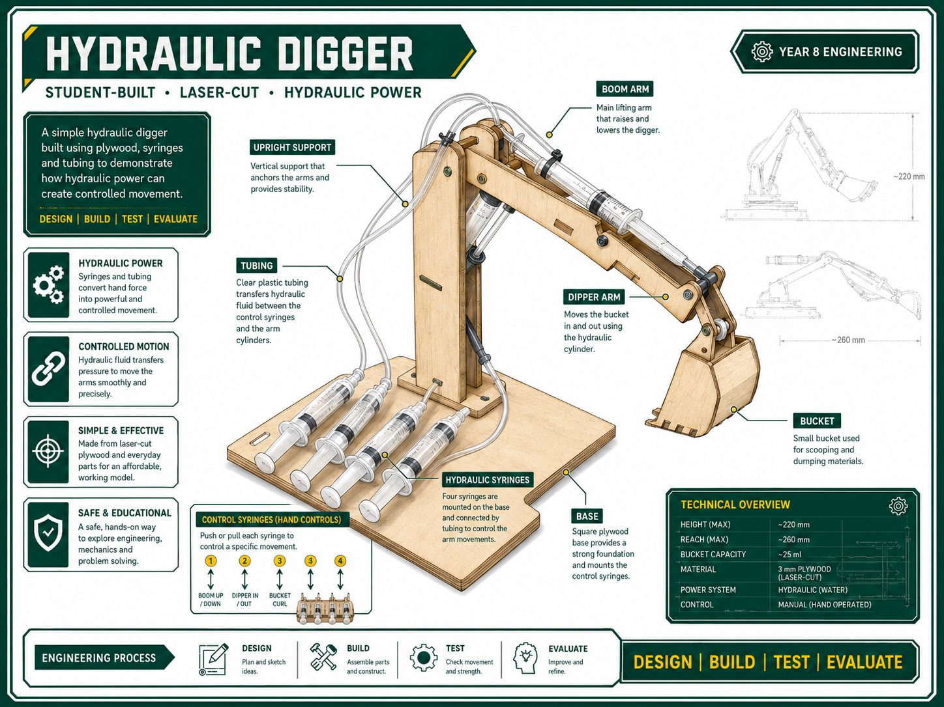
SECTION 1
BEST PRACTICE ANSWER
YEAR 9 ENGINEERING
PROJECT BRIEF
A strong answer defines the design challenge, success criteria, and the evidence that will prove the digger works.
1
Design challenge
2
Success criteria
3
Evidence to collect
- Create a tabletop hydraulic digger
- Use boom, dipper and bucket movement
- Transfer force with syringes and tubing
- 3 circuits: boom, dipper, bucket
- Smooth, leak-free motion
- Reach, lift and control evidence
- Sketches and pivot layout
- Syringe sizes and calculations
- Test data, photos and evaluation
OK
BEST PRACTICE STUDENT RESPONSE
The design challenge was to build a tabletop hydraulic digger with three controlled hydraulic movements. A successful digger needed smooth, leak-free boom, dipper and bucket action. My folio will use sketches, photos, test data and calculations to prove reach, lift and control.
BEFORE YOU TICK DONE
Brief stated
Criteria named
Evidence planned

Slide 2
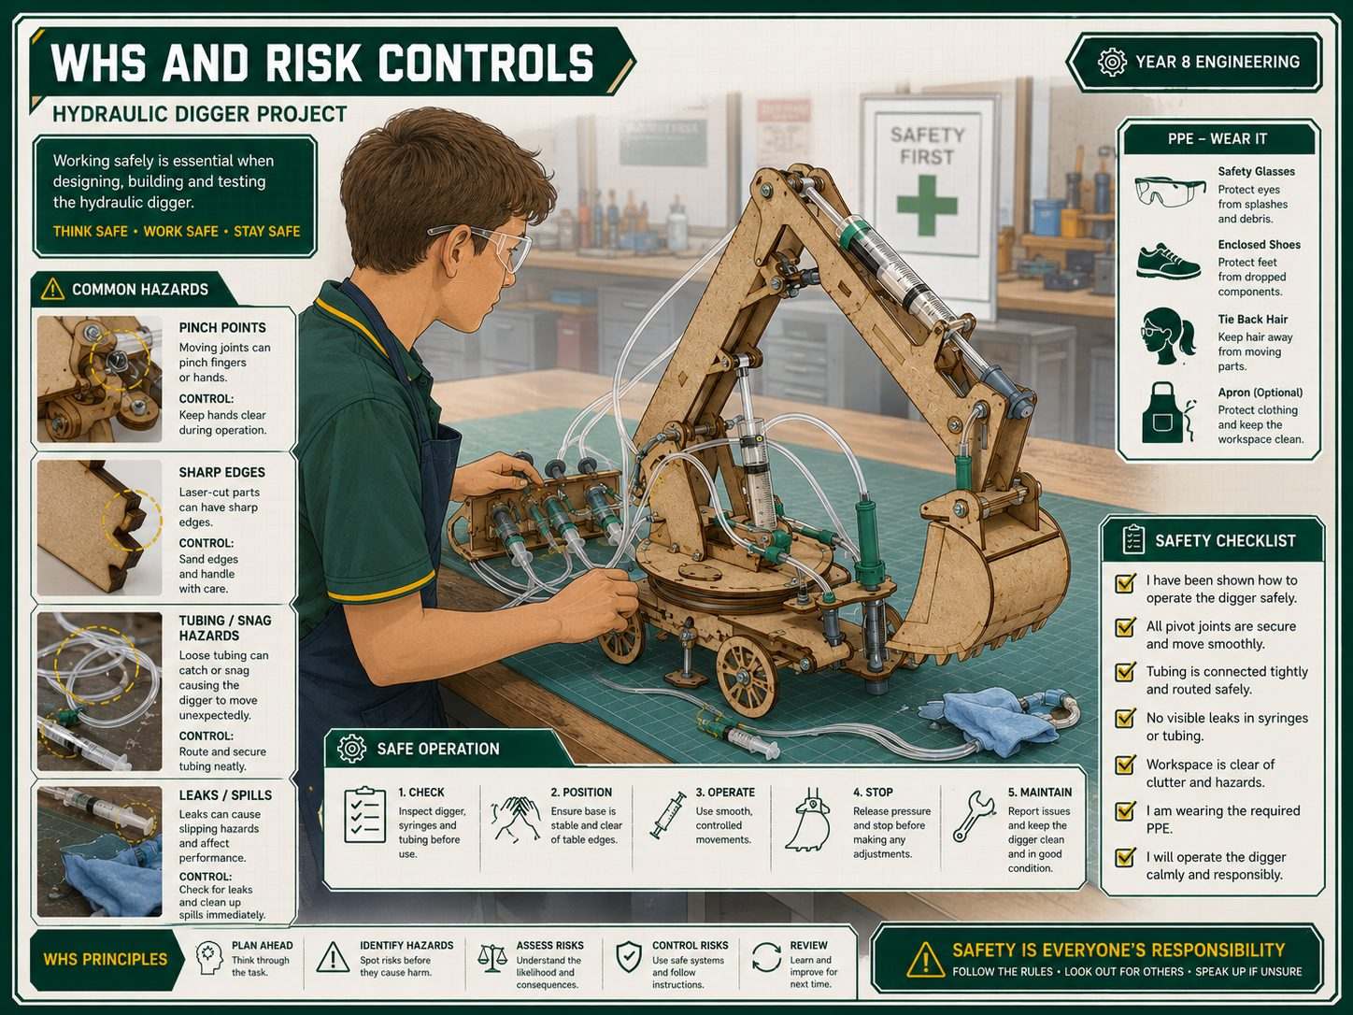
SECTION 2
BEST PRACTICE ANSWER
YEAR 9 ENGINEERING
WHS AND RISK CONTROLS
A strong answer explains the hazards and shows how safe workshop practice controlled the risks.
1
Main hazards
2
Risk controls
3
Safe testing
- Drilling and cutting hazards
- Pinch points in linkages
- Water spills near the work area
- Wear PPE and follow tool rules
- Clamp work before drilling
- Keep fingers clear of moving arms
- Clear test area
- Control water leaks quickly
- Keep hands away during movement
OK
BEST PRACTICE STUDENT RESPONSE
The main hazards were drilling, cutting, water spills and pinch points in the linkage. We controlled these risks by wearing PPE, clamping timber before drilling, keeping fingers clear of moving arms and cleaning water leaks before testing.
BEFORE YOU TICK DONE
Hazards named
Controls explained
Testing safe

Slide 3
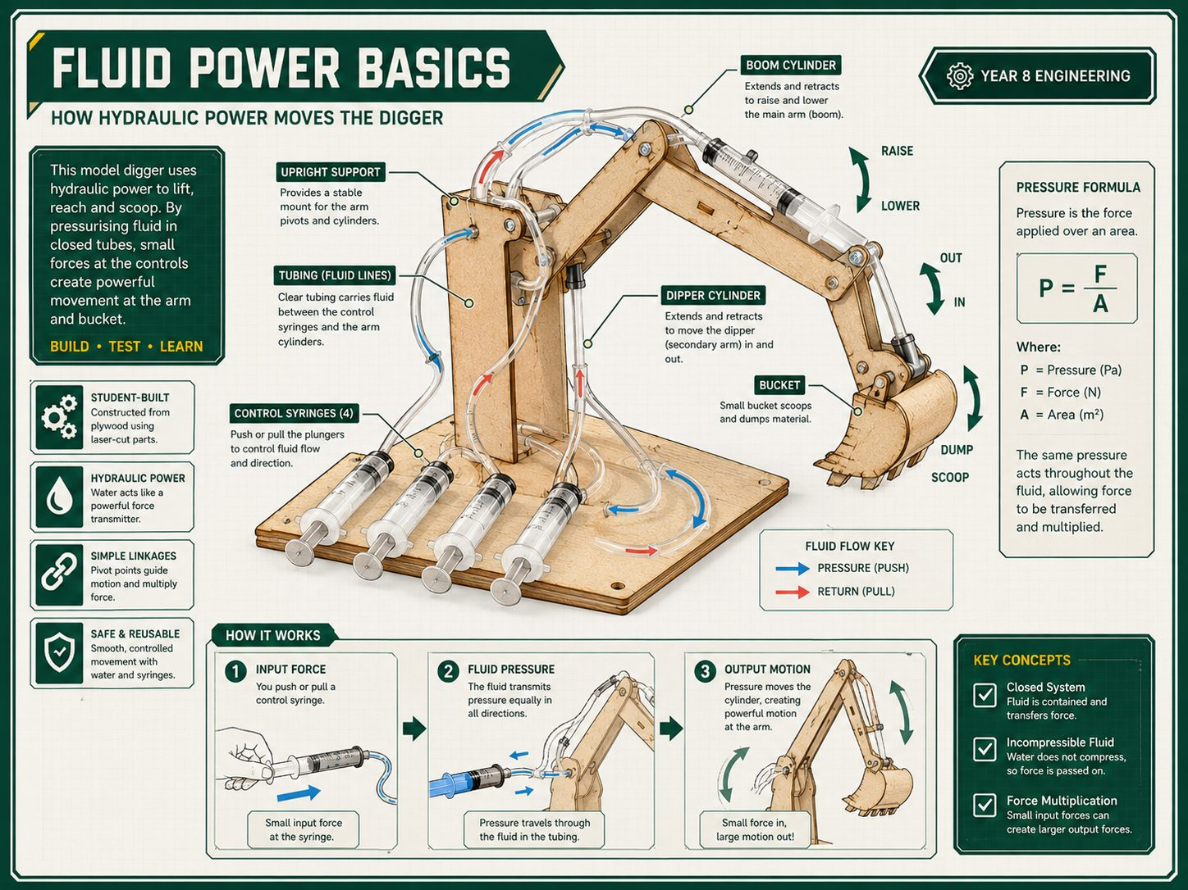
SECTION 3
BEST PRACTICE ANSWER
YEAR 9 ENGINEERING
FLUID POWER BASICS
A strong answer uses Pascals principle to explain how force is transferred through trapped liquid.
1
Pascals principle
2
Pressure formula
3
Control problems
- Force on one piston creates pressure
- Pressure transfers through trapped water
- Output piston moves the linkage
- Pressure = Force / Area
- Larger piston area changes output force
- Use correct units in calculations
- Air makes movement spongy
- Leaks reduce control
- Kinks stop smooth flow
OK
BEST PRACTICE STUDENT RESPONSE
Pascals principle means pressure applied to trapped water is transferred through the tubing. The output syringe moves because pressure acts on its piston area. Air bubbles or leaks reduce control, so the system must be filled and sealed carefully.
BEFORE YOU TICK DONE
Pascal explained
Formula used
Air/leaks linked

Slide 4
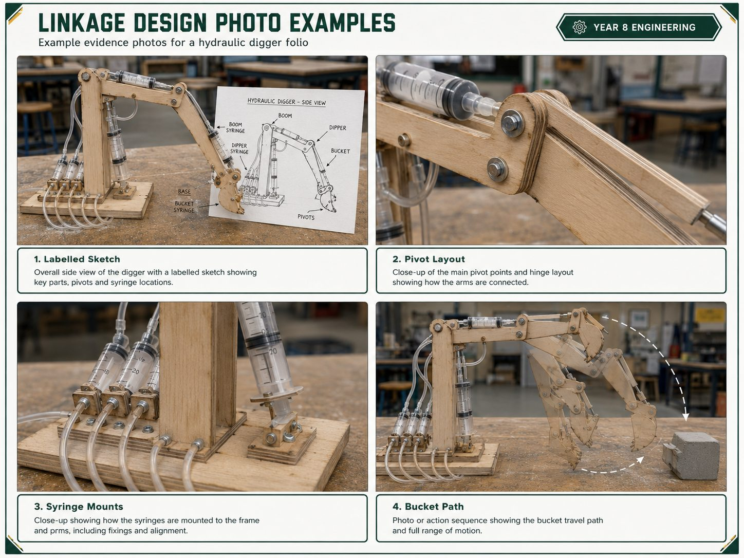
SECTION 4
BEST PRACTICE ANSWER
YEAR 9 ENGINEERING
LINKAGE DESIGN
A strong answer documents the arm geometry, pivot points, syringe mounts and expected movement path.
1
Labelled sketch
2
Movement path
3
Photo evidence
- Show boom, dipper and bucket
- Label fulcrum, load and effort points
- Mark syringe mount positions
- Predict bucket curl path
- Check for binding or collision
- Show expected travel direction
- Labelled Sketch
- Pivot Layout
- Syringe Mounts
- Bucket Path
OK
BEST PRACTICE STUDENT RESPONSE
Our linkage sketch shows the boom, dipper, bucket, pivot points and syringe mounts. We placed the syringe mounts to give controlled movement without binding. The bucket path sketch shows how the bucket should curl and where movement may be limited.
BEFORE YOU TICK DONE
Pivots labelled
Mounts shown
Path explained

Slide 5
SECTION 5
BEST PRACTICE ANSWER
YEAR 9 ENGINEERING
SYRINGE SIZING
A strong answer records syringe choices and explains the force-travel trade-off using piston area.
1
Syringe choice
2
Calculations
3
Trade-off
- Record input and output syringe sizes
- Match sizes to boom, dipper and bucket
- Explain why each pair was chosen
- Find piston area
- Use pressure and force ideas
- Show units clearly
- Larger output gives more force
- More force usually means less travel
- Compare prediction with testing
OK
BEST PRACTICE STUDENT RESPONSE
We chose syringe sizes by thinking about force and travel. A larger output syringe can create more lifting force, but it moves a shorter distance. Our calculations used piston area to predict how the boom, dipper and bucket would behave.
BEFORE YOU TICK DONE
Sizes recorded
Areas calculated
Trade-off explained

Slide 6
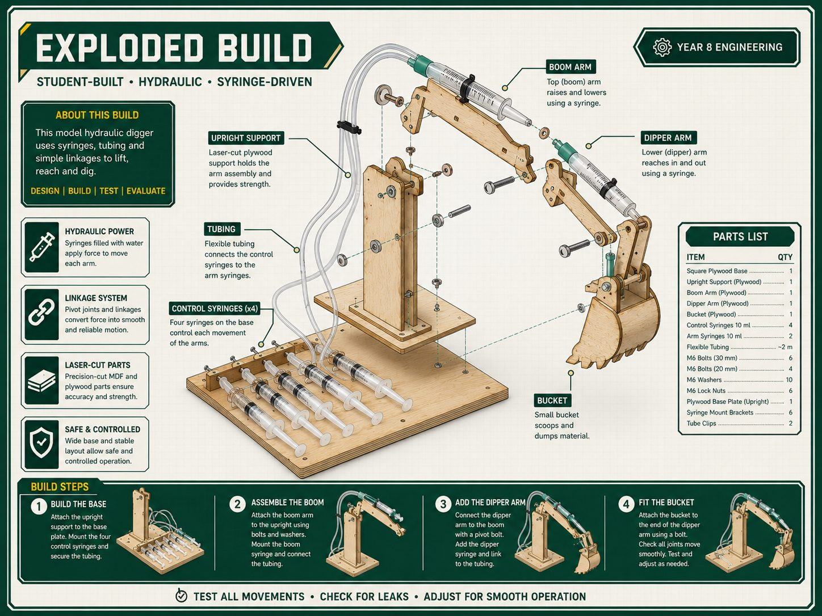
SECTION 6
BEST PRACTICE ANSWER
YEAR 9 ENGINEERING
BUILD PLAN
A strong answer shows the planned construction sequence before parts are cut and assembled.
1
Sequence
2
Accuracy checks
3
Hydraulic layout
- Build base first
- Add boom, dipper and bucket
- Install pivots before hydraulics
- Mark and drill holes accurately
- Keep arms stiff and aligned
- Check movement before final fixing
- Plan tidy hose routing
- Avoid kinks and sharp bends
- Leave room for syringe travel
OK
BEST PRACTICE STUDENT RESPONSE
Our build sequence was base, boom, dipper, bucket, pivots and then hydraulic circuits. We checked accuracy by marking hole positions carefully and testing arm movement before final assembly. Tidy hose routing was needed to avoid kinks and leaks.
BEFORE YOU TICK DONE
Sequence clear
Accuracy checked
Hoses planned

Slide 7
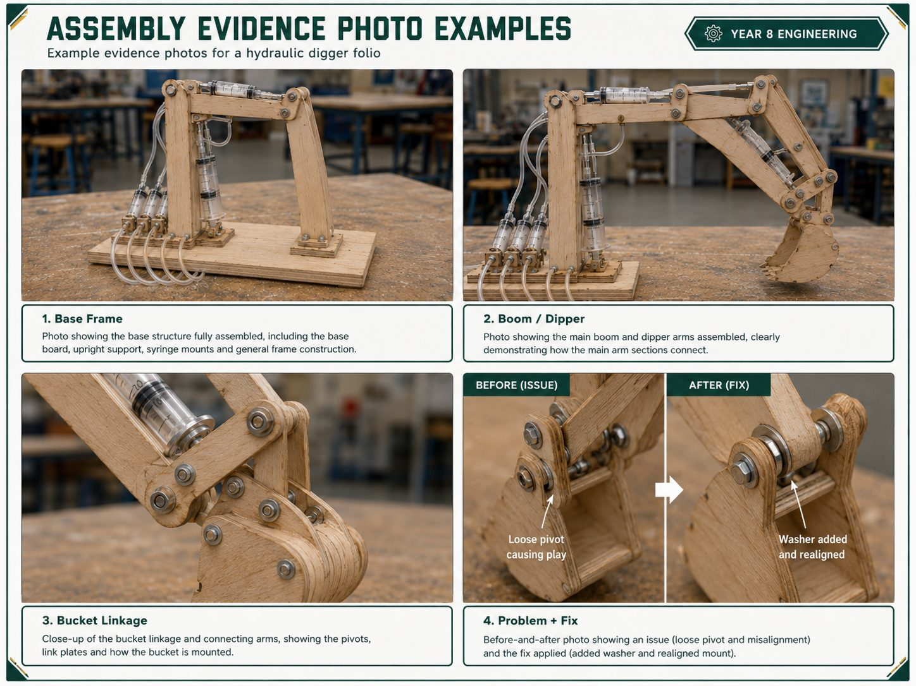
SECTION 7
BEST PRACTICE ANSWER
YEAR 9 ENGINEERING
ASSEMBLY EVIDENCE
A strong answer uses build-log evidence to explain decisions, problems, fixes and quality checks.
1
Build photos
2
Problems and fixes
3
Quality checks
- Base Frame
- Boom / Dipper
- Bucket Linkage
- Syringe Mounts
- Name one issue clearly
- Explain what caused it
- Show the fix with evidence
- Pivots move freely
- Arms are stiff and aligned
- Mounts are secure
OK
BEST PRACTICE STUDENT RESPONSE
During assembly we built the base, boom, dipper and bucket linkage, then checked that each pivot moved freely. One problem was a loose pivot, which caused poor bucket control. We fixed it by adding a washer and realigning the mount.
BEFORE YOU TICK DONE
Photos included
Problem fixed
Quality checked

Slide 8
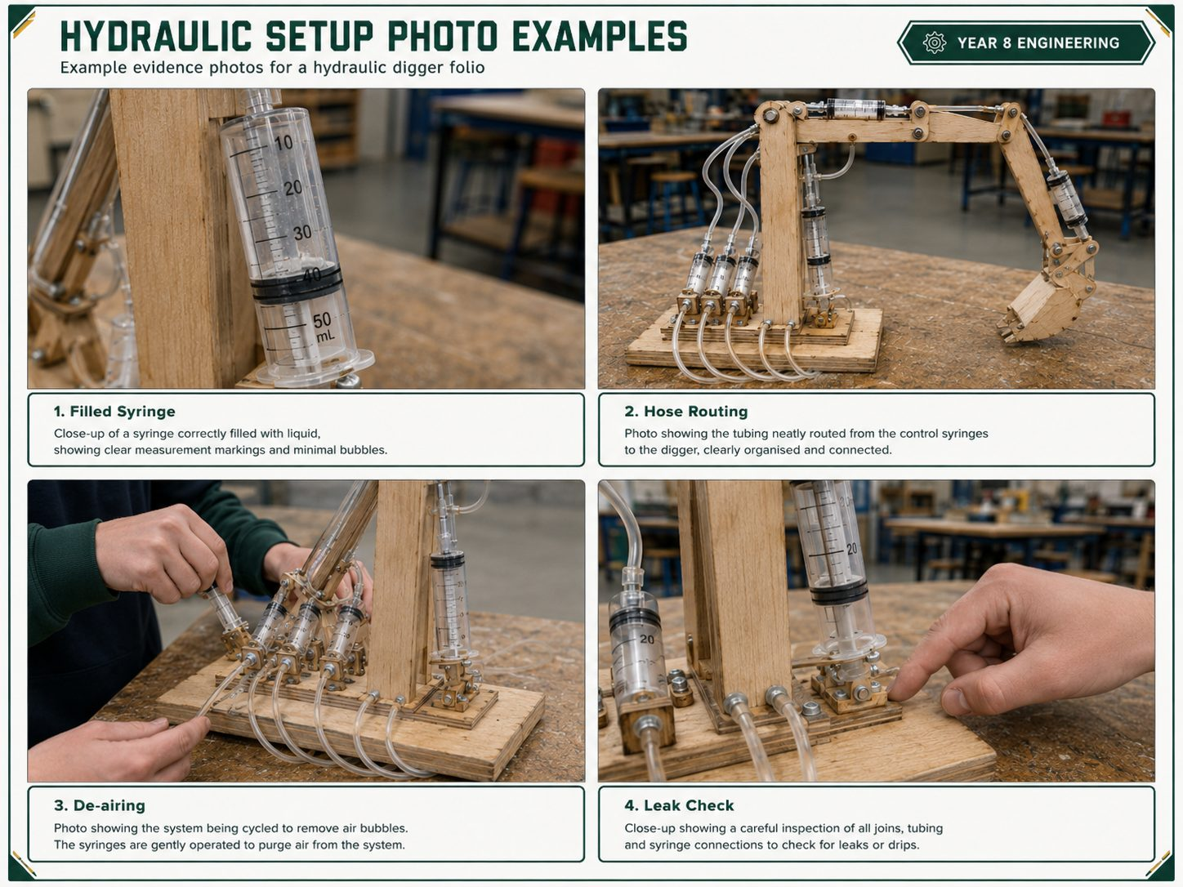
SECTION 8
BEST PRACTICE ANSWER
YEAR 9 ENGINEERING
HYDRAULIC SETUP
A strong answer documents filling, plumbing, de-airing, leak checks, hose routing and syringe mounting.
1
Fill and connect
2
De-air system
3
Leak check
- Fill syringes with water
- Connect tubing securely
- Route hoses to avoid kinks
- Remove bubbles from tubing
- Cycle syringes before testing
- Refill if movement feels spongy
- Filled Syringe
- Hose Routing
- De-airing
- Leak Check
OK
BEST PRACTICE STUDENT RESPONSE
We filled each hydraulic circuit with water and connected the tubing securely. We removed air by cycling the syringes until movement was smooth. The system worked best when there were no bubbles, no kinks and no leaks at the joins.
BEFORE YOU TICK DONE
Filled shown
Air removed
Leaks checked

Slide 9
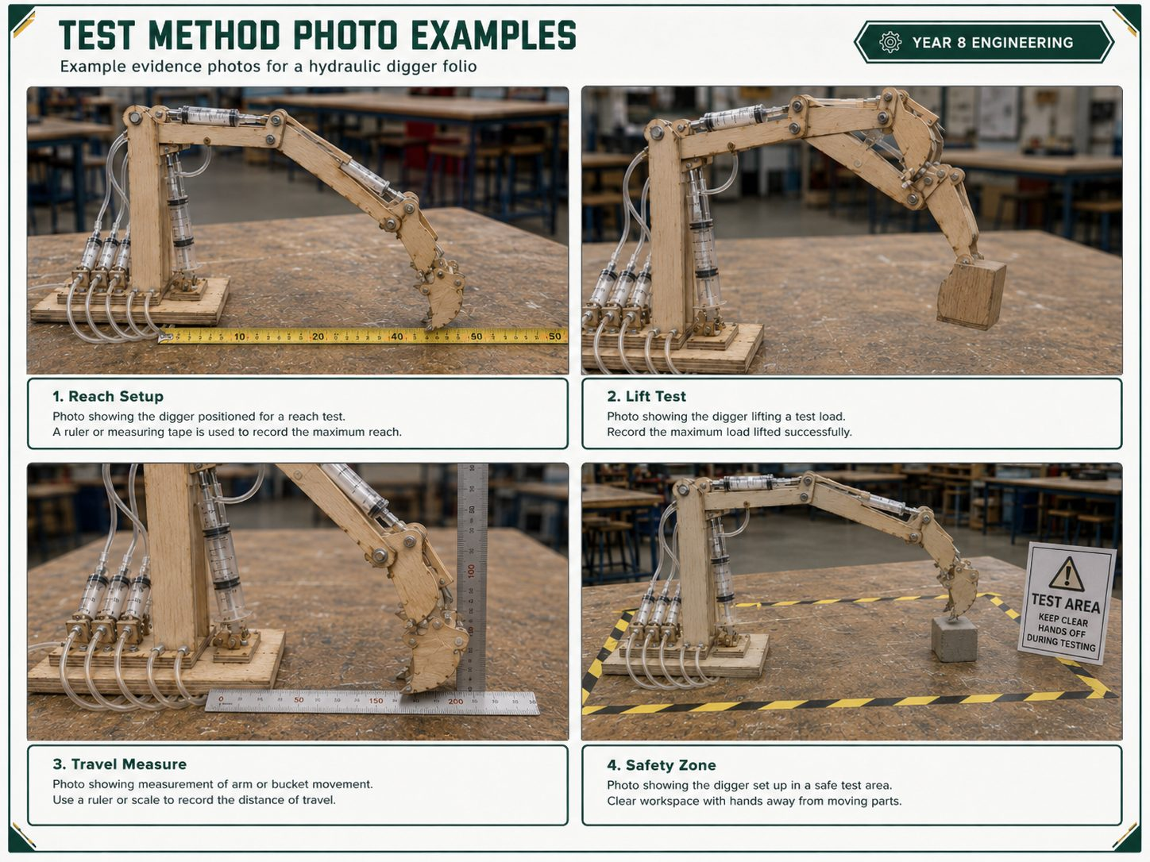
SECTION 9
BEST PRACTICE ANSWER
YEAR 9 ENGINEERING
TEST METHOD
A strong answer describes a fair, repeatable setup another group could follow safely.
1
Fair setup
2
Measurements
3
Safety zone
- Use the same start position
- Keep the base in the same place
- Use the same load for lift tests
- Measure reach
- Measure lift or load capacity
- Measure input/output travel
- Clear the test area
- Keep hands away from linkages
- Record results straight away
OK
BEST PRACTICE STUDENT RESPONSE
To test the digger, we used the same start position each time and measured reach, lift and travel with a ruler. The test was fair because the base position and load were kept the same. We kept a clear safety zone during movement.
BEFORE YOU TICK DONE
Fair setup
Measures named
Safety clear

Slide 10
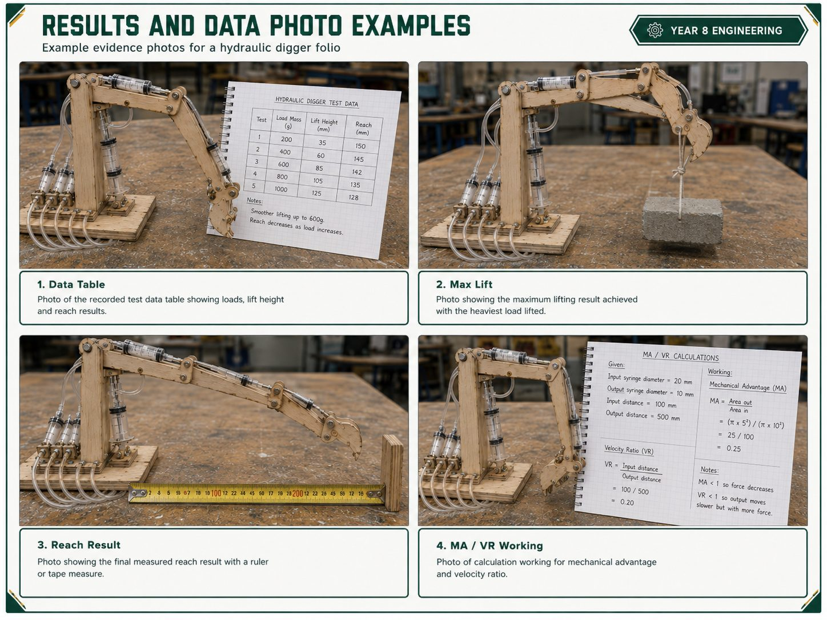
SECTION 10
BEST PRACTICE ANSWER
YEAR 9 ENGINEERING
RESULTS AND DATA
A strong answer reports measured performance and interprets reach, lift, movement, MA, VR and efficiency.
1
Data table
2
Performance
3
Calculations
- Record reach and lift results
- Record input and output travel
- Use clear headings and units
- Maximum lift
- Reach result
- Smooth movement observations
- Mechanical advantage
- Velocity ratio
- Efficiency or losses
OK
BEST PRACTICE STUDENT RESPONSE
The results table shows our measured reach, lift and input/output travel. The maximum lift was recorded during a controlled test. The MA and VR results show the trade-off between force and movement, with losses caused by friction, flex and small leaks.
BEFORE YOU TICK DONE
Data table
Units used
Results interpreted

Slide 11
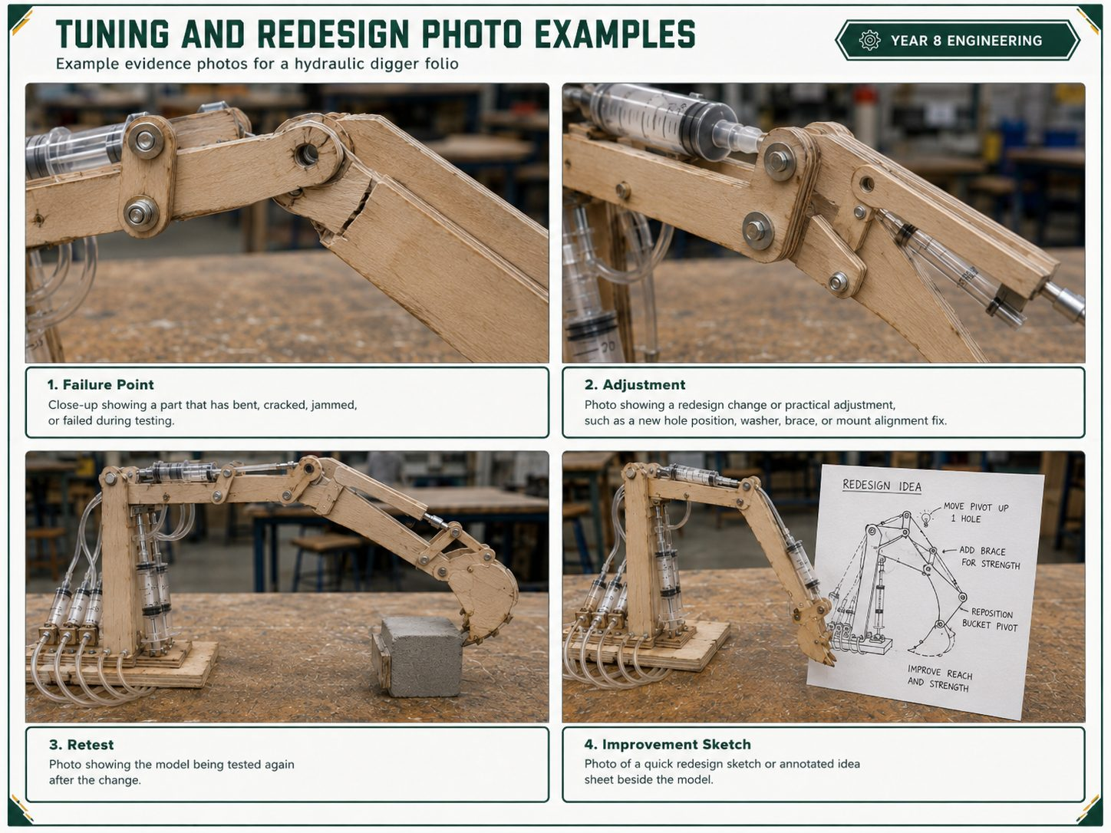
SECTION 11
BEST PRACTICE ANSWER
YEAR 9 ENGINEERING
TUNING AND REDESIGN
A strong answer analyses what limited performance and proposes a specific improvement.
1
Find the limit
2
Make one change
3
Retest and explain
- Leaks, air or friction
- Flex in arms or mounts
- Binding at pivots
- Adjust mount position
- Tighten or align a pivot
- Improve hose route or seal
- Failure Point
- Adjustment
- Retest
- Improvement Sketch
OK
BEST PRACTICE STUDENT RESPONSE
The first limit was flex in the arm and friction at one pivot. This reduced smooth movement and lifting control. We improved it by realigning the pivot and would strengthen the arm next time. The retest showed smoother movement but still some loss from friction.
BEFORE YOU TICK DONE
Limit named
Change shown
Trade-off explained

Slide 12
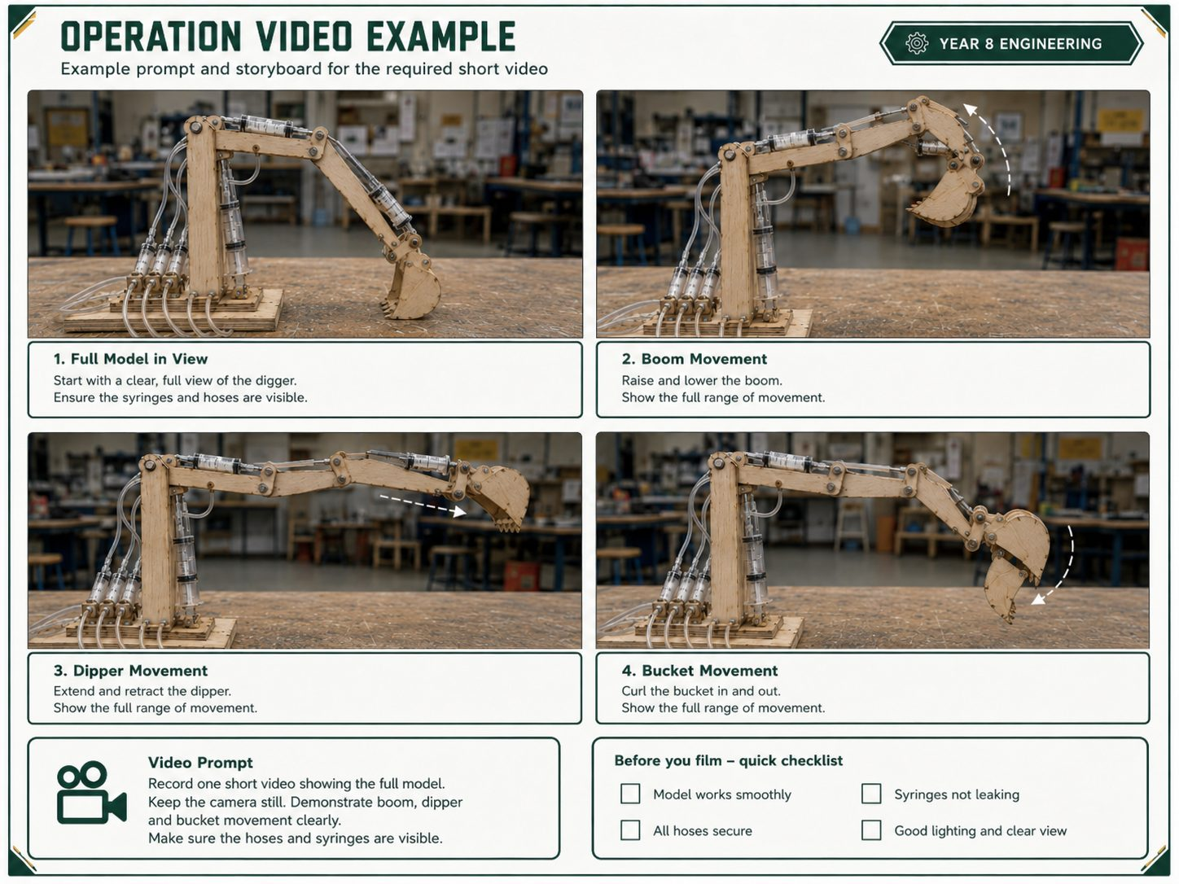
SECTION 12
BEST PRACTICE ANSWER
YEAR 9 ENGINEERING
FINAL EVALUATION
A strong answer makes a final judgement that links evidence, engineering theory, WHS and improvements.
1
Judge success
2
Link theory
3
Reflect and improve
- What worked best
- What failed first
- Use evidence, not guesses
- Hydraulic pressure transfer
- Force-travel trade-off
- Friction, leaks and air loss
- Name a practical improvement
- Explain why it would help
- Refer to operation video evidence
OK
BEST PRACTICE STUDENT RESPONSE
Overall, our digger met the brief because it produced controlled boom, dipper and bucket movement. The strongest evidence is the test data, photos and operation video. This project taught me that small leaks, air bubbles and pivot friction can strongly affect hydraulic performance.
BEFORE YOU TICK DONE
Judgement made
Evidence linked
Improvement named

