Slide 1
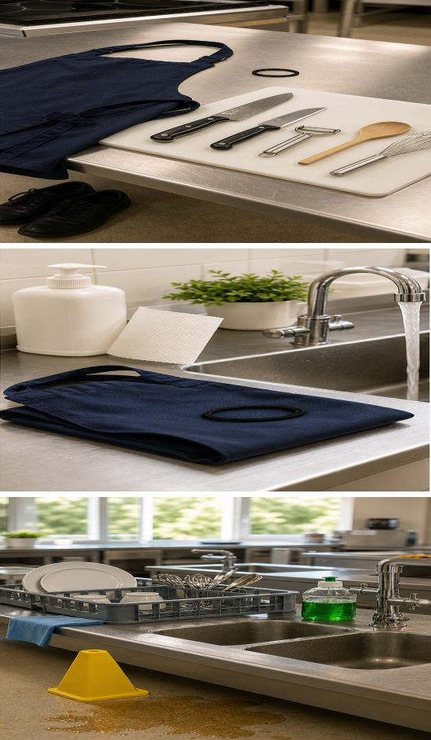
MODULE 1
Kitchen ready
Prepare, work and clean up safely so every practical starts calmly and finishes hygienically.
Teacher-led classroom presentation
Notes:
Teacher cue: use this slide to teach Module 1 content, then pause for the student prompt.
[Sources]
- PROG-2024: authorised Fantastic Food course source.
- BOOK-2023-STUDENT: authorised Fantastic Food course source.
- MODULE-1-GENERATED-VISUAL: project-specific generated teaching visual, local course asset.
[/Sources]

Slide 2
TODAY’S LEARNING PATH
Where are we going?
1
Ready to work safely
RETRIEVAL WARM-UP
What do you already know?
2
Personal hygiene
Name one routine that makes a practical safer. Explain how it reduces risk.
3
Kitchen hygiene and washing up
MODULE 1 • KITCHEN READY
02
Notes:
Teacher cue: use this slide to teach Module 1 content, then pause for the student prompt.
[Sources]
- PROG-2024: authorised Fantastic Food course source.
- BOOK-2023-STUDENT: authorised Fantastic Food course source.
[/Sources]

Slide 3
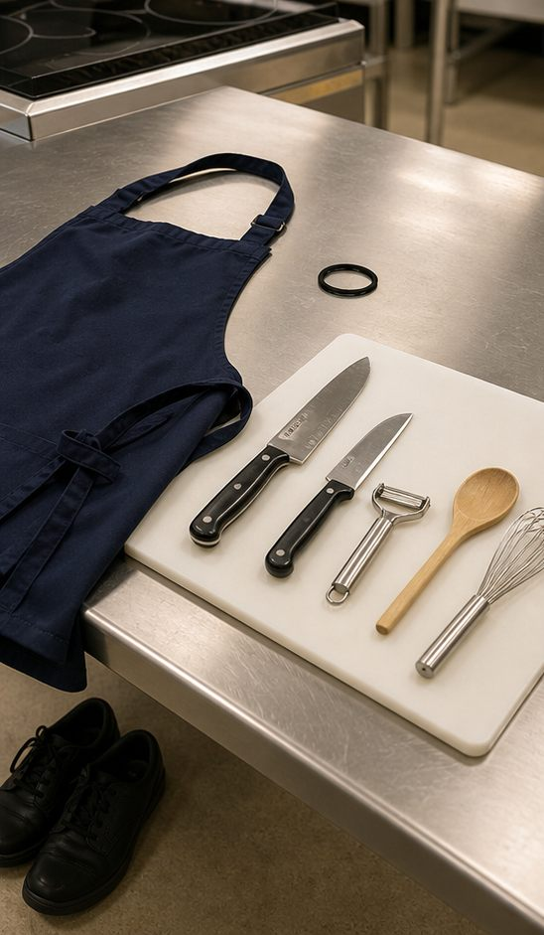
1.1 READY TO WORK SAFELY
Ready to work safely
THREE IDEAS TO PUT ON THE BOARD
Begin before cooking: secure hair, wear clean protective clothing and closed shoes, then clear the bench.
Complete required safety learning and follow teacher instructions before using unfamiliar equipment.
If you notice a hazard or feel unsure, stop, keep others clear and ask the teacher before continuing.
ASK THE ROOM | A utensil is damaged before use. What should you do, and why?
MODULE 1 • KITCHEN READY
03
Notes:
Teacher cue: use this slide to teach Module 1 content, then pause for the student prompt.
[Sources]
- PROG-2024: authorised Fantastic Food course source.
- BOOK-2023-STUDENT: authorised Fantastic Food course source.
- MODULE-1-GENERATED-VISUAL: project-specific generated teaching visual, local course asset.
[/Sources]

Slide 4
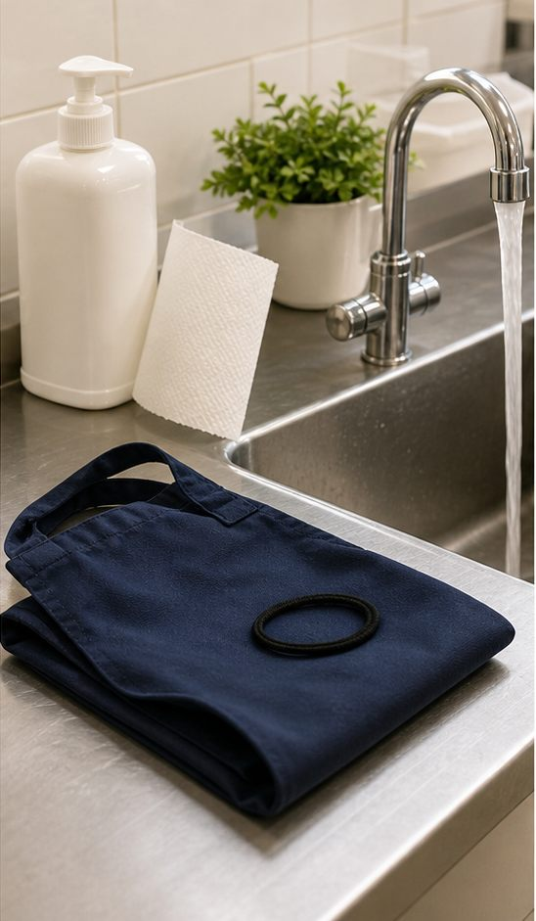
1.2 PERSONAL HYGIENE
Personal hygiene
THREE IDEAS TO PUT ON THE BOARD
Wash and dry hands thoroughly before food work and after contamination, including coughing, touching hair or handling waste.
Keep hair restrained, cover cuts correctly and avoid touching ready-to-eat food unnecessarily.
If a hygiene routine is interrupted, pause and restore the control before returning to the practical.
ASK THE ROOM | You touch your hair while preparing food. What is the correct next action?
MODULE 1 • KITCHEN READY
04
Notes:
Teacher cue: use this slide to teach Module 1 content, then pause for the student prompt.
[Sources]
- PROG-2024: authorised Fantastic Food course source.
- BOOK-2023-STUDENT: authorised Fantastic Food course source.
- MODULE-1-GENERATED-VISUAL: project-specific generated teaching visual, local course asset.
[/Sources]

Slide 5
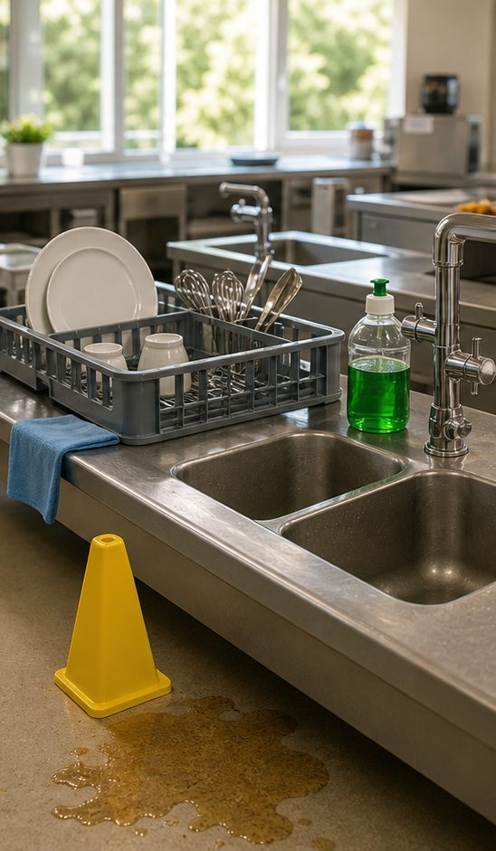
1.3 HYGIENE, HAZARDS AND WASHING UP
Kitchen hygiene and washing up
THREE IDEAS TO PUT ON THE BOARD
Keep raw materials, clean equipment and waste separated so the work area stays controlled.
Notice hazards early, report them clearly and use the teacher-approved response rather than stepping around the problem.
Wash, rinse, dry and store equipment in order; a clean finish protects the next user and shows complete practical work.
ASK THE ROOM | Why is leaving washing up until the final minute a safety and workflow problem?
MODULE 1 • KITCHEN READY
05
Notes:
Teacher cue: use this slide to teach Module 1 content, then pause for the student prompt.
[Sources]
- PROG-2024: authorised Fantastic Food course source.
- BOOK-2023-STUDENT: authorised Fantastic Food course source.
- MODULE-1-GENERATED-VISUAL: project-specific generated teaching visual, local course asset.
[/Sources]

Slide 6
CHECK FOR UNDERSTANDING
Stop. Think. Explain.
Answer silently first, then justify your thinking with a partner.
1
What should you do when equipment is damaged or you are unsure?
2
Name two personal-hygiene controls and explain the risk each reduces.
3
How does an orderly washing-up routine protect the next practical?
MODULE 1 • KITCHEN READY
06
Notes:
Teacher cue: use this slide to teach Module 1 content, then pause for the student prompt.
[Sources]
- PROG-2024: authorised Fantastic Food course source.
- BOOK-2023-STUDENT: authorised Fantastic Food course source.
[/Sources]

Slide 7
MODEL A LONGER RESPONSE
Read → Select → Explain → Check
THE QUESTION
WHAT IS THIS ASKING?
Explain what you should do when you notice a kitchen hazard or feel unsure, and why that response matters.
Describe the action, identify who is protected and link the action to safety or hygiene.
1 SELECT
2 EXPLAIN
3 CHECK
Choose the relevant hazard, the immediate control and the teacher-support step.
Use because, so or therefore to connect your action to the risk it reduces.
Make sure you have answered both what to do and why it matters.
Sentence starter: If I notice a hazard or feel unsure, I should… This matters because…
MODULE 1 • KITCHEN READY
07
Notes:
Teacher cue: use this slide to teach Module 1 content, then pause for the student prompt.
[Sources]
- PROG-2024: authorised Fantastic Food course source.
- BOOK-2023-STUDENT: authorised Fantastic Food course source.
[/Sources]

Slide 8
EXIT TICKET
Before you pack up…
1. One safety routine I can now explain is…
SAVE
YOUR
EVIDENCE
2. One hygiene action I will use in the next practical is…
3. One question I should ask before using unfamiliar equipment is…
MODULE 1 • KITCHEN READY
08
Notes:
Teacher cue: use this slide to teach Module 1 content, then pause for the student prompt.
[Sources]
- PROG-2024: authorised Fantastic Food course source.
- BOOK-2023-STUDENT: authorised Fantastic Food course source.
[/Sources]

