Slide 1
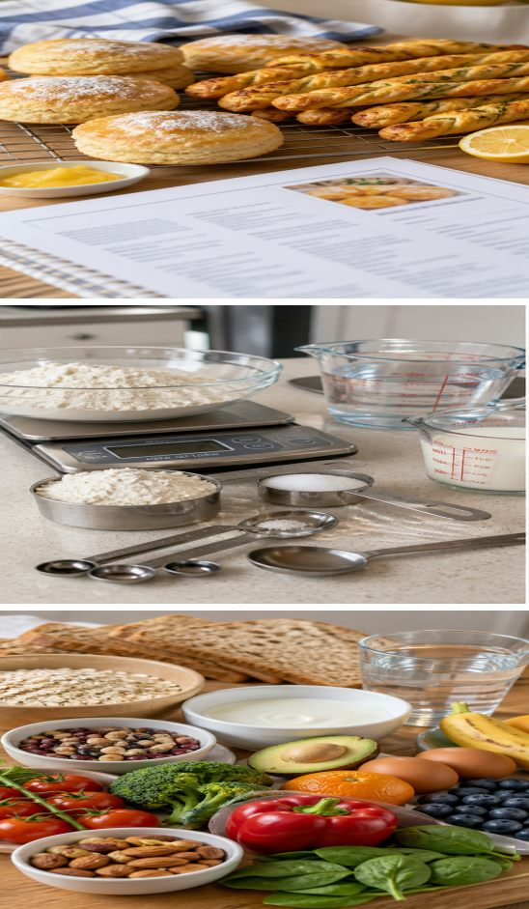
MODULE 2
Recipes and nutrients
Read a recipe as a plan, measure accurately and explain how different nutrients support the body.
Teacher-led classroom presentation
Notes:
Teacher cue: use this slide to teach Module 2 content, then pause for the student prompt.
[Sources]
- PROG-2024: authorised Fantastic Food course source.
- REC-SCONES: authorised Fantastic Food course source.
- REC-TWISTS: authorised Fantastic Food course source.
- MODULE-2-GENERATED-VISUAL: project-specific generated teaching visual, local course asset.
[/Sources]

Slide 2
TODAY’S LEARNING PATH
Where are we going?
1
Reading recipes
RETRIEVAL WARM-UP
What do you already know?
2
Accurate measuring
What information should you find before starting a recipe? Name one measuring habit that improves consistency.
3
Six essential nutrients
MODULE 2 • RECIPES AND NUTRIENTS
02
Notes:
Teacher cue: use this slide to teach Module 2 content, then pause for the student prompt.
[Sources]
- PROG-2024: authorised Fantastic Food course source.
- REC-SCONES: authorised Fantastic Food course source.
- REC-TWISTS: authorised Fantastic Food course source.
[/Sources]

Slide 3
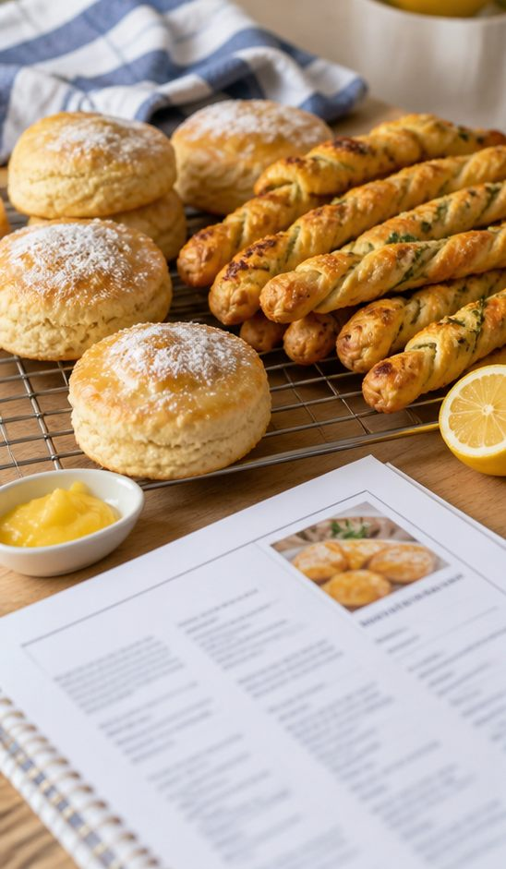
2.1 READING RECIPES
Reading recipes
THREE IDEAS TO PUT ON THE BOARD
A recipe combines the ingredient list, quantities, equipment, method, timing and yield into one working plan.
Read the complete method before collecting equipment so dependent steps and waiting times are visible.
Use the current teacher recipe for Scones or Savoury Twists and check each completed step rather than relying on memory.
ASK THE ROOM | Why can reading only the next line create delays or mistakes?
MODULE 2 • RECIPES AND NUTRIENTS
03
Notes:
Teacher cue: use this slide to teach Module 2 content, then pause for the student prompt.
[Sources]
- PROG-2024: authorised Fantastic Food course source.
- REC-SCONES: authorised Fantastic Food course source.
- REC-TWISTS: authorised Fantastic Food course source.
- MODULE-2-GENERATED-VISUAL: project-specific generated teaching visual, local course asset.
[/Sources]

Slide 4
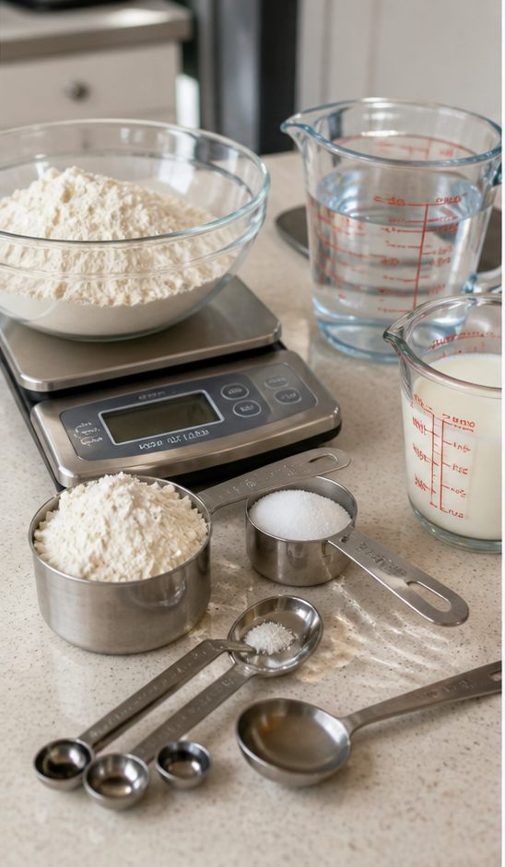
2.2 ACCURATE MEASURING
Measure accurately
THREE IDEAS TO PUT ON THE BOARD
Match the tool to the ingredient: scales for mass, a level measure for dry volume and a jug for liquid volume.
Place equipment steadily, zero the scale and read liquid measurements at eye level.
Pause before mixing. Check the ingredient, amount and unit while a correction is still possible.
ASK THE ROOM | You measure too much flour but have not mixed it. What should happen next?
MODULE 2 • RECIPES AND NUTRIENTS
04
Notes:
Teacher cue: use this slide to teach Module 2 content, then pause for the student prompt.
[Sources]
- PROG-2024: authorised Fantastic Food course source.
- REC-SCONES: authorised Fantastic Food course source.
- REC-TWISTS: authorised Fantastic Food course source.
- MODULE-2-GENERATED-VISUAL: project-specific generated teaching visual, local course asset.
[/Sources]

Slide 5
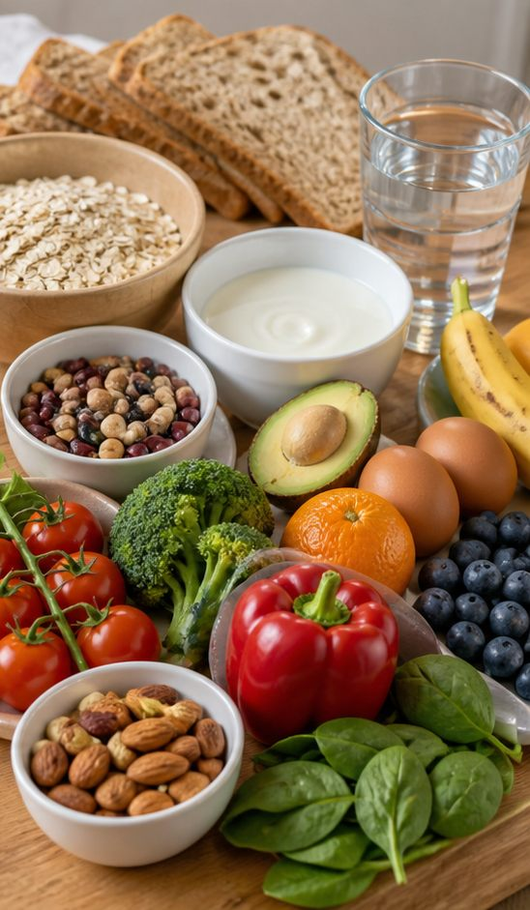
2.3 SIX ESSENTIAL NUTRIENTS
Six essential nutrients
THREE IDEAS TO PUT ON THE BOARD
Carbohydrate and fat can provide energy, while protein supports growth and repair.
Vitamins and minerals support many normal body processes; water supports hydration and body function.
No single food supplies everything in the right balance, so a varied food pattern matters more than one ‘perfect’ ingredient.
ASK THE ROOM | Why is ‘this food has vitamins’ not a complete explanation of its value?
MODULE 2 • RECIPES AND NUTRIENTS
05
Notes:
Teacher cue: use this slide to teach Module 2 content, then pause for the student prompt.
[Sources]
- PROG-2024: authorised Fantastic Food course source.
- MODULE-2-GENERATED-VISUAL: project-specific generated teaching visual, local course asset.
[/Sources]

Slide 6
CHECK FOR UNDERSTANDING
Stop. Think. Explain.
Answer silently first, then justify your thinking with a partner.
1
Which recipe information helps you organise equipment and timing before cooking?
2
What three checks should happen before an ingredient is mixed?
3
Which nutrient groups support energy, growth and normal body processes?
MODULE 2 • RECIPES AND NUTRIENTS
06
Notes:
Teacher cue: use this slide to teach Module 2 content, then pause for the student prompt.
[Sources]
- PROG-2024: authorised Fantastic Food course source.
- REC-SCONES: authorised Fantastic Food course source.
- REC-TWISTS: authorised Fantastic Food course source.
[/Sources]

Slide 7
MODEL A LONGER RESPONSE
Read → Select → Explain → Check
THE QUESTION
WHAT IS THIS ASKING?
Explain why reading the whole method before starting improves practical organisation, sequence and safety.
Link recipe reading to at least two practical decisions, not just to ‘following instructions’.
1 SELECT
2 EXPLAIN
3 CHECK
Choose evidence about equipment, dependent steps, timing or hazards from the current recipe.
Show how seeing the whole method changes what the cook does before and during the practical.
Include organisation, sequence and safety in your response.
Sentence starter: Reading the complete method first helps the cook to… because…
MODULE 2 • RECIPES AND NUTRIENTS
07
Notes:
Teacher cue: use this slide to teach Module 2 content, then pause for the student prompt.
[Sources]
- PROG-2024: authorised Fantastic Food course source.
- REC-SCONES: authorised Fantastic Food course source.
- REC-TWISTS: authorised Fantastic Food course source.
[/Sources]

Slide 8
EXIT TICKET
Before you pack up…
1. One recipe feature I will check before starting is…
SAVE
YOUR
EVIDENCE
2. One measuring habit that improves consistency is…
3. One nutrient job I can explain accurately is…
MODULE 2 • RECIPES AND NUTRIENTS
08
Notes:
Teacher cue: use this slide to teach Module 2 content, then pause for the student prompt.
[Sources]
- PROG-2024: authorised Fantastic Food course source.
[/Sources]

