Slide 1
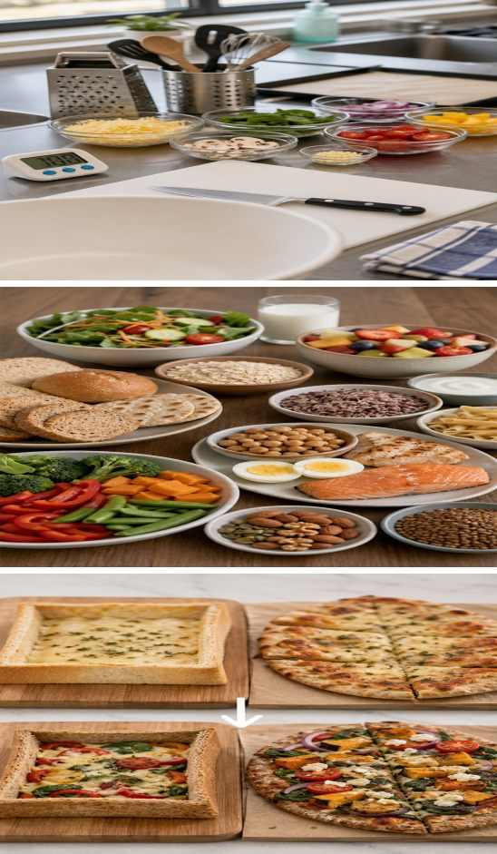
MODULE 3
Workflow and healthy choices
Plan a workable practical sequence, use healthy-eating guidance and justify purposeful recipe improvements.
Teacher-led classroom presentation
Notes:
Teacher cue: use this slide to teach Module 3 content, then pause for the student prompt.
[Sources]
- PROG-2024: authorised Fantastic Food course source.
- BOOK-2023-STUDENT: authorised Fantastic Food course source.
- REC-BREAD-CASES: authorised Fantastic Food course source.
- REC-FLATBREAD: authorised Fantastic Food course source.
- MODULE-3-GENERATED-VISUAL: project-specific generated teaching visual, local course asset.
[/Sources]

Slide 2
TODAY’S LEARNING PATH
Where are we going?
1
Workflow planning
RETRIEVAL WARM-UP
What do you already know?
2
Healthy eating
What makes two practical steps dependent? Name one reason a food solution might be modified.
3
Recipe modification
MODULE 3 • WORKFLOW AND HEALTHY CHOICES
02
Notes:
Teacher cue: use this slide to teach Module 3 content, then pause for the student prompt.
[Sources]
- PROG-2024: authorised Fantastic Food course source.
- BOOK-2023-STUDENT: authorised Fantastic Food course source.
[/Sources]

Slide 3
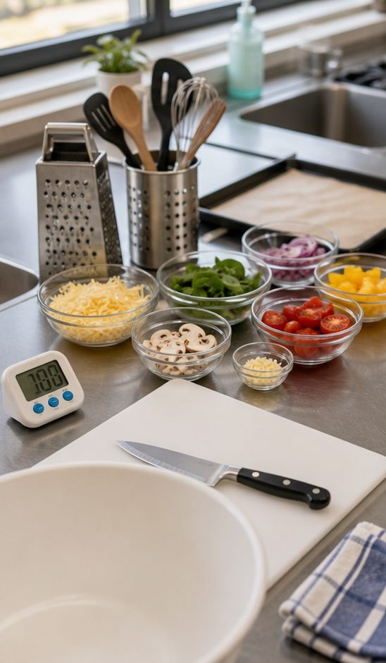
3.1 WORKFLOW PLANNING
Plan the workflow
THREE IDEAS TO PUT ON THE BOARD
Start with the serving time, then work backwards through cooking, preparation, measuring and equipment setup.
Place dependent steps in a workable order: an oven must preheat before baking, while clean-up can happen during safe waiting time.
Check progress against the plan and adjust early if equipment, timing or ingredients change.
ASK THE ROOM | Which task could safely happen while Bread Cases bake, and why?
MODULE 3 • WORKFLOW AND HEALTHY CHOICES
03
Notes:
Teacher cue: use this slide to teach Module 3 content, then pause for the student prompt.
[Sources]
- PROG-2024: authorised Fantastic Food course source.
- REC-TWISTS: authorised Fantastic Food course source.
- REC-BREAD-CASES: authorised Fantastic Food course source.
- MODULE-3-GENERATED-VISUAL: project-specific generated teaching visual, local course asset.
[/Sources]

Slide 4
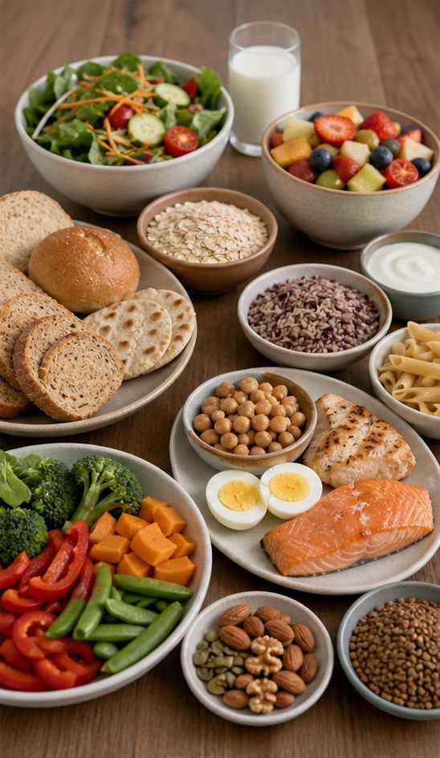
3.2 HEALTHY EATING FOR ADOLESCENTS
Healthy eating for adolescents
THREE IDEAS TO PUT ON THE BOARD
The Australian Guide to Healthy Eating organises foods into five groups that contribute different nutrients and food experiences.
Adolescents need an overall pattern that supports growth, activity, learning and hydration.
Use variety, suitable portions and the person’s day as planning evidence; avoid treating one food as automatically ‘good’ or ‘bad’.
ASK THE ROOM | How could two different lunch choices both show food-group variety?
MODULE 3 • WORKFLOW AND HEALTHY CHOICES
04
Notes:
Teacher cue: use this slide to teach Module 3 content, then pause for the student prompt.
[Sources]
- PROG-2024: authorised Fantastic Food course source.
- BOOK-2023-STUDENT: authorised Fantastic Food course source.
- MODULE-3-GENERATED-VISUAL: project-specific generated teaching visual, local course asset.
[/Sources]

Slide 5
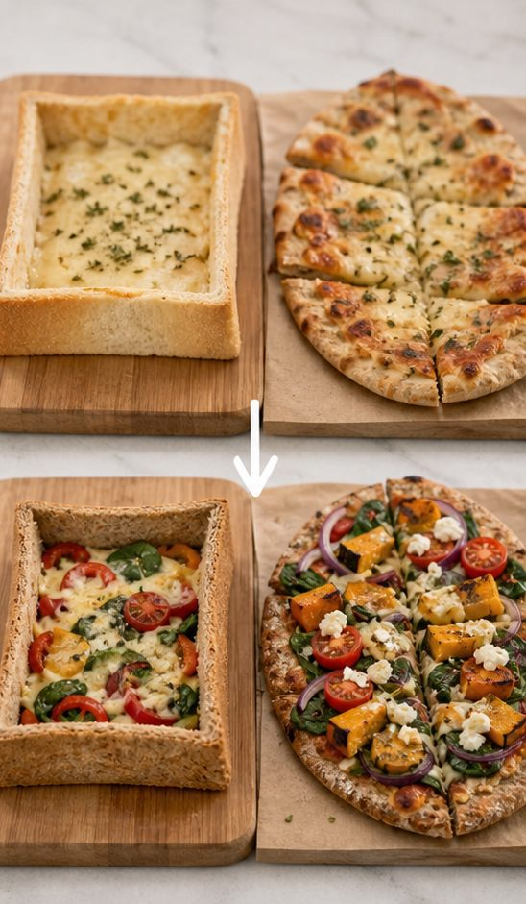
3.3 RECIPE MODIFICATION
Modify with a reason
THREE IDEAS TO PUT ON THE BOARD
Begin with a stated user need or nutritional goal, then choose one teacher-permitted change that responds to it.
Predict the effect on flavour, texture, appearance, cost, workflow and nutrition before making the change.
Compare the result with clear criteria so the evaluation explains what improved, what changed unexpectedly and what should happen next.
ASK THE ROOM | What evidence would show that a wholegrain or vegetable change was successful?
MODULE 3 • WORKFLOW AND HEALTHY CHOICES
05
Notes:
Teacher cue: use this slide to teach Module 3 content, then pause for the student prompt.
[Sources]
- PROG-2024: authorised Fantastic Food course source.
- REC-BREAD-CASES: authorised Fantastic Food course source.
- REC-FLATBREAD: authorised Fantastic Food course source.
- MODULE-3-GENERATED-VISUAL: project-specific generated teaching visual, local course asset.
[/Sources]

Slide 6
CHECK FOR UNDERSTANDING
Stop. Think. Explain.
Answer silently first, then justify your thinking with a partner.
1
Why is planning backwards from serving time useful?
2
How do five food groups help plan for adolescent needs?
3
What must be predicted before a teacher-approved recipe change is tested?
MODULE 3 • WORKFLOW AND HEALTHY CHOICES
06
Notes:
Teacher cue: use this slide to teach Module 3 content, then pause for the student prompt.
[Sources]
- PROG-2024: authorised Fantastic Food course source.
- BOOK-2023-STUDENT: authorised Fantastic Food course source.
[/Sources]

Slide 7
MODEL A LONGER RESPONSE
Read → Select → Explain → Check
THE QUESTION
WHAT IS THIS ASKING?
Propose one teacher-permitted recipe modification for a stated user or nutritional goal, predict its effects and explain how you would evaluate it.
Connect one purposeful change to a user, a predicted result and observable evidence.
1 SELECT
2 EXPLAIN
3 CHECK
Choose the original recipe feature, the approved change and two suitable criteria.
Use cause-and-effect language to predict changes to nutrition and product quality.
Confirm the user, reason, prediction and evaluation evidence are all included.
Sentence starter: For a user who needs…, I would change… This should… I would judge it by…
MODULE 3 • WORKFLOW AND HEALTHY CHOICES
07
Notes:
Teacher cue: use this slide to teach Module 3 content, then pause for the student prompt.
[Sources]
- PROG-2024: authorised Fantastic Food course source.
- REC-BREAD-CASES: authorised Fantastic Food course source.
- REC-FLATBREAD: authorised Fantastic Food course source.
[/Sources]

Slide 8
EXIT TICKET
Before you pack up…
1. One dependency I will include in my workflow is…
SAVE
YOUR
EVIDENCE
2. One way food-group guidance supports planning is…
3. One criterion I can use to judge a modification is…
MODULE 3 • WORKFLOW AND HEALTHY CHOICES
08
Notes:
Teacher cue: use this slide to teach Module 3 content, then pause for the student prompt.
[Sources]
- PROG-2024: authorised Fantastic Food course source.
[/Sources]

