Slide 1
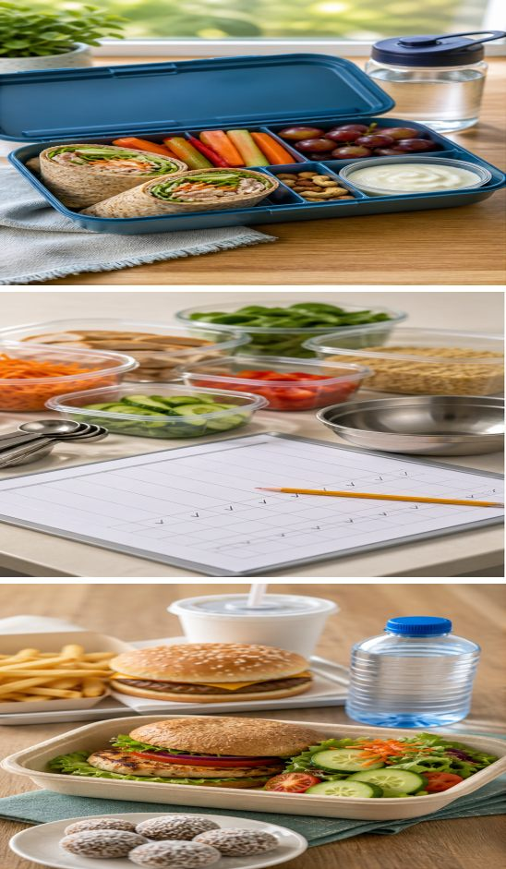
MODULE 4
Lunchbox design
Plan for a real user, organise food resources and evaluate a healthier redesign using clear criteria.
Teacher-led classroom presentation
Notes:
Teacher cue: use this slide to teach Module 4 content, then pause for the student prompt.
[Sources]
- PROG-2024: authorised Fantastic Food course source.
- BOOK-2023-STUDENT: authorised Fantastic Food course source.
- REC-COCONUT: authorised Fantastic Food course source.
- MODULE-4-GENERATED-VISUAL: project-specific generated teaching visual, local course asset.
[/Sources]

Slide 2
TODAY’S LEARNING PATH
Where are we going?
1
Balanced lunchbox
RETRIEVAL WARM-UP
What do you already know?
2
Food orders
What information about a person and their day would change a lunchbox plan? What makes a food order usable?
3
Evaluate a redesign
MODULE 4 • LUNCHBOX DESIGN
02
Notes:
Teacher cue: use this slide to teach Module 4 content, then pause for the student prompt.
[Sources]
- PROG-2024: authorised Fantastic Food course source.
- BOOK-2023-STUDENT: authorised Fantastic Food course source.
[/Sources]

Slide 3
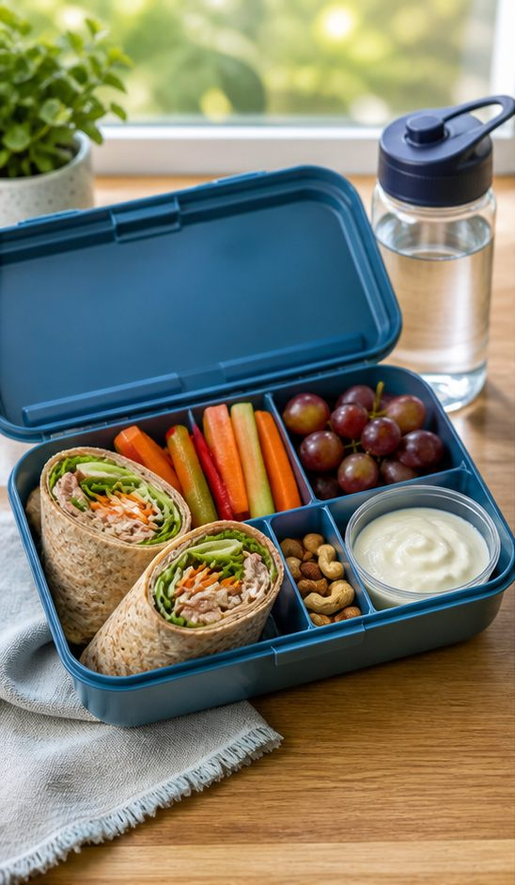
4.1 BALANCED LUNCHBOX
Plan a balanced lunchbox
THREE IDEAS TO PUT ON THE BOARD
Start with the person: their school day, activity, food preferences, access to storage and practical eating time.
Build variety across the whole lunchbox using food groups, water and realistic portions rather than judging one item alone.
Review safety, portability, waste, cost and appeal, then make one evidence-based improvement.
ASK THE ROOM | Which detail about the student’s day would most change this lunchbox plan?
MODULE 4 • LUNCHBOX DESIGN
03
Notes:
Teacher cue: use this slide to teach Module 4 content, then pause for the student prompt.
[Sources]
- PROG-2024: authorised Fantastic Food course source.
- BOOK-2023-STUDENT: authorised Fantastic Food course source.
- MODULE-4-GENERATED-VISUAL: project-specific generated teaching visual, local course asset.
[/Sources]

Slide 4
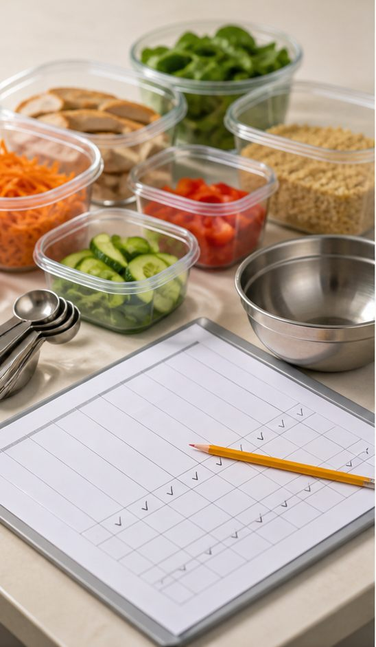
4.2 FOOD ORDERS
Create a usable food order
THREE IDEAS TO PUT ON THE BOARD
A clear order names each ingredient, gives an accurate amount and states its planned use.
Combine repeated ingredients only after checking the total needed across the recipe and group roles.
Connect the order to the workflow so ingredients arrive in time, waste is limited and every practical step has the required resource.
ASK THE ROOM | Why is ‘cheese — one’ not yet a usable food-order entry?
MODULE 4 • LUNCHBOX DESIGN
04
Notes:
Teacher cue: use this slide to teach Module 4 content, then pause for the student prompt.
[Sources]
- PROG-2024: authorised Fantastic Food course source.
- BOOK-2023-STUDENT: authorised Fantastic Food course source.
- MODULE-4-GENERATED-VISUAL: project-specific generated teaching visual, local course asset.
[/Sources]

Slide 5
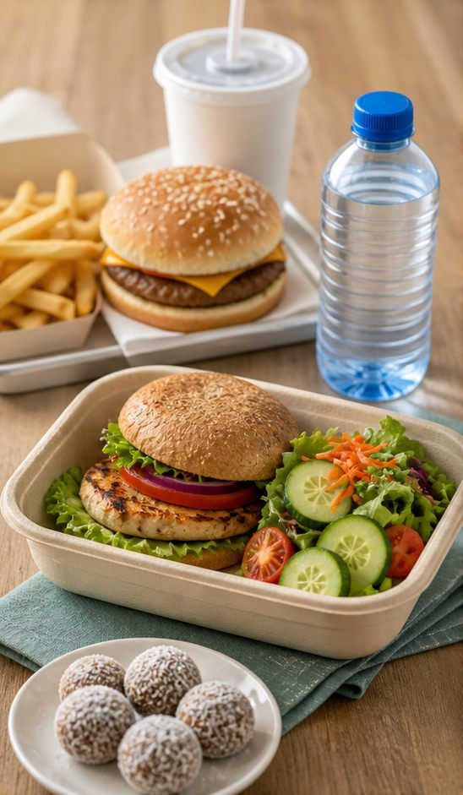
4.3 PRACTICAL AND REDESIGN
Evaluate a healthier redesign
THREE IDEAS TO PUT ON THE BOARD
Record practical evidence while making Coconut Balls: sequence, consistency, hygiene, teamwork and the quality of the finished product.
For a fast-food redesign, define ‘healthier’ with specific criteria such as food-group variety, fibre, preparation method or suitable portion.
Compare original and redesigned solutions using the same criteria, then explain one improvement supported by observations.
ASK THE ROOM | Which criterion would make ‘healthier’ testable rather than just an opinion?
MODULE 4 • LUNCHBOX DESIGN
05
Notes:
Teacher cue: use this slide to teach Module 4 content, then pause for the student prompt.
[Sources]
- PROG-2024: authorised Fantastic Food course source.
- REC-COCONUT: authorised Fantastic Food course source.
- BOOK-2023-STUDENT: authorised Fantastic Food course source.
- MODULE-4-GENERATED-VISUAL: project-specific generated teaching visual, local course asset.
[/Sources]

Slide 6
CHECK FOR UNDERSTANDING
Stop. Think. Explain.
Answer silently first, then justify your thinking with a partner.
1
Which user and day details belong in a balanced lunchbox plan?
2
What three pieces of information make a food-order line usable?
3
How can evidence make a healthier fast-food claim testable?
MODULE 4 • LUNCHBOX DESIGN
06
Notes:
Teacher cue: use this slide to teach Module 4 content, then pause for the student prompt.
[Sources]
- PROG-2024: authorised Fantastic Food course source.
- BOOK-2023-STUDENT: authorised Fantastic Food course source.
[/Sources]

Slide 7
MODEL A LONGER RESPONSE
Read → Select → Explain → Check
THE QUESTION
WHAT IS THIS ASKING?
Plan one improvement to a healthier fast-food redesign and explain how evidence would show whether it worked.
Name the criterion, the design change, the expected effect and the observation you would collect.
1 SELECT
2 EXPLAIN
3 CHECK
Choose one clear criterion such as variety, fibre, preparation method, portion, appeal or ease of eating.
Connect the change to the criterion and to the needs of the stated user.
Avoid unsupported words such as ‘better’; include evidence that could be observed.
Sentence starter: I would improve… by… This should… I would know it worked if…
MODULE 4 • LUNCHBOX DESIGN
07
Notes:
Teacher cue: use this slide to teach Module 4 content, then pause for the student prompt.
[Sources]
- PROG-2024: authorised Fantastic Food course source.
- REC-COCONUT: authorised Fantastic Food course source.
- BOOK-2023-STUDENT: authorised Fantastic Food course source.
[/Sources]

Slide 8
EXIT TICKET
Before you pack up…
1. One user detail that changes a lunchbox plan is…
SAVE
YOUR
EVIDENCE
2. One check that improves a food order is…
3. One criterion I can use to evaluate a redesign is…
MODULE 4 • LUNCHBOX DESIGN
08
Notes:
Teacher cue: use this slide to teach Module 4 content, then pause for the student prompt.
[Sources]
- PROG-2024: authorised Fantastic Food course source.
[/Sources]

