Slide 1
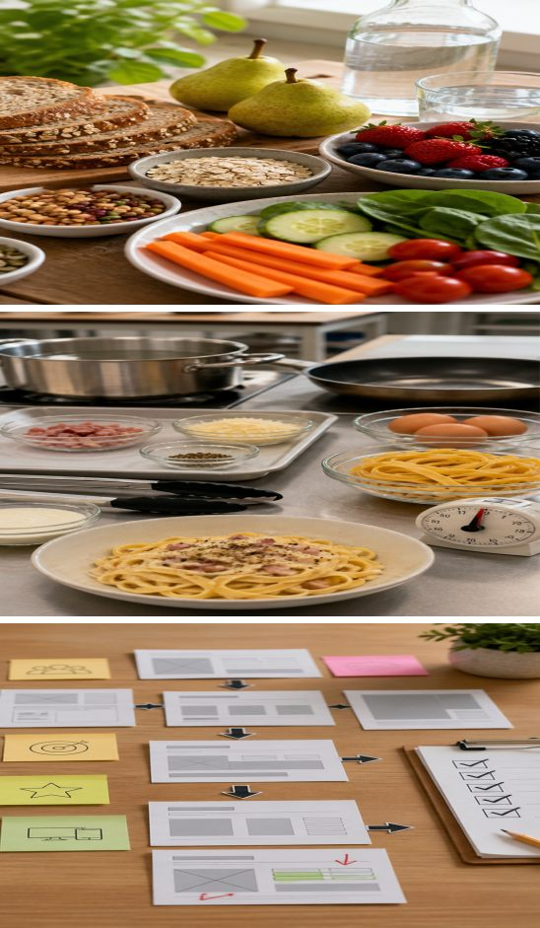
MODULE 5
Evaluate and complete
Explain fibre and water, manage the Carbonara workflow, then communicate and evaluate food solutions with evidence.
Teacher-led classroom presentation
Notes:
Teacher cue: use this slide to teach Module 5 content, then pause for the student prompt.
[Sources]
- PROG-2024: authorised Fantastic Food course source.
- BOOK-2023-STUDENT: authorised Fantastic Food course source.
- REC-CARBONARA: authorised Fantastic Food course source.
- MODULE-5-GENERATED-VISUAL: project-specific generated teaching visual, local course asset.
[/Sources]

Slide 2
TODAY’S LEARNING PATH
Where are we going?
1
Fibre and water
RETRIEVAL WARM-UP
What do you already know?
2
Carbonara workflow
What is the difference between describing a food solution and evaluating it? Name one dependent pasta step.
3
Communicate and evaluate
MODULE 5 • EVALUATE AND COMPLETE
02
Notes:
Teacher cue: use this slide to teach Module 5 content, then pause for the student prompt.
[Sources]
- PROG-2024: authorised Fantastic Food course source.
- BOOK-2023-STUDENT: authorised Fantastic Food course source.
- REC-CARBONARA: authorised Fantastic Food course source.
[/Sources]

Slide 3
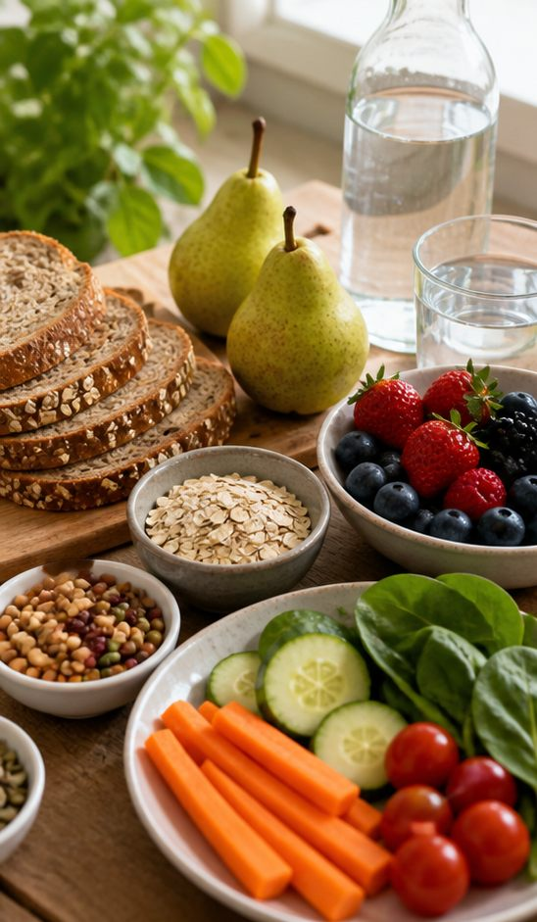
5.1 FIBRE AND WATER
Fibre and water
THREE IDEAS TO PUT ON THE BOARD
Fibre comes from plant foods and supports healthy digestive function as part of an overall varied food pattern.
Water supports hydration and many body functions; needs can change with activity, weather and the person’s day.
Use wholegrains, legumes, vegetables and fruit across meals, and make water a regular practical choice.
ASK THE ROOM | Why should fibre and water be explained as different but connected needs?
MODULE 5 • EVALUATE AND COMPLETE
03
Notes:
Teacher cue: use this slide to teach Module 5 content, then pause for the student prompt.
[Sources]
- PROG-2024: authorised Fantastic Food course source.
- BOOK-2023-STUDENT: authorised Fantastic Food course source.
- MODULE-5-GENERATED-VISUAL: project-specific generated teaching visual, local course asset.
[/Sources]

Slide 4
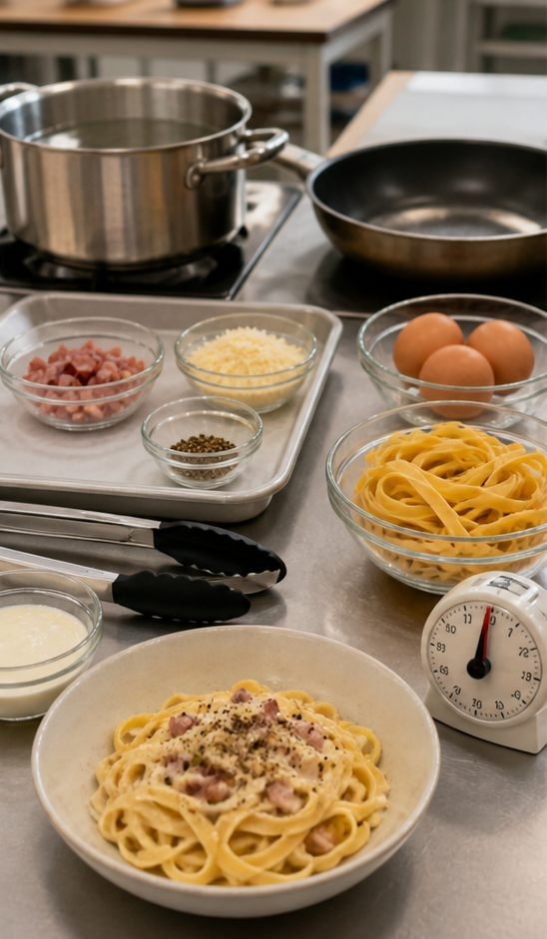
5.2 FETTUCCINE CARBONARA
Carbonara: safe sequencing
THREE IDEAS TO PUT ON THE BOARD
Read the current teacher recipe completely, identify cooking times and prepare measured ingredients before heat begins.
Coordinate dependent steps so pasta, sauce ingredients and serving readiness come together without unsafe rushing.
Use heat safely, check doneness and consistency, then serve promptly and complete washing up while reviewing one workflow improvement.
ASK THE ROOM | Which steps must be timed together so Carbonara finishes safely and well?
MODULE 5 • EVALUATE AND COMPLETE
04
Notes:
Teacher cue: use this slide to teach Module 5 content, then pause for the student prompt.
[Sources]
- PROG-2024: authorised Fantastic Food course source.
- REC-CARBONARA: authorised Fantastic Food course source.
- MODULE-5-GENERATED-VISUAL: project-specific generated teaching visual, local course asset.
[/Sources]

Slide 5

5.3 COMMUNICATE AND EVALUATE
Communicate and evaluate
THREE IDEAS TO PUT ON THE BOARD
Define the adolescent audience and the communication tool’s purpose before choosing content or layout.
Organise a clear home or title page, suitable course content and navigation that helps a student find the next action.
Evaluate the food solution and communication tool for appeal and ease of use, using observations as evidence and naming one improvement.
ASK THE ROOM | What evidence would show that another student can navigate the communication tool easily?
MODULE 5 • EVALUATE AND COMPLETE
05
Notes:
Teacher cue: use this slide to teach Module 5 content, then pause for the student prompt.
[Sources]
- PROG-2024: authorised Fantastic Food course source.
- BOOK-2023-STUDENT: authorised Fantastic Food course source.
- MODULE-5-GENERATED-VISUAL: project-specific generated teaching visual, local course asset.
[/Sources]

Slide 6
CHECK FOR UNDERSTANDING
Stop. Think. Explain.
Answer silently first, then justify your thinking with a partner.
1
How do fibre and water support the body in different ways?
2
Which Carbonara steps depend on one another, and what checks control them?
3
What evidence can test a communication tool’s appeal and ease of use?
MODULE 5 • EVALUATE AND COMPLETE
06
Notes:
Teacher cue: use this slide to teach Module 5 content, then pause for the student prompt.
[Sources]
- PROG-2024: authorised Fantastic Food course source.
- BOOK-2023-STUDENT: authorised Fantastic Food course source.
- REC-CARBONARA: authorised Fantastic Food course source.
[/Sources]

Slide 7
MODEL A LONGER RESPONSE
Read → Select → Explain → Check
THE QUESTION
WHAT IS THIS ASKING?
Create a communication-tool plan for adolescents and explain one evidence-based usability improvement.
Identify the audience and purpose, organise the content, then use evidence to improve appeal or ease of use.
1 SELECT
2 EXPLAIN
3 CHECK
Choose a home or title page, suitable content, clear navigation and one observation from a user check.
Show how the observation leads directly to a specific improvement.
Include audience, purpose, organisation, evidence and improvement without naming platform controls.
Sentence starter: My communication tool is for… Its purpose is… Evidence showed… so I would improve…
MODULE 5 • EVALUATE AND COMPLETE
07
Notes:
Teacher cue: use this slide to teach Module 5 content, then pause for the student prompt.
[Sources]
- PROG-2024: authorised Fantastic Food course source.
- BOOK-2023-STUDENT: authorised Fantastic Food course source.
[/Sources]

Slide 8
EXIT TICKET
Before you pack up…
1. One difference between fibre and water is…
SAVE
YOUR
EVIDENCE
2. One Carbonara dependency I will plan carefully is…
3. One piece of usability evidence I will collect is…
MODULE 5 • EVALUATE AND COMPLETE
08
Notes:
Teacher cue: use this slide to teach Module 5 content, then pause for the student prompt.
[Sources]
- PROG-2024: authorised Fantastic Food course source.
- BOOK-2023-STUDENT: authorised Fantastic Food course source.
[/Sources]

