Slide 1
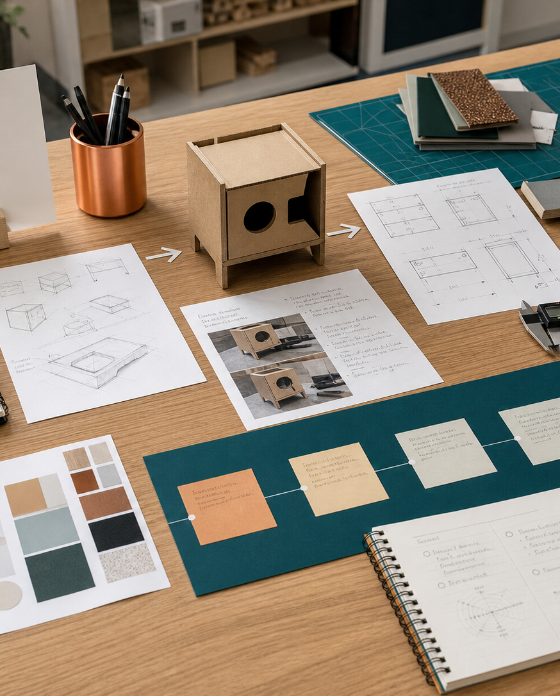
MODULE 01
Design and Technology foundations
Understand the course, the work of designers and the adaptable processes used to move from a need to an evaluated solution.
Research Assignment launch · P1.1 · P2.1
FORMATIVE LEARNING DECK
01
Notes:
Teaching focus: Establish the purpose of Design and Technology foundations.
Talking points
- Understand the course, the work of designers and the adaptable processes used to move from a need to an evaluated solution.
- Name the three learning areas without teaching them yet: What Design and Technology studies; Design professions and design practice; Design processes across contexts.
- Explain that this deck supports classroom learning and formative evidence. Current teacher directions and formal notices remain authoritative.
Transition: Move from the module purpose to the three-part learning map.
[Sources]
- NESA Design and Technology Stage 6 Syllabus (2013), official course authority
- Current Year 11 site source register and source-bound module data
- Visual: approved family-generated teaching asset, Year 12 D&T assets/images/course-hero.png
[/Sources]

Slide 2
YEAR 11 DESIGN & TECHNOLOGY · MODULE 01
Three ideas build one evidence pathway
APPLY + KEEP EVIDENCE
Create a design-profession map and compare how two designers move from client need to final presentation.
Year 11 Preliminary · Term 1 · Weeks 1–2
02
Notes:
Teaching focus: Preview the three named ideas as a connected sequence.
Talking points
- 1. What Design and Technology studies: Explain how designing, producing and evaluating work together in the Preliminary course.
- 2. Design professions and design practice: Investigate the varied work of designers and recognise overlap between professional roles.
- 3. Design processes across contexts: Compare design processes used in domestic, community, industrial and commercial settings.
- Retrieval prompt: Which idea is most likely to change a real design decision in Research Assignment launch, and why?
Transition: Begin with What Design and Technology studies.
[Sources]
- NESA Design and Technology Stage 6 Syllabus (2013), official course authority
- Current Year 11 site source register and source-bound module data
- Visual: current Year 11 local teaching asset assets/module-01-map.svg
[/Sources]

Slide 3

YEAR 11 DESIGN & TECHNOLOGY · MODULE 01
What Design and Technology studies
Designing identifies and develops a response to a need or opportunity.
Producing turns a developed idea into a product, system or environment using suitable resources and processes.
Evaluation occurs throughout the project and again when the solution is completed.
LOOK FOR · KEY RELATIONSHIPS AND EVIDENCE
EVIDENCE PROMPT · A student has built a neat object but cannot explain who needs it or how it was tested. What is the best next action?
Year 11 Preliminary · Term 1 · Weeks 1–2
03
Notes:
Teaching focus: Explain how designing, producing and evaluating work together in the Preliminary course.
Talking points
- Designing identifies and develops a response to a need or opportunity.
- Producing turns a developed idea into a product, system or environment using suitable resources and processes.
- Evaluation occurs throughout the project and again when the solution is completed.
- A design folio records evidence of decisions, testing, changes and evaluation rather than merely decorating the final result.
- Visual notice: Ask students what the scene makes visible about what design and technology studies, then connect observations to the stated principles.
- Evidence prompt: A student has built a neat object but cannot explain who needs it or how it was tested. What is the best next action?
Likely misconceptions
- Designing finishes as soon as the first sketch is drawn.
- Producing is successful whenever the object is completed, even if it misses the need.
- Evaluation should be left until the final lesson.
Transition: Move to Design professions and design practice.
[Sources]
- Y11 source note: NESA course description and course requirements; teacher answer booklet course foundations.
- Visual: approved family-generated teaching asset, Year 12 D&T assets/images/m01s01.png
[/Sources]

Slide 4
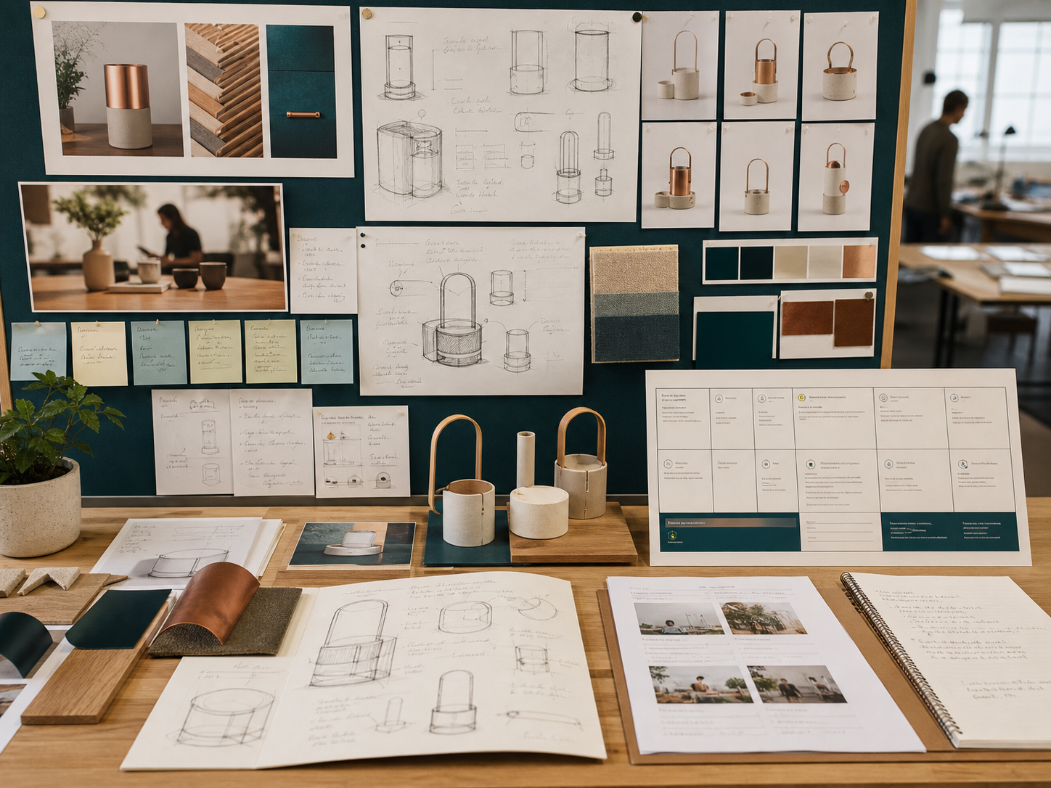
YEAR 11 DESIGN & TECHNOLOGY · MODULE 01
Design professions and design practice
Professional design work is shaped by a client, user, context and purpose.
Design professions overlap because complex projects require different knowledge and skills.
Designers communicate with technical and non-technical audiences using methods suited to each audience.
EVIDENCE PROMPT · A team is developing an accessible public drinking fountain. Which approach best reflects professional design practice?
LOOK FOR · KEY RELATIONSHIPS AND EVIDENCE
Year 11 Preliminary · Term 1 · Weeks 1–2
04
Notes:
Teaching focus: Investigate the varied work of designers and recognise overlap between professional roles.
Talking points
- Professional design work is shaped by a client, user, context and purpose.
- Design professions overlap because complex projects require different knowledge and skills.
- Designers communicate with technical and non-technical audiences using methods suited to each audience.
- Studying an Australian designer should connect the designer’s practices, tools and decisions to the impact of the resulting product or service.
- Visual notice: Ask students what the scene makes visible about design professions and design practice, then connect observations to the stated principles.
- Evidence prompt: A team is developing an accessible public drinking fountain. Which approach best reflects professional design practice?
Likely misconceptions
- Each design profession works independently and rarely shares information.
- A designer’s job is mainly to make products look attractive.
- The same presentation method is equally suitable for every audience.
Transition: Move to Design processes across contexts.
[Sources]
- Y11 source note: Current 2026 Research Assignment task; NESA Preliminary content on designers and design professions.
- Visual: approved family-generated teaching asset, Year 12 D&T assets/images/m03s01.png
[/Sources]

Slide 5
YEAR 11 DESIGN & TECHNOLOGY · MODULE 01
Design processes across contexts
Compare design processes used in domestic, community, industrial and commercial settings.
ITERATE
CONTEXT
CONSULT
A design process can be iterative, with research, testing and evaluation causing earlier decisions to change.
Domestic projects are often small and flexible, while industrial and commercial projects usually involve specialised roles and formal systems.
Community design requires meaningful consultation with the people affected by the outcome.
EVIDENCE PROMPT · A community group rejects an early playground concept because it excludes some users. What should the design team do?
Year 11 Preliminary · Term 1 · Weeks 1–2
05
Notes:
Teaching focus: Compare design processes used in domestic, community, industrial and commercial settings.
Talking points
- A design process can be iterative, with research, testing and evaluation causing earlier decisions to change.
- Domestic projects are often small and flexible, while industrial and commercial projects usually involve specialised roles and formal systems.
- Community design requires meaningful consultation with the people affected by the outcome.
- The process should be adapted to the project rather than followed as a fixed one-way checklist.
- Diagram notice: Trace ITERATE → CONTEXT → CONSULT and ask where evidence changes the next decision.
- Evidence prompt: A community group rejects an early playground concept because it excludes some users. What should the design team do?
Likely misconceptions
- Every design project must follow exactly the same linear sequence.
- Domestic design does not require research or evaluation.
- Community consultation is unnecessary when the designer has experience.
Transition: Move from teaching into retrieval across all three ideas.
[Sources]
- Y11 source note: NESA Preliminary course content; teacher answer booklet comparison of settings.
- Visual: editable native PowerPoint relationship diagram derived only from the three source-bound section principles
[/Sources]

Slide 6
YEAR 11 DESIGN & TECHNOLOGY · MODULE 01
Retrieve first; then check and improve
Answer without notes. Use one precise sentence for each check.
01
A student has built a neat object but cannot explain who needs it or how it was tested. What is the best next action?
A calm checking cycle
1 Recall from memory
02
A team is developing an accessible public drinking fountain. Which approach best reflects professional design practice?
2 Check the matching section
3 Repair the reason, not just the word
03
A community group rejects an early playground concept because it excludes some users. What should the design team do?
4 Try the question again
Year 11 Preliminary · Term 1 · Weeks 1–2
06
Notes:
Teaching focus: Use retrieval to expose and repair reasoning gaps across all three sections.
Talking points
- Give quiet recall time before inviting answers.
- Check 1: A student has built a neat object but cannot explain who needs it or how it was tested. What is the best next action?
- Indicative answer: Return to the identified need, establish criteria and collect evidence through testing before claiming the design is successful.
- Check 2: A team is developing an accessible public drinking fountain. Which approach best reflects professional design practice?
- Indicative answer: Combine user research, industrial design, engineering, manufacturing advice and testing with intended users.
- Check 3: A community group rejects an early playground concept because it excludes some users. What should the design team do?
- Indicative answer: Use the feedback to revisit needs and criteria, develop alternatives and test a revised concept with stakeholders.
- Ask students to explain why the answer is defensible before they return to notes.
Transition: Use the retrieved ideas to construct one sustained piece of evidence.
[Sources]
- Y11 source note: NESA course description and course requirements; teacher answer booklet course foundations.
- Y11 source note: Current 2026 Research Assignment task; NESA Preliminary content on designers and design professions.
- Y11 source note: NESA Preliminary course content; teacher answer booklet comparison of settings.
[/Sources]

Slide 7
YEAR 11 DESIGN & TECHNOLOGY · MODULE 01
Construct evidence that makes reasoning visible
Create a design-profession map and compare how two designers move from client need to final presentation.
READ
Identify the design question
SELECT
• Name the user, context or design issue.
• Select one relevant principle from this module.
• Explain how the evidence changes a decision.
• Check the decision against the need, criteria or source.
Choose relevant evidence
EXPLAIN
Connect evidence to the decision
CHECK
Test against the requirement
SENTENCE SUPPORT · The evidence shows … This matters because … Therefore I would …
Year 11 Preliminary · Term 1 · Weeks 1–2
07
Notes:
Teaching focus: Guide one higher-order formative response using all three module ideas.
Talking points
- Prompt: Create a design-profession map and compare how two designers move from client need to final presentation.
- Read: identify the user, context and design question.
- Select: choose source-bound evidence rather than a preference.
- Explain: connect the evidence to a design consequence or decision.
- Check: test the response against the relevant need, criterion or source.
- Remind students that this is formative learning evidence, not a formal submission instruction.
Transition: Close by asking each student to retain the response and name the next useful action.
[Sources]
- Y11 source note: NESA course description and course requirements; teacher answer booklet course foundations.
- Y11 source note: Current 2026 Research Assignment task; NESA Preliminary content on designers and design professions.
- Y11 source note: NESA Preliminary course content; teacher answer booklet comparison of settings.
[/Sources]

Slide 8
YEAR 11 DESIGN & TECHNOLOGY · MODULE 01
Leave with evidence, not just notes
01
02
03
RECALL
APPLY
ACT
One idea I can now explain accurately
One design decision or evidence judgement I can justify
One next action for Research Assignment launch
Save a dated response in your module learning record or design folio. Follow teacher directions for any formal submission.
Year 11 Preliminary · Term 1 · Weeks 1–2
08
Notes:
Teaching focus: Make the exit ticket produce a concrete learning record and a manageable next action.
Talking points
- Ask students to complete all three prompts individually before discussion.
- Keep the record labelled formative learning evidence; do not imply a cloud submission or formal assessment requirement.
- Next action: connect the module evidence to Research Assignment launch.
Transition: End with each student's own next action, not a generic summary.
[Sources]
- Y11 source note: NESA course description and course requirements; teacher answer booklet course foundations.
- Y11 source note: Current 2026 Research Assignment task; NESA Preliminary content on designers and design professions.
- Y11 source note: NESA Preliminary course content; teacher answer booklet comparison of settings.
[/Sources]

