Slide 1
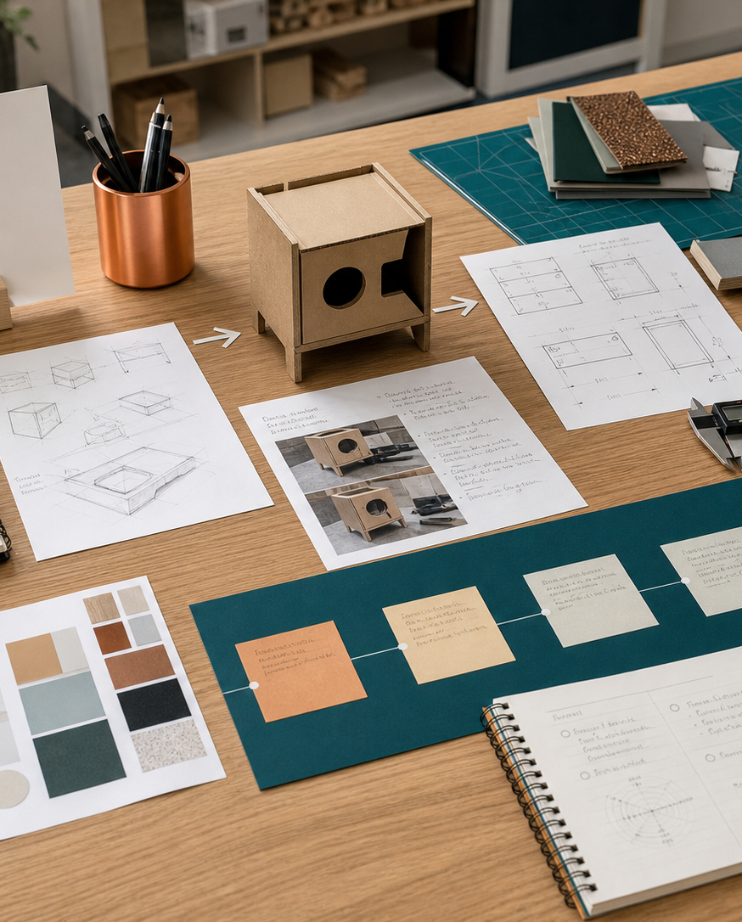
MODULE 02
Factors affecting design
Analyse how needs, function, aesthetics, ergonomics, finance, quality, safety and environmental consequences interact.
Research Assignment · P1.1 · P2.2
FORMATIVE LEARNING DECK
01
Notes:
Teaching focus: Establish the purpose of Factors affecting design.
Talking points
- Analyse how needs, function, aesthetics, ergonomics, finance, quality, safety and environmental consequences interact.
- Name the three learning areas without teaching them yet: Needs, function and appropriateness; Aesthetics, ergonomics and quality; Finance, WHS, environment and product life.
- Explain that this deck supports classroom learning and formative evidence. Current teacher directions and formal notices remain authoritative.
Transition: Move from the module purpose to the three-part learning map.
[Sources]
- NESA Design and Technology Stage 6 Syllabus (2013), official course authority
- Current Year 11 site source register and source-bound module data
- Visual: approved family-generated teaching asset, Year 12 D&T assets/images/course-hero.png
[/Sources]

Slide 2
YEAR 11 DESIGN & TECHNOLOGY · MODULE 02
Three ideas build one evidence pathway
APPLY + KEEP EVIDENCE
Complete a product success-and-failure audit that identifies evidence, trade-offs and consequences.
Year 11 Preliminary · Term 1 · Weeks 3–4
02
Notes:
Teaching focus: Preview the three named ideas as a connected sequence.
Talking points
- 1. Needs, function and appropriateness: Analyse whether a design solution is appropriate for its intended user, purpose and context.
- 2. Aesthetics, ergonomics and quality: Explain how appearance, human use and dependable performance influence design success.
- 3. Finance, WHS, environment and product life: Discuss how financial, safety and whole-of-life consequences shape design decisions.
- Retrieval prompt: Which idea is most likely to change a real design decision in Research Assignment, and why?
Transition: Begin with Needs, function and appropriateness.
[Sources]
- NESA Design and Technology Stage 6 Syllabus (2013), official course authority
- Current Year 11 site source register and source-bound module data
- Visual: current Year 11 local teaching asset assets/module-02-map.svg
[/Sources]

Slide 3

YEAR 11 DESIGN & TECHNOLOGY · MODULE 02
Needs, function and appropriateness
A need should be supported by research rather than assumed from the designer’s personal preference.
Functional requirements should be observable or testable wherever possible.
An appropriate solution fits the intended context, not merely the designer’s technical ability.
LOOK FOR · KEY RELATIONSHIPS AND EVIDENCE
EVIDENCE PROMPT · A compact camping table supports a load but is too heavy for its target users to carry. What is the strongest conclusion?
Year 11 Preliminary · Term 1 · Weeks 3–4
03
Notes:
Teaching focus: Analyse whether a design solution is appropriate for its intended user, purpose and context.
Talking points
- A need should be supported by research rather than assumed from the designer’s personal preference.
- Functional requirements should be observable or testable wherever possible.
- An appropriate solution fits the intended context, not merely the designer’s technical ability.
- A product can perform its basic function and still be inappropriate because of cost, access, safety or environmental consequences.
- Visual notice: Ask students what the scene makes visible about needs, function and appropriateness, then connect observations to the stated principles.
- Evidence prompt: A compact camping table supports a load but is too heavy for its target users to carry. What is the strongest conclusion?
Likely misconceptions
- Any problem noticed by a designer automatically represents a genuine need.
- Function can be proved by describing what the product is meant to do.
- The most technically complex solution is usually the most appropriate.
Transition: Move to Aesthetics, ergonomics and quality.
[Sources]
- Y11 source note: NESA factors affecting design; teacher answer booklet on user needs, function and success.
- Visual: approved family-generated teaching asset, Year 12 D&T assets/images/m07s02.png
[/Sources]

Slide 4
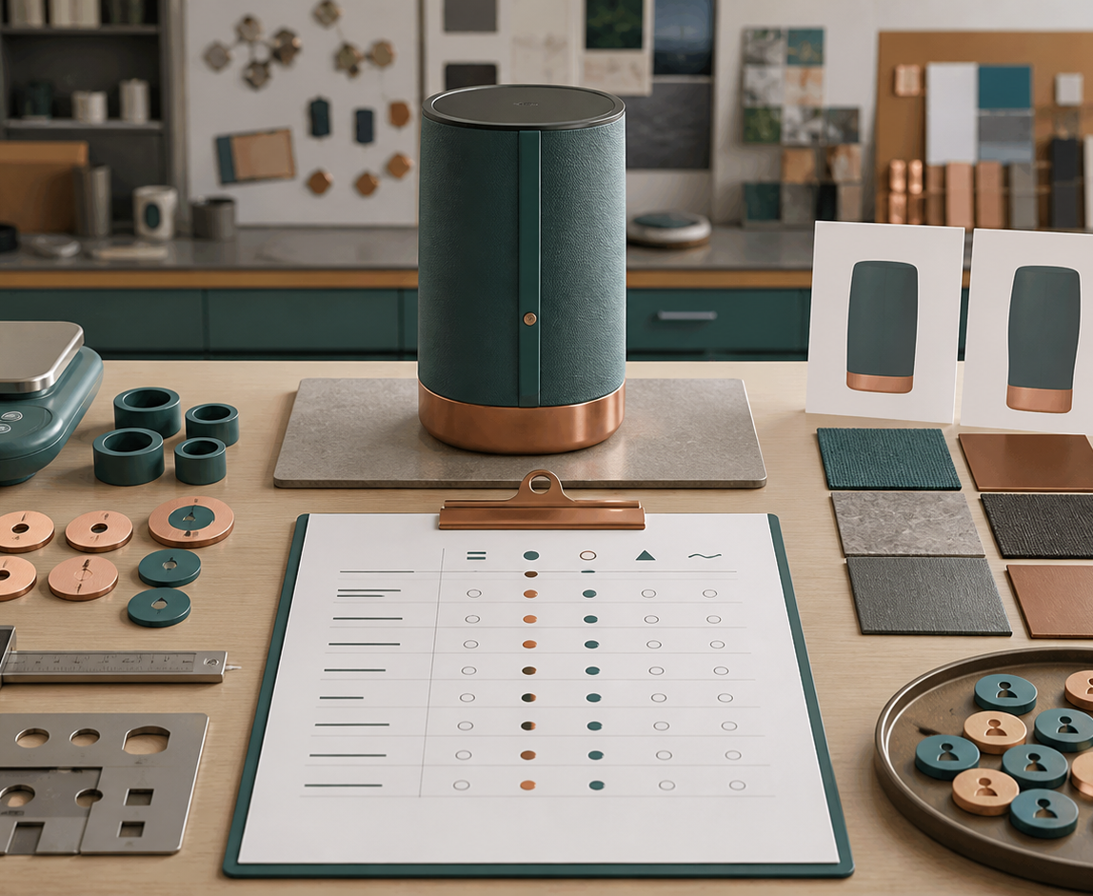
YEAR 11 DESIGN & TECHNOLOGY · MODULE 02
Aesthetics, ergonomics and quality
Aesthetic choices should support the target market, context and intended identity of the solution.
Ergonomic decisions should be based on user characteristics, tasks, reach, force, visibility, comfort and safety.
Quality includes reliable performance and consistency, not simply an expensive or polished appearance.
EVIDENCE PROMPT · A jar opener is visually appealing but requires high grip strength. What is the most defensible modification?
LOOK FOR · KEY RELATIONSHIPS AND EVIDENCE
Year 11 Preliminary · Term 1 · Weeks 3–4
04
Notes:
Teaching focus: Explain how appearance, human use and dependable performance influence design success.
Talking points
- Aesthetic choices should support the target market, context and intended identity of the solution.
- Ergonomic decisions should be based on user characteristics, tasks, reach, force, visibility, comfort and safety.
- Quality includes reliable performance and consistency, not simply an expensive or polished appearance.
- Improving one factor may affect another; for example, a larger handle may improve grip but alter size, appearance and cost.
- Visual notice: Ask students what the scene makes visible about aesthetics, ergonomics and quality, then connect observations to the stated principles.
- Evidence prompt: A jar opener is visually appealing but requires high grip strength. What is the most defensible modification?
Likely misconceptions
- Aesthetics is simply whether the designer personally likes the appearance.
- Ergonomics is concerned only with chair comfort.
- A flawless surface finish proves that a product is high quality.
Transition: Move to Finance, WHS, environment and product life.
[Sources]
- Y11 source note: NESA factors affecting design; teacher answer booklet examples on ergonomics, aesthetics and durability/quality.
- Visual: approved family-generated teaching asset, Year 12 D&T assets/images/m11s02.png
[/Sources]

Slide 5
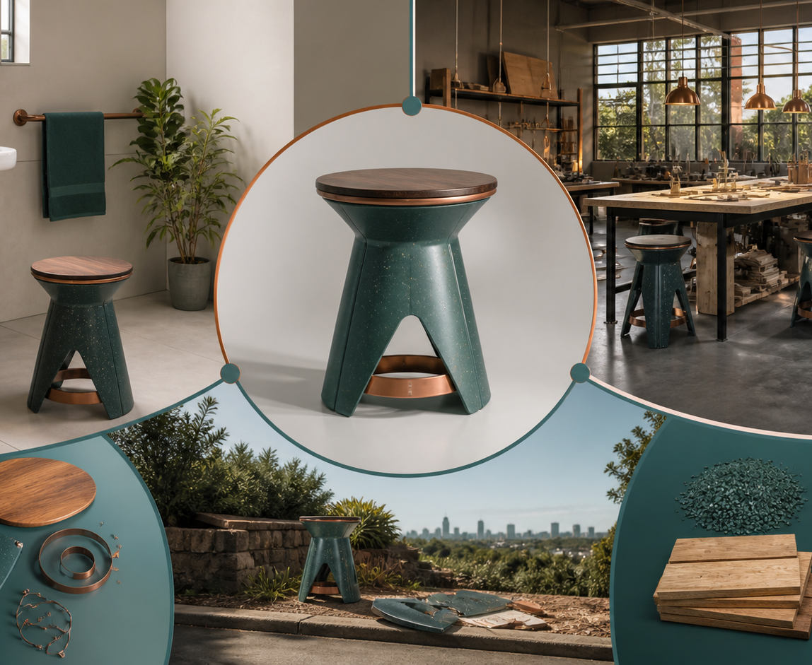
YEAR 11 DESIGN & TECHNOLOGY · MODULE 02
Finance, WHS, environment and product life
A finance decision should consider total project and production costs rather than material price alone.
WHS begins with identifying hazards and applying suitable controls; personal protective equipment is only one part of the system.
Life-cycle analysis examines impacts from raw materials through manufacture, distribution, use, maintenance and end-of-life.
LOOK FOR · KEY RELATIONSHIPS AND EVIDENCE
EVIDENCE PROMPT · A durable housing is difficult to recycle but can be repaired and used for many years. What should the designer do?
Year 11 Preliminary · Term 1 · Weeks 3–4
05
Notes:
Teaching focus: Discuss how financial, safety and whole-of-life consequences shape design decisions.
Talking points
- A finance decision should consider total project and production costs rather than material price alone.
- WHS begins with identifying hazards and applying suitable controls; personal protective equipment is only one part of the system.
- Life-cycle analysis examines impacts from raw materials through manufacture, distribution, use, maintenance and end-of-life.
- Durability, repairability, recyclability and obsolescence can create trade-offs that require evidence-based judgement.
- Visual notice: Ask students what the scene makes visible about finance, whs, environment and product life, then connect observations to the stated principles.
- Evidence prompt: A durable housing is difficult to recycle but can be repaired and used for many years. What should the designer do?
Likely misconceptions
- The cheapest material always produces the most financially responsible design.
- Wearing PPE removes the need to control hazards at their source.
- Environmental evaluation begins after the product is discarded.
Transition: Move from teaching into retrieval across all three ideas.
[Sources]
- Y11 source note: NESA factors affecting design; teacher answer booklet on WHS, life cycle, durability, cost and obsolescence.
- Visual: approved family-generated teaching asset, Year 12 D&T assets/images/m11s03.png
[/Sources]

Slide 6
YEAR 11 DESIGN & TECHNOLOGY · MODULE 02
Retrieve first; then check and improve
Answer without notes. Use one precise sentence for each check.
01
A compact camping table supports a load but is too heavy for its target users to carry. What is the strongest conclusion?
A calm checking cycle
1 Recall from memory
02
A jar opener is visually appealing but requires high grip strength. What is the most defensible modification?
2 Check the matching section
3 Repair the reason, not just the word
03
A durable housing is difficult to recycle but can be repaired and used for many years. What should the designer do?
4 Try the question again
Year 11 Preliminary · Term 1 · Weeks 3–4
06
Notes:
Teaching focus: Use retrieval to expose and repair reasoning gaps across all three sections.
Talking points
- Give quiet recall time before inviting answers.
- Check 1: A compact camping table supports a load but is too heavy for its target users to carry. What is the strongest conclusion?
- Indicative answer: It meets one functional requirement but is not yet appropriate because portability is part of the intended context.
- Check 2: A jar opener is visually appealing but requires high grip strength. What is the most defensible modification?
- Indicative answer: Test alternative handle shapes and operating forces with intended users, then refine the form while retaining a suitable visual identity.
- Check 3: A durable housing is difficult to recycle but can be repaired and used for many years. What should the designer do?
- Indicative answer: Compare whole-of-life impacts, expected service life, repair pathways and end-of-life options before making a justified selection.
- Ask students to explain why the answer is defensible before they return to notes.
Transition: Use the retrieved ideas to construct one sustained piece of evidence.
[Sources]
- Y11 source note: NESA factors affecting design; teacher answer booklet on user needs, function and success.
- Y11 source note: NESA factors affecting design; teacher answer booklet examples on ergonomics, aesthetics and durability/quality.
- Y11 source note: NESA factors affecting design; teacher answer booklet on WHS, life cycle, durability, cost and obsolescence.
[/Sources]

Slide 7
YEAR 11 DESIGN & TECHNOLOGY · MODULE 02
Construct evidence that makes reasoning visible
Complete a product success-and-failure audit that identifies evidence, trade-offs and consequences.
READ
Identify the design question
SELECT
• Name the user, context or design issue.
• Select one relevant principle from this module.
• Explain how the evidence changes a decision.
• Check the decision against the need, criteria or source.
Choose relevant evidence
EXPLAIN
Connect evidence to the decision
CHECK
Test against the requirement
SENTENCE SUPPORT · The evidence shows … This matters because … Therefore I would …
Year 11 Preliminary · Term 1 · Weeks 3–4
07
Notes:
Teaching focus: Guide one higher-order formative response using all three module ideas.
Talking points
- Prompt: Complete a product success-and-failure audit that identifies evidence, trade-offs and consequences.
- Read: identify the user, context and design question.
- Select: choose source-bound evidence rather than a preference.
- Explain: connect the evidence to a design consequence or decision.
- Check: test the response against the relevant need, criterion or source.
- Remind students that this is formative learning evidence, not a formal submission instruction.
Transition: Close by asking each student to retain the response and name the next useful action.
[Sources]
- Y11 source note: NESA factors affecting design; teacher answer booklet on user needs, function and success.
- Y11 source note: NESA factors affecting design; teacher answer booklet examples on ergonomics, aesthetics and durability/quality.
- Y11 source note: NESA factors affecting design; teacher answer booklet on WHS, life cycle, durability, cost and obsolescence.
[/Sources]

Slide 8
YEAR 11 DESIGN & TECHNOLOGY · MODULE 02
Leave with evidence, not just notes
01
02
03
RECALL
APPLY
ACT
One idea I can now explain accurately
One design decision or evidence judgement I can justify
One next action for Research Assignment
Save a dated response in your module learning record or design folio. Follow teacher directions for any formal submission.
Year 11 Preliminary · Term 1 · Weeks 3–4
08
Notes:
Teaching focus: Make the exit ticket produce a concrete learning record and a manageable next action.
Talking points
- Ask students to complete all three prompts individually before discussion.
- Keep the record labelled formative learning evidence; do not imply a cloud submission or formal assessment requirement.
- Next action: connect the module evidence to Research Assignment.
Transition: End with each student's own next action, not a generic summary.
[Sources]
- Y11 source note: NESA factors affecting design; teacher answer booklet on user needs, function and success.
- Y11 source note: NESA factors affecting design; teacher answer booklet examples on ergonomics, aesthetics and durability/quality.
- Y11 source note: NESA factors affecting design; teacher answer booklet on WHS, life cycle, durability, cost and obsolescence.
[/Sources]

