Slide 1

MODULE 03
Research that informs design
Use varied, ethical and fit-for-purpose research to establish needs, build criteria and modify ideas.
Research Assignment · P5.3 · P5.2
FORMATIVE LEARNING DECK
01
Notes:
Teaching focus: Establish the purpose of Research that informs design.
Talking points
- Use varied, ethical and fit-for-purpose research to establish needs, build criteria and modify ideas.
- Name the three learning areas without teaching them yet: Primary and secondary research; Qualitative and quantitative data; Ethical research and evidence synthesis.
- Explain that this deck supports classroom learning and formative evidence. Current teacher directions and formal notices remain authoritative.
Transition: Move from the module purpose to the three-part learning map.
[Sources]
- NESA Design and Technology Stage 6 Syllabus (2013), official course authority
- Current Year 11 site source register and source-bound module data
- Visual: approved family-generated teaching asset, Year 12 D&T assets/images/course-hero.png
[/Sources]

Slide 2
YEAR 11 DESIGN & TECHNOLOGY · MODULE 03
Three ideas build one evidence pathway
APPLY + KEEP EVIDENCE
Prepare a research plan that combines methods, identifies participants and shows how findings will affect decisions.
Year 11 Preliminary · Term 1 · Weeks 5–6
02
Notes:
Teaching focus: Preview the three named ideas as a connected sequence.
Talking points
- 1. Primary and secondary research: Distinguish primary and secondary research and select methods that suit a design question.
- 2. Qualitative and quantitative data: Explain how descriptive and numerical data provide different evidence for design decisions.
- 3. Ethical research and evidence synthesis: Collect, evaluate and combine research without misleading or harming participants.
- Retrieval prompt: Which idea is most likely to change a real design decision in Research Assignment, and why?
Transition: Begin with Primary and secondary research.
[Sources]
- NESA Design and Technology Stage 6 Syllabus (2013), official course authority
- Current Year 11 site source register and source-bound module data
- Visual: current Year 11 local teaching asset assets/module-03-map.svg
[/Sources]

Slide 3
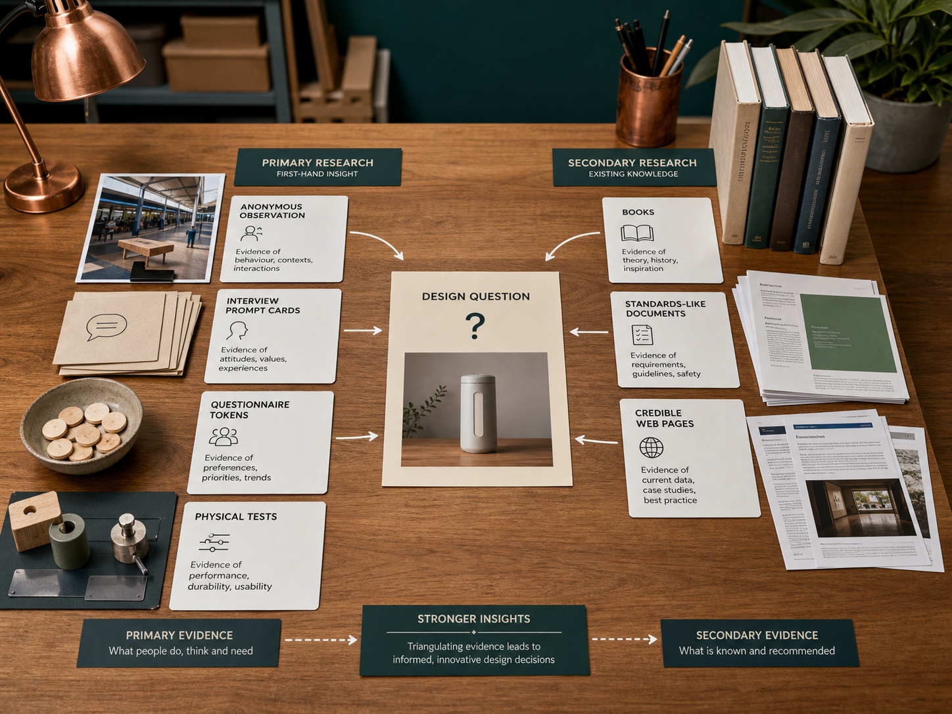
YEAR 11 DESIGN & TECHNOLOGY · MODULE 03
Primary and secondary research
Primary research can include observation, interviews, questionnaires, focus groups, measurements and user testing.
Secondary research can include standards, textbooks, reliable websites, product specifications, published data and industry information.
The method should be selected because it answers a specific research question, not because it is quick or familiar.
LOOK FOR · KEY RELATIONSHIPS AND EVIDENCE
EVIDENCE PROMPT · A designer wants to understand why older users struggle with a packaging closure. Which combination is strongest?
Year 11 Preliminary · Term 1 · Weeks 5–6
03
Notes:
Teaching focus: Distinguish primary and secondary research and select methods that suit a design question.
Talking points
- Primary research can include observation, interviews, questionnaires, focus groups, measurements and user testing.
- Secondary research can include standards, textbooks, reliable websites, product specifications, published data and industry information.
- The method should be selected because it answers a specific research question, not because it is quick or familiar.
- Using more than one method allows findings to be compared and reduces reliance on one incomplete source.
- Visual notice: Ask students what the scene makes visible about primary and secondary research, then connect observations to the stated principles.
- Evidence prompt: A designer wants to understand why older users struggle with a packaging closure. Which combination is strongest?
Likely misconceptions
- Internet research is always primary because the designer gathers it personally.
- A questionnaire is the best method for every design problem.
- Secondary research is less useful because it was collected by someone else.
Transition: Move to Qualitative and quantitative data.
[Sources]
- Y11 source note: Teacher answer booklet on primary/secondary research and using multiple methods; current Research Assignment.
- Visual: approved family-generated teaching asset, Year 12 D&T assets/images/m05s01.png
[/Sources]

Slide 4

YEAR 11 DESIGN & TECHNOLOGY · MODULE 03
Qualitative and quantitative data
Qualitative methods can reveal language, frustrations, preferences and unexpected user experiences.
Quantitative methods can compare dimensions, forces, frequencies, rankings, percentages and performance results.
Data should be analysed rather than simply displayed; patterns and limitations need to be identified.
EVIDENCE PROMPT · A trial shows that 70% of participants take longer than ten seconds to use a latch, and interviews describe confusion about its direction. What is the best use of the findings?
LOOK FOR · KEY RELATIONSHIPS AND EVIDENCE
Year 11 Preliminary · Term 1 · Weeks 5–6
04
Notes:
Teaching focus: Explain how descriptive and numerical data provide different evidence for design decisions.
Talking points
- Qualitative methods can reveal language, frustrations, preferences and unexpected user experiences.
- Quantitative methods can compare dimensions, forces, frequencies, rankings, percentages and performance results.
- Data should be analysed rather than simply displayed; patterns and limitations need to be identified.
- The conclusions drawn must match the sample and method, avoiding claims that the evidence cannot support.
- Visual notice: Ask students what the scene makes visible about qualitative and quantitative data, then connect observations to the stated principles.
- Evidence prompt: A trial shows that 70% of participants take longer than ten seconds to use a latch, and interviews describe confusion about its direction. What is the best use of the findings?
Likely misconceptions
- Qualitative data is unreliable because it is not numerical.
- Quantitative data automatically explains the causes behind a result.
- A graph is analysis even when no pattern or implication is explained.
Transition: Move to Ethical research and evidence synthesis.
[Sources]
- Y11 source note: Teacher answer booklet on qualitative and quantitative data and evidence application.
- Visual: approved family-generated teaching asset, Year 12 D&T assets/images/m05s02.png
[/Sources]

Slide 5

YEAR 11 DESIGN & TECHNOLOGY · MODULE 03
Ethical research and evidence synthesis
Participants should understand the purpose, activity and intended use of their information before agreeing.
Personal information should be protected and reported only with appropriate permission.
Conflicting evidence should be examined rather than hidden; differences may reveal user groups, context or method limitations.
LOOK FOR · KEY RELATIONSHIPS AND EVIDENCE
EVIDENCE PROMPT · A student wants to photograph a participant using a prototype and include the image in a public presentation. What is required?
Year 11 Preliminary · Term 1 · Weeks 5–6
05
Notes:
Teaching focus: Collect, evaluate and combine research without misleading or harming participants.
Talking points
- Participants should understand the purpose, activity and intended use of their information before agreeing.
- Personal information should be protected and reported only with appropriate permission.
- Conflicting evidence should be examined rather than hidden; differences may reveal user groups, context or method limitations.
- A conclusion should distinguish what the evidence shows from what the designer assumes or still needs to test.
- Visual notice: Ask students what the scene makes visible about ethical research and evidence synthesis, then connect observations to the stated principles.
- Evidence prompt: A student wants to photograph a participant using a prototype and include the image in a public presentation. What is required?
Likely misconceptions
- Consent is unnecessary when research is completed for a school project.
- Removing a participant’s name allows any personal detail to be published.
- Evidence that challenges the preferred concept can be excluded as an outlier.
Transition: Move from teaching into retrieval across all three ideas.
[Sources]
- Y11 source note: Teacher answer booklet on research ethics and applying conclusions; school-authorised assessment context.
- Visual: approved family-generated teaching asset, Year 12 D&T assets/images/m05s03.png
[/Sources]

Slide 6
YEAR 11 DESIGN & TECHNOLOGY · MODULE 03
Retrieve first; then check and improve
Answer without notes. Use one precise sentence for each check.
01
A designer wants to understand why older users struggle with a packaging closure. Which combination is strongest?
A calm checking cycle
1 Recall from memory
02
A trial shows that 70% of participants take longer than ten seconds to use a latch, and interviews describe confusion about its direction. What is the best use of the findings?
2 Check the matching section
3 Repair the reason, not just the word
03
A student wants to photograph a participant using a prototype and include the image in a public presentation. What is required?
4 Try the question again
Year 11 Preliminary · Term 1 · Weeks 5–6
06
Notes:
Teaching focus: Use retrieval to expose and repair reasoning gaps across all three sections.
Talking points
- Give quiet recall time before inviting answers.
- Check 1: A designer wants to understand why older users struggle with a packaging closure. Which combination is strongest?
- Indicative answer: Observe and interview intended users, measure the task where appropriate, and compare findings with existing packaging and ergonomic guidance.
- Check 2: A trial shows that 70% of participants take longer than ten seconds to use a latch, and interviews describe confusion about its direction. What is the best use of the findings?
- Indicative answer: Use the timing data to confirm a performance issue and the interview comments to guide changes to the latch and its cues.
- Check 3: A student wants to photograph a participant using a prototype and include the image in a public presentation. What is required?
- Indicative answer: Explain the purpose and audience, obtain appropriate consent, protect personal information and provide a genuine option not to participate.
- Ask students to explain why the answer is defensible before they return to notes.
Transition: Use the retrieved ideas to construct one sustained piece of evidence.
[Sources]
- Y11 source note: Teacher answer booklet on primary/secondary research and using multiple methods; current Research Assignment.
- Y11 source note: Teacher answer booklet on qualitative and quantitative data and evidence application.
- Y11 source note: Teacher answer booklet on research ethics and applying conclusions; school-authorised assessment context.
[/Sources]

Slide 7
YEAR 11 DESIGN & TECHNOLOGY · MODULE 03
Construct evidence that makes reasoning visible
Prepare a research plan that combines methods, identifies participants and shows how findings will affect decisions.
READ
Identify the design question
SELECT
• Name the user, context or design issue.
• Select one relevant principle from this module.
• Explain how the evidence changes a decision.
• Check the decision against the need, criteria or source.
Choose relevant evidence
EXPLAIN
Connect evidence to the decision
CHECK
Test against the requirement
SENTENCE SUPPORT · The evidence shows … This matters because … Therefore I would …
Year 11 Preliminary · Term 1 · Weeks 5–6
07
Notes:
Teaching focus: Guide one higher-order formative response using all three module ideas.
Talking points
- Prompt: Prepare a research plan that combines methods, identifies participants and shows how findings will affect decisions.
- Read: identify the user, context and design question.
- Select: choose source-bound evidence rather than a preference.
- Explain: connect the evidence to a design consequence or decision.
- Check: test the response against the relevant need, criterion or source.
- Remind students that this is formative learning evidence, not a formal submission instruction.
Transition: Close by asking each student to retain the response and name the next useful action.
[Sources]
- Y11 source note: Teacher answer booklet on primary/secondary research and using multiple methods; current Research Assignment.
- Y11 source note: Teacher answer booklet on qualitative and quantitative data and evidence application.
- Y11 source note: Teacher answer booklet on research ethics and applying conclusions; school-authorised assessment context.
[/Sources]

Slide 8
YEAR 11 DESIGN & TECHNOLOGY · MODULE 03
Leave with evidence, not just notes
01
02
03
RECALL
APPLY
ACT
One idea I can now explain accurately
One design decision or evidence judgement I can justify
One next action for Research Assignment
Save a dated response in your module learning record or design folio. Follow teacher directions for any formal submission.
Year 11 Preliminary · Term 1 · Weeks 5–6
08
Notes:
Teaching focus: Make the exit ticket produce a concrete learning record and a manageable next action.
Talking points
- Ask students to complete all three prompts individually before discussion.
- Keep the record labelled formative learning evidence; do not imply a cloud submission or formal assessment requirement.
- Next action: connect the module evidence to Research Assignment.
Transition: End with each student's own next action, not a generic summary.
[Sources]
- Y11 source note: Teacher answer booklet on primary/secondary research and using multiple methods; current Research Assignment.
- Y11 source note: Teacher answer booklet on qualitative and quantitative data and evidence application.
- Y11 source note: Teacher answer booklet on research ethics and applying conclusions; school-authorised assessment context.
[/Sources]

