Slide 1
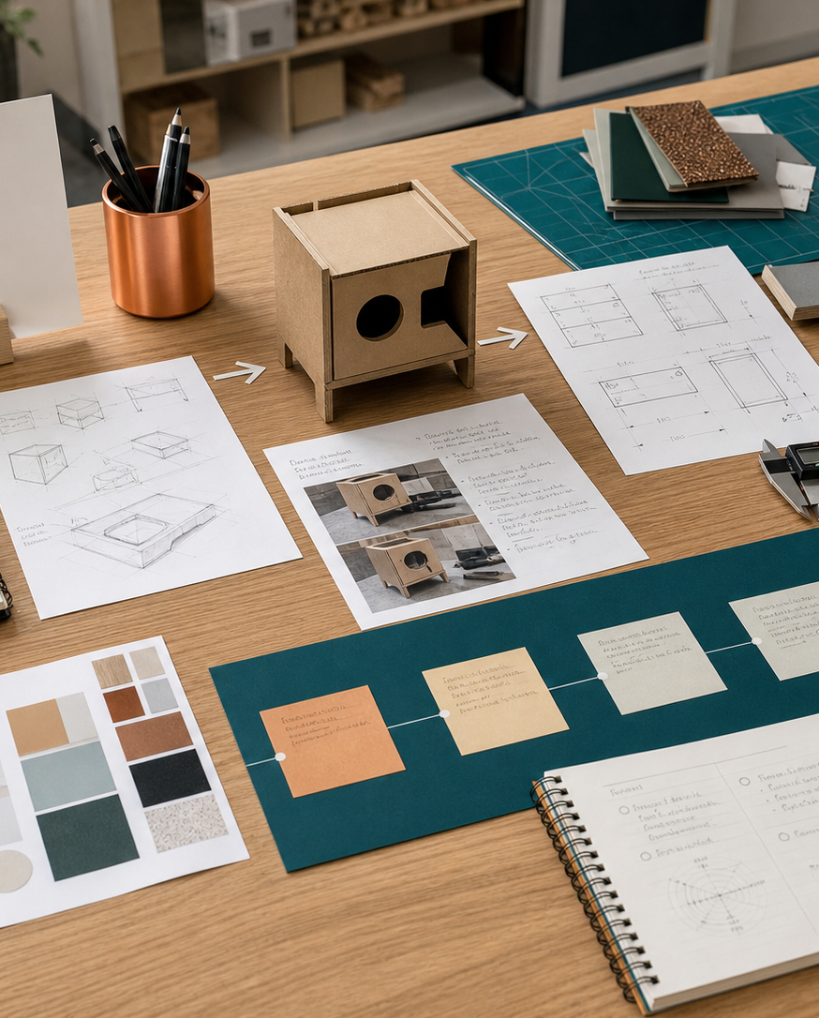
MODULE 04
Design and production settings
Relate school design projects to domestic, community, industrial and commercial practices and technologies.
Research Assignment · P2.1 · P2.2 · P6.1
FORMATIVE LEARNING DECK
01
Notes:
Teaching focus: Establish the purpose of Design and production settings.
Talking points
- Relate school design projects to domestic, community, industrial and commercial practices and technologies.
- Name the three learning areas without teaching them yet: Domestic, community, industrial and commercial settings; Technologies in industrial and commercial settings; Impacts on individuals, society and the environment.
- Explain that this deck supports classroom learning and formative evidence. Current teacher directions and formal notices remain authoritative.
Transition: Move from the module purpose to the three-part learning map.
[Sources]
- NESA Design and Technology Stage 6 Syllabus (2013), official course authority
- Current Year 11 site source register and source-bound module data
- Visual: approved family-generated teaching asset, Year 12 D&T assets/images/course-hero.png
[/Sources]

Slide 2
YEAR 11 DESIGN & TECHNOLOGY · MODULE 04
Three ideas build one evidence pathway
APPLY + KEEP EVIDENCE
Compare one school production process with a domestic and an industrial/commercial process.
Year 11 Preliminary · Term 1 · Weeks 7–8
02
Notes:
Teaching focus: Preview the three named ideas as a connected sequence.
Talking points
- 1. Domestic, community, industrial and commercial settings: Identify features of different design and production settings and explain how setting changes decisions.
- 2. Technologies in industrial and commercial settings: Compare technologies used in school projects with those used in industry and commerce.
- 3. Impacts on individuals, society and the environment: Analyse connected consequences of design and technology activities.
- Retrieval prompt: Which idea is most likely to change a real design decision in Research Assignment, and why?
Transition: Begin with Domestic, community, industrial and commercial settings.
[Sources]
- NESA Design and Technology Stage 6 Syllabus (2013), official course authority
- Current Year 11 site source register and source-bound module data
- Visual: current Year 11 local teaching asset assets/module-04-map.svg
[/Sources]

Slide 3
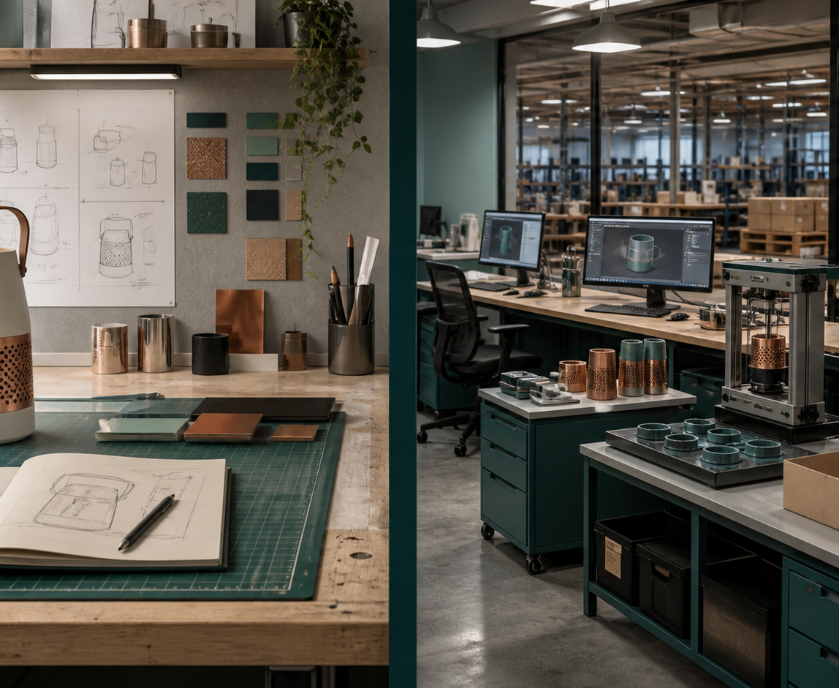
YEAR 11 DESIGN & TECHNOLOGY · MODULE 04
Domestic, community, industrial and commercial settings
Domestic production is commonly small-scale, adaptable and completed by one person or a small group.
Community design should involve affected groups and consider equitable access and public benefit.
Industrial production commonly uses specialised equipment, standardised processes and defined roles.
LOOK FOR · KEY RELATIONSHIPS AND EVIDENCE
EVIDENCE PROMPT · A handmade product begins supplying a national retailer. Which change is most likely?
Year 11 Preliminary · Term 1 · Weeks 7–8
03
Notes:
Teaching focus: Identify features of different design and production settings and explain how setting changes decisions.
Talking points
- Domestic production is commonly small-scale, adaptable and completed by one person or a small group.
- Community design should involve affected groups and consider equitable access and public benefit.
- Industrial production commonly uses specialised equipment, standardised processes and defined roles.
- Commercial decisions connect user needs with cost, market demand, production capacity and financial viability.
- Visual notice: Ask students what the scene makes visible about domestic, community, industrial and commercial settings, then connect observations to the stated principles.
- Evidence prompt: A handmade product begins supplying a national retailer. Which change is most likely?
Likely misconceptions
- Domestic projects are exempt from quality and safety considerations.
- Community design is successful whenever most users are satisfied.
- Industrial production always uses fully automated machinery.
Transition: Move to Technologies in industrial and commercial settings.
[Sources]
- Y11 source note: NESA Preliminary settings content; teacher answer booklet comparison of production settings.
- Visual: approved family-generated teaching asset, Year 12 D&T assets/images/m09s03.png
[/Sources]

Slide 4
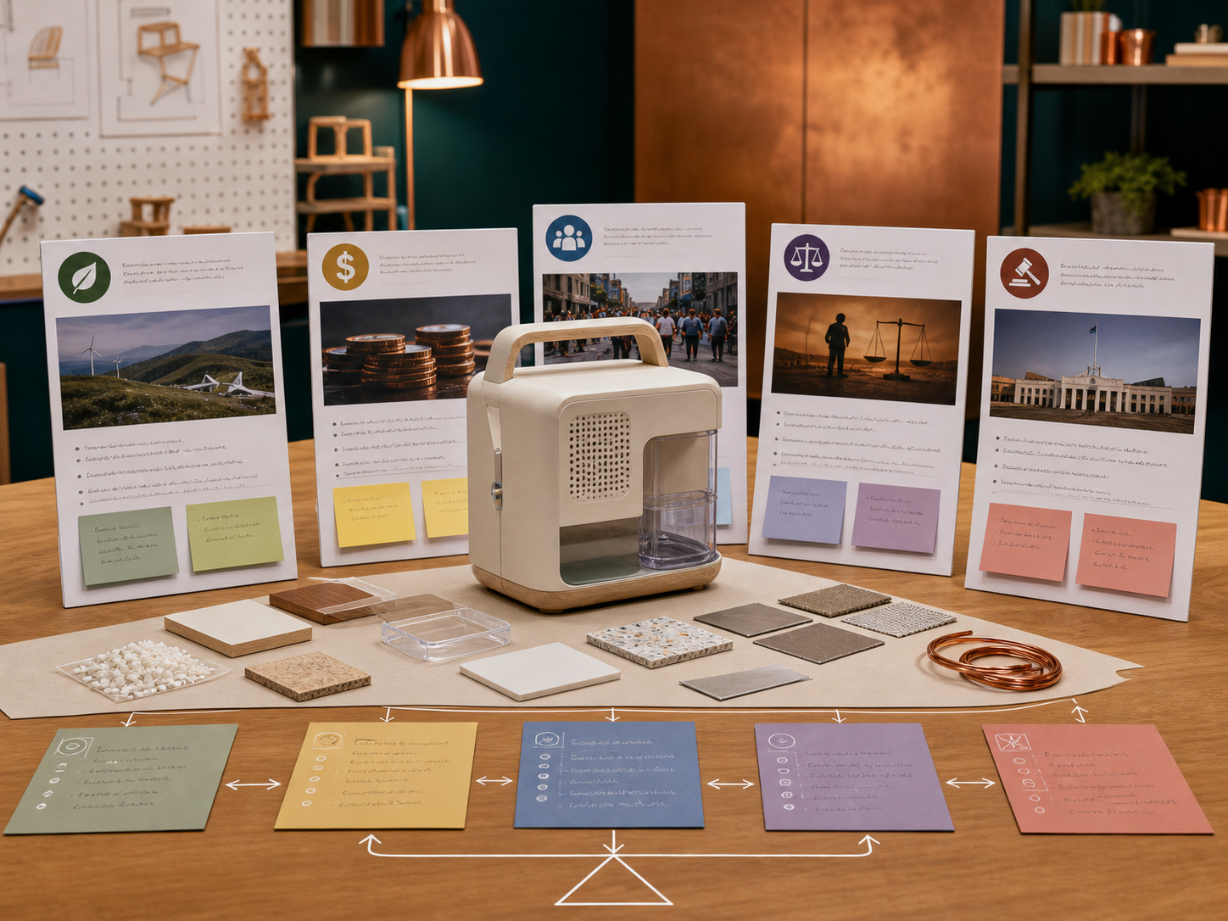
YEAR 11 DESIGN & TECHNOLOGY · MODULE 04
Technologies in industrial and commercial settings
Technology should be selected because it suits the task and context, not because it is new.
CAD, CAM and CNC can create an integrated flow from digital design to controlled manufacture.
Automation can improve repeatability and remove some hazardous or repetitive work, but it requires investment, maintenance and skills.
EVIDENCE PROMPT · A small maker needs 20 customised components each month. What technology decision is most defensible?
LOOK FOR · KEY RELATIONSHIPS AND EVIDENCE
Year 11 Preliminary · Term 1 · Weeks 7–8
04
Notes:
Teaching focus: Compare technologies used in school projects with those used in industry and commerce.
Talking points
- Technology should be selected because it suits the task and context, not because it is new.
- CAD, CAM and CNC can create an integrated flow from digital design to controlled manufacture.
- Automation can improve repeatability and remove some hazardous or repetitive work, but it requires investment, maintenance and skills.
- Appropriate technology balances benefit with scale, cost, resources, user needs and social or environmental consequences.
- Visual notice: Ask students what the scene makes visible about technologies in industrial and commercial settings, then connect observations to the stated principles.
- Evidence prompt: A small maker needs 20 customised components each month. What technology decision is most defensible?
Likely misconceptions
- The newest technology is automatically the most appropriate.
- Computer-controlled production removes the need to check files and dimensions.
- Automation always reduces total employment and cost.
Transition: Move to Impacts on individuals, society and the environment.
[Sources]
- Y11 source note: NESA Preliminary technologies content; teacher answer booklet CAD/CAM, automation and industry comparisons.
- Visual: approved family-generated teaching asset, Year 12 D&T assets/images/m02s03.png
[/Sources]

Slide 5
YEAR 11 DESIGN & TECHNOLOGY · MODULE 04
Impacts on individuals, society and the environment
Analyse connected consequences of design and technology activities.
INDIVIDUAL
SOCIETY
ENVIRONMENT
Individual impacts can include safety, convenience, cost, privacy, independence, health and access.
Societal impacts can include employment, equity, infrastructure, cultural practices, regulation and community participation.
Environmental impacts can occur during extraction, manufacture, transport, use, maintenance and end-of-life.
EVIDENCE PROMPT · A shared e-bike scheme is proposed for a regional city. What is the strongest analysis?
Year 11 Preliminary · Term 1 · Weeks 7–8
05
Notes:
Teaching focus: Analyse connected consequences of design and technology activities.
Talking points
- Individual impacts can include safety, convenience, cost, privacy, independence, health and access.
- Societal impacts can include employment, equity, infrastructure, cultural practices, regulation and community participation.
- Environmental impacts can occur during extraction, manufacture, transport, use, maintenance and end-of-life.
- The same technology may create benefits and costs for different stakeholders, so conclusions should be balanced and conditional.
- Diagram notice: Trace INDIVIDUAL → SOCIETY → ENVIRONMENT and ask where evidence changes the next decision.
- Evidence prompt: A shared e-bike scheme is proposed for a regional city. What is the strongest analysis?
Likely misconceptions
- A popular product has a positive societal impact by definition.
- Environmental impact refers only to waste sent to landfill.
- Employment changes are an individual issue rather than a societal one.
Transition: Move from teaching into retrieval across all three ideas.
[Sources]
- Y11 source note: NESA Preliminary impact content; teacher answer booklet individual/society/environment scenarios.
- Visual: editable native PowerPoint relationship diagram derived only from the three source-bound section principles
[/Sources]

Slide 6
YEAR 11 DESIGN & TECHNOLOGY · MODULE 04
Retrieve first; then check and improve
Answer without notes. Use one precise sentence for each check.
01
A handmade product begins supplying a national retailer. Which change is most likely?
A calm checking cycle
1 Recall from memory
02
A small maker needs 20 customised components each month. What technology decision is most defensible?
2 Check the matching section
3 Repair the reason, not just the word
03
A shared e-bike scheme is proposed for a regional city. What is the strongest analysis?
4 Try the question again
Year 11 Preliminary · Term 1 · Weeks 7–8
06
Notes:
Teaching focus: Use retrieval to expose and repair reasoning gaps across all three sections.
Talking points
- Give quiet recall time before inviting answers.
- Check 1: A handmade product begins supplying a national retailer. Which change is most likely?
- Indicative answer: The producer may need standardised components, specialised equipment, reliable suppliers, formal quality control and production scheduling.
- Check 2: A small maker needs 20 customised components each month. What technology decision is most defensible?
- Indicative answer: Compare manual, jig-assisted and digital production against volume, accuracy, setup cost, skill and customisation before selecting a process.
- Check 3: A shared e-bike scheme is proposed for a regional city. What is the strongest analysis?
- Indicative answer: Examine user access and safety, transport choice and public-space management, plus energy, battery and end-of-life impacts under realistic use conditions.
- Ask students to explain why the answer is defensible before they return to notes.
Transition: Use the retrieved ideas to construct one sustained piece of evidence.
[Sources]
- Y11 source note: NESA Preliminary settings content; teacher answer booklet comparison of production settings.
- Y11 source note: NESA Preliminary technologies content; teacher answer booklet CAD/CAM, automation and industry comparisons.
- Y11 source note: NESA Preliminary impact content; teacher answer booklet individual/society/environment scenarios.
[/Sources]

Slide 7
YEAR 11 DESIGN & TECHNOLOGY · MODULE 04
Construct evidence that makes reasoning visible
Compare one school production process with a domestic and an industrial/commercial process.
READ
Identify the design question
SELECT
• Name the user, context or design issue.
• Select one relevant principle from this module.
• Explain how the evidence changes a decision.
• Check the decision against the need, criteria or source.
Choose relevant evidence
EXPLAIN
Connect evidence to the decision
CHECK
Test against the requirement
SENTENCE SUPPORT · The evidence shows … This matters because … Therefore I would …
Year 11 Preliminary · Term 1 · Weeks 7–8
07
Notes:
Teaching focus: Guide one higher-order formative response using all three module ideas.
Talking points
- Prompt: Compare one school production process with a domestic and an industrial/commercial process.
- Read: identify the user, context and design question.
- Select: choose source-bound evidence rather than a preference.
- Explain: connect the evidence to a design consequence or decision.
- Check: test the response against the relevant need, criterion or source.
- Remind students that this is formative learning evidence, not a formal submission instruction.
Transition: Close by asking each student to retain the response and name the next useful action.
[Sources]
- Y11 source note: NESA Preliminary settings content; teacher answer booklet comparison of production settings.
- Y11 source note: NESA Preliminary technologies content; teacher answer booklet CAD/CAM, automation and industry comparisons.
- Y11 source note: NESA Preliminary impact content; teacher answer booklet individual/society/environment scenarios.
[/Sources]

Slide 8
YEAR 11 DESIGN & TECHNOLOGY · MODULE 04
Leave with evidence, not just notes
01
02
03
RECALL
APPLY
ACT
One idea I can now explain accurately
One design decision or evidence judgement I can justify
One next action for Research Assignment
Save a dated response in your module learning record or design folio. Follow teacher directions for any formal submission.
Year 11 Preliminary · Term 1 · Weeks 7–8
08
Notes:
Teaching focus: Make the exit ticket produce a concrete learning record and a manageable next action.
Talking points
- Ask students to complete all three prompts individually before discussion.
- Keep the record labelled formative learning evidence; do not imply a cloud submission or formal assessment requirement.
- Next action: connect the module evidence to Research Assignment.
Transition: End with each student's own next action, not a generic summary.
[Sources]
- Y11 source note: NESA Preliminary settings content; teacher answer booklet comparison of production settings.
- Y11 source note: NESA Preliminary technologies content; teacher answer booklet CAD/CAM, automation and industry comparisons.
- Y11 source note: NESA Preliminary impact content; teacher answer booklet individual/society/environment scenarios.
[/Sources]

